Slide 1
Leyenda de colores
Order_number
Reference
Quantity
Ship_out_date
Arrival_date

Slide 2
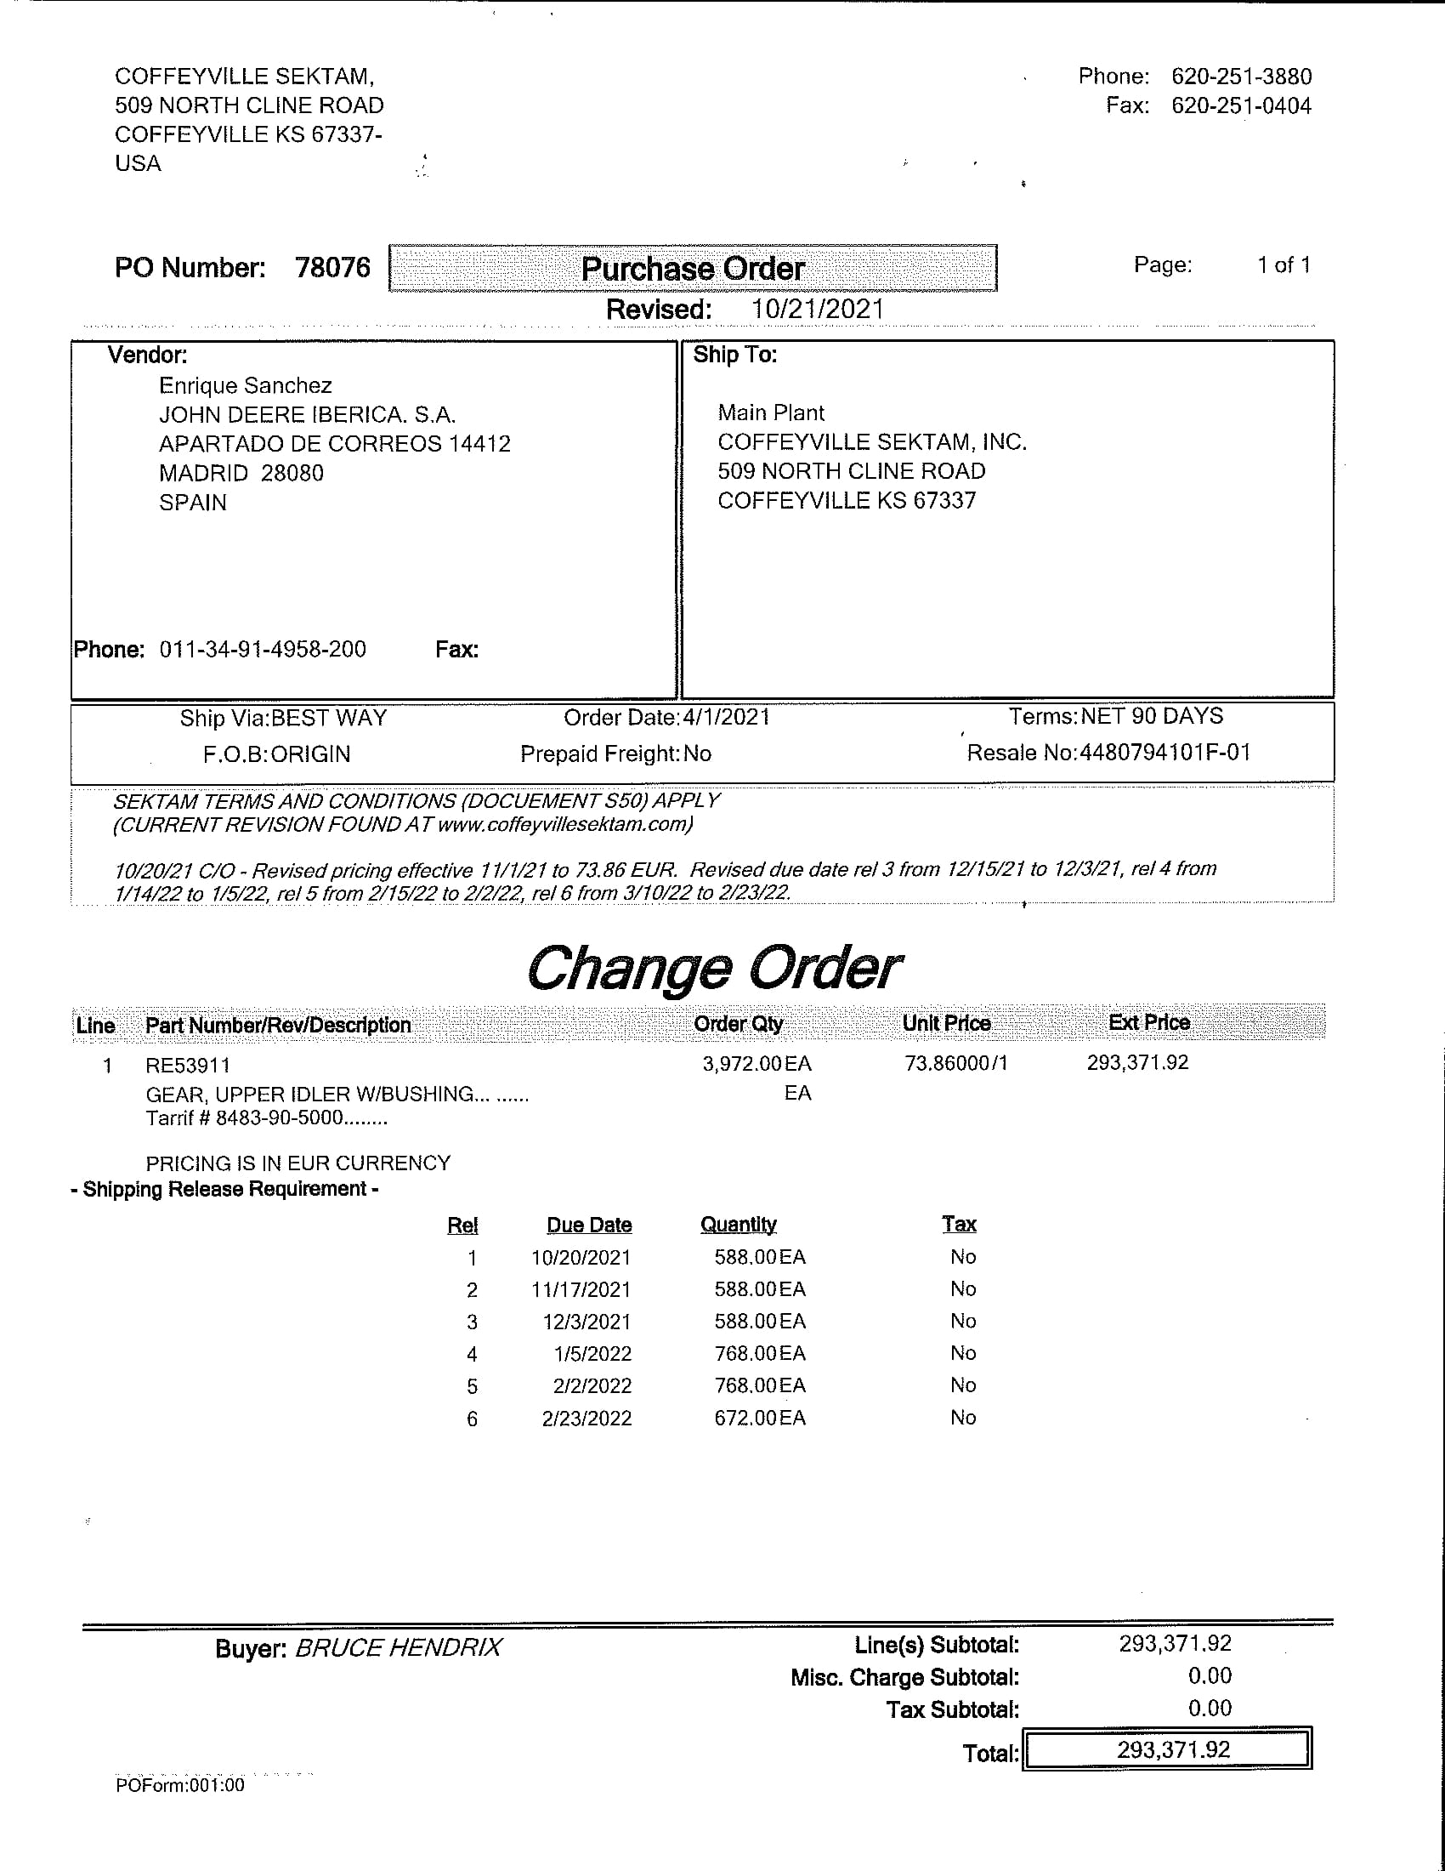
Coffeyville Sektam
Escaneado

Slide 3
Concentric
Concentric Pumps Pune Pvt ltd (Eou div) |  |  |  |  |  |  | 31/07/2021
Supplier Schedules For the month of Aug-21 to Apr-22
 |  |  |  | Firm |  | Tentative
Sr.No. | Part. No. | Supplier | Description | Aug-21 | Sep-21 | Oct-21 | Nov-21 | Dec-21 | Jan-22 | Feb-22 | Mar-22 | Apr-22
1 | R527691B | JD Iberica | Gear JD T4 OP | 0 | 0 | 0 | 1000 | 0 | 0 | 0 | 0 | 0
2 | R527010 | JD Iberica | Gear JD T4 OP | 4725 | 3780 | 4725 | 3780 | 3780 | 4725 | 3780 | 3780 | 3780

Slide 4
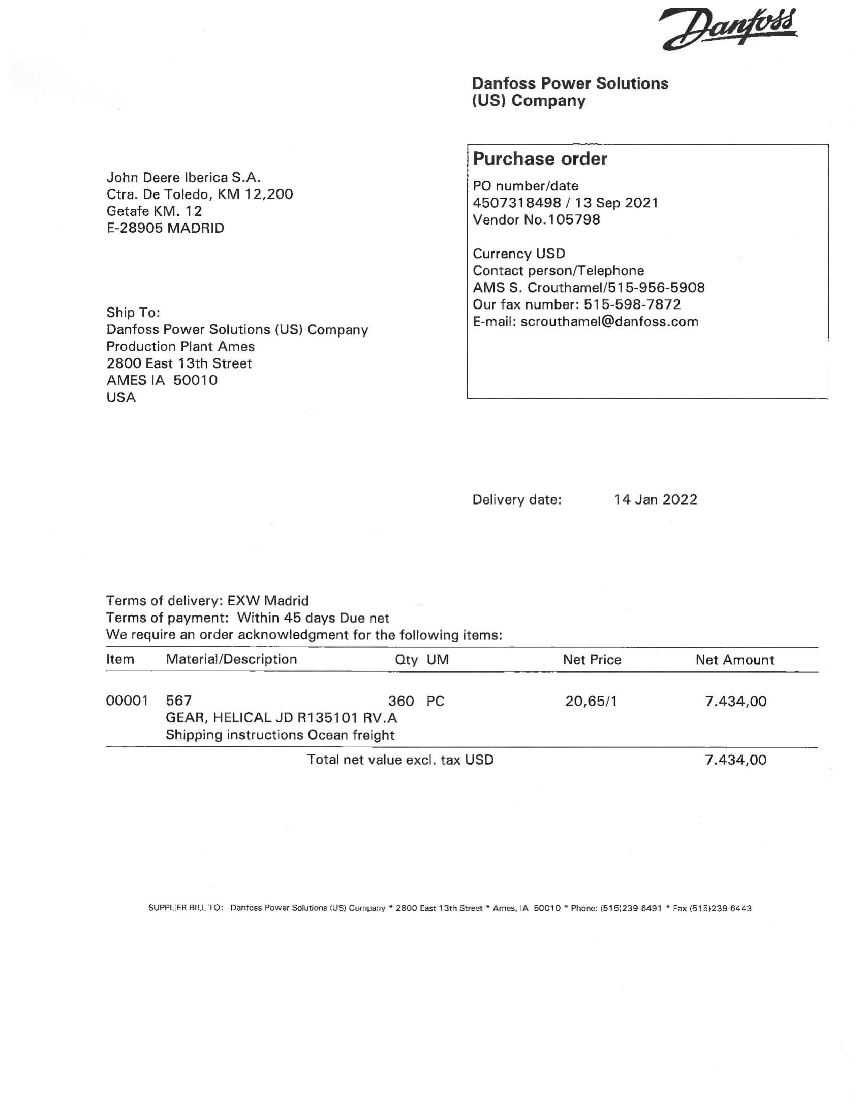
Danfoss
Escaneado

Slide 5
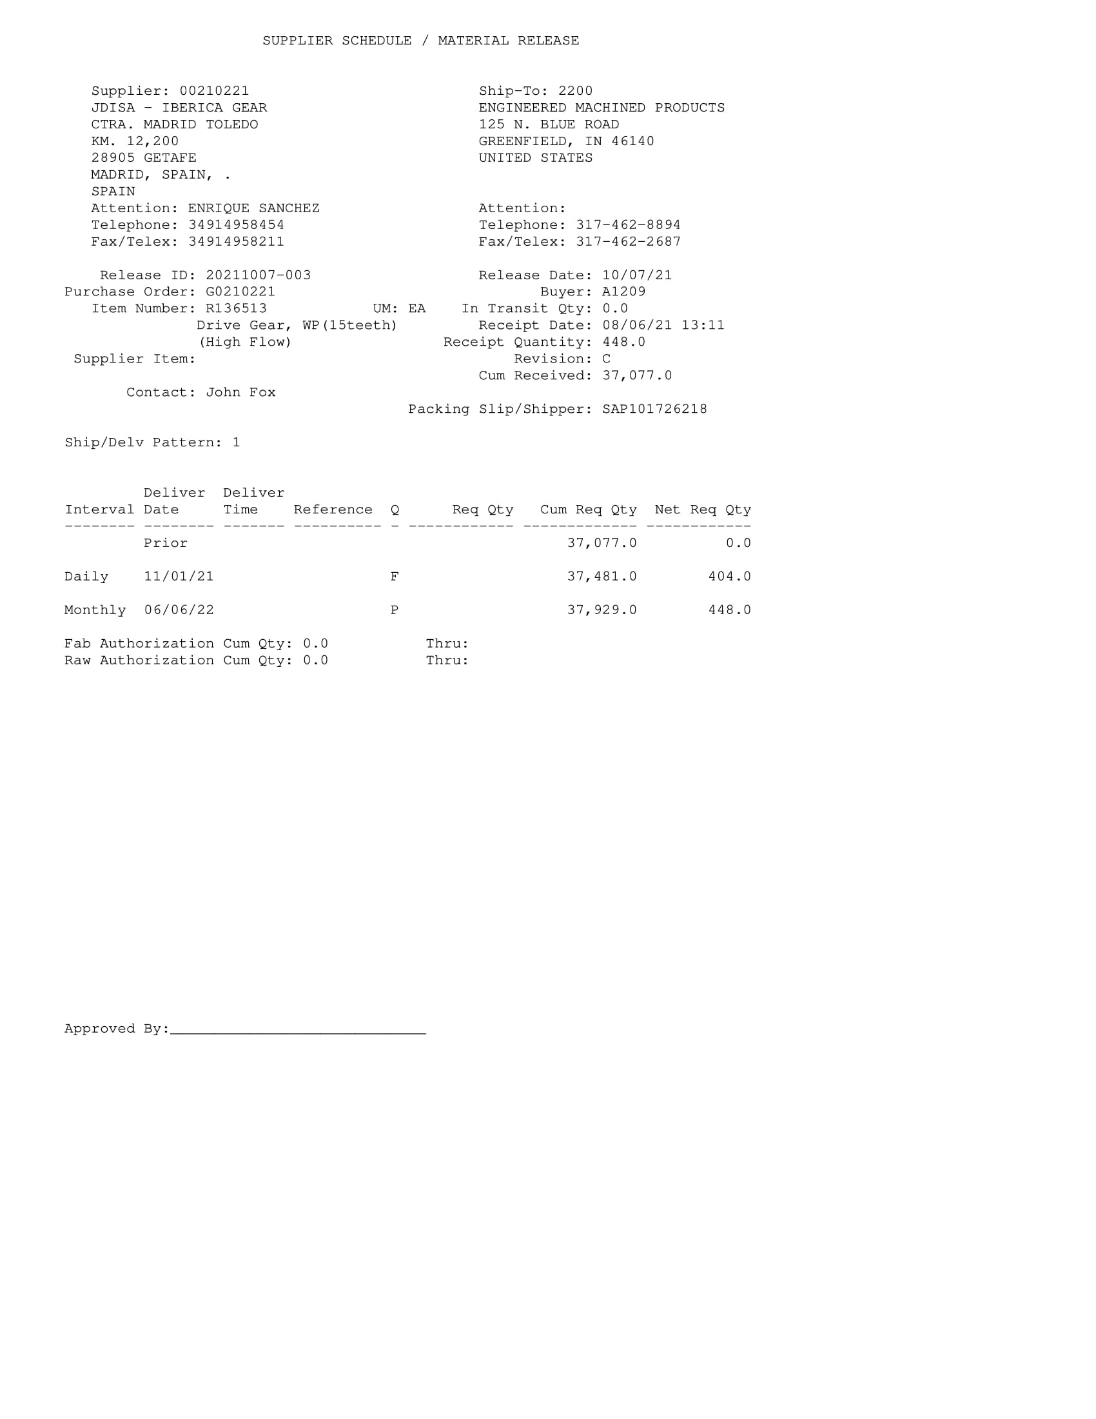
EMP
Campos validos
No Escaneado

Slide 6
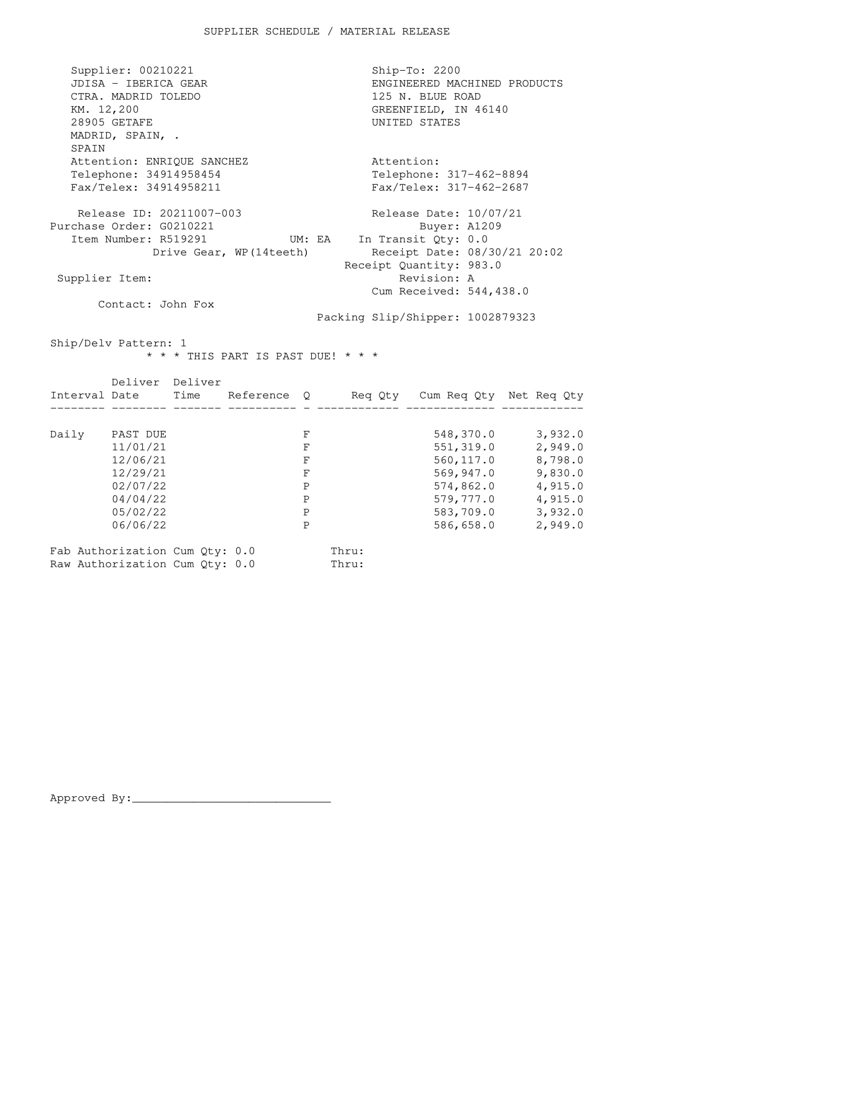
EMP
Campos validos
No escaneado

Slide 7
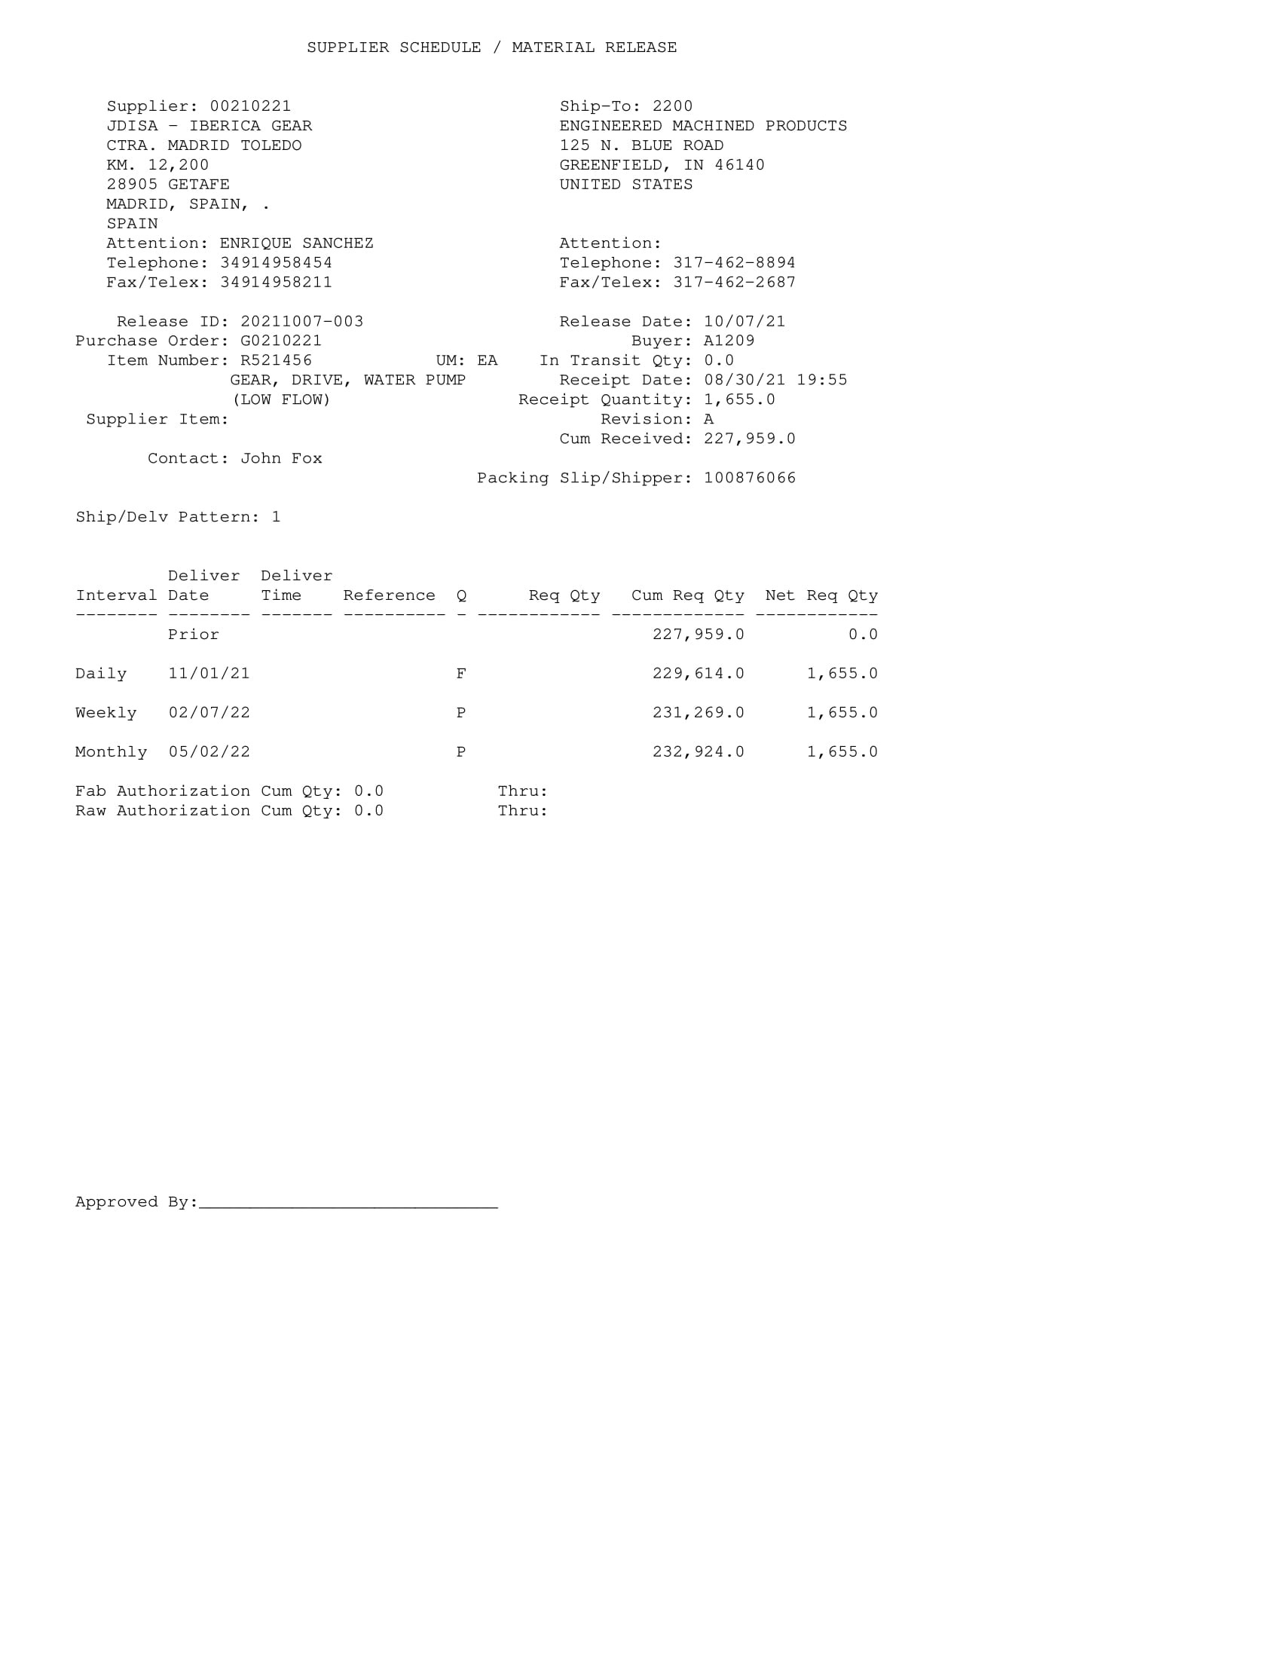
EMP
Campos validos
No escaneado

Slide 8
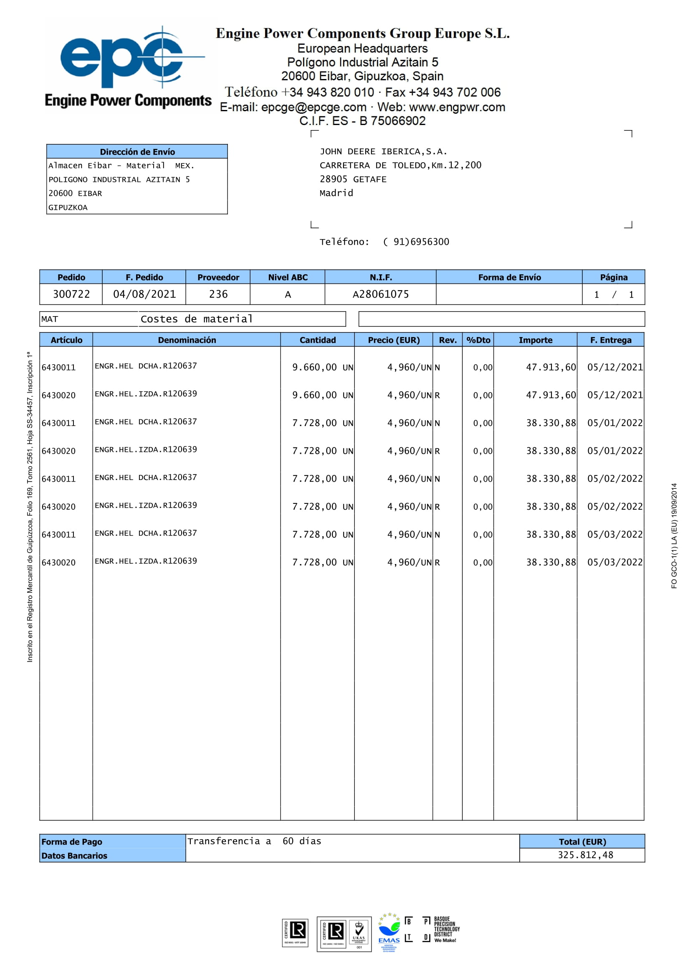

Engine Power Compoments
Campos validos
No escaneado

Slide 9
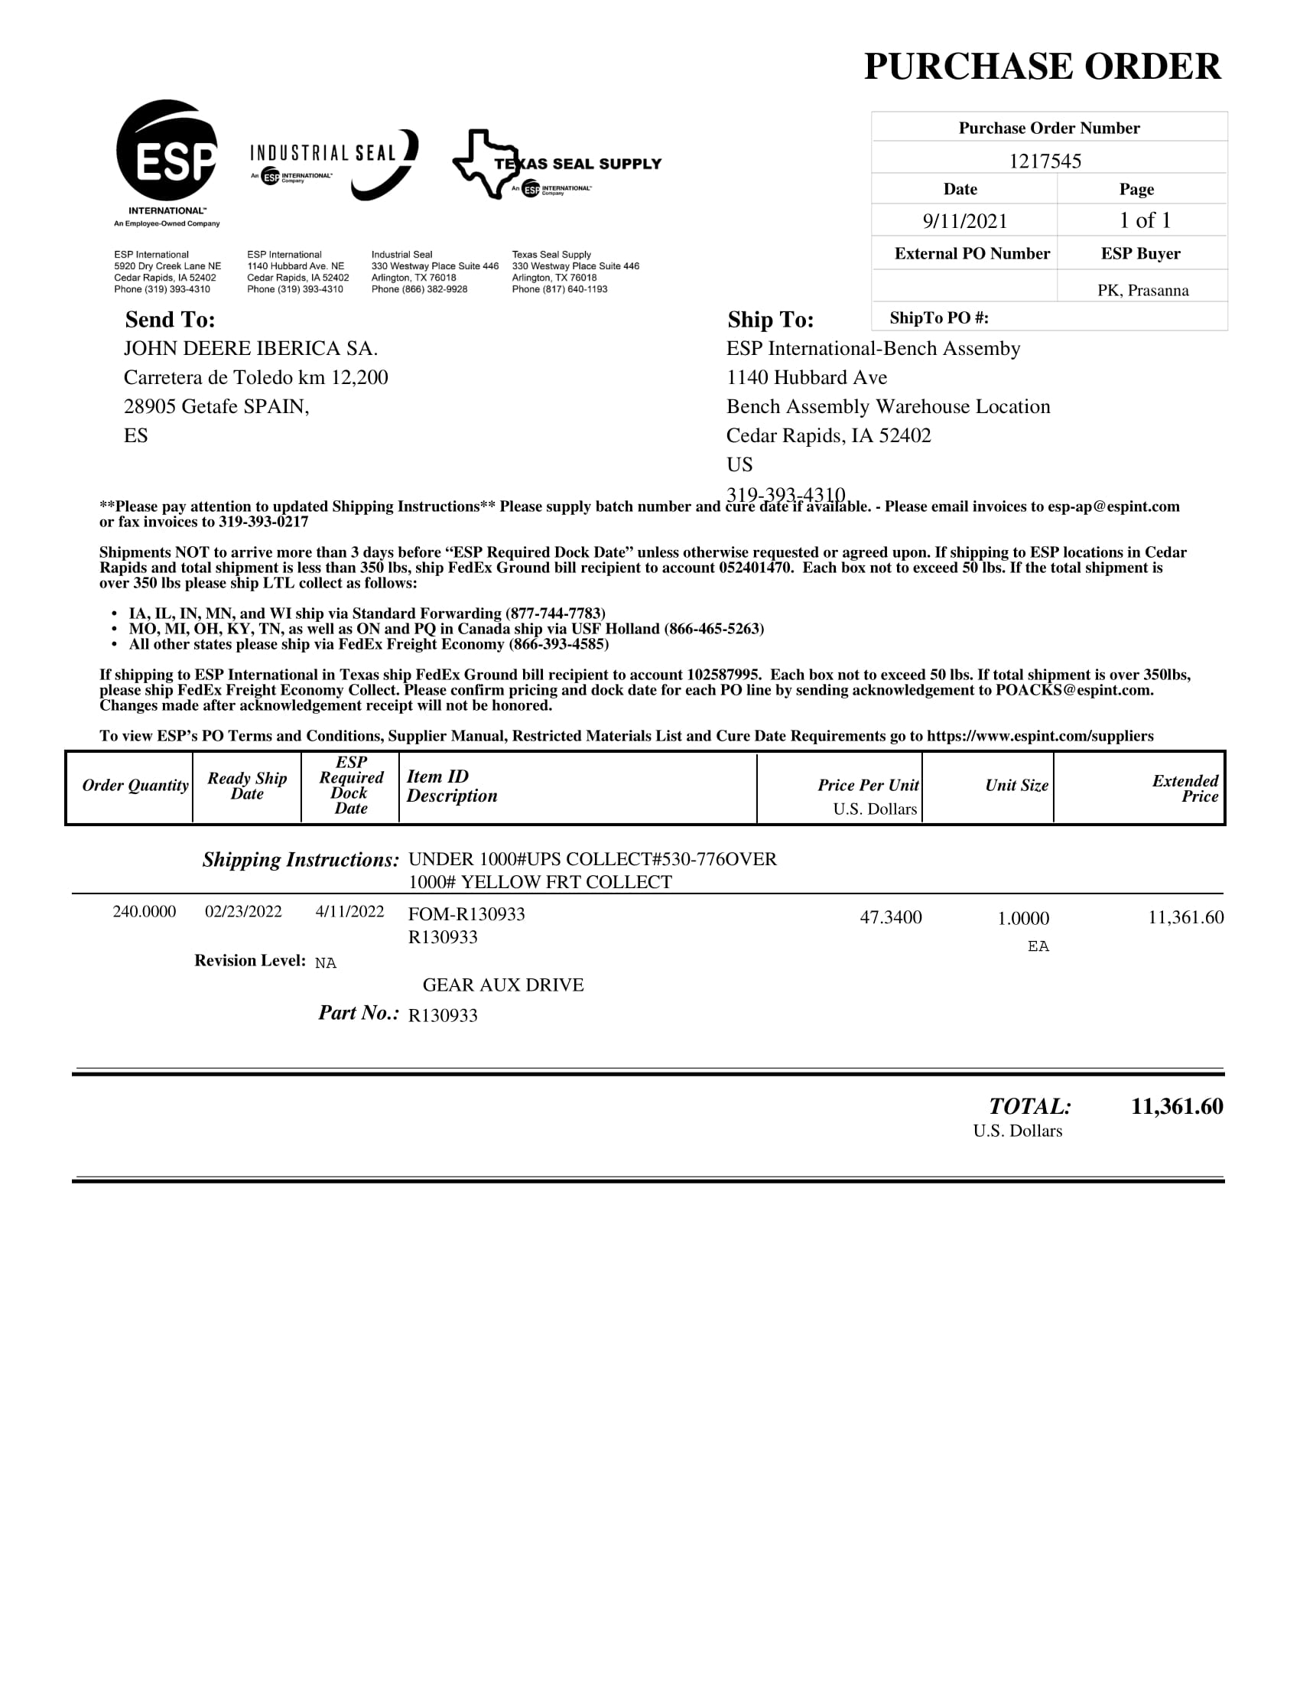
ESP
No escaneado

Slide 10
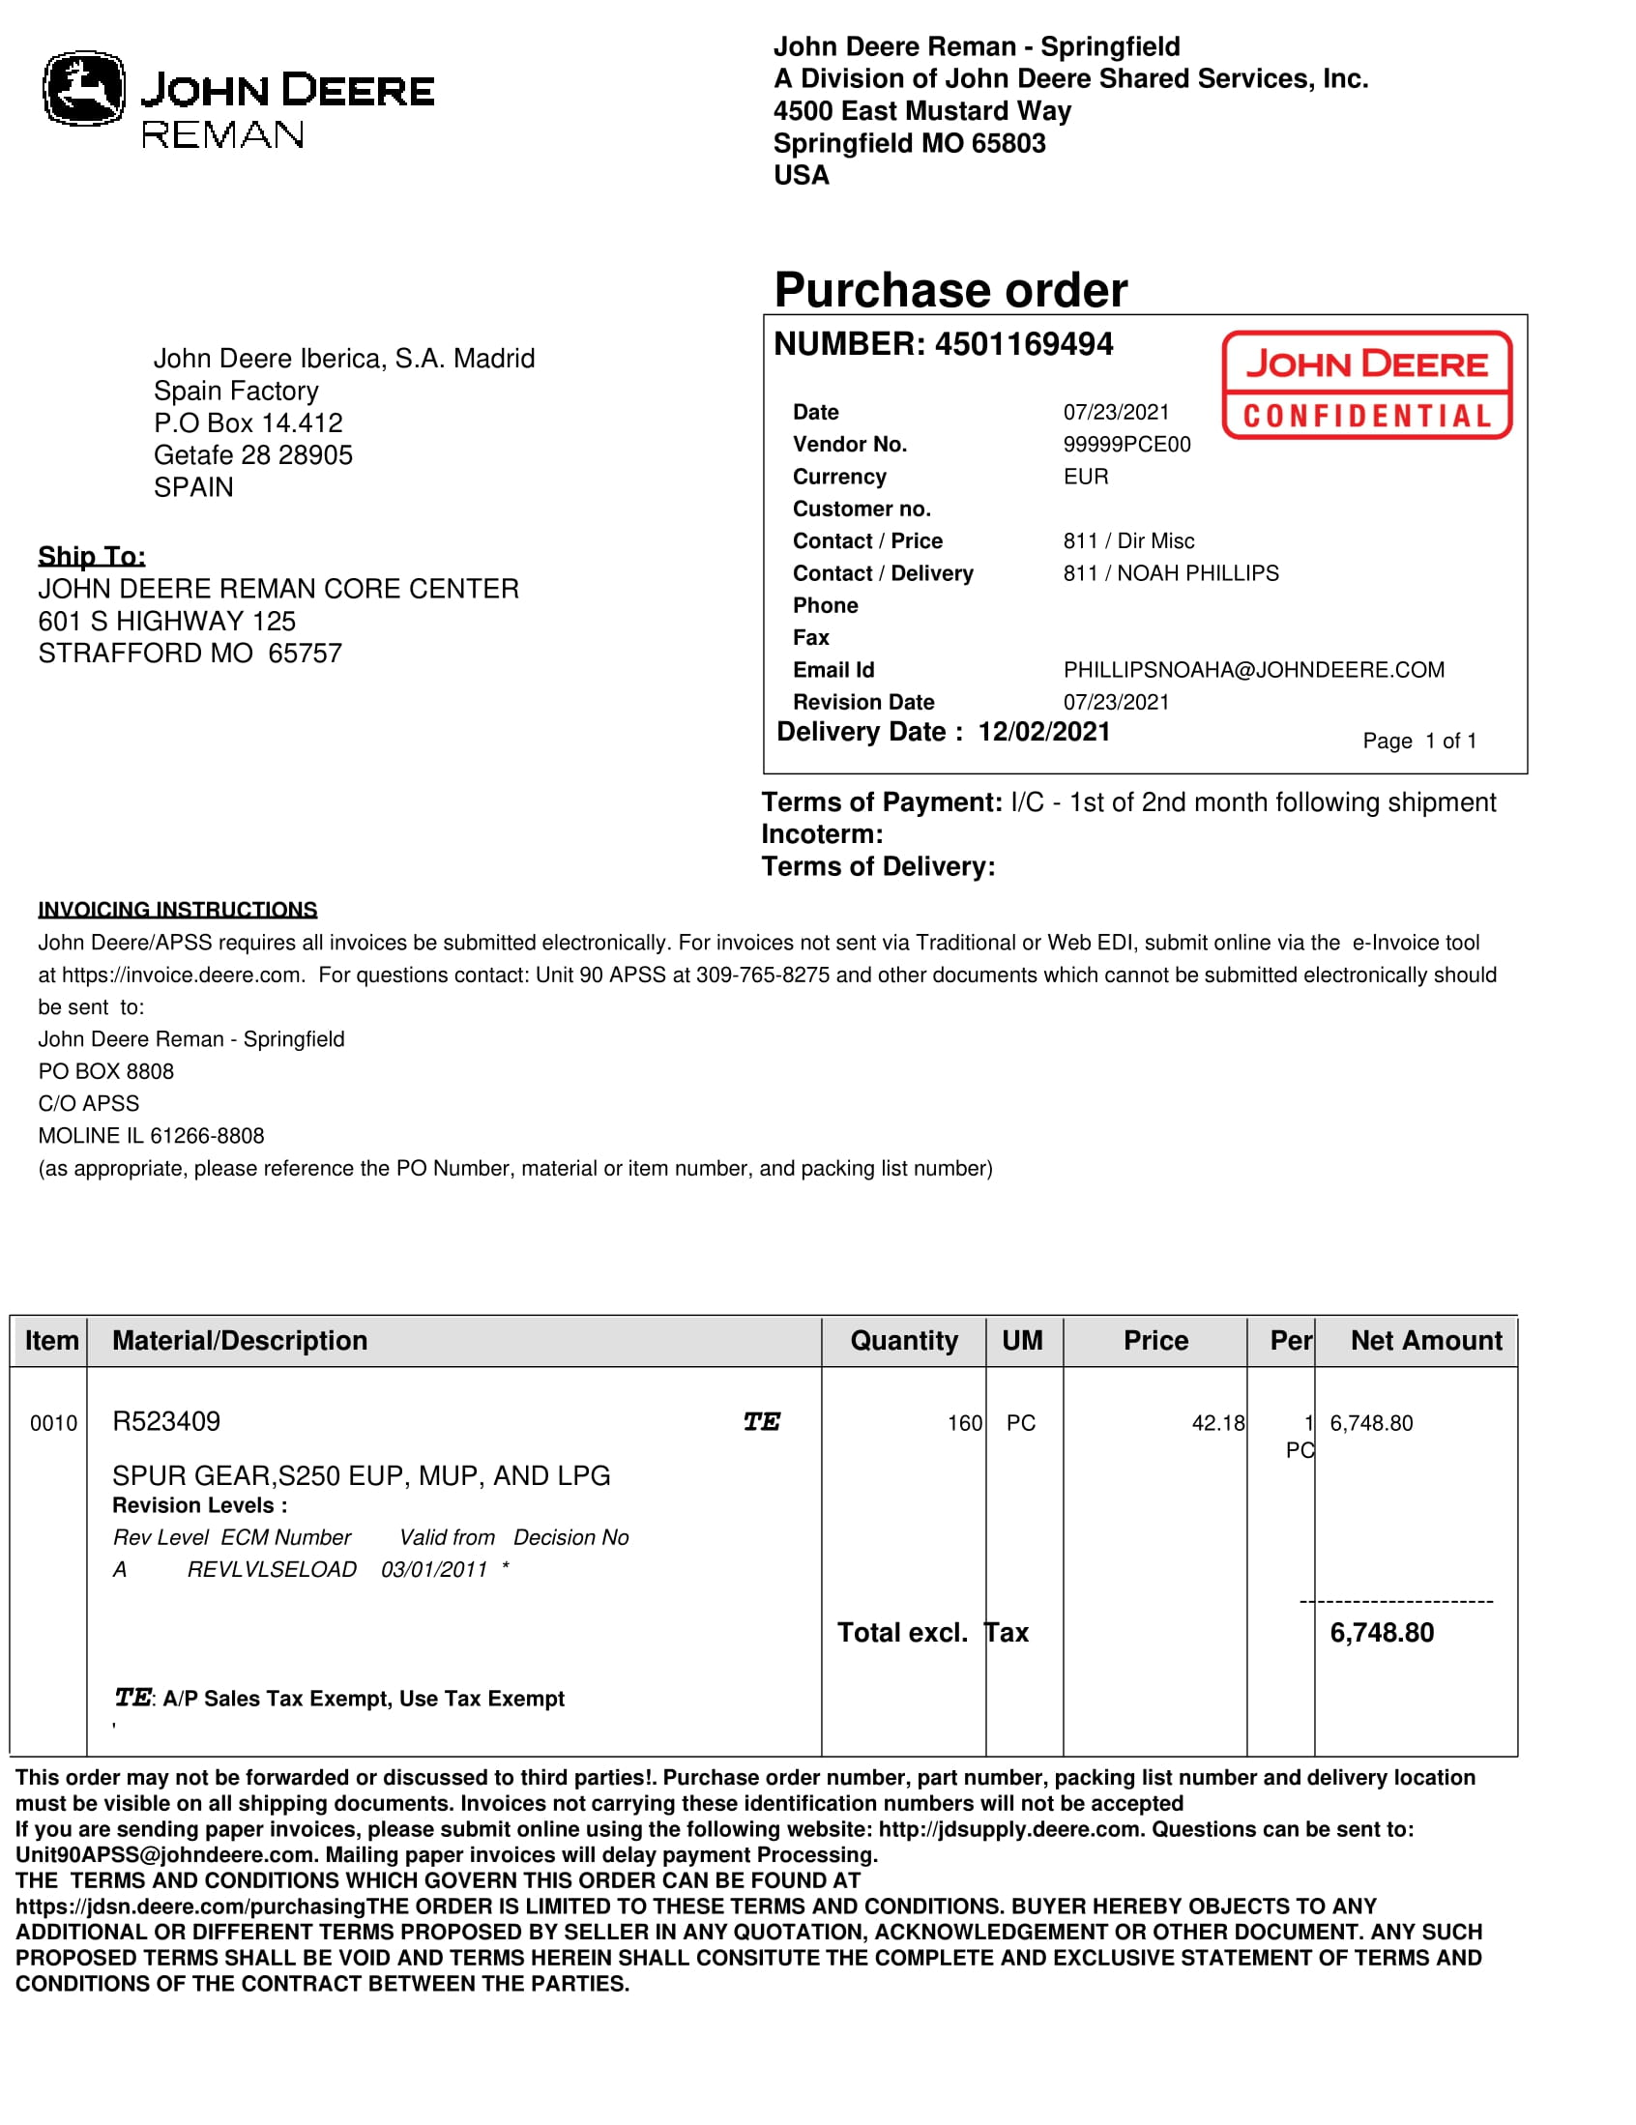
JD REMAN
No escaneado

Slide 11
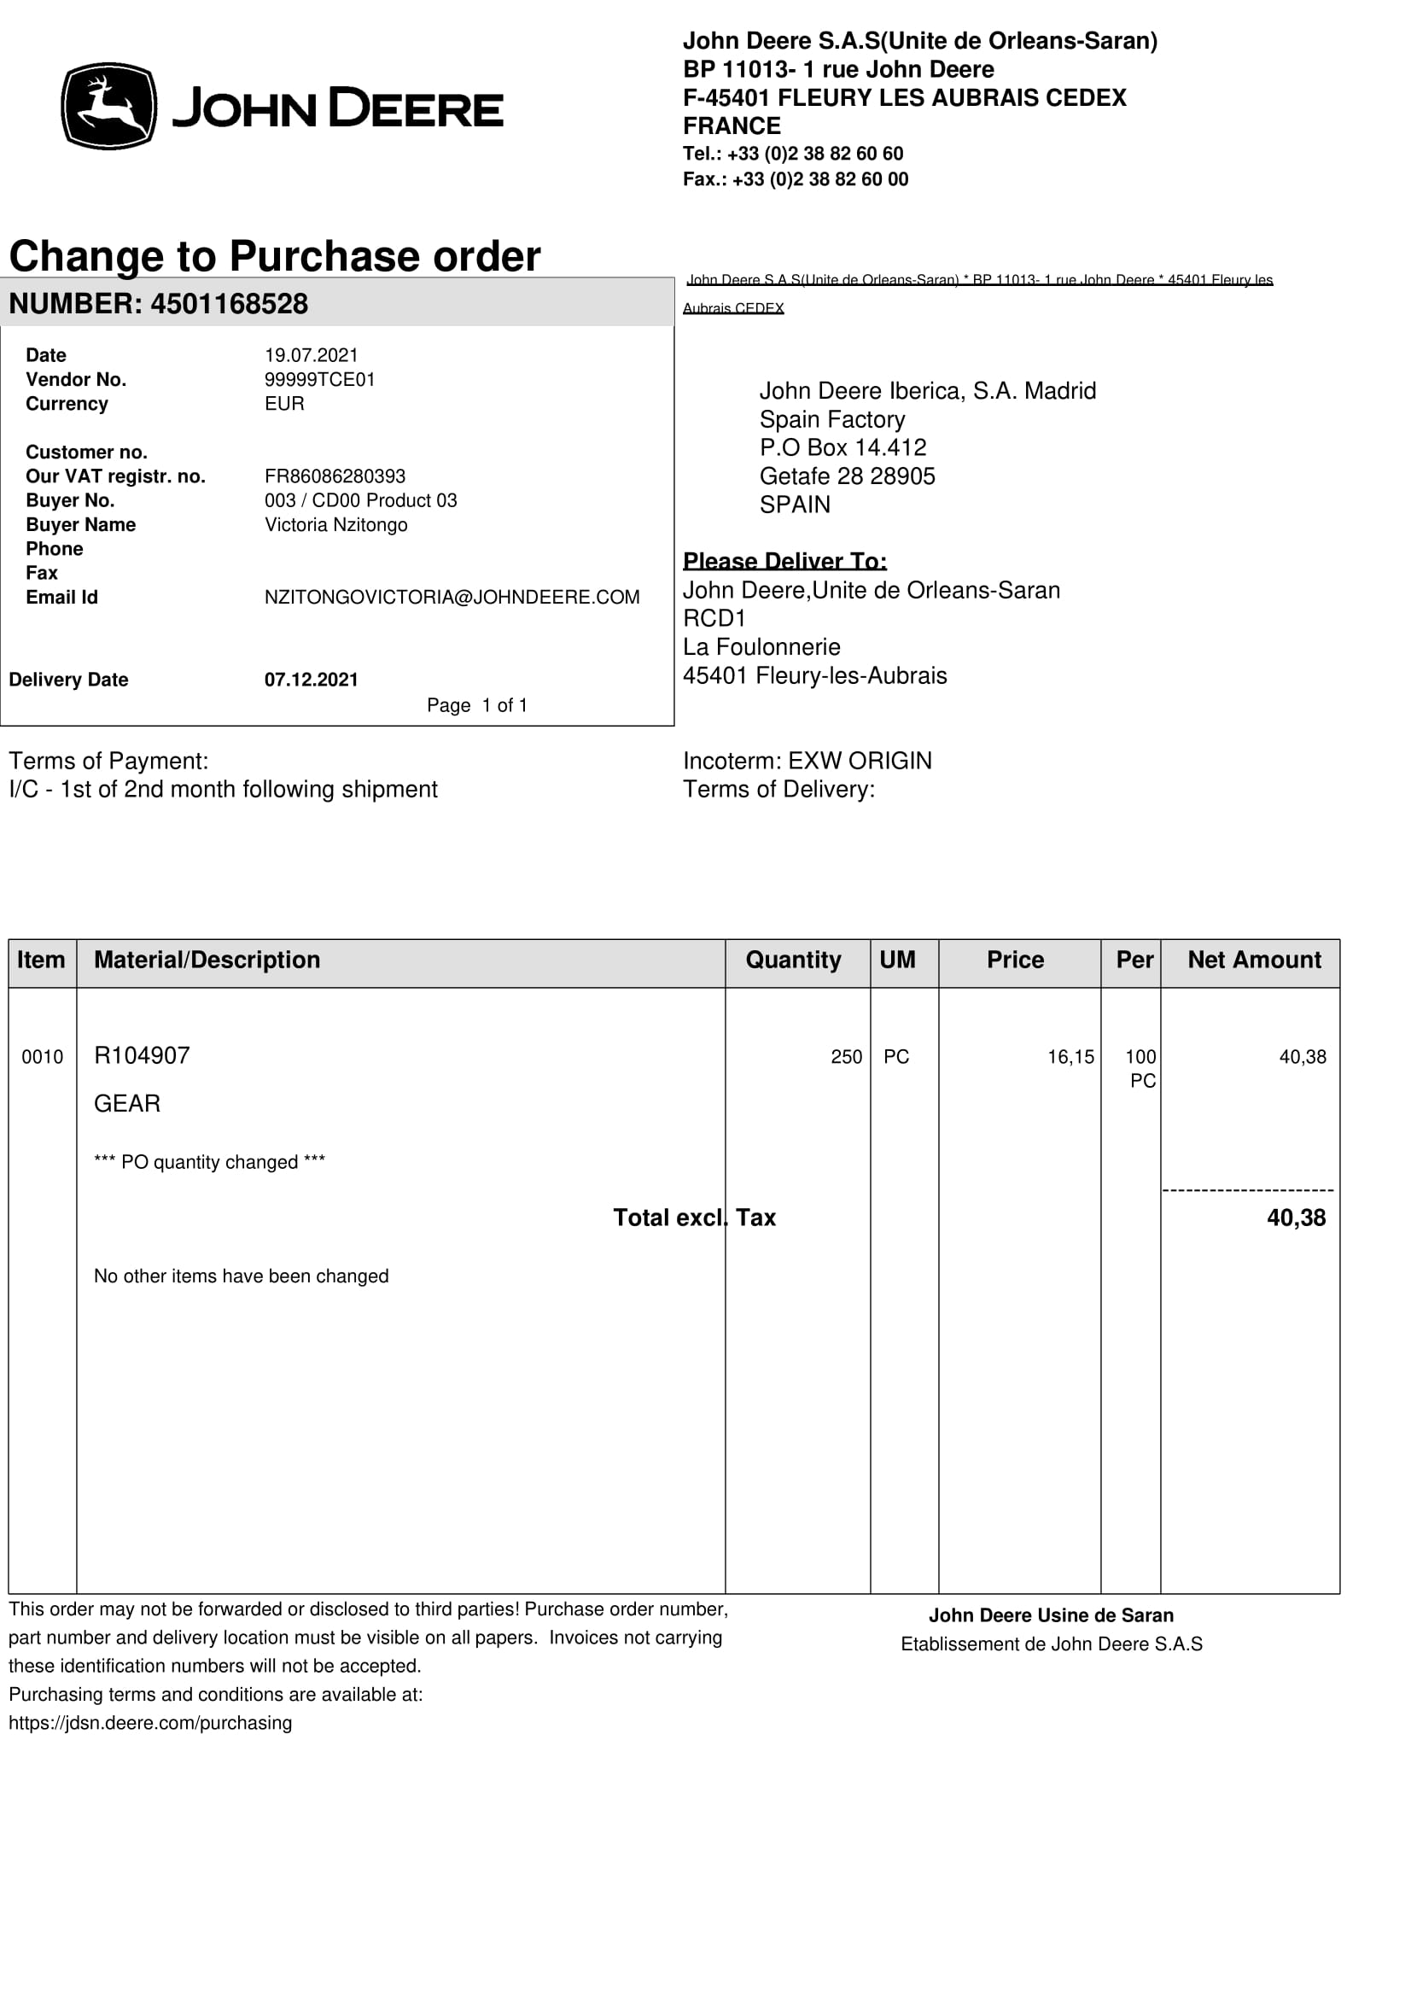
JD SARAN
No escaneado

Slide 12
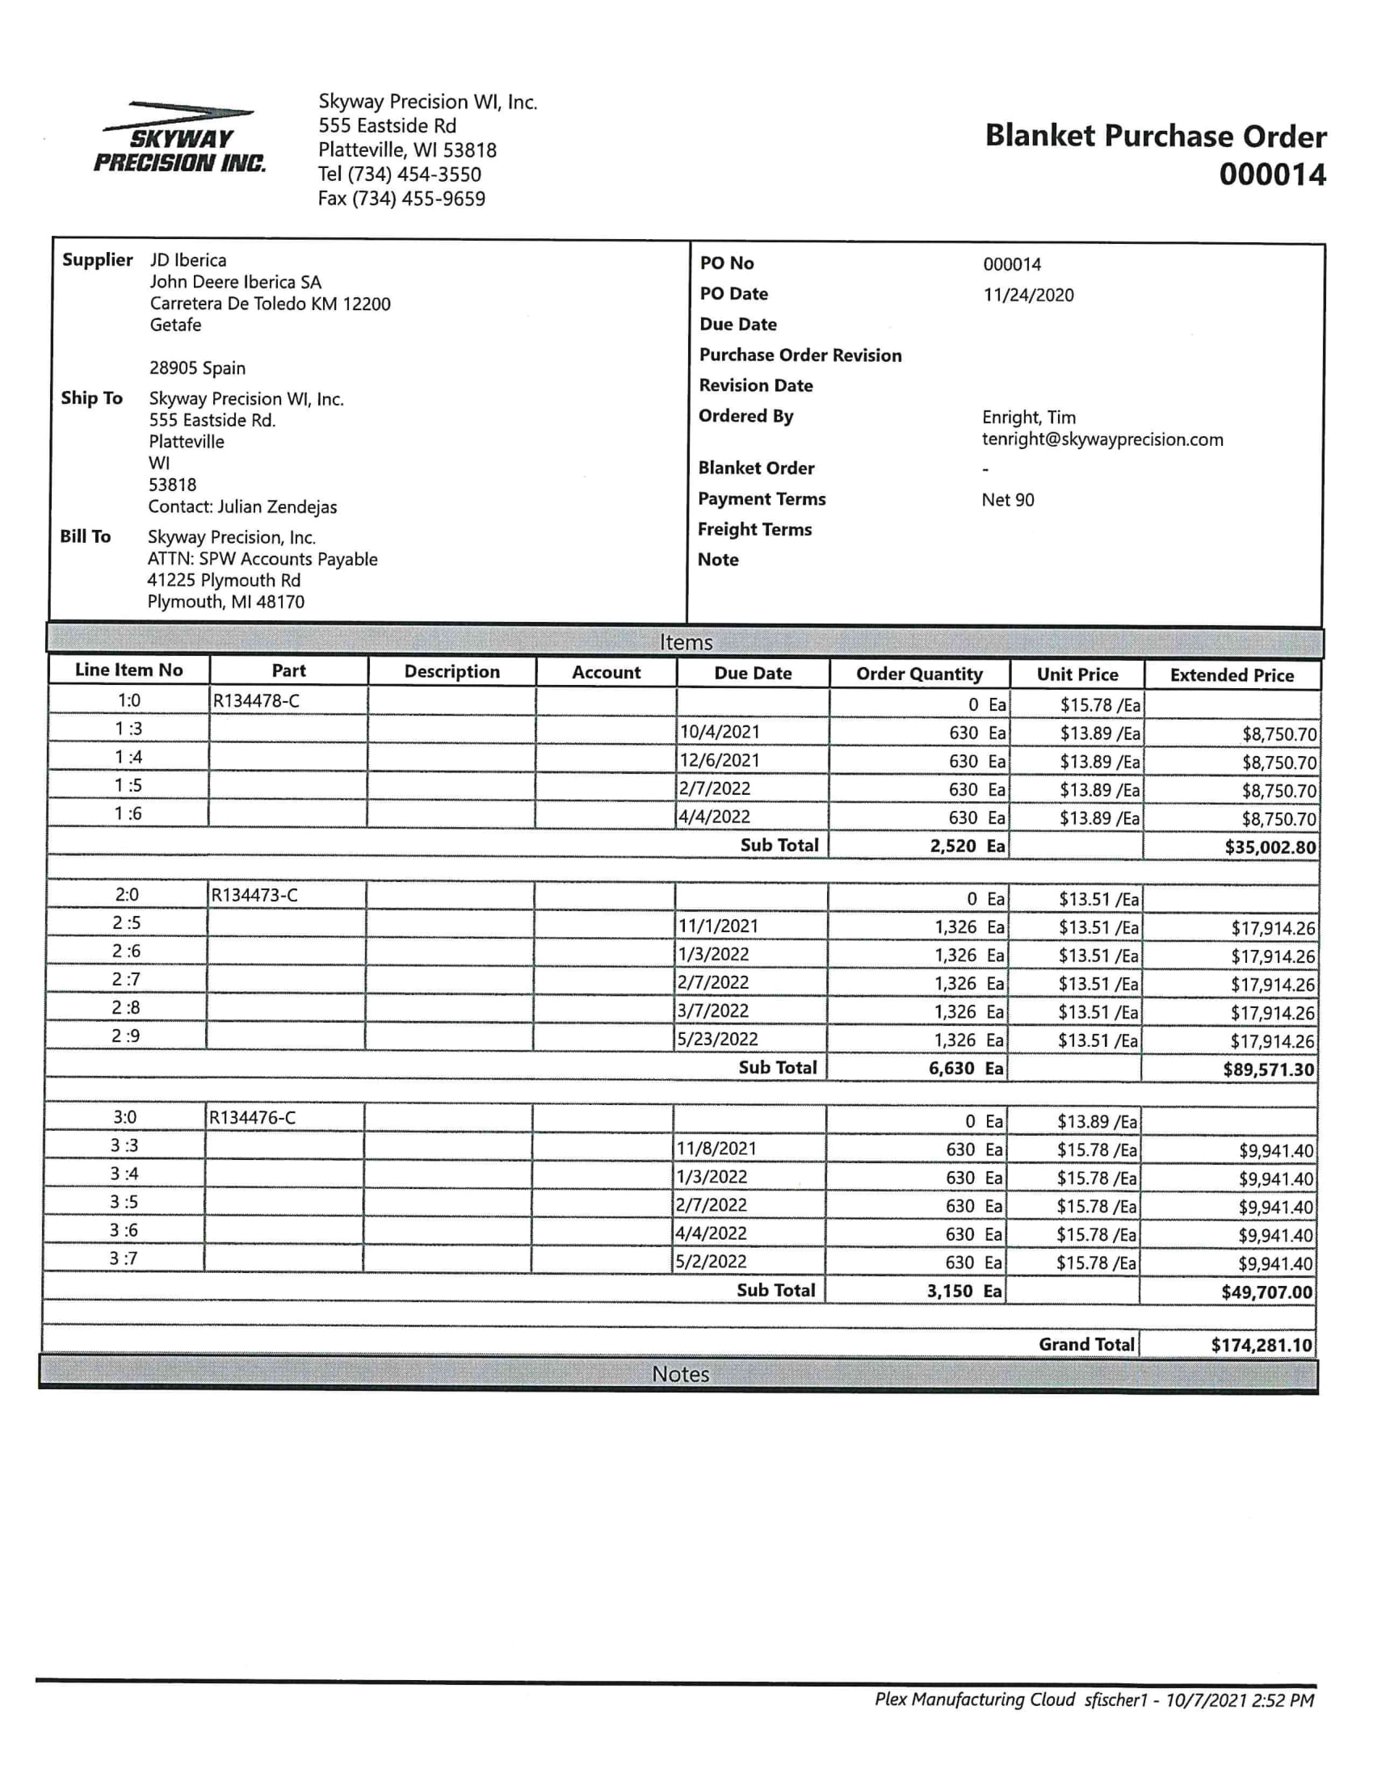
Skyway
Escaneado

Slide 13
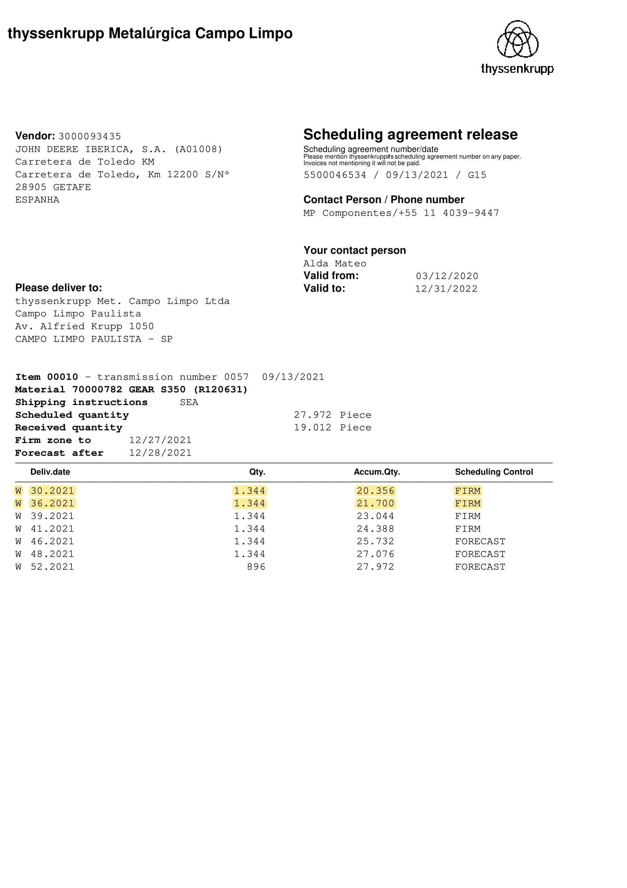
Thyssenkrupp Campo Limpo
Campos validos
No escaneado

Slide 14
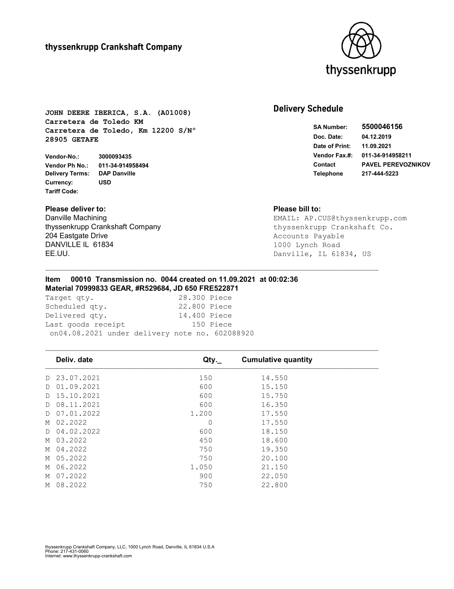
Thyssenkrupp Crankshaft
Campos validos
No escaneado

Slide 15
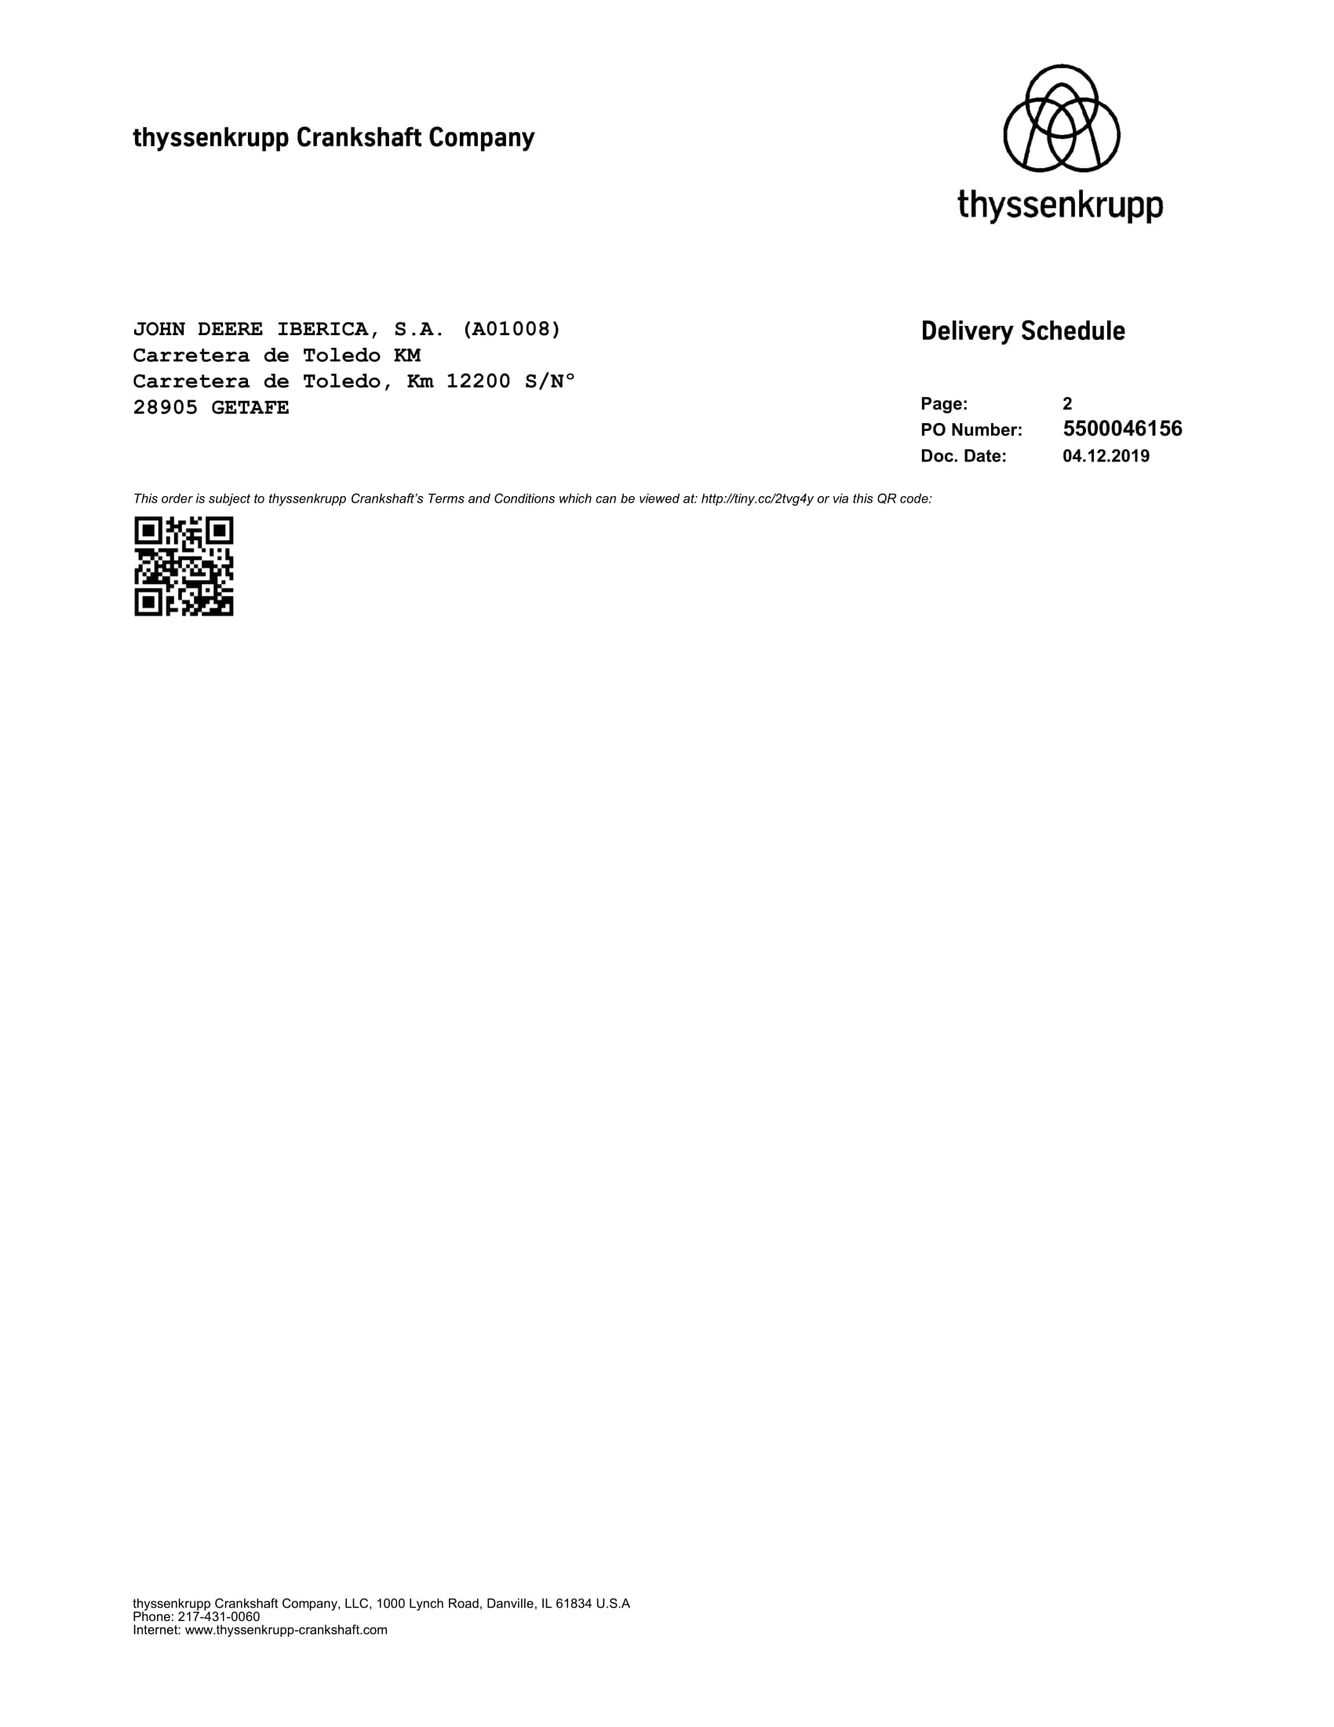
Thyssenkrupp Crankshaft
Campos validos
No escaneado

Slide 16
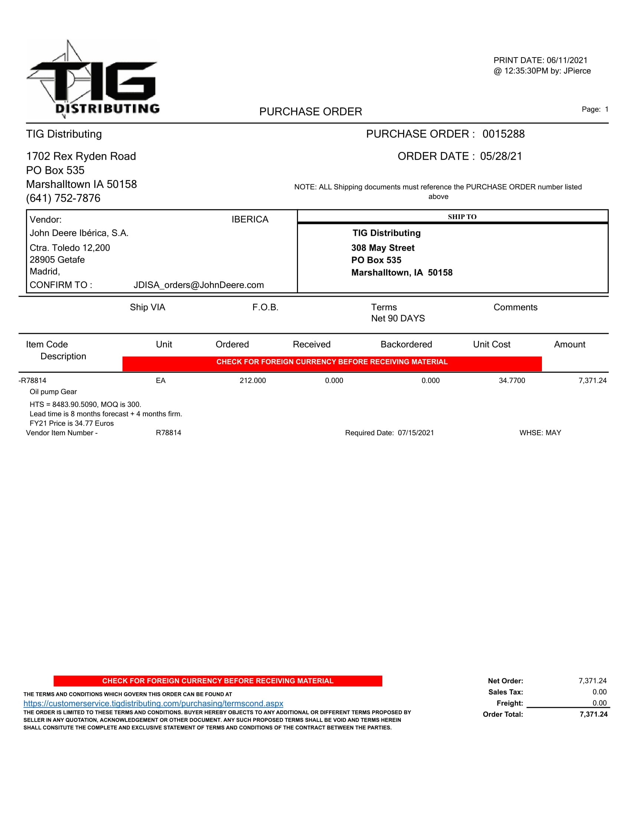
TIG
No escaneado

Slide 17
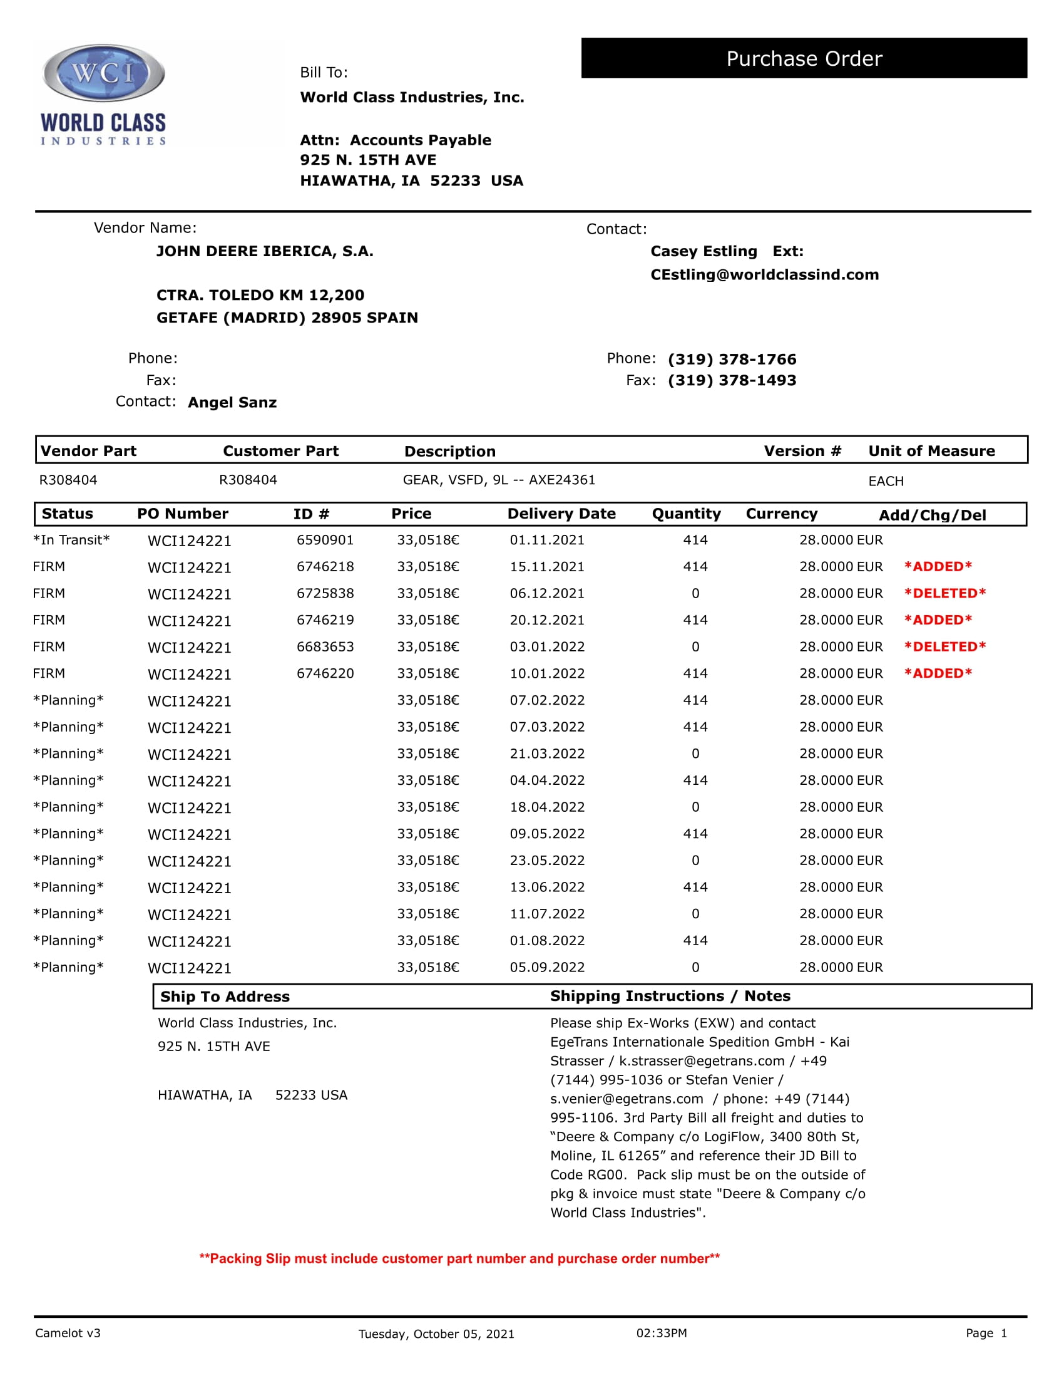
WordClass Industries
Campos validos
No escaneado

Slide 18
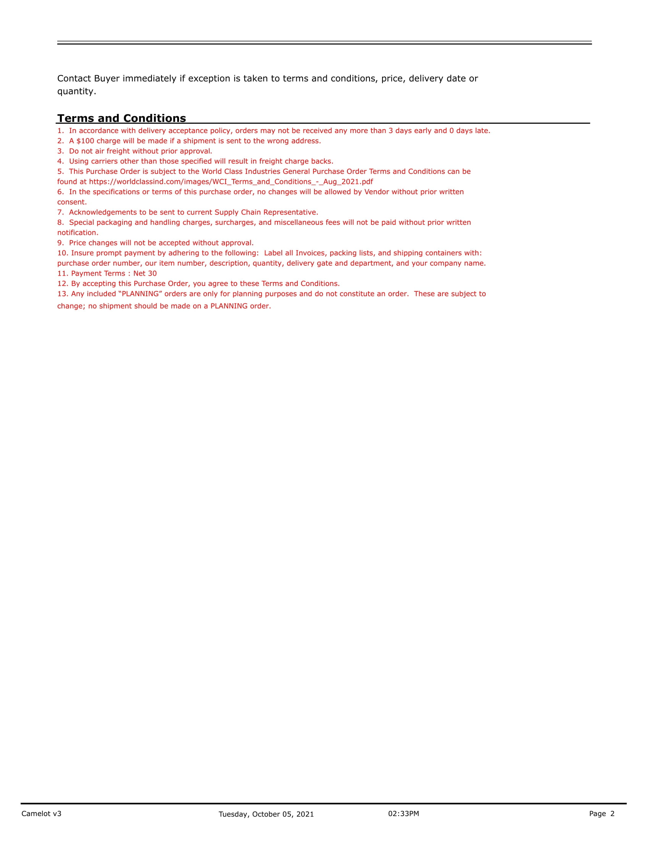
WordClass Industries
Campos validos
No escaneado

