Slide 1
Leyenda de colores
Order_number
Reference
Quantity
Ship_out_date
Arrival_date

Slide 2
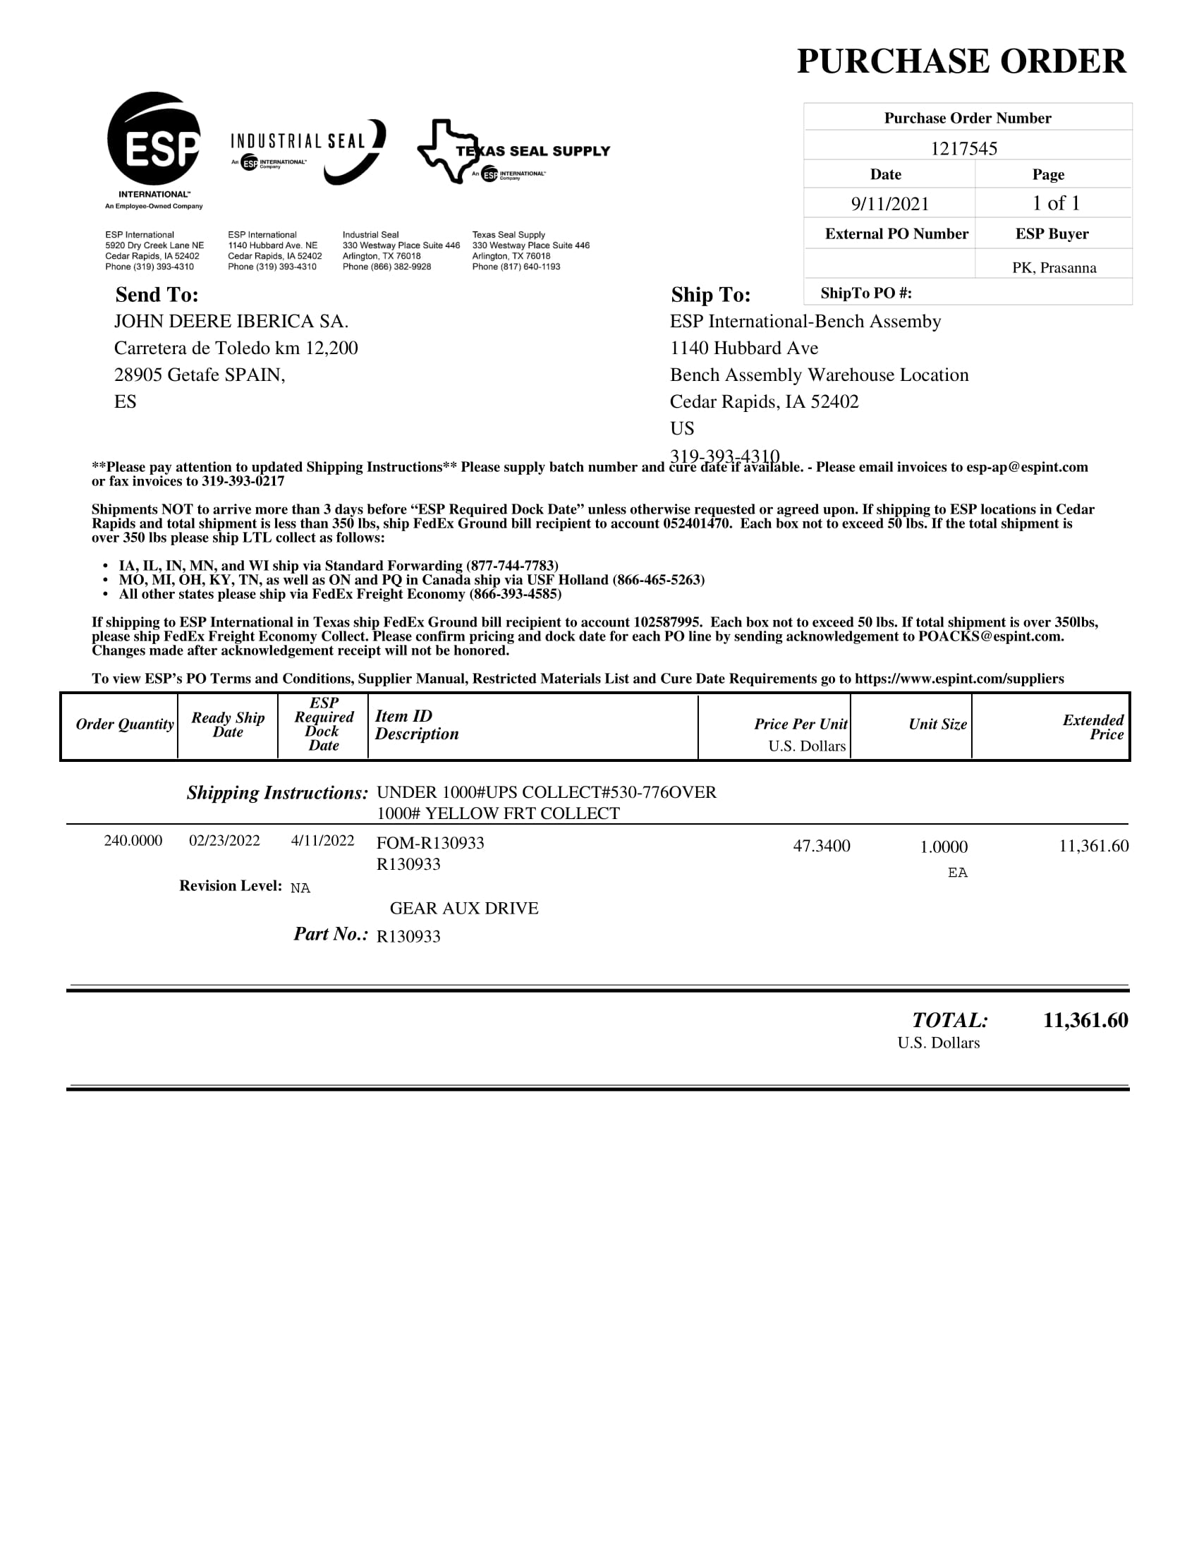

ESP (70001256)
Campos validos
No escaneado

Slide 3
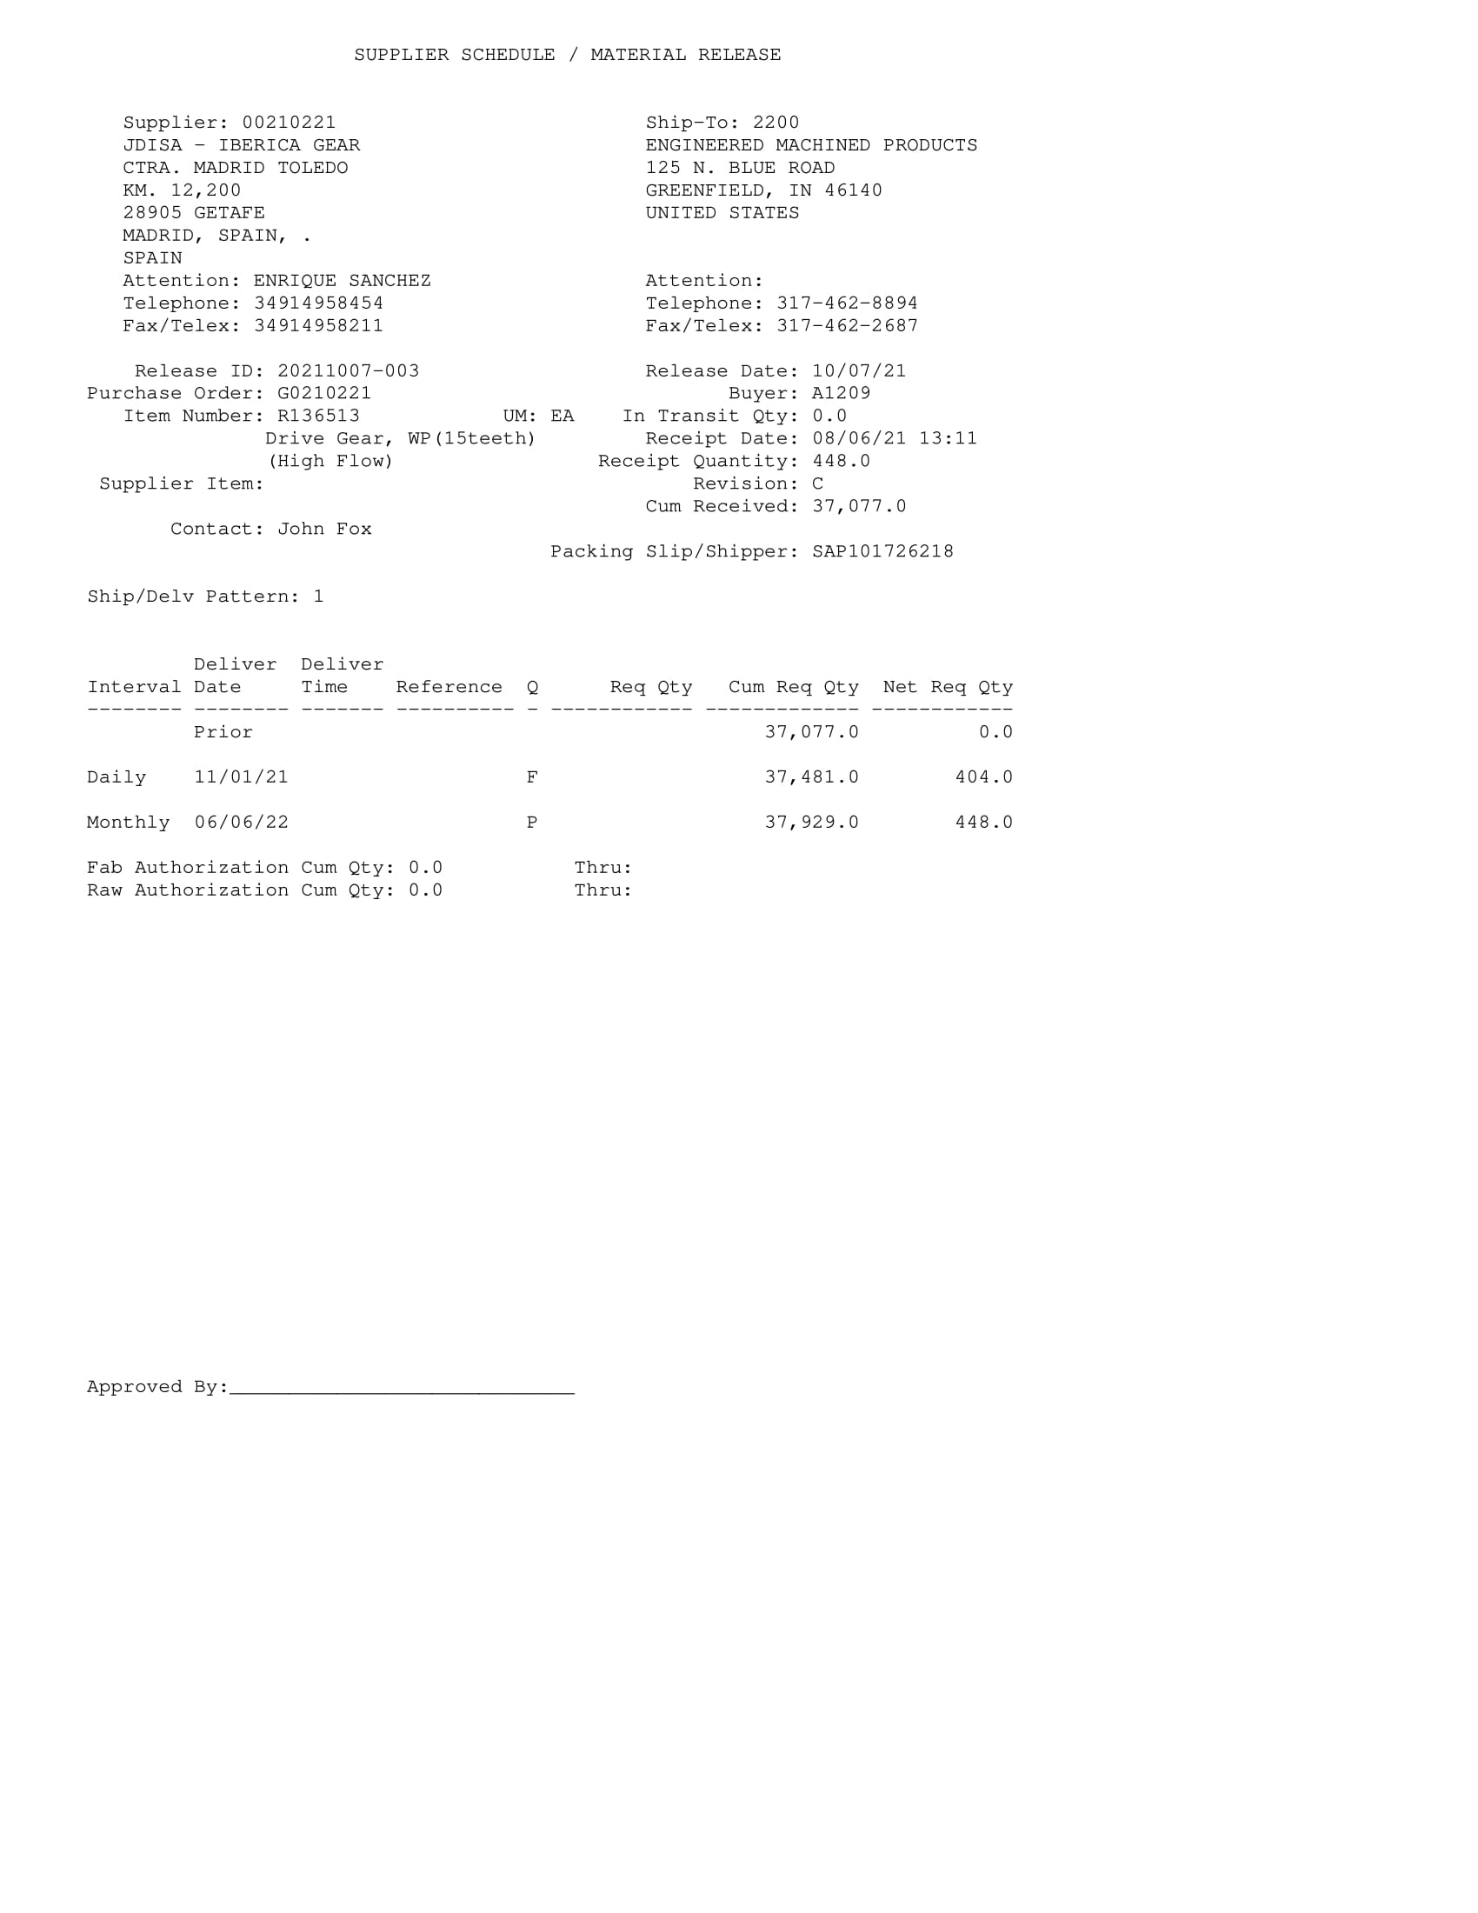
EMP (70012672)
Campos validos
No Escaneado

Slide 4
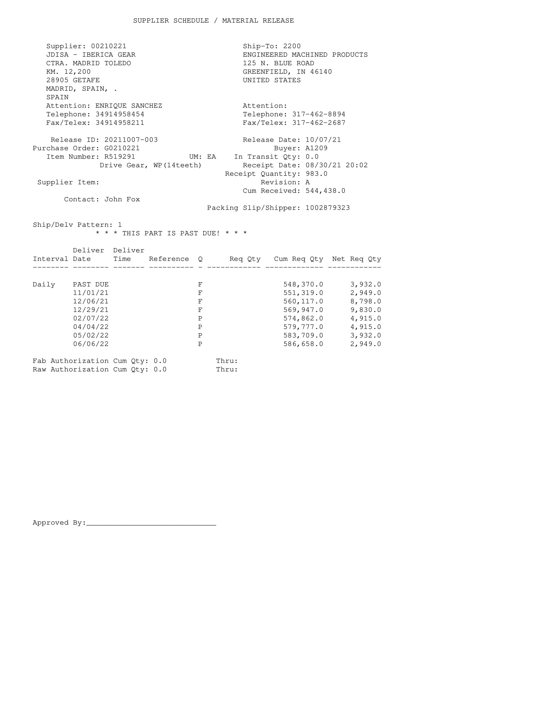
EMP
Campos validos
No escaneado

Slide 5
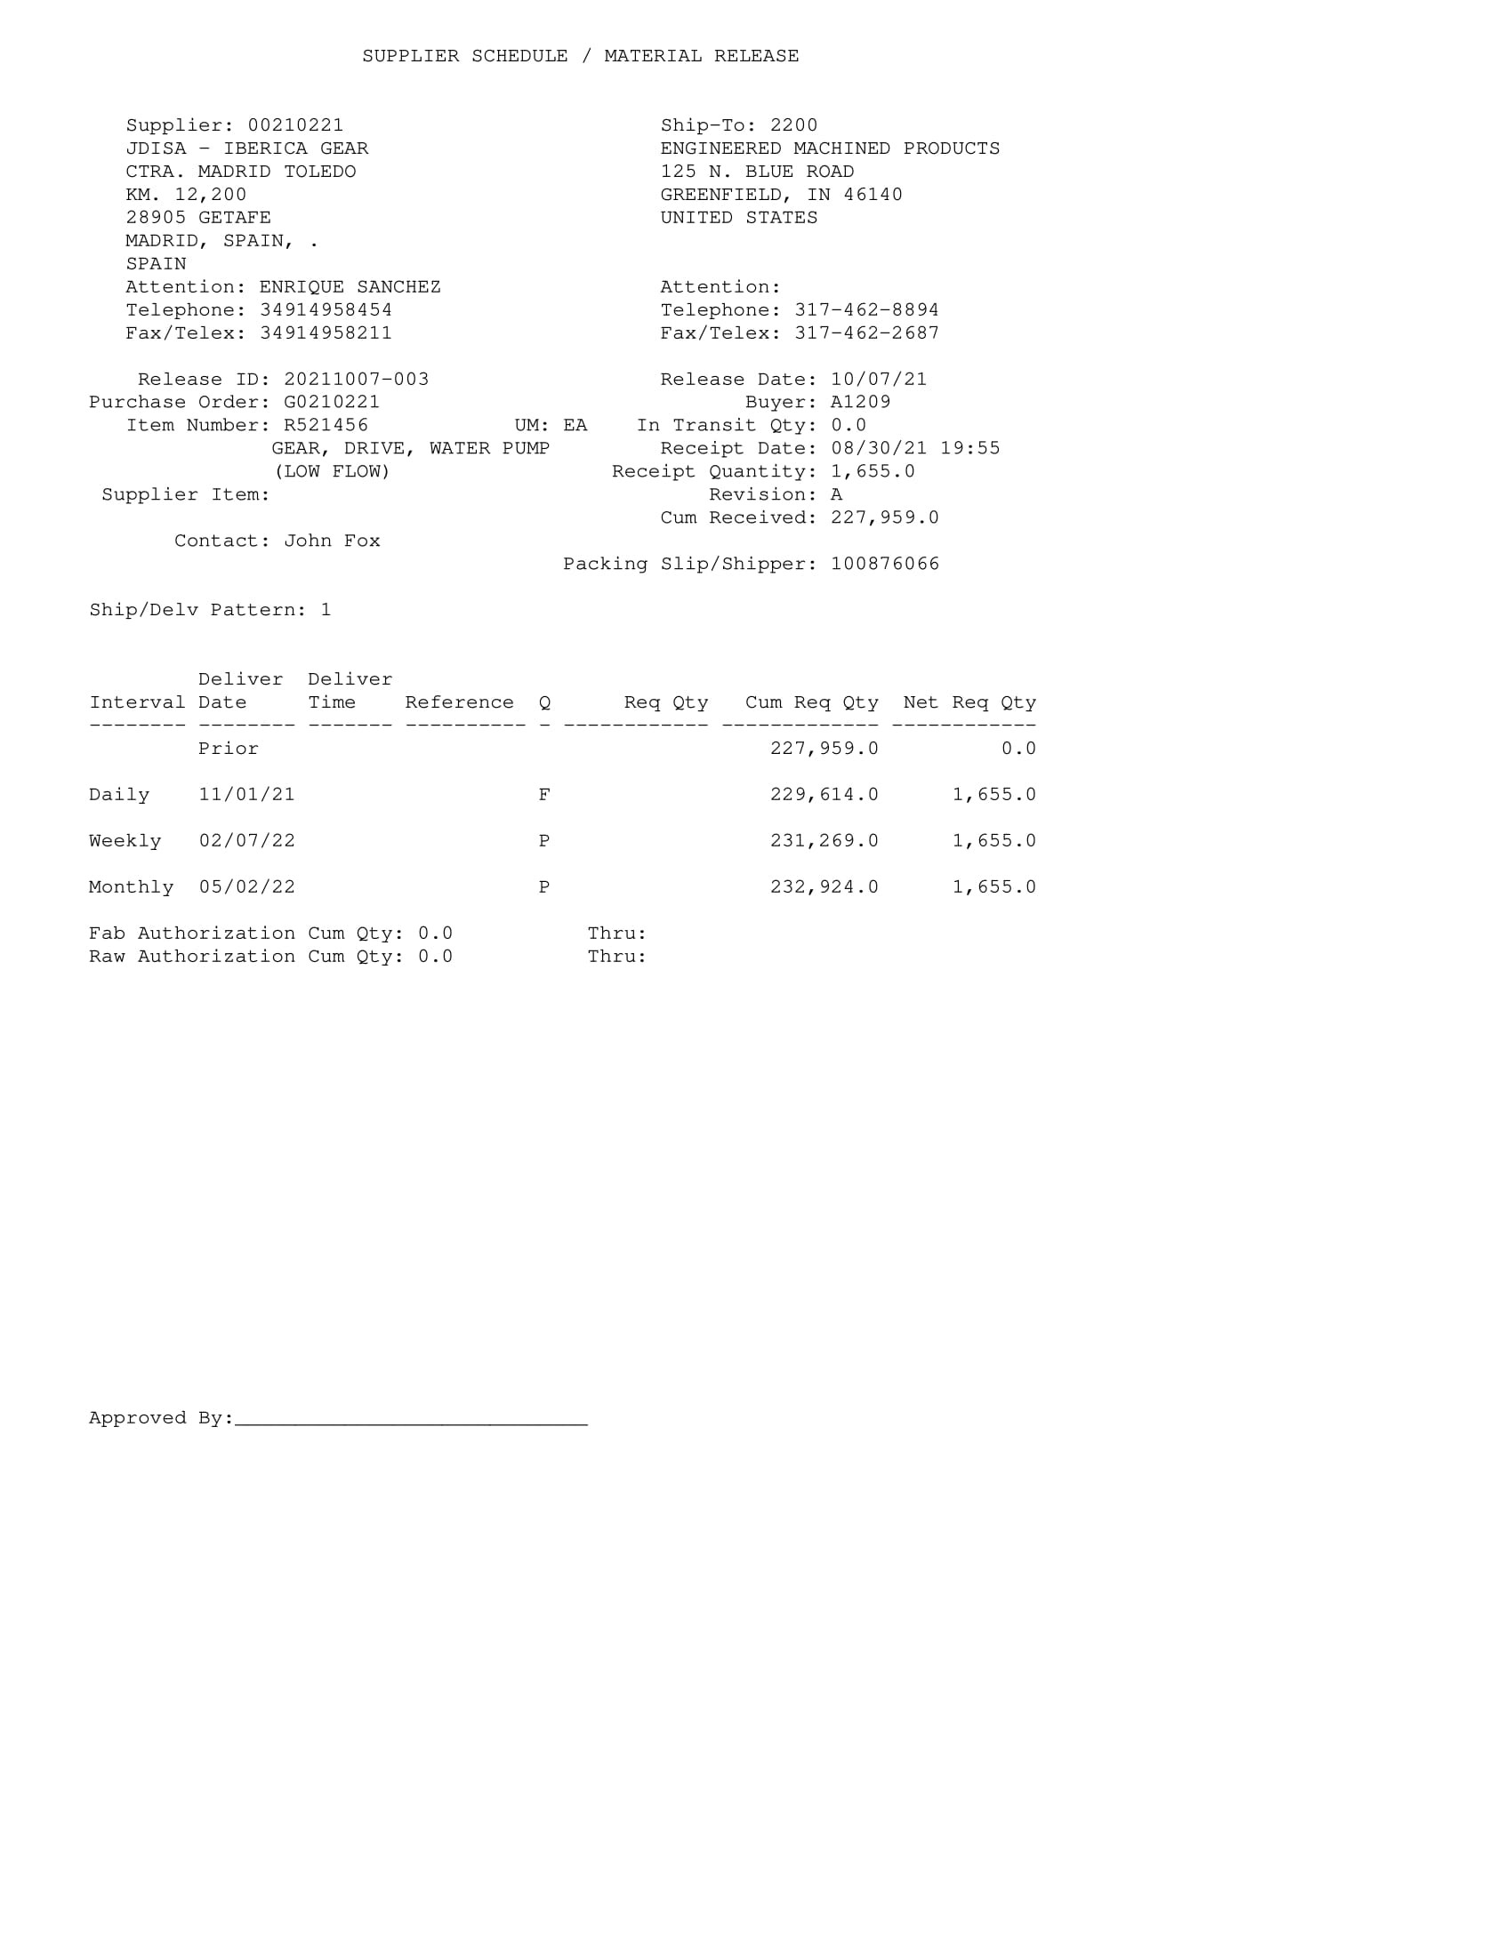
EMP
Campos validos
No escaneado

Slide 6
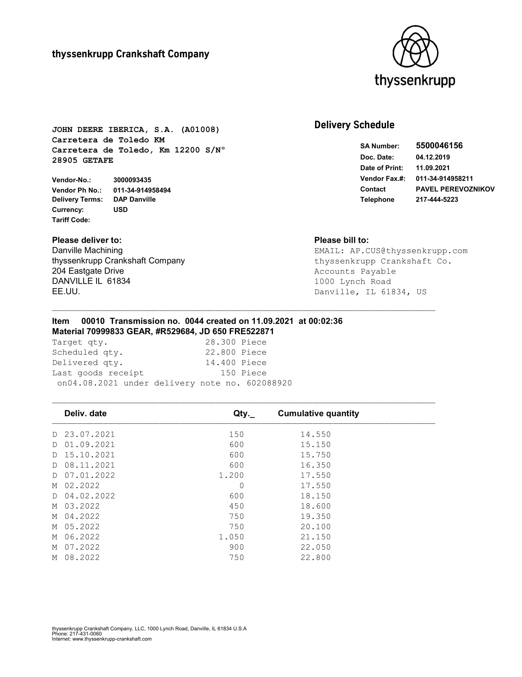
Thyssenkrupp Crankshaft (70017048)
Campos validos
No escaneado

Slide 7
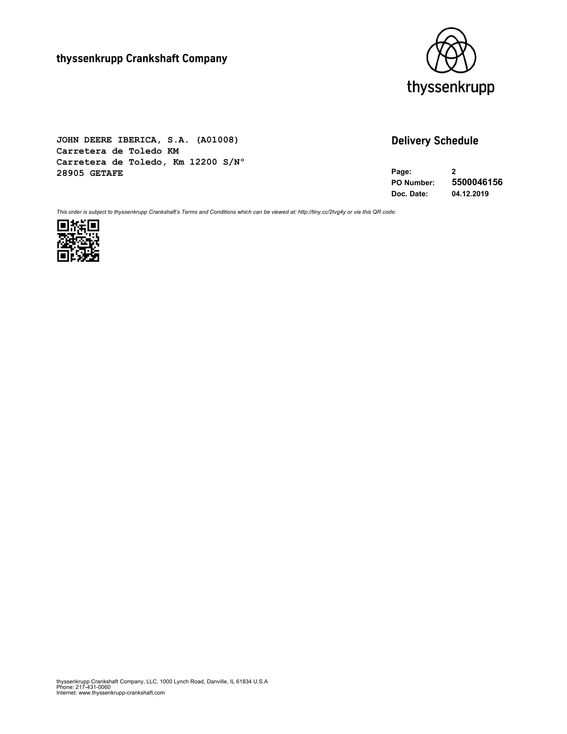
Thyssenkrupp Crankshaft
Campos validos
No escaneado

Slide 8
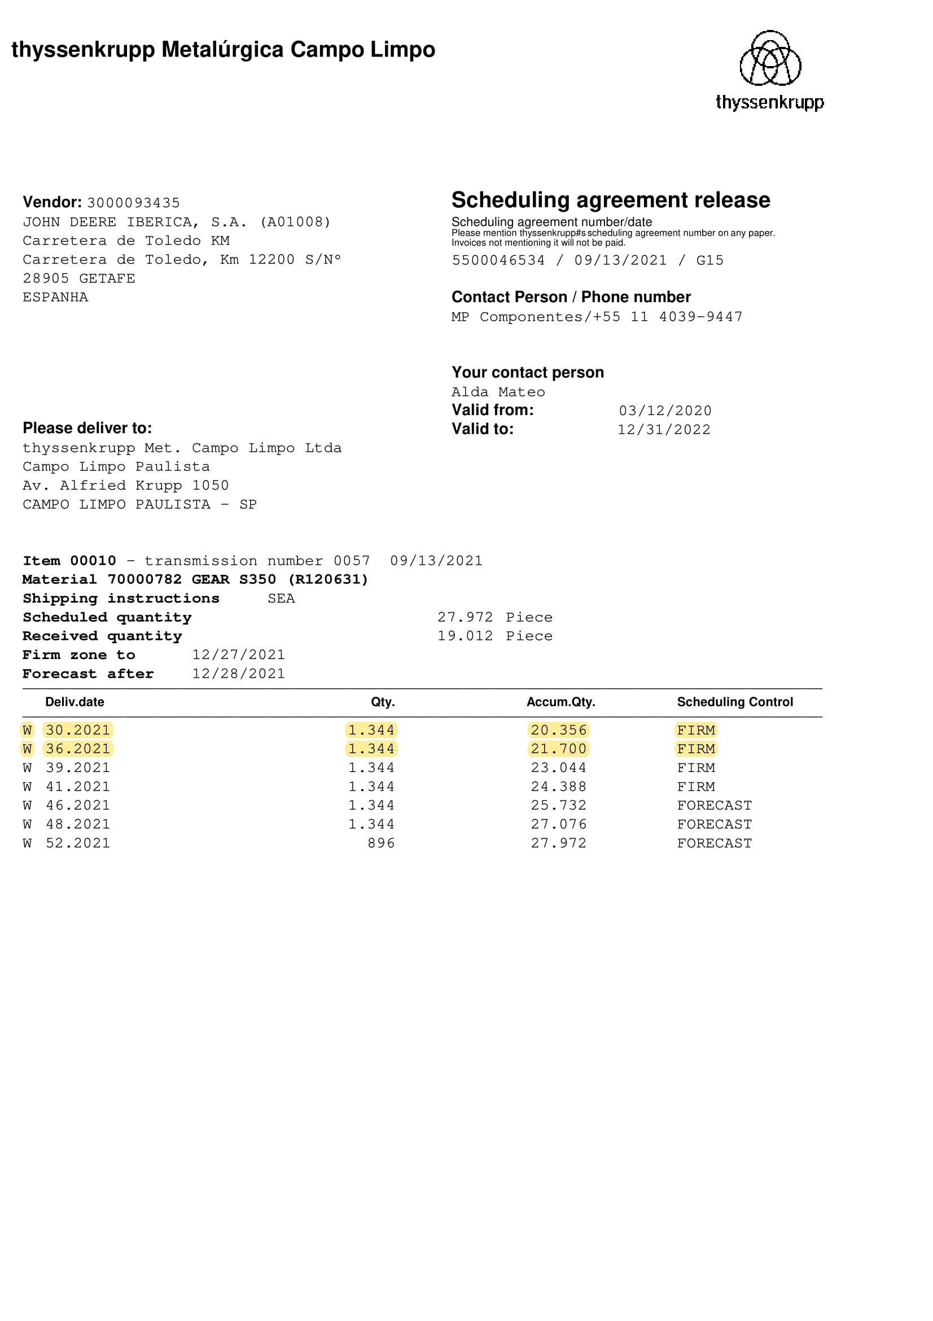
Thyssenkrupp Campo Limpo (70017078)
Campos validos
No escaneado

Slide 9
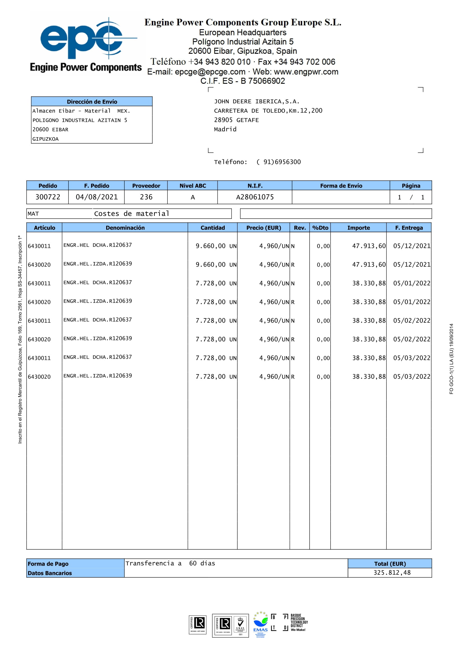
Engine Power Compoments (70017703)
Campos validos
No escaneado

Slide 10
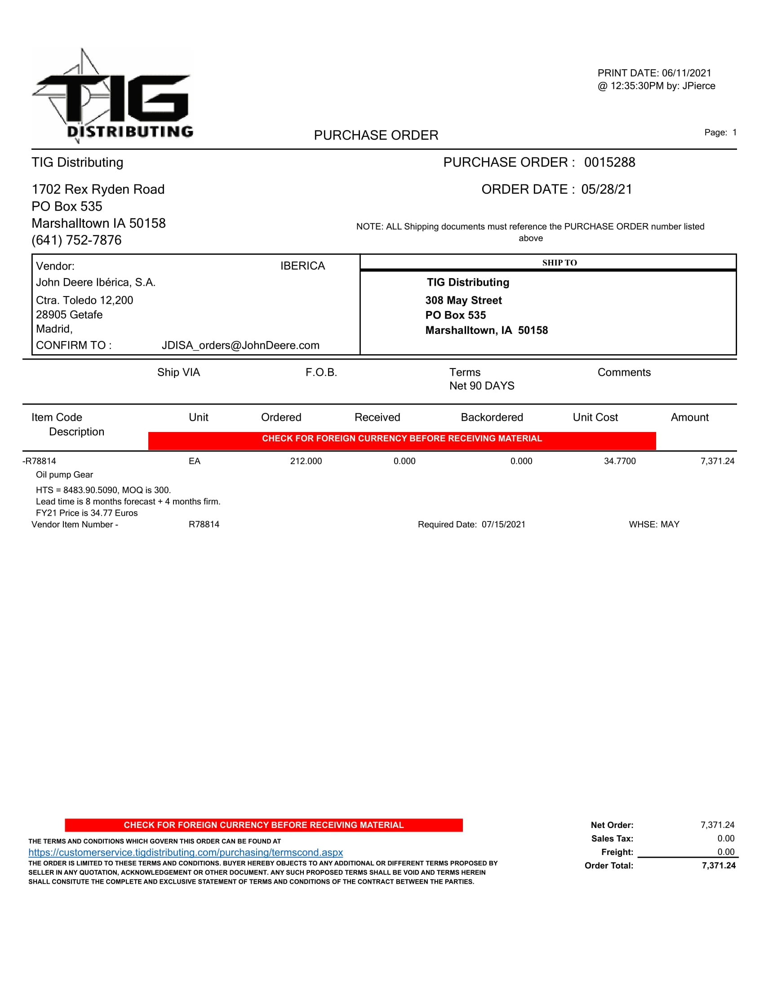
TIG (70017869)
Campos validos
No escaneado

Slide 11
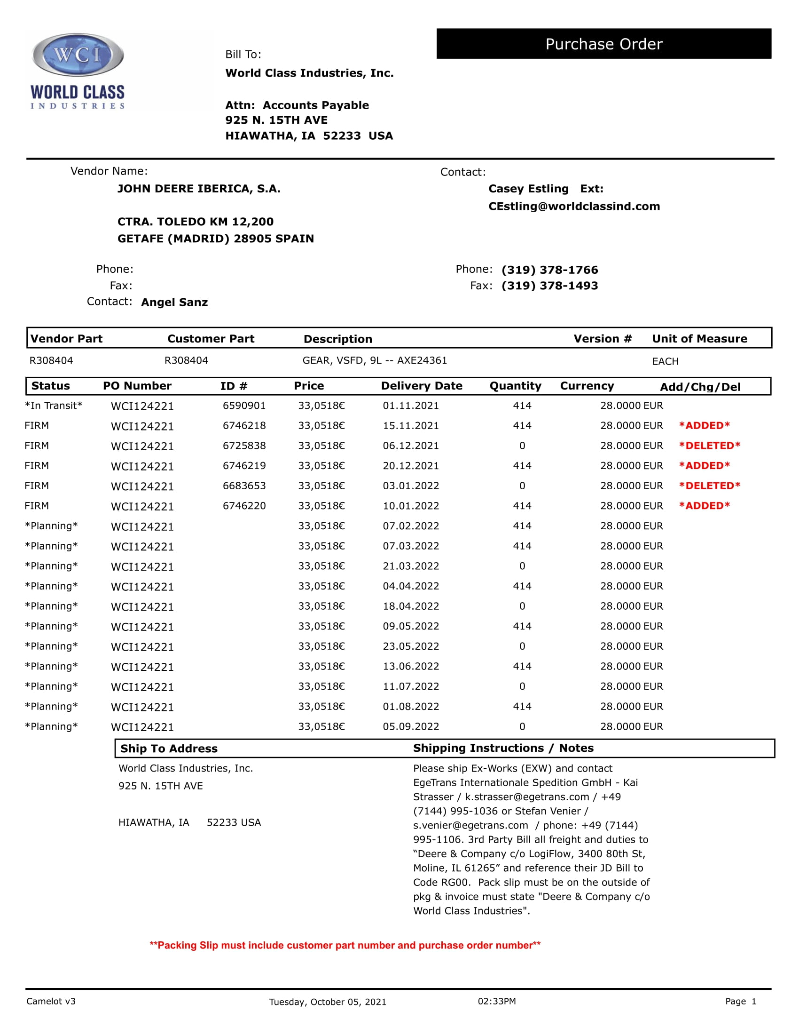
WordClass Industries (70018938)
Campos validos
No escaneado

Slide 12
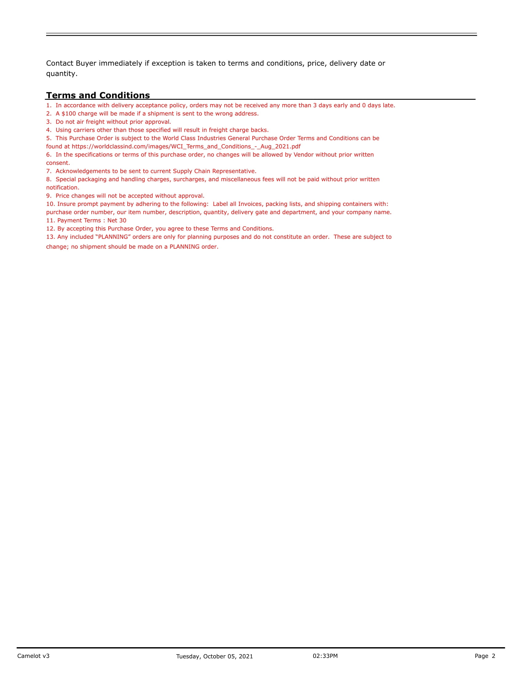
WordClass Industries
Campos validos
No escaneado

Slide 13
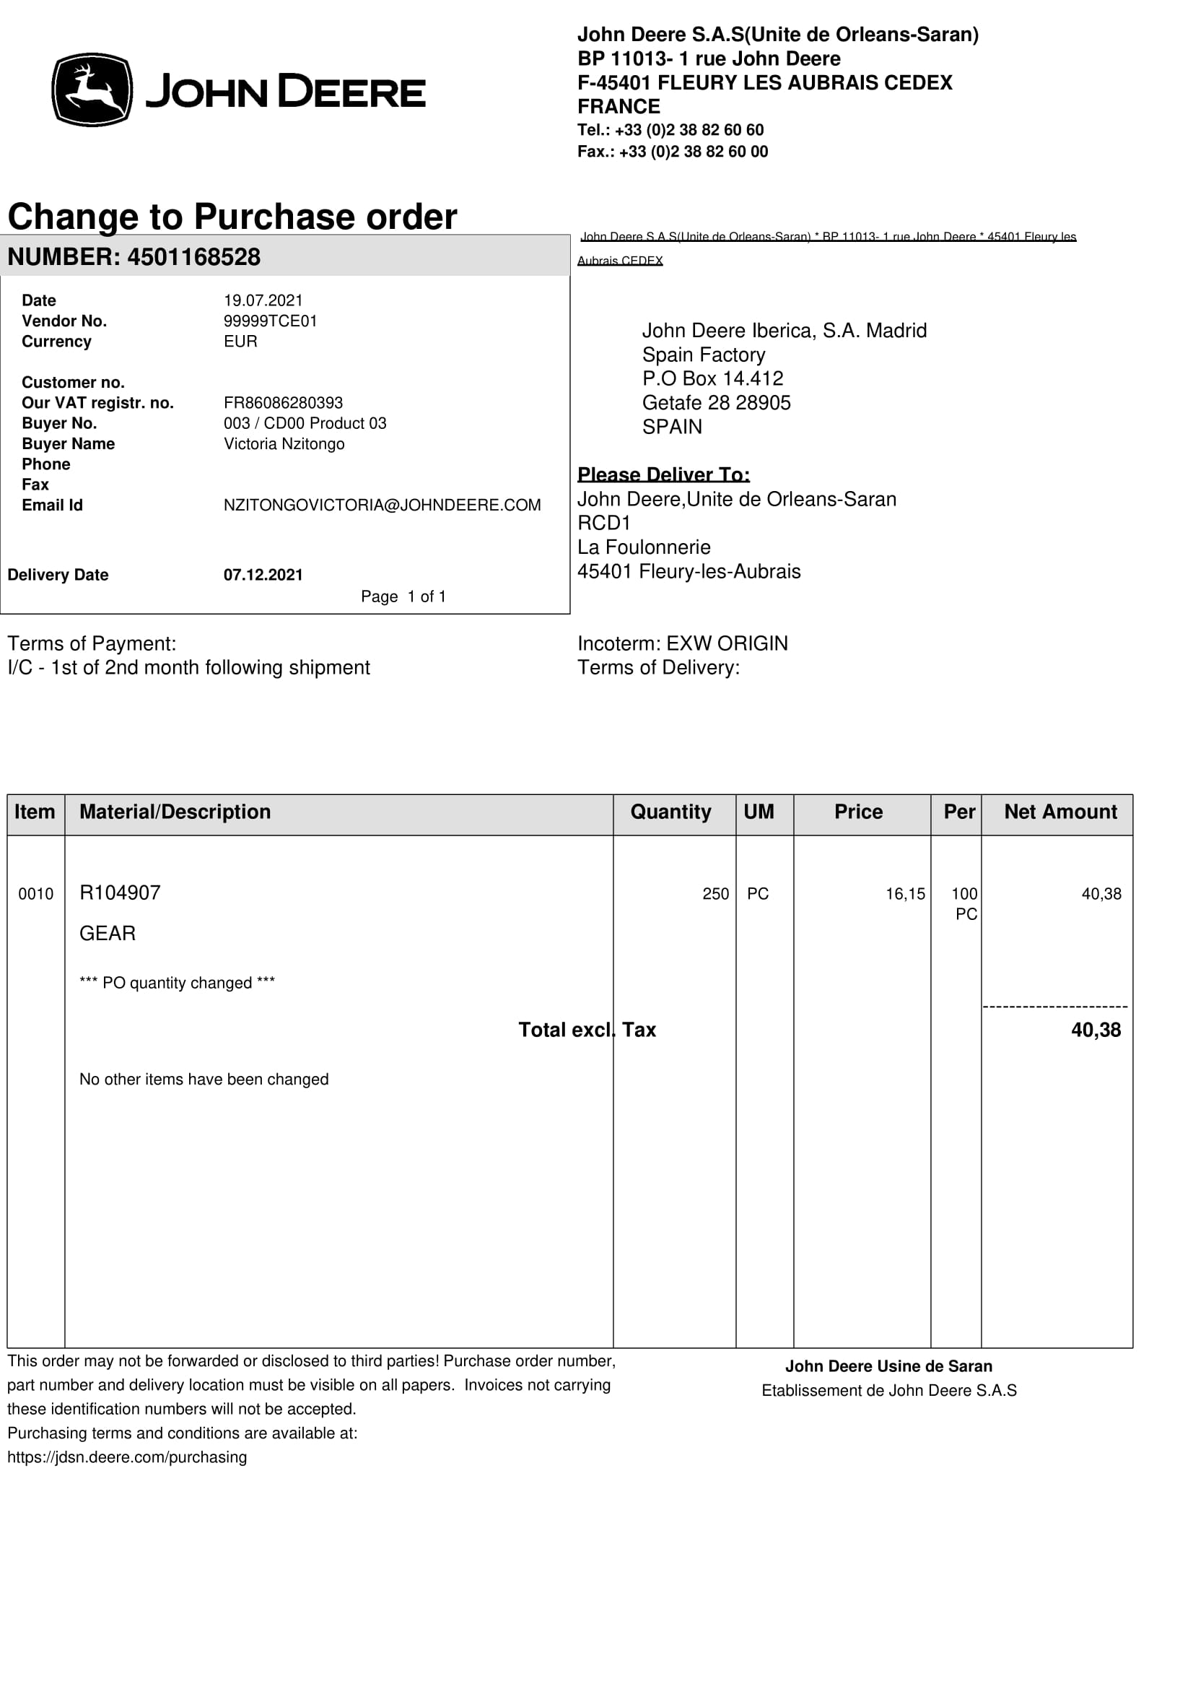
JD SARAN (99999TCD00)
Campos validos
No escaneado

Slide 14
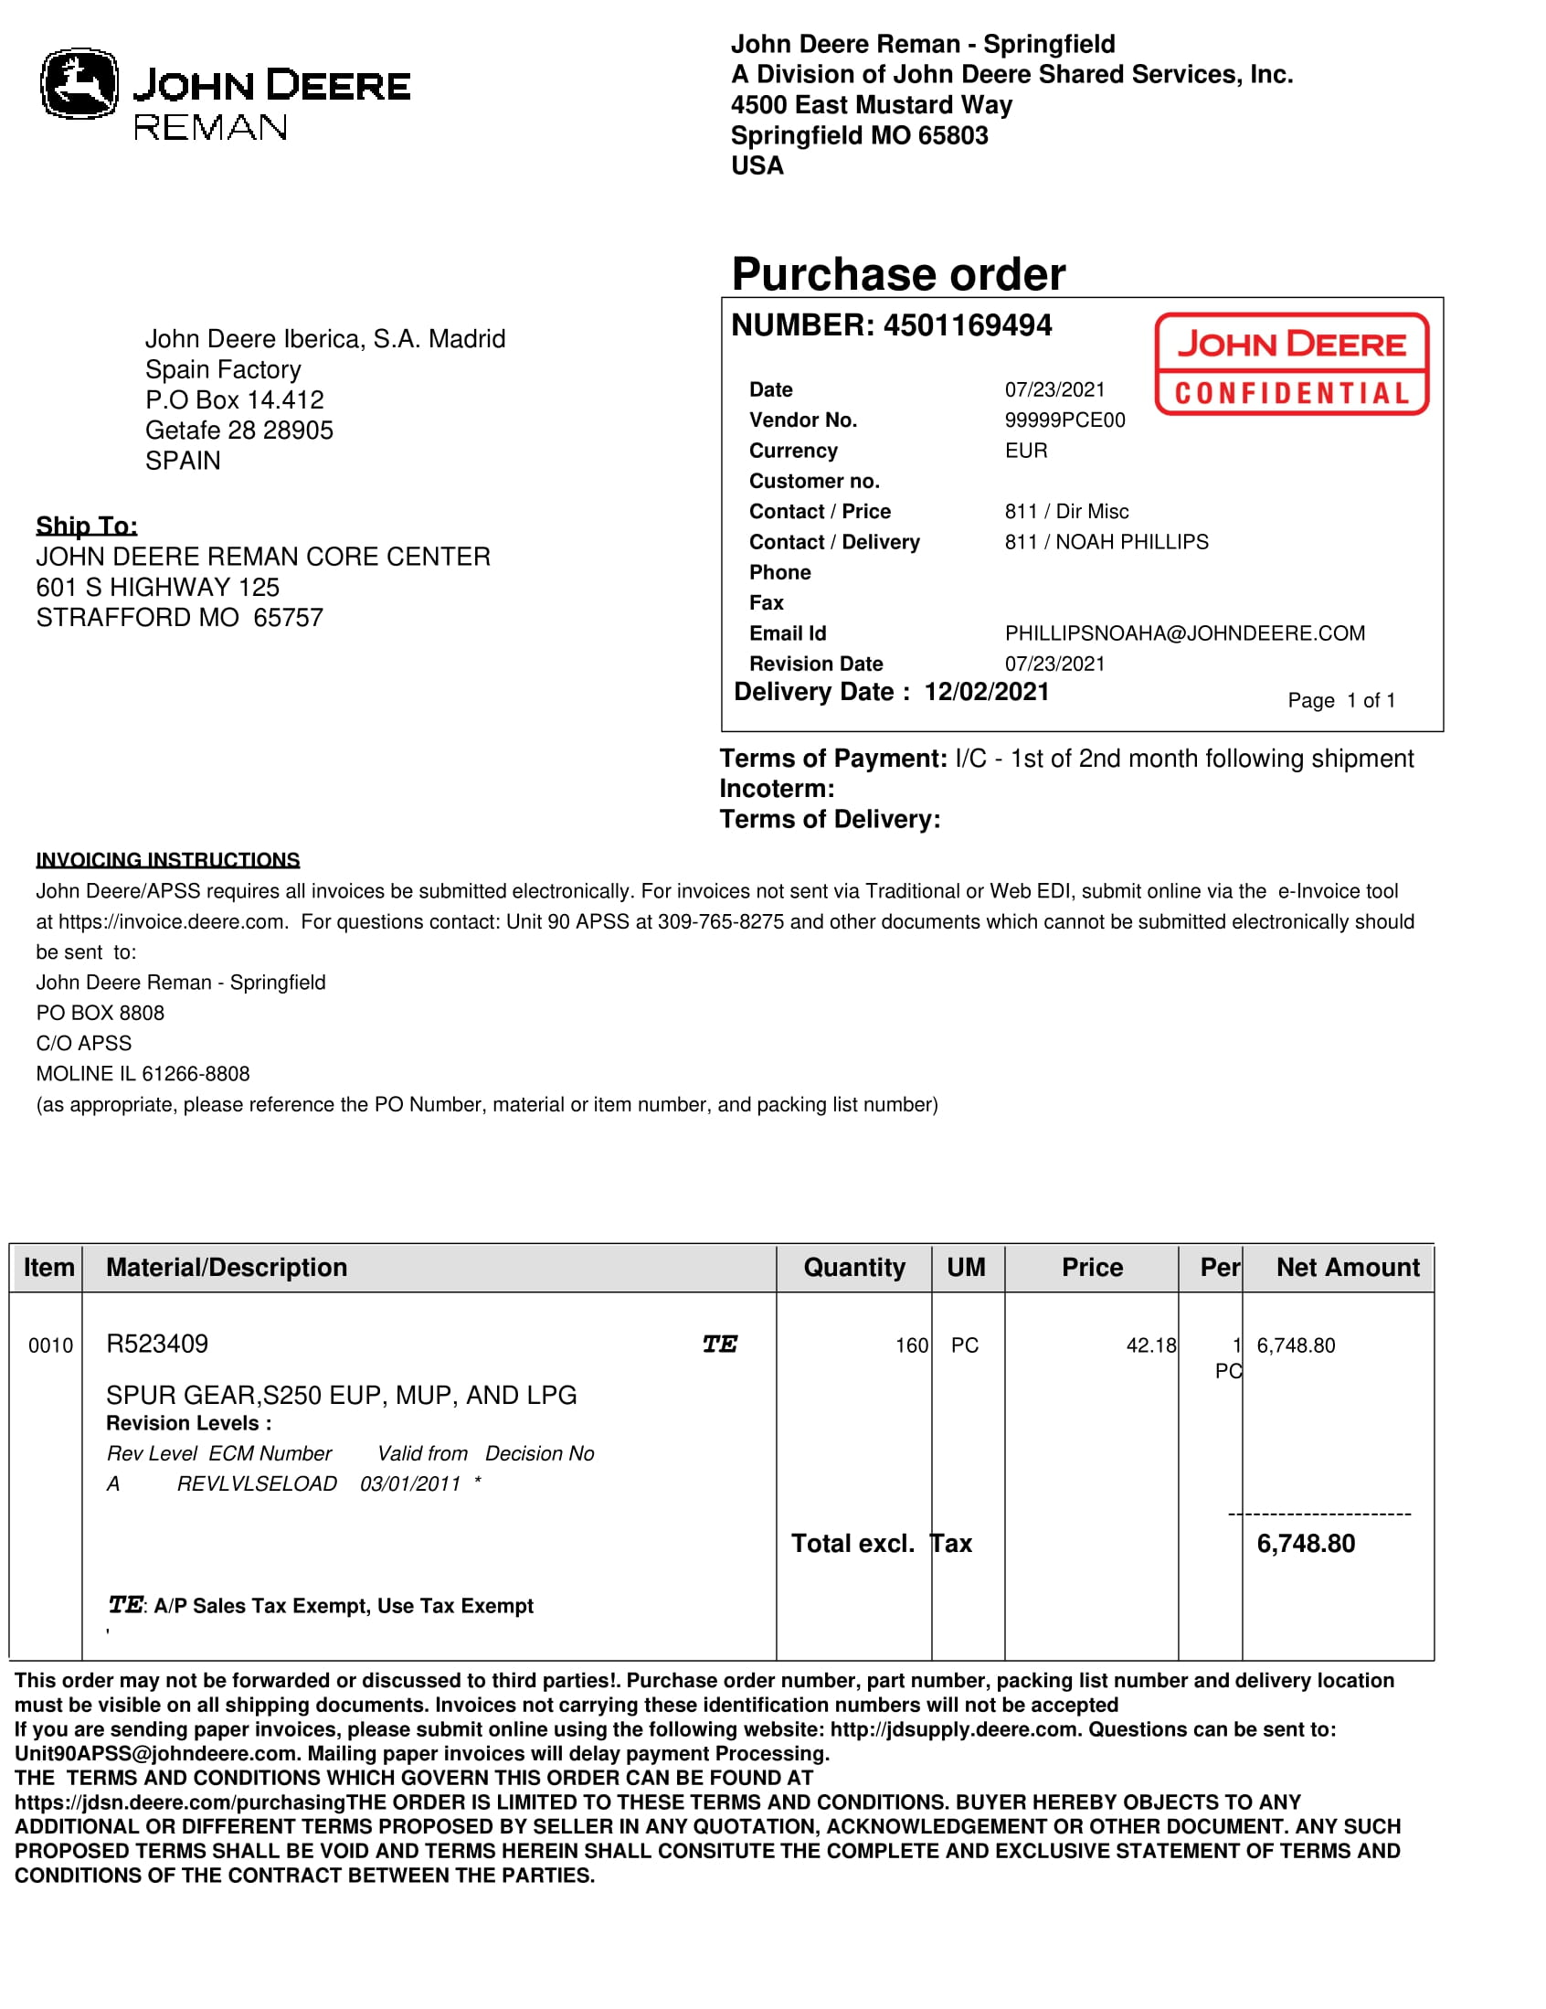
JD REMAN (99999TSE01)
Campos validos
No escaneado

Slide 15
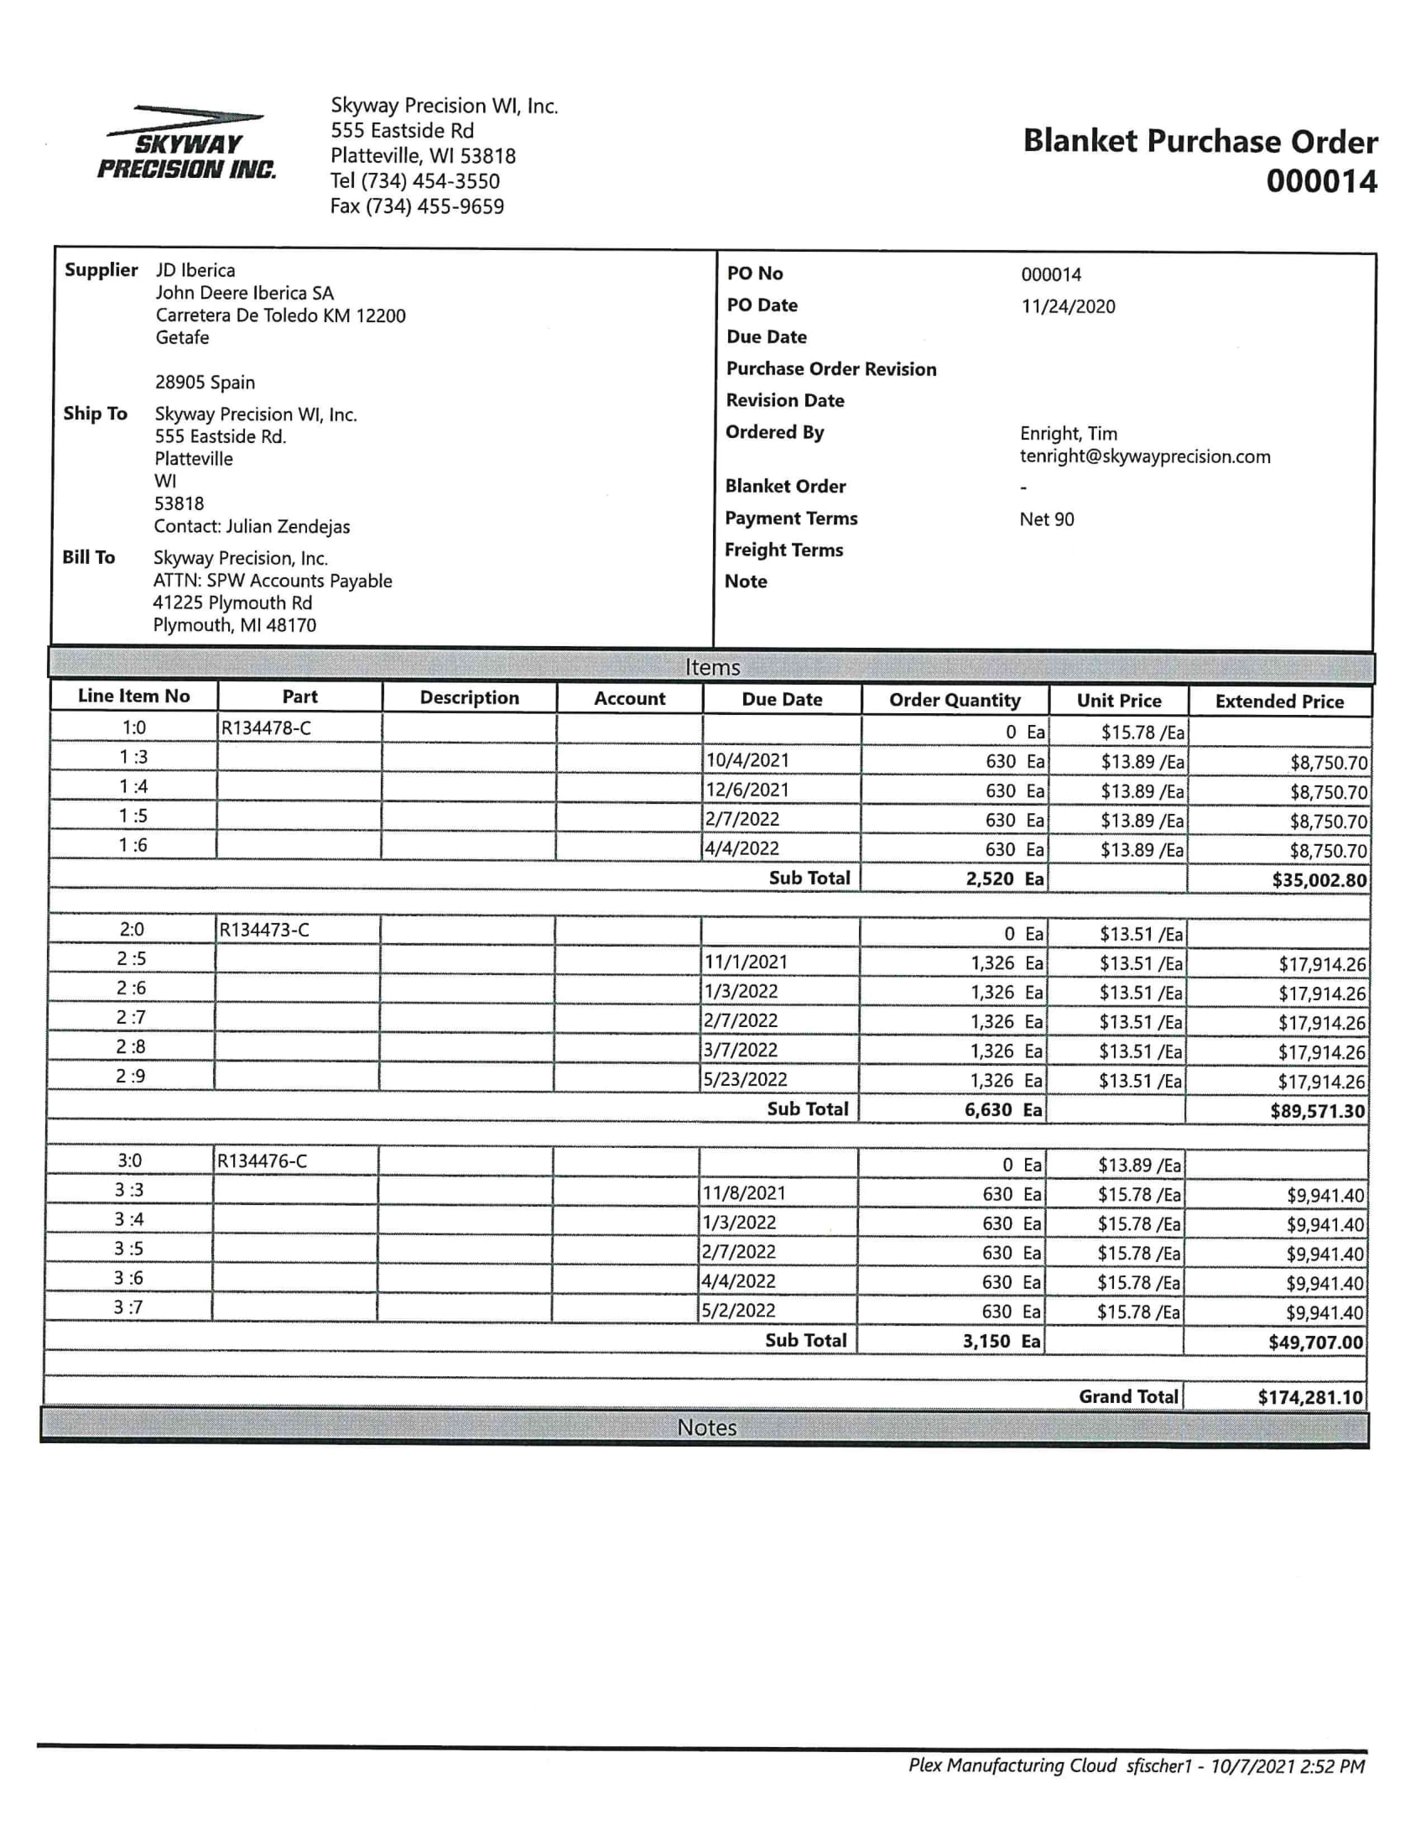
Skyway (70001353)
Campos validos
No escaneado

Slide 16
Concentric (70016983)
Concentric Pumps Pune Pvt ltd (Eou div) |  |  |  |  |  |  | 31/07/2021
Supplier Schedules For the month of Aug-21 to Apr-22
 |  |  |  | Firm |  | Tentative
Sr.No. | Part. No. | Supplier | Description | Aug-21 | Sep-21 | Oct-21 | Nov-21 | Dec-21 | Jan-22 | Feb-22 | Mar-22 | Apr-22
1 | R527691B | JD Iberica | Gear JD T4 OP | 0 | 0 | 0 | 1000 | 0 | 0 | 0 | 0 | 0
2 | R527010 | JD Iberica | Gear JD T4 OP | 4725 | 3780 | 4725 | 3780 | 3780 | 4725 | 3780 | 3780 | 3780

Slide 17
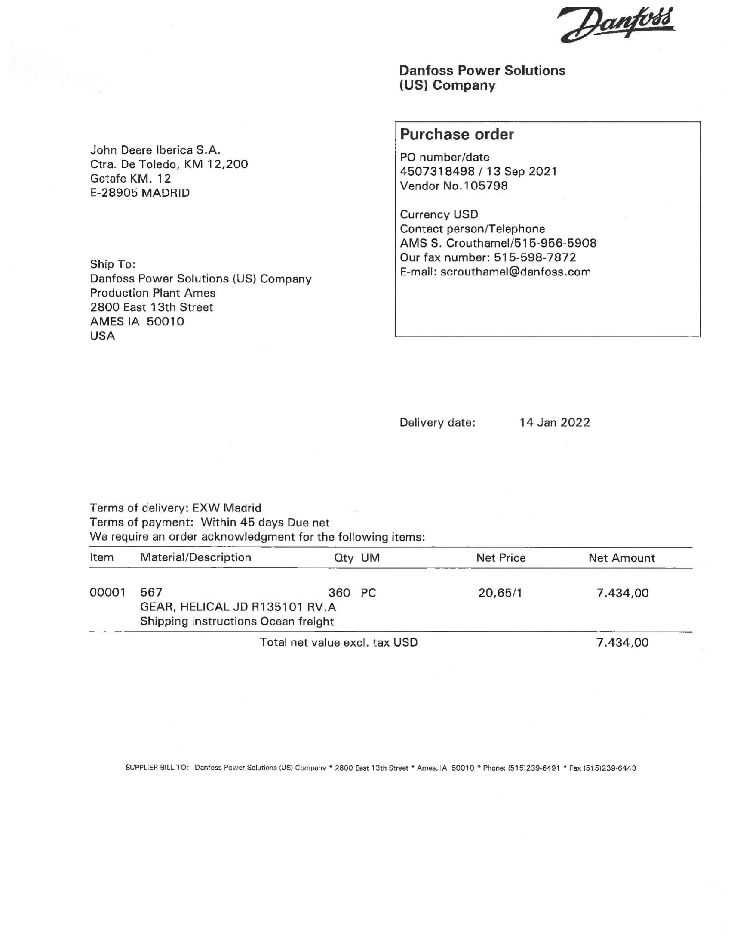
Danfoss (70013219)
Escaneado

Slide 18
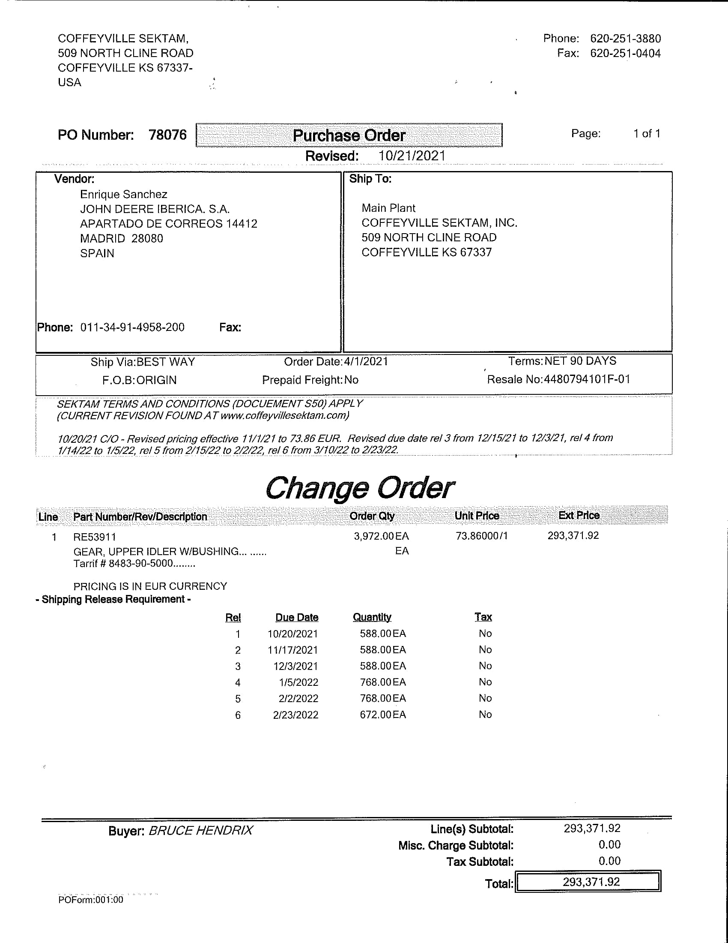
Coffeyville Sektam (70004530)
DESCARTADO
Escaneado

