Slide 1
Unpaired Image-to-Image Translation using Cycle-Consistent Adversarial networks Hacker
By Juan Duran

Slide 2
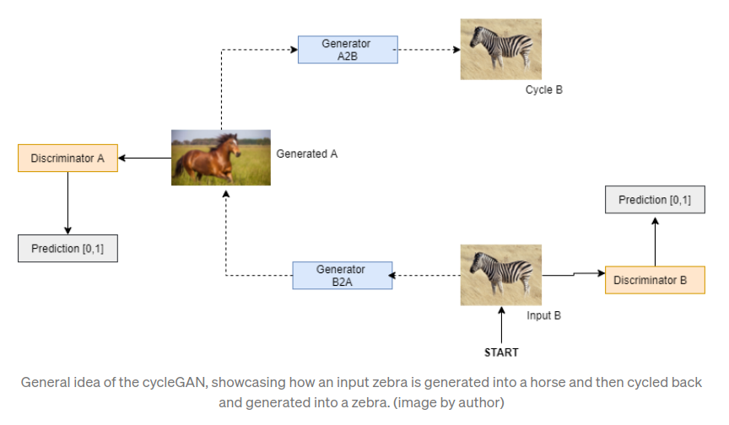
Intuition
From https://towardsdatascience.com/cycle-gan-with-pytorch-ebe5db947a99

Slide 3
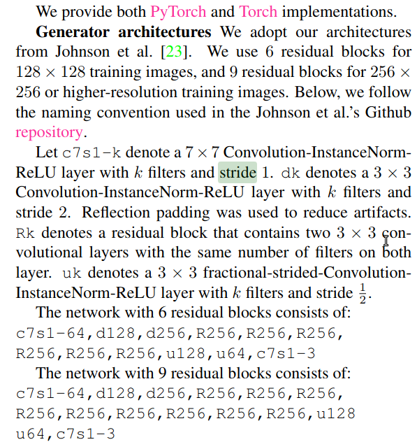
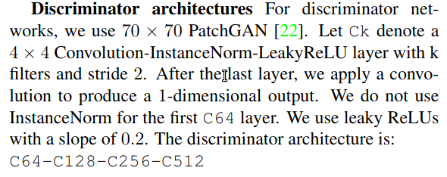
Architecture
From https://arxiv.org/pdf/1703.10593.pdf

Slide 4
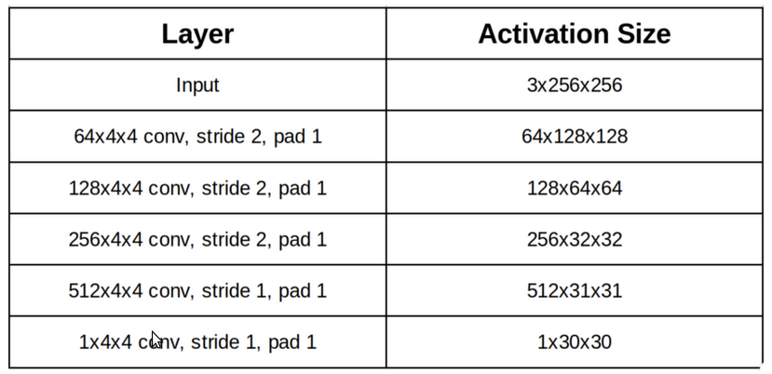
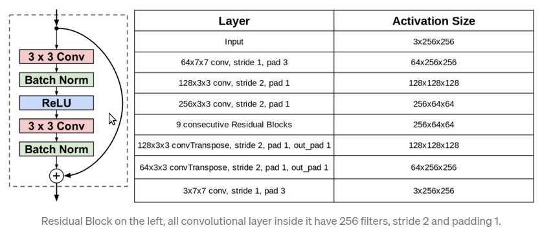
Architecture
Discriminator
Generator
From https://towardsdatascience.com/overview-of-cyclegan-architecture-and-training-afee31612a2f

Slide 5
Backbone
https://github.com/aladdinpersson/Machine-Learning-Collection

Slide 6

Show discriminator and generator

Slide 7
Loss functions
-Discriminator loss function
-Adversarial loss function
-Cycle consistency loss function

Slide 8
Show loss functions

Slide 9
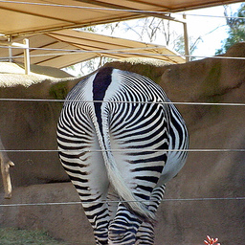
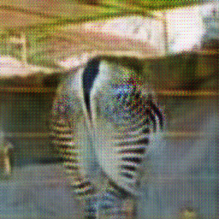
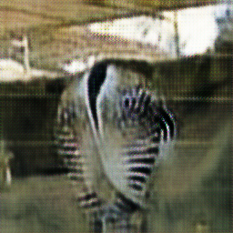
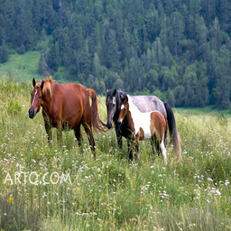
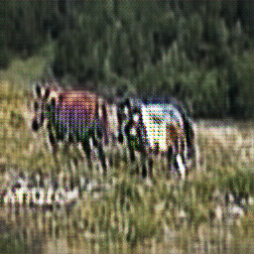
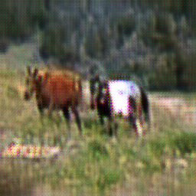
Results after 2 epochs
Original Fake Cycled

Slide 10
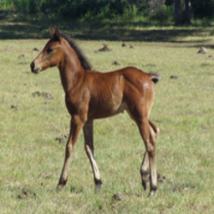
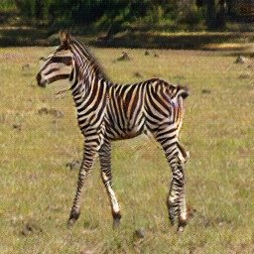
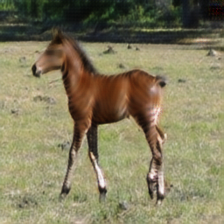
Results after 100 epochs
Original Fake Cycled

Slide 11

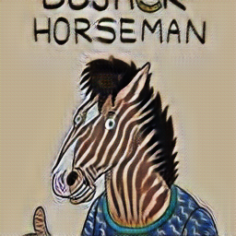
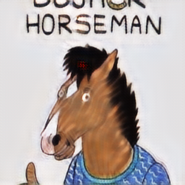
Results after 100 epochs
Original Fake Cycled

Slide 12
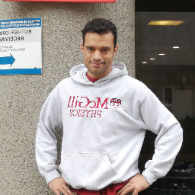
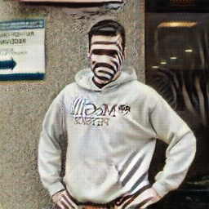
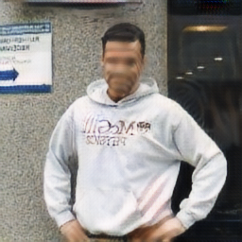
Results after 100 epochs
Original Fake Cycled

