Slide 1
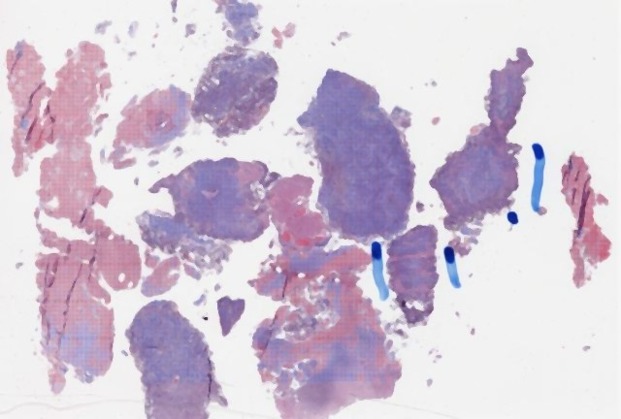
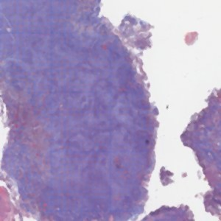
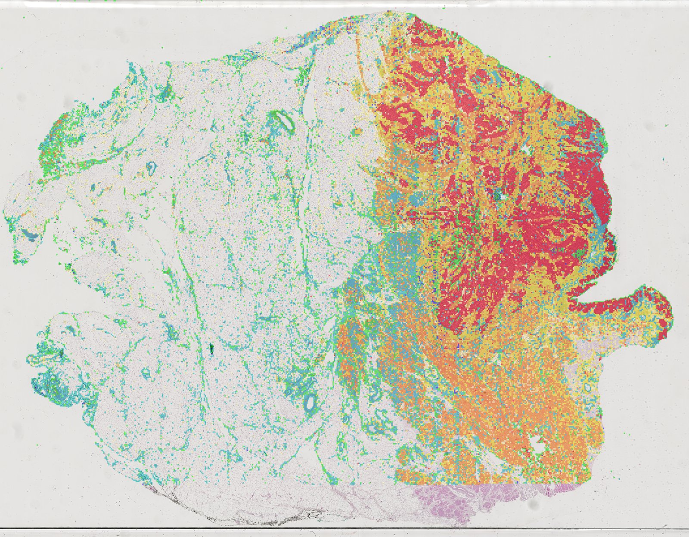
The audited model
8 compartments in bladder (BLCA), 9 in breast (BRCA); each tile belongs to one
Whole-slide image (H&E)
Tiles, 256 × 256 px
CONCH labels each tile
UNI-2: one
vector per tile
check: how decisively?
One encoder per compartment
One learned weight
per compartment
check first: performance against clinical-only Cox, ABMIL and Kaplan–Meier
Tumour tiles
encoder
h₁
Cross-region
attention
w₁
Necrosis tiles
encoder
h₂
w₂
Σ
Risk score
Observed outcome:
progression-free
interval (PFI)
Adipose tiles
encoder
h₃
w₃
… every compartment
encoder
h_{R}
weights
w_{R}
risk vs outcome
risk score
I
Interpretability
E
Explainability
R
Reliability
Read the model's own weights
Explain the score from outside
Find where reliability differs
WHAT IT SEEMS TO SAY
WHAT IT SEEMS TO SAY
WHAT IT SEEMS TO SAY
“This tissue drives the risk.”
“These features explain the risk.”
“The model is more or less reliable for these patients.”
HOW THE AUDIT CHECKS IT
HOW THE AUDIT CHECKS IT
HOW THE AUDIT CHECKS IT
1
Hide compartments in every combination (2⁸ or 2⁹ sets).
1
A random forest learns the risk score from clinical and pathomic features.
1
Error per patient over comparable pairs, aware of censoring.
2
Score each set twice: each patient's risk score, and the C‑index against outcome.
risk
2
Rank the features by importance.
2
MED3pa learns rules that flag groups, on discovery patients.
feature > t
C-index
3
Compare both with the weights; repeat on unseen hospitals and on a planted signal.
3
Re-rank with a second estimator; test each feature against observed outcome.
q < 0.05?
3
On held-out patients: is error predictable? C-index in each group; 90% bounds by subgroup.
PASSES IF
PASSES IF
PASSES IF
Weights order the tissues as the model uses them, and that use orders them as outcome does.
The ranking survives a change of estimator, and features survive multiple-testing control against outcome.
A flagged group's C-index interval excludes the all-patient value (and bounds hold where promised).
Each explanation is checked against the model and against what happened to patients.

