Slide 1
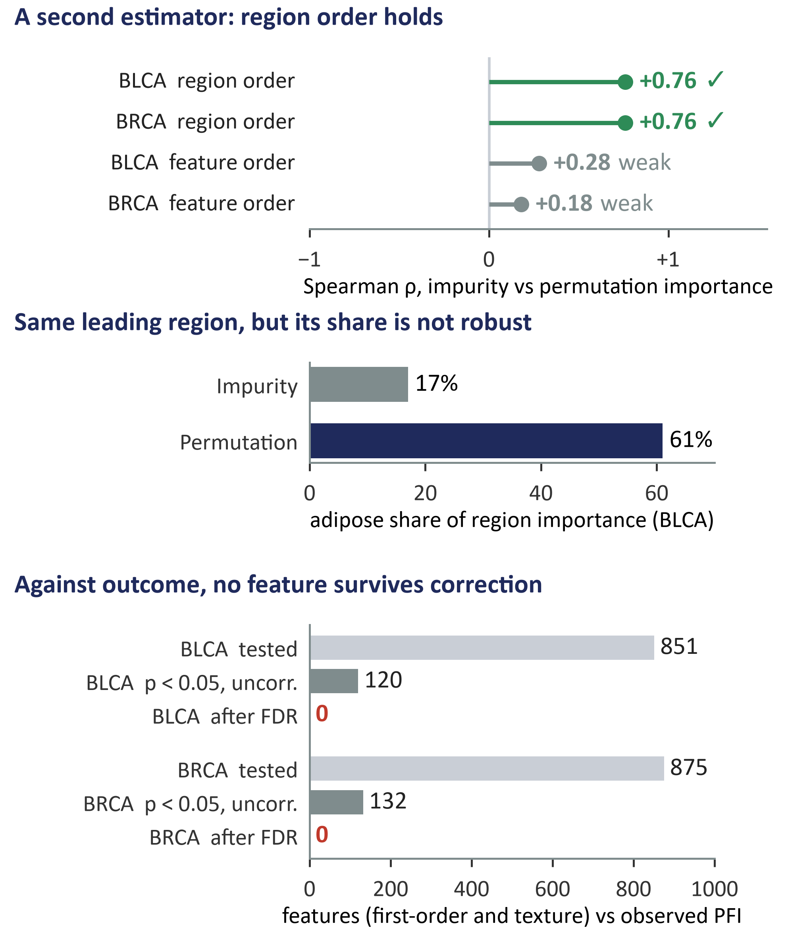
E
(a) How the surrogate check works
(b) What the audit found
1
Start from each patient's out-of-bag risk score.
2
A random forest learns that score from clinical (21 BLCA, 25 BRCA) and first-order pathomic features (504, 514).
3
Rank features and compartments by importance (impurity).
4
Two checks: does the order survive a second estimator, and does each feature predict observed PFI after false-discovery-rate control?
permutation importance
Cox vs PFI, FDR
WHY IT MATTERS
The surrogate explains the model's score. Only features that pass the outcome test say something about the disease.

