Slide 1
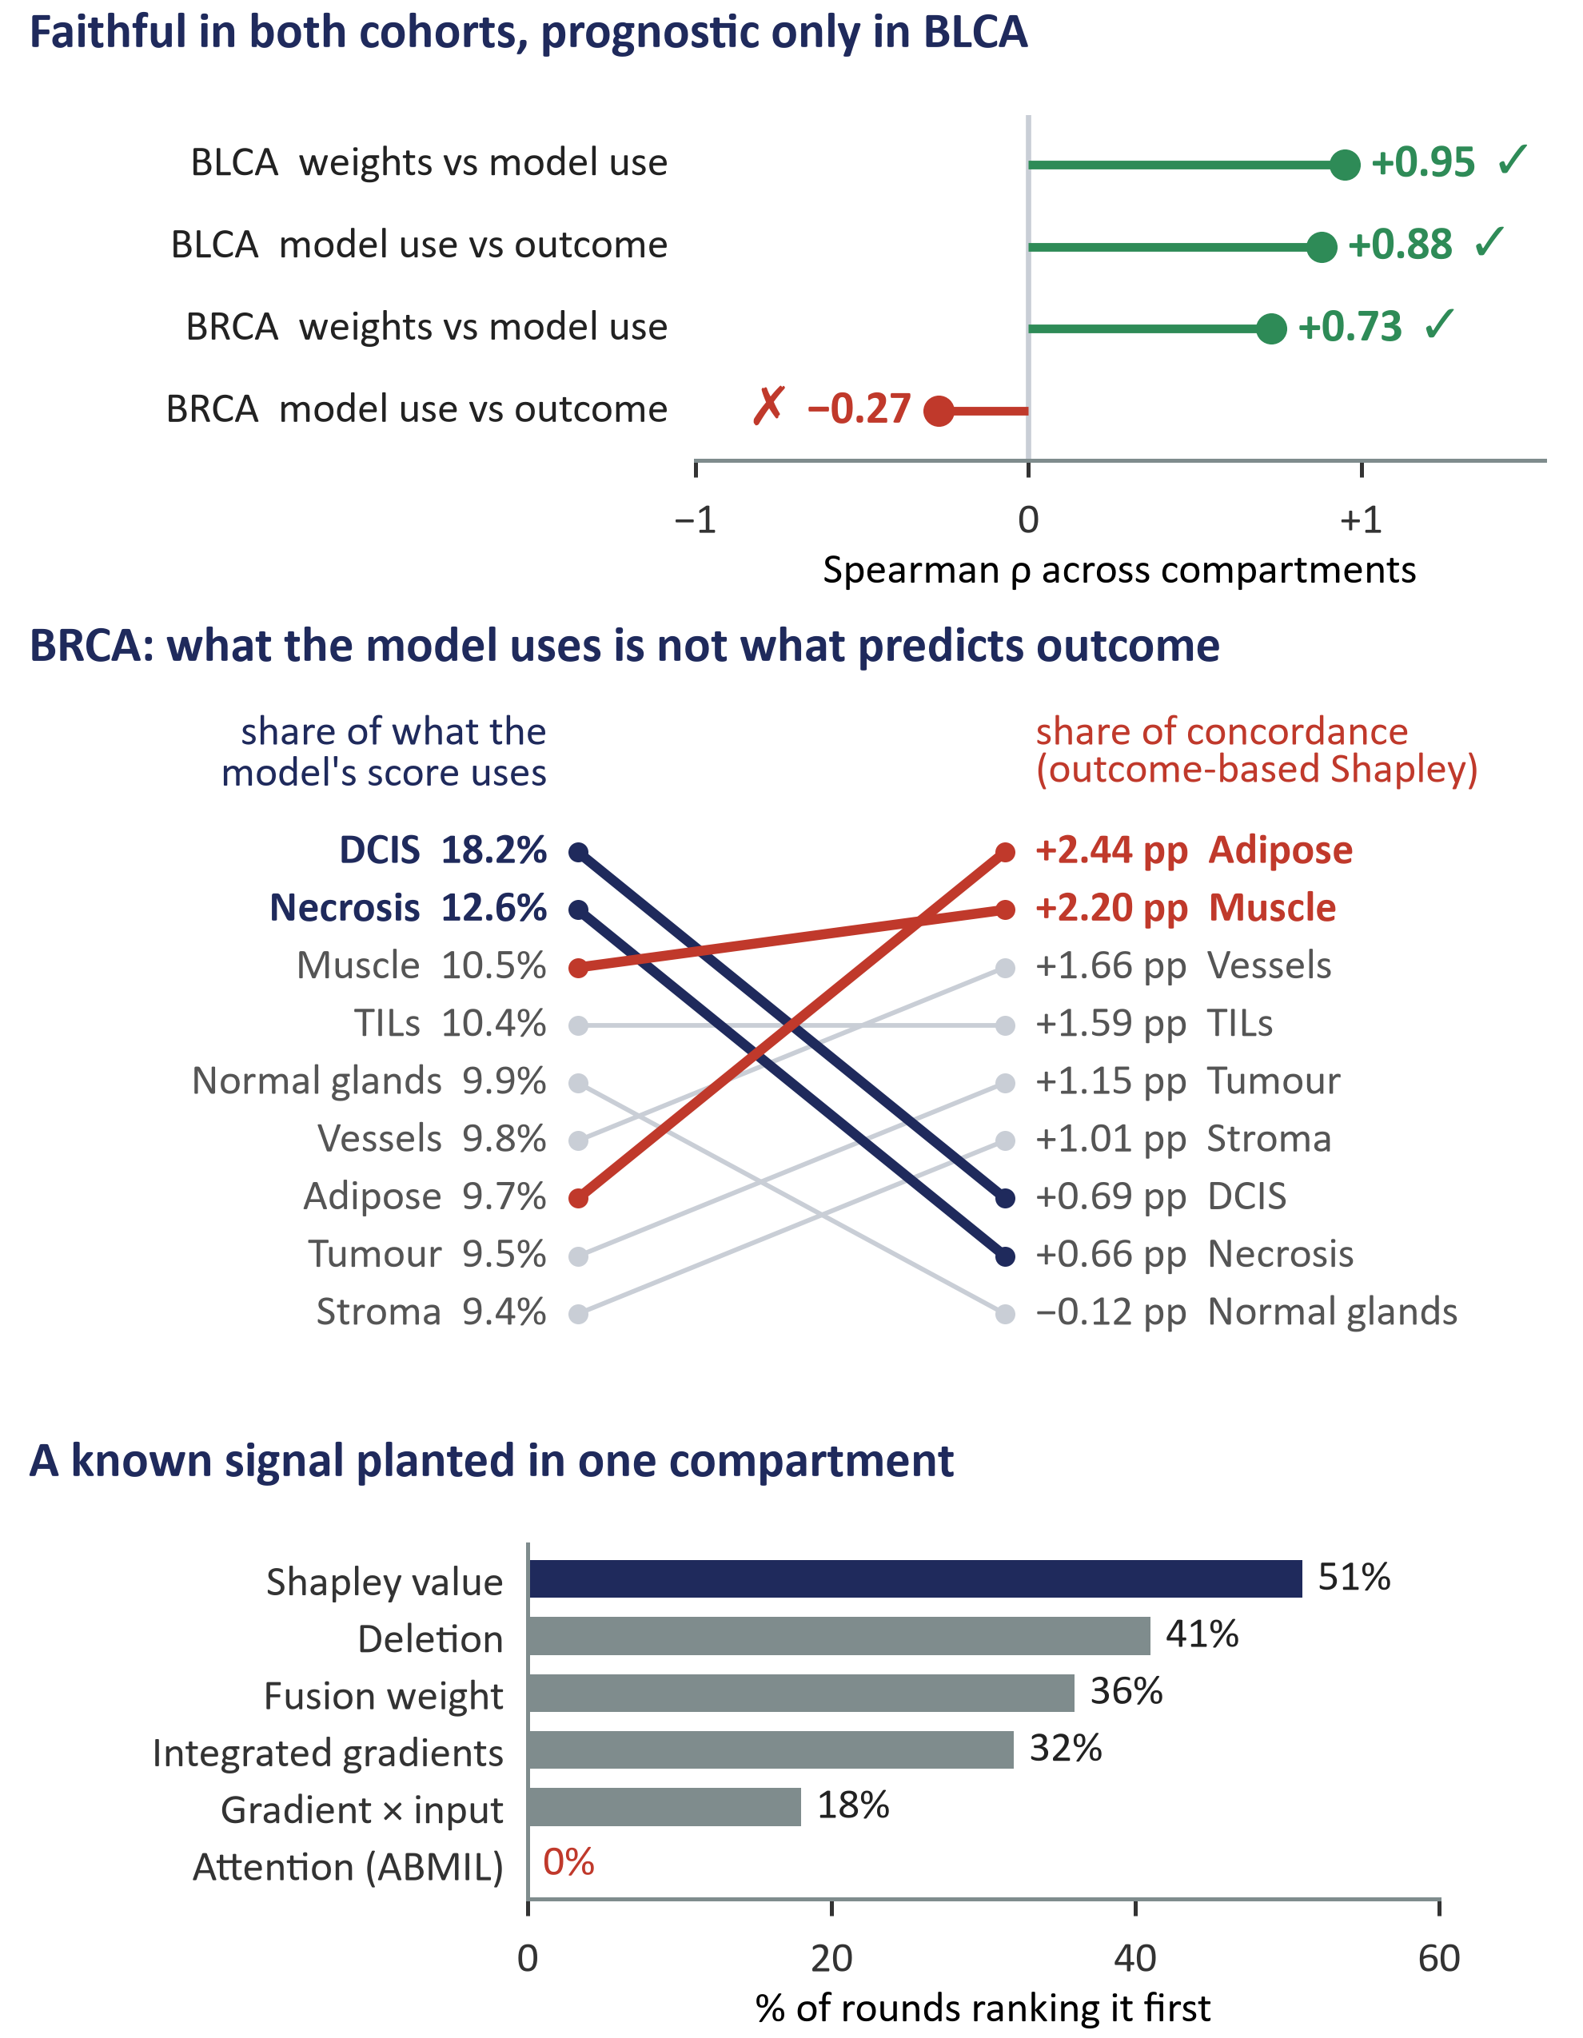
I
(a) How the weight check works
(b) What the audit found
1
The model reports one learned weight per compartment.
Tumour
Necrosis
Adipose
…
2
Hide compartments in every combination: 2⁸ = 256 sets in BLCA, 2⁹ = 512 in BRCA, each scored exactly.
3
Score every set twice: by each patient's risk score (what the model uses, no outcome) and by the out-of-bag C-index (what carries outcome signal). Shapley values share the credit.
risk score
C-index vs outcome
4
Compare the weights with what the model uses, and what the model uses with outcome.
weights ↔ use
faithful?
use ↔ outcome
prognostic?
STRESS TESTS
Repeat on hospitals the model never saw and with removed compartments masked out; plant a known signal in one compartment and ask which measure ranks it first.

