Slide 1
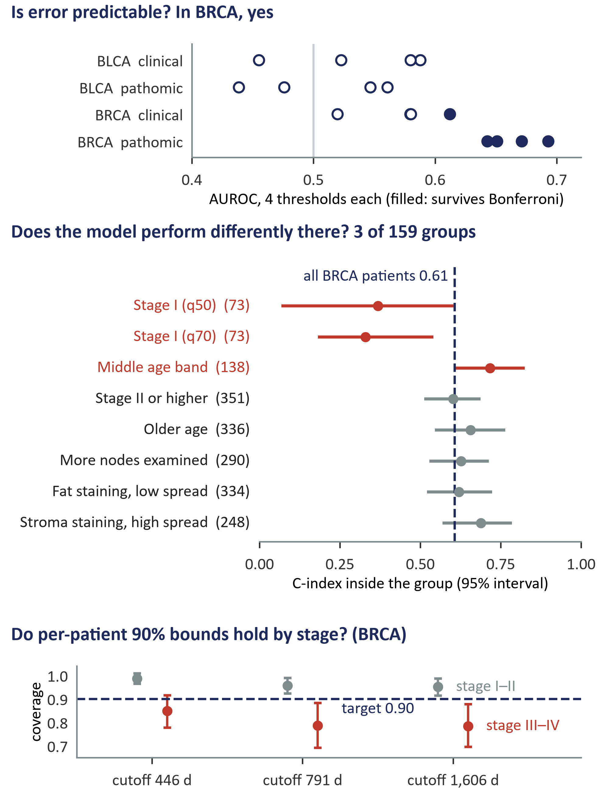
R
(a) How the reliability check works
(b) What the audit found
1
Error per patient: the share of that patient's comparable pairs the model orders wrongly (censoring-aware).
2
Label high error at a threshold (median, 70th, 80th or 90th percentile).
median cut
3
MED3pa learns rules on discovery patients from clinical or pathomic features; each rule defines a profile.
rule on a feature
60% discovery
4
On held-out patients: is error predictable, does the model's C-index differ inside each profile, and do per-patient bounds hold by subgroup?
40% held out:
• AUROC vs 0.5
• C-index in group
• 90% bound coverage
TWO DIFFERENT CLAIMS
“Error is predictable here” is not “the model performs differently here”; the audit tests each separately.

