Slide 1
City Simulation. School
Team Gold
Juan Eladio Pareja Martin
Alba Maria Ramirez Jimenez
Monday 19 May 2025

Slide 2
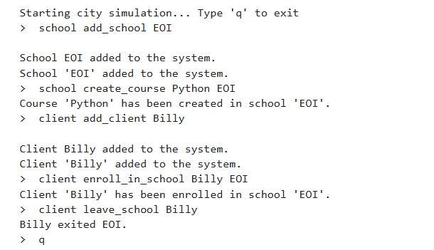

Objectives and Functionality
1.
Project description
Our objective is to develop an interactive city simulator that allows the management of Schools through textual commands entered by the user.
This project is entirely interactive through commands. We can manage agents, do interactions between them and allow the management in the system by commands like this:

Slide 3
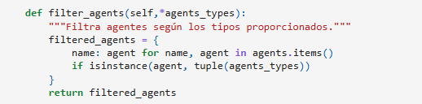
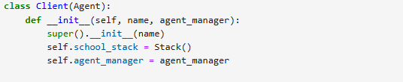
Agent
2.
Implemented classes
Atributes
name: allows to put a name in the agent
Methods
agent.describe(): Returns a description of the agent
Client
This class inherits from Agent
Atributes
stack_school
agent_manager
Methods
assist_course(course_name): Assist a course in a school.

Slide 4
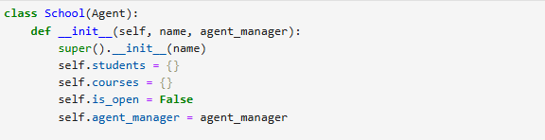
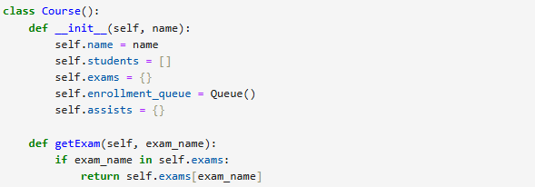
School
2.
Implemented classes
This class inherits from Agent
Atributes
school
courses
Methods
add_school
show_list_students
Course
Atributes
exams
Methods
getExam

Slide 5


Exam
2.
Implemented classes
The Exam class represents an exam within the simulation. It stores the exam name and the grades of students who have taken it.
Atributes
exams_student: A dictionary that stores student-related exam data.
Methods
grade_exam: Grade an exam that the client has taken in a course.

Slide 6
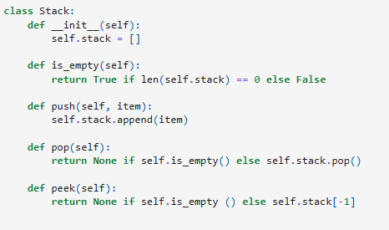
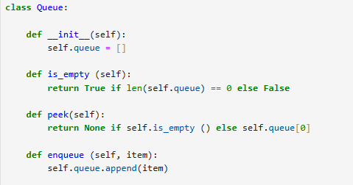
Stack
3.
Data management
Used to track temporary states or navigation history, such as the client’s enrollment.
Methods
push(item): Add an item to the top.
pop(): Remove and return to the top item.
is_empty(): Check if the stack is empty.
Queue
Manages the waiting lists, like enrollment queues.
Methods
enqueue(item): Add an item to the end.
peek(): view the first item without removing it.

Slide 7

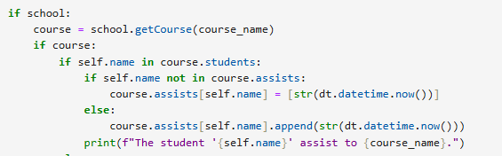
Lists
3.
Data management
Used for storing collections such as student lists, school lists, etc.
Dictionaries
Stores all agents in the system:

Slide 8

Tuples
3.
Data management
Used for fixed groupings of data, such as coordinates or composite identifiers.

Slide 9

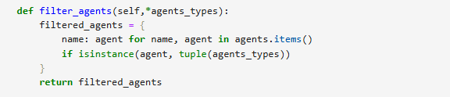
Search agent by name
4.
Search
get_agent_by_name(agent name, agent type)
Locates a specific agent by name and type
Filter agents by type
filter_agents(agent types)
Returns a list of all agents matching the given types, such as Client, School, etc.

Slide 10

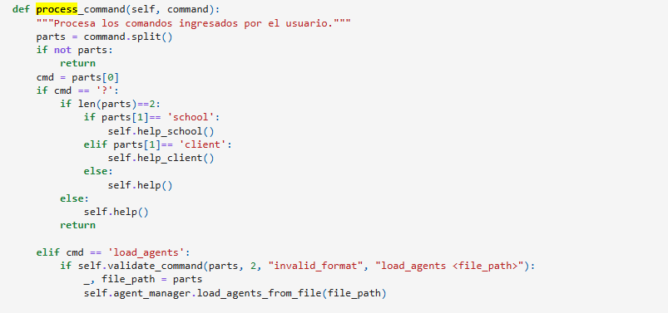
Validation
6.
Validation and Processing
Validation ensured that the user entered the correct command that follows the correct syntax. If not, it prints and error message.
Processing
It process the commands entered by the user.

Slide 11

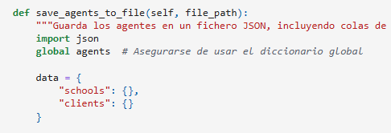
General Commands
7.
Description of operation of each command
? school: Show available commands for schools
? client: Show available commands for clients
q: Exit the simulation
JSON Commands
load_agents_from_file(self, file_path)
Description: Load agents from a JSON file.
save_agents_to_file(self, file_path)
Description: Save agents from a JSON file.

Slide 12


School Commands
7.
Description of operation of each command
add_school <school_name>
Description: Add a new school to the system.
Example
Output
create_course <course_name> <school_name>
Description: Create a new course at school.
Example
Output
show_students <school_name>
Description: Show the list of all students registered at school.
Example
Output

Slide 13


7.
Description of operation of each command
show_enrollment_queue <school_name>
Description: Show the enrollment queue for the course.
admit_student_from_queue <school_name>
Description: Admit the next student from the queue to enroll in to a course.
show_courses <school_name>
Description: Show the available courses at school.

Slide 14


7.
Description of operation of each command
remove_student <school_name> <client_name>
Description: Remove a student from school.
This command ensures that in case you make a mistake typing a client name, it can be deleted.
show_list
Description: Show the list of schools in the system.
close / open <school_name>
Description: Open or close school, if there isn’t students at class.

Slide 15
7.
Description of operation of each command
add_exam_to_course <school_name> <course_name> <client_name> <exam_name>
Description: Add an exam to a specific course at school.
grade_exam <school_name> <course_name> <client_name> <exam_name> <grade>
Description: Grade an exam that the client has taken in a course.
remove_exam_from_course <school_name> <course_name> <exam_name>
Description: Remove an exam from a course if no client has submitted it.

Slide 16
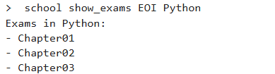
7.
Description of operation of each command
show_exams <school_name> <course_name>
Description: Show the list of exams available for a couse at the school.
remove_school <school_name>
Description: Removes the school from the system.

Slide 17


Client Commands
7.
Description of operation of each command
add_client <client_name>
Description: Add a client (student) to the system
Example
Output
client_enroll_in_school <client_name> <school_name>
Description: Enroll a client in a specific school.
client leave_school <client_name>
Description: Allow a client to leave school.

Slide 18

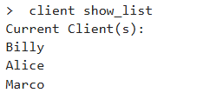
7.
Description of operation of each command
join_enrollment_queue <client_name> <school_name> <course_name>
Description: Join a client in a queue to enroll a course.
assist_course <client_name> <school_name>
Description: Assist a course in a school.
show_list
Description: Show the list of clients in the system.

Slide 19

7.
Description of operation of each command
take_exam<client_name> <course_name> <exam_name>
Description: Allow a student to take an exam of an enrolled course
remove_client <client_name>
Description: Removes the client from the agents.
This command ensures that in case you make a mistake typing a client name, it can be deleted.

Slide 20
What we learned
7.
Conclusion
Implement commands in a simulation system
Organize agent interactions
Apply validation and filtering techniques
Problem solving skills
Teamwork
Improvements
More optimization by other techniques
Expand the agent manager
Our githhub with the complete project here

