Slide 1
Power BI Report: Resort Occupancy during high Season
Power bi report example

Slide 2
Background
A company has a dataset related to its revenue from 2015 to 2017 from two types of accommodation, hotel and resort. The company wants to get insight from the year 2016 and they want to focus on cancellation level, average daily revenue rate compared to lost rate on a monthly basis.

Slide 3
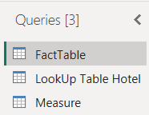

Power Query
The data was transformed with power query. I carried out different data transformation for different insights and the data model.

Slide 4
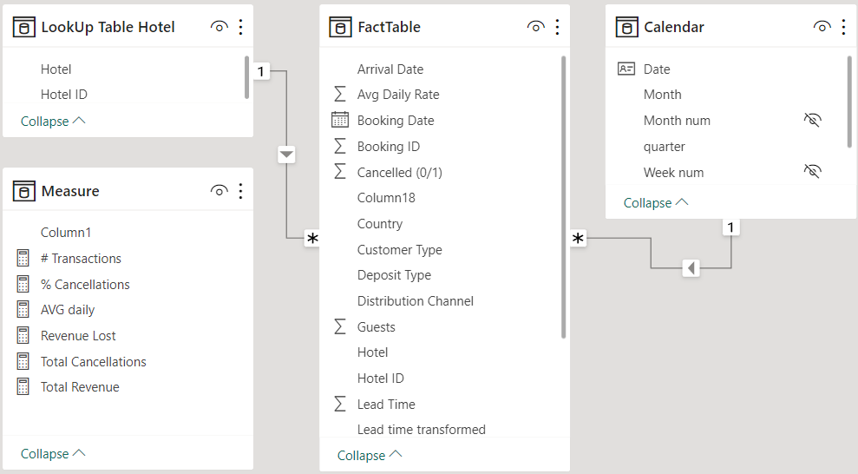
Model View
Data Model: * a star schema with date table and a dimension table, LookUp table hotel. * A measure table keeps different calculation for report insights

Slide 5
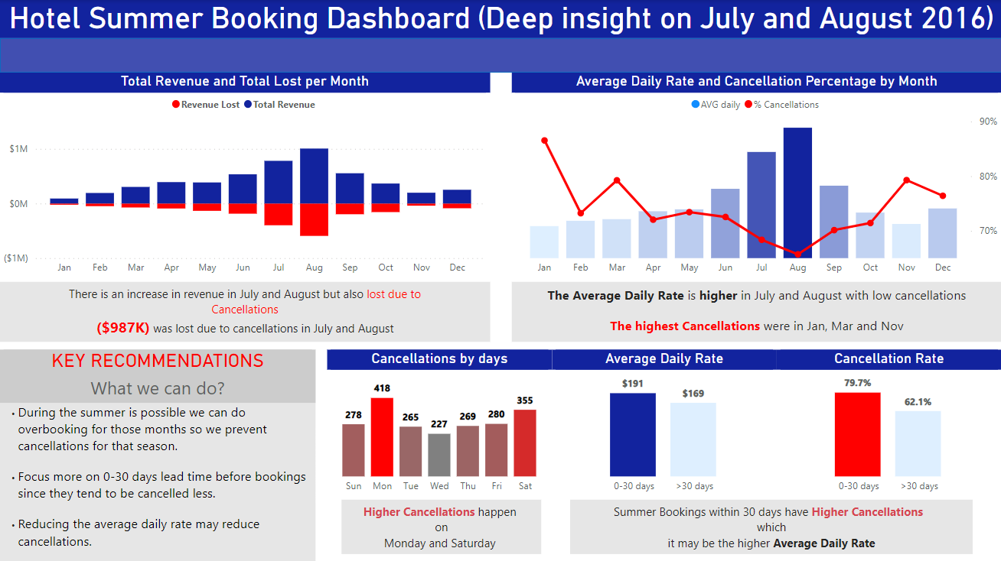
report

Slide 6
Stakeholder recommendations
Some actions for different stakeholders:
Managers:
During summer between July and august, an overbooking process could be beneficial to prevent cancellation.
It is more important to focus on early bookings clients since they are more likely to cancel.
Front desk staff:
They should be aware of this season change to improve client support.

