Slide 1
Wind Turbine Signal Analysis
TFM Master Data Science Juan Fajardo
14th edition Kschool – June 22, 2019

Slide 2
Project analysis slide 3
INTRODUCTION
Energy industry is changing and we want to be part of the change
Energy Sources
Players
Data Projects
From conventional to clean
From big players to small players
Difficult to simple projects
Notes:
Energy sources: Conventional Energy sources(coal, natural gas, nuclear, etc…) are very big projects and therefore these projects are very expensive. However, new clean Energy sources can have smaller projects and therefore cheaper.
Players: in the past few big companies, now many medium/small companies that are making the market more competitive. To compete you need creative ideas.
Data Projects that in the past were beyond 100 kUSD, now are much smaller through the wide use of programming languages and online tools.

Slide 3


Project analysis slide 4
PROPOSAL
Predicting future values compared with real values > predicting errors
Model for wind turbine signal analysis, maximizing:
Usage of Data
Plant availability
Maintenance Costs
Staff time
Machine Learning Tools
Based on the use of Data
Better preventive maintenance
Focus on value added tasks
Notes:
Plant availability: The use of technology improve plant availability (necessary to keep in the market)
Maintenance: additionally technologies allow to reduce maintenance costs, with a better use of the preventive maintenance.
Staff time: additionally

Slide 4
Project analysis slide 4
METHOD
Project work flow
56 signals / 10 min
Good quality signals
OPC
Verify signals quality
Forecast values
Dashboard
-Signals in Blue
-Signals in Red
-Signal in colors
-Plot signals historic

Slide 5
Project analysis slide 4
METHODOLOGY
Follow the 5 steps by Hyndman:
Identify the problem
Gathering information
Preliminary exploratory analysis
Clean
Prepare Data
Choosing and fitting the model
Using and evaluating a forecasting model
Notes:
Preliminary exploratory analysis:
Clean
-Selecting the fields we need
Prepare data:
-Time index
-Data in float
-Plotting
-Outliers
-Missing value
K-means. It creates ‘k’ similar clusters of data points.
-Seasonality
Make the TS stationary by differentiating (stationary means: properties of a process generating a time series do not change over time)
To do that differentiating ( seasonal+trend+random ) check if there is evidence of a trend so we can
Augmented Dick-Fuller test : Null Hypothesis: TS has a unit root and hence is non-stationary.
We train the model with the residuals
Cluster (k-means clustering aims to partition n observations into k clusters in which each observation belongs to the cluster with the nearest mean)

Slide 6
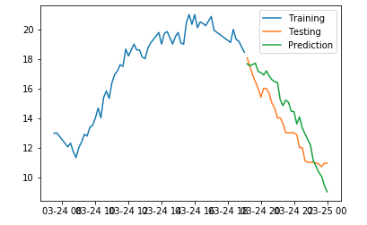

Project analysis slide 4
MODEL SELECTION
Select best parameters – AutoArima
Fit the model with Train
Predict N_periods
Compare (prediction vs Test)
Model Selected
Different Models:
Facebook Prophet
Moving average
Notes:
AutoArima (Auto Regresive Integrating Moving Average) try several parameters to get the optimal Akaike information criterion (AIC) comparing results of the model with other models. -> model selection.

Slide 7
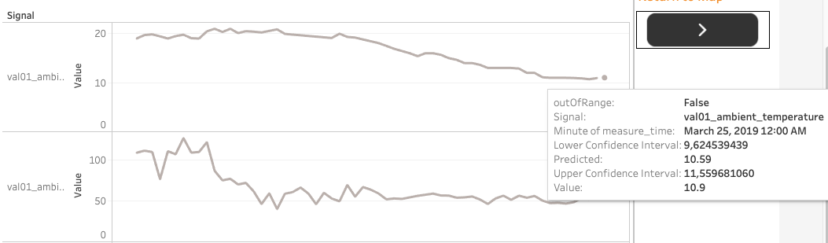
Project analysis slide 4
FORECASTING
Use the model to predict 1 hour ahead (6 periods) extracting:
Lower Confidence Interval
Upper confidence interval
Predicted Value
Real values not in range of confidence intervals produce errors
Alternative methods:
Clustering signals
Google scholar

Slide 8
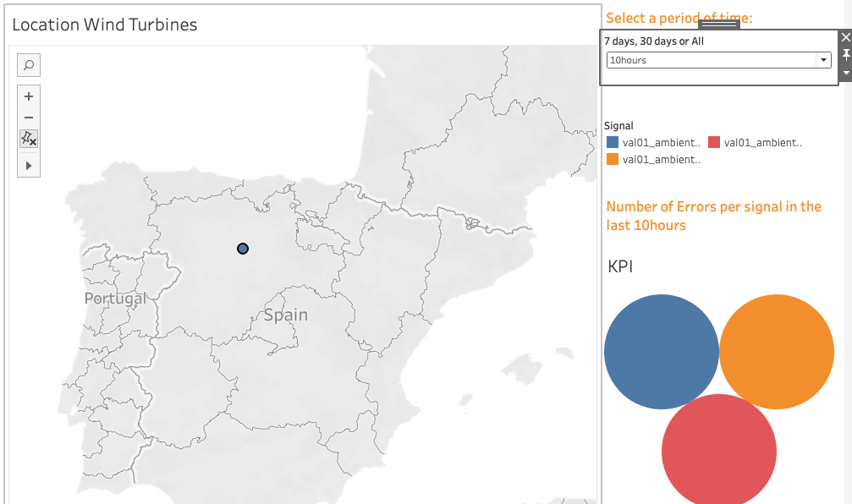
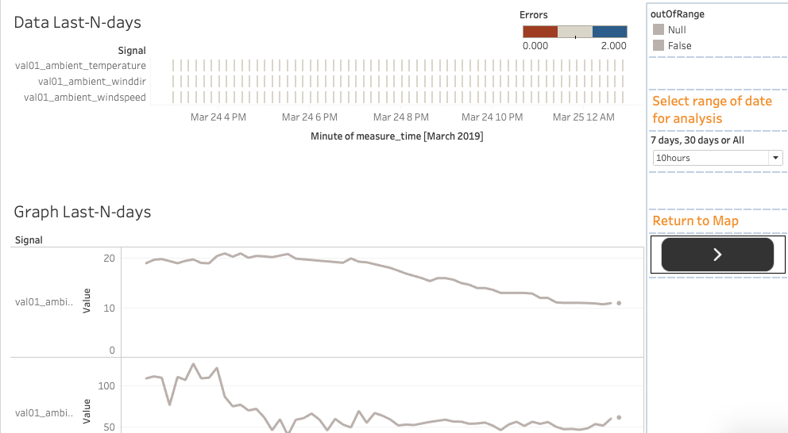
Project analysis slide 4
FINAL RESULT
Maximize use of existing data
Improve performance of assets
Optimize experts time
We are part of the change

Slide 9
Thank You

