Slide 1
Real time signal analysis
TFM Master Data Science Juan Fajardo
14th edition Kschool – 14th June 2019

Slide 2
Project analysis slide 3
Project Analysis
Motivation
Data
Goal
Technical Analysis
Project Planning
Current existing problem
56 signals every 10 minutes
Create a forecast model
Statistical models
14th June 2019

Slide 3
Project analysis slide 4
Create the models
56 signals / 2019
Good quality signals
Signal quality model
Optional:
Adapt to different WT Models
Historic signals
Forecast model
-Flat
-Out of the scope
-Gaps
-Outlier
-Train the variables
-Inform bad quality signal constant
-Not used for the training

Slide 4
Project analysis slide 4
Project Workflow
56 signals / 10 min
Good quality signals
Verify signals quality
Dashboard
-Signal in colors
-Plot signals historic
PI
Forecast values
-Signals in blue
-Signals in Red/Yellow

Slide 5
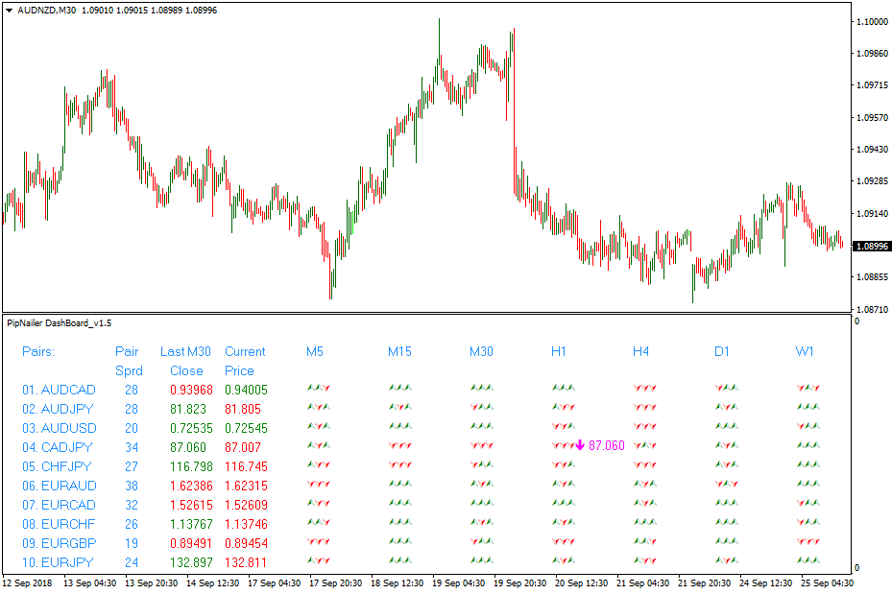
Project analysis slide 4
Final result

Slide 6
Project analysis slide 4
Project Planning
Signal prediction 22nd April
Quality signals 29th April
Dashboard 10th May

Slide 7
Thank You

