Slide 1
Weather Trends: Comparing the average global temperature to the local temperature in Munich
Juan Garcia

Slide 2
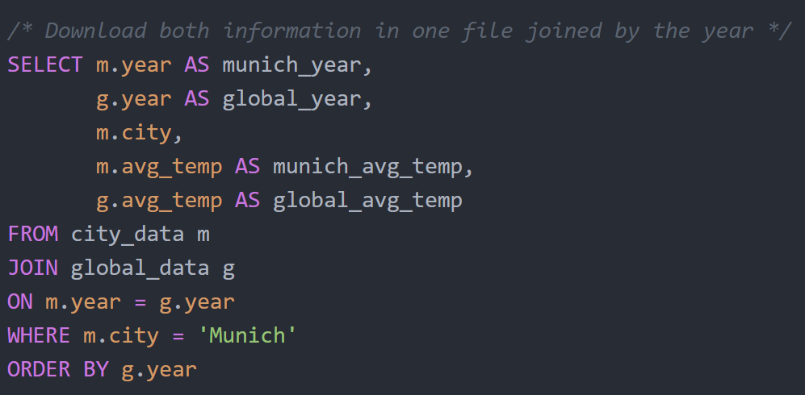
Methodology: Getting the data with SQL
To download the data as a csv file, I used a simple SQL command to get the file with all required data:
Good to know:
All the changes have been committed to a repository in GitHub:
https://github.com/JuanGarcia10/Weather-trends-in-Duesseldorf-Germany

Slide 3
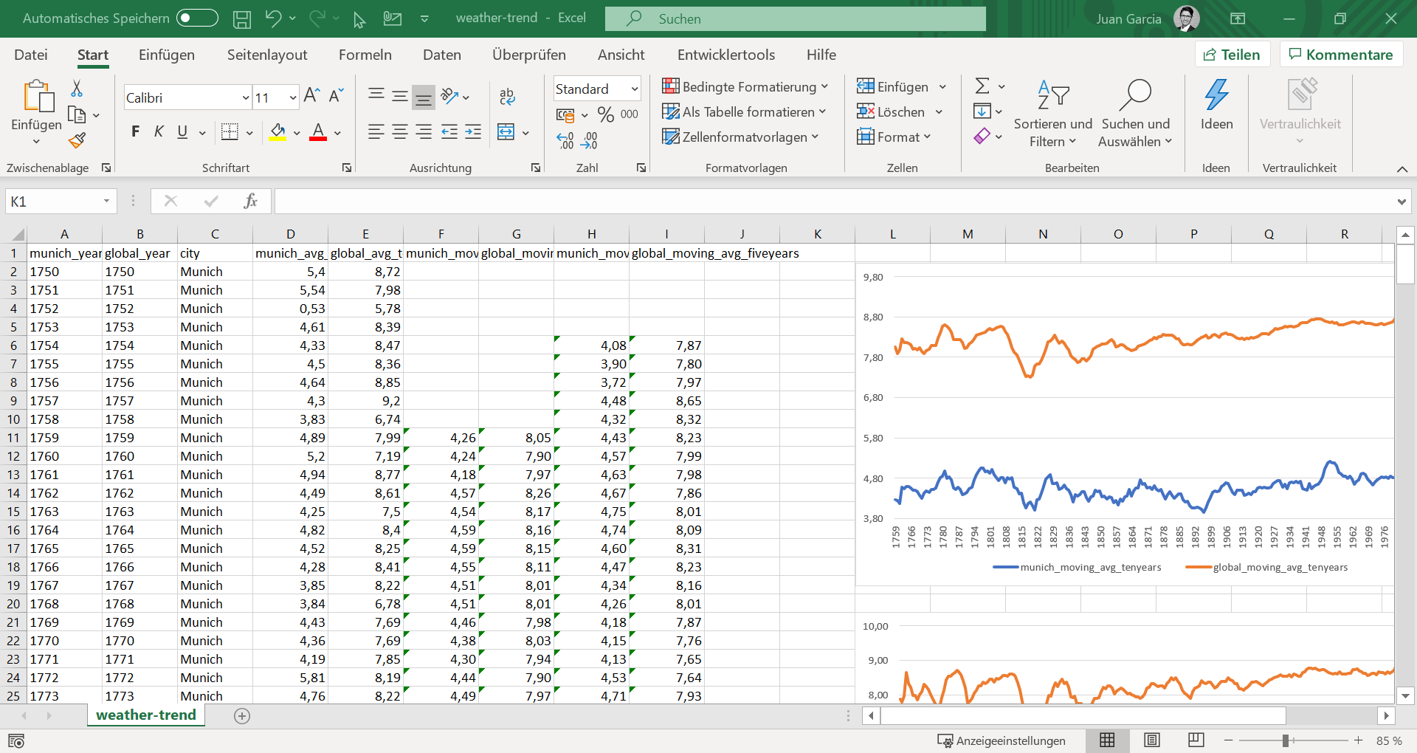
Methodology: Preparing and Analyzing the Data with Excel
For the analysis of the csv file I used a spreadsheet in Excel. For this I calculated the moving averages (10 and 5 years). Finally I decided to use the 10 year period, since the line was smoother and the detailed level was enough
To create the charts I used the graphic tool
I needed to do further small adjustments to the standard graph of excel:
New Values for the vertical axis, so that the changes in temperature are easier to see

Slide 4
Results: Munich‘s Temperature Development is Historically below the Global Development. However, the same Trend is Observed
The temperature in Munich is on average almost 4 degrees below global temperature over time
The fluctuations in the global temperature and Munich‘s temperature are very similar
In both cases the temperature has been increasing over the years
The temperature records of Munich are much more volatile than the global development which is (as expected) smoother.

