Slide 1




Analyst Recruitment Case Study
Marketing Science (Business Performance - Web)
Last Updated: March 2026

Slide 2


Marketing Science lead analysis Juan Sebastian Gonzalez
Notes:
Background: Educational background in Biology.
Perspective: "I treat data ecosystems like biological habitats—identifying 'limiting nutrients' (bottlenecks) and 'evolutionary shifts' (market trends)."
Technical Stack: Python (Pandas, Scikit-Learn), SQL, Power BI/Tableau
I approach data science through the lens of my background in Biology. Just as we study how environmental variables affect the growth of a species, I look at how marketing channels and site UX affect the 'growth' of our lead generation. I focus on finding the 'Limiting Nutrients' in a funnel to unlock the full potential of a digital habitat.

Slide 3


Case Information
In this scenario, the client is an automotive brand, and you are reviewing metrics from their website. It includes:
Visits: total visits and a break-out of visits from different media channels
Shopping Actions: Start Configuration, Complete Configuration, Financial Calculator Visits
Leads: Test Drive, Financial Calculator, Request a Quote
The client’s goal is to better understand the performance of their models, and look for opportunities to increase leads.

Slide 4
Data Reliability: Audit Process
Anomaly Detection: Identifies and resolved a “temporal leak” (2024 data in the 2023 source)
Standardization: Aligned disparate naming conventions for cross-year parity
Feature Engineering: Created a unified metric (total leads) to align with client goals
Notes:
"Before diving into insights, I performed a rigorous data audit. I discovered a temporal leak where 2024 records were mixed into the 2023 source; I quarantined these to ensure our YoY growth numbers are scientifically valid. Trust in the data is the foundation of every recommendation I’m about to make. Excel file into 3 csv. For performance Naming of the columns Deleting Columns Making sure both 2023 and 2024 have the same columns strip removes spaces at the beginning or end, lower for lowercase and replace is for spaces '_' into _ #2023 uses 'showrooms_visits' and 2024 uses 'car_model_visits'

Slide 5
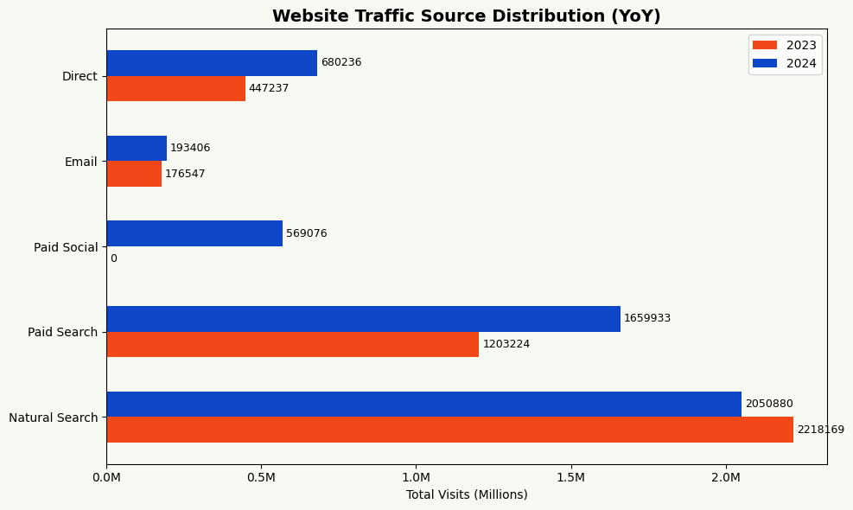
Traffic & Acquisition
Natural Search: Remains the bedrock of traffic volume
Paid Social: Strategic pivot identified in 2024 –driving significant top-of-funnel awareness
The Gap: High volume channels require high-efficiency landing paged to maintain ROI
Notes:
The “where”

Slide 6
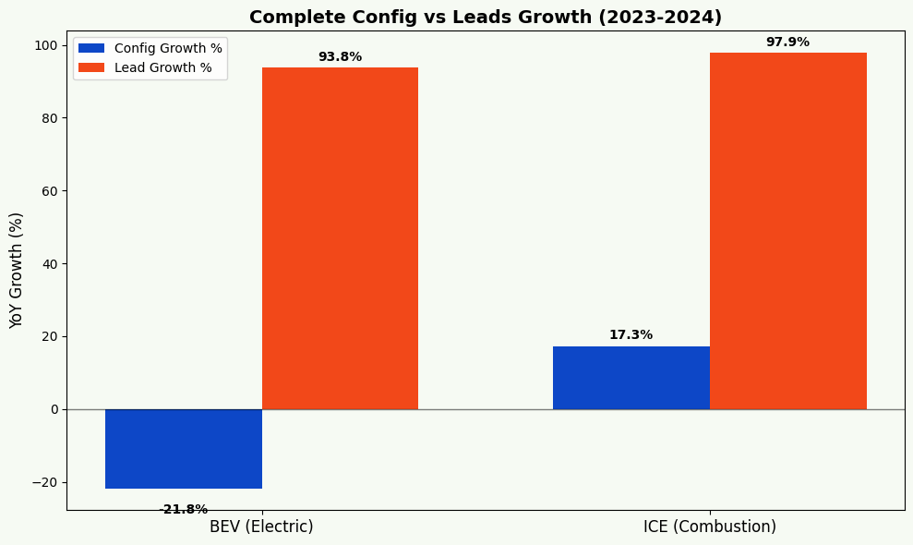
Strategic Trends: ICE vs BEV
The Paradox: Traffic for BEVs is down 22%, but leads are up 94%
Efficiency: We have moved past the “curiosity phase”. The current audience is highly qualified and ready to convert
Notes:
Growth: Total leads increased by 96% YoY
Efficiency: BEV (Electric) lead efficiency has doubled, despite a slight contraction in traffic
Target: Fix the “start-gate” friction in Model E to unlock 2025 growth
# Calculate YoY Growth %
# Formula: ((2024 - 2023) / 2023) * 100
I refined my YoY analysis to compare Complete Configurations—which my Random Forest model identified as our key lead driver—against final Lead volume.
The results reveal a fascinating Efficiency Paradox in the BEV segment: While total configurations dropped by 22%, our leads nearly doubled. This suggests a massive shift in Audience Quality. We are no longer seeing 'curiosity configurations'; we are seeing 'purchase configurations.'
Conversely, the ICE segment shows traditional volume-driven growth. This tells us we have two different strategies: we need to maintain volume for ICE, but we need to optimize the entry-gate for BEV to capture more of that high-intensity intent Here we see a fascinating Efficiency Paradox. While Combustion (ICE) is growing through scale, our Electric (BEV) segment is growing through quality. BEV configurations actually dropped by 22%, yet leads grew by 94%. This suggests our electric audience has moved past the 'curiosity' phase and into a high-intent 'purchasing' phase.

Slide 7
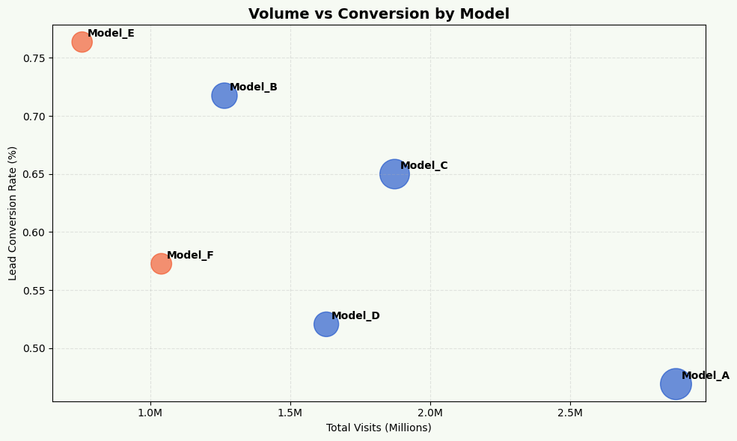
Portfolio Strategy: Volume Leaders vs Efficiency Gems
Volume Anchor: Model A remains the primary driver of site traffic
Efficiency Leader: Model E has the highest Lead Conversation Rate
Growth Lever: Reallocating media spend toward high-conversion models
Notes:
Zooming into the individual models, we see that Model_A drives our volume, but Model_E is our efficiency champion. In biological terms, Model_E has a much higher 'Metabolic Efficiency.' My primary strategic recommendation is to scale traffic to these high-converting models to maximize our lead yield for every dollar spent.

Slide 8
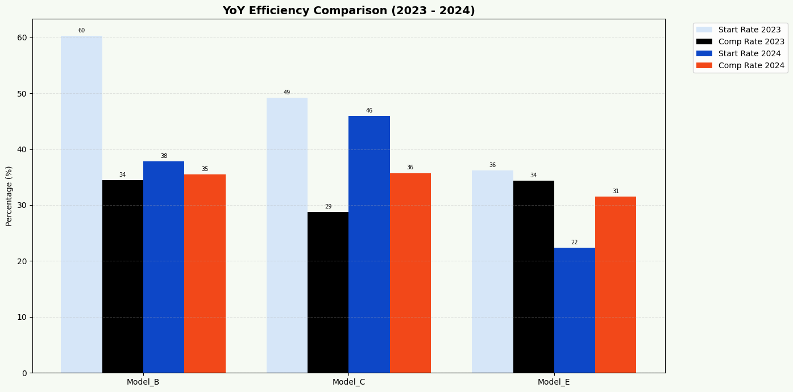
Margin for Improvement
Model E: High completion rates, but a start rate drop-off
Problem: Friction at the “Build Your Car” entry point
The Fix: Optimize CTA placement and price transparency on landing pages

Slide 9
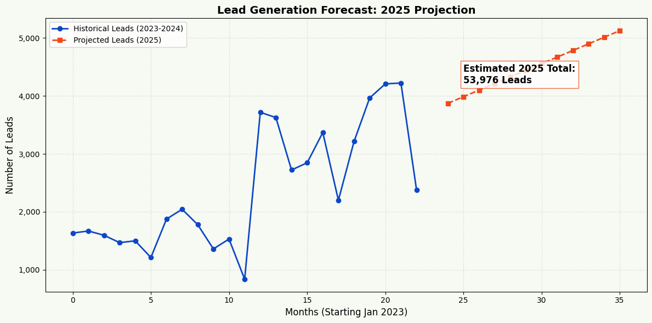
Predictive Analytics & 2025 Forecast
Linear Baseline: Projecting 54k leads for 2025 based on current momentum
Key Driver: Random Forest modeling identifies “complete configuration” as the #1 statistical predictor of a lead
Strategy: Focus all optimizations on driving “configurator completions” to outperform this forecast
Notes:
To look forward, I implemented a Linear Regression model. Based on current momentum, we are on track for 54,000 leads in 2025. I also used a Random Forest model to rank 'Key Drivers,' confirming that 'Complete Configuration' is our strongest statistical predictor of a lead. This validates our focus on fixing the configurator funnel

Slide 10
Scaling the Strategy
Media Spend Dara: Required to calculate true Cost per Lead (CPL)
Attribution Modeling: To understand how paid social interacts with natural search
Offline Conversion: Tracking leads to actual dealership sales to measure true ROI
Notes:
Text: "Turning Data into Decisions."
Summary: fix the BEV funnel, scale the high-efficiency Model E, and align budget with weekday peak intent.

Slide 11
Predictive Analytics & 2025 Forecast
Linear Baseline: Projecting 54k leads for 2025 based on current momentum
Key Driver: Random Forest modeling identifies “complete configuration” as the #1 statistical predictor of a lead
Strategy: Focus all optimizations on driving “configurator completions” to outperform this forecast
Notes:
Growth: Total leads increased by 96% YoY
Efficiency: BEV (Electric) lead efficiency has doubled, despite a slight contraction in traffic
Target: Fix the “start-gate” friction in Model E to unlock 2025 growth
# Calculate YoY Growth %
# Formula: ((2024 - 2023) / 2023) * 100
I refined my YoY analysis to compare Complete Configurations—which my Random Forest model identified as our key lead driver—against final Lead volume.
The results reveal a fascinating Efficiency Paradox in the BEV segment: While total configurations dropped by 22%, our leads nearly doubled. This suggests a massive shift in Audience Quality. We are no longer seeing 'curiosity configurations'; we are seeing 'purchase configurations.'
Conversely, the ICE segment shows traditional volume-driven growth. This tells us we have two different strategies: we need to maintain volume for ICE, but we need to optimize the entry-gate for BEV to capture more of that high-intensity intent

Slide 12
Thank you
© Critical Mass Inc. All Rights Reserved.

