Slide 1
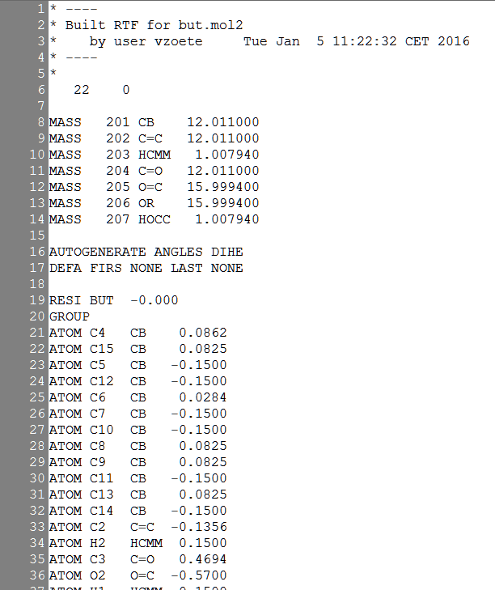
SwissParam data to generate PQR files
Atom radii derived from CHARMM
values in proteins & nucleic acids
Carbon
Aromatic 1.9924 (CB)
Double bond 2.0000 (C=)
Carboxyl 2.0000 (CO)
Single bond 2.1750 (CR)
Oxygen
Carbonyl, carboxyl 1.7000 (O=, O2)
Radical oxygen 1.7000 (OM)
Hydroxyl, ether 1.7700 (OR)
Nitrogen
Unique value 1.8500 (N)
Phosphorus
Unique value 2.1500 (P)
Sulfur
Unique value 2.0000 (S)
Hydrogen
Bonded to O or N 0.2245 (HO, HN)
Bonded to C 1.3500 (HC)
Total charge
Atom Atomic
types charges

