Slide 1
CSC340 Project Greensboro Lawncare Company (GLC)
OP-10
Juan Jimenez, Sammy Arreaza

Slide 2

GLC
Web-Based App designed to simulate a lawncare company
Offers four different services
Flexible Service Plans
Basic/Simple layout
User Friendly

Slide 3
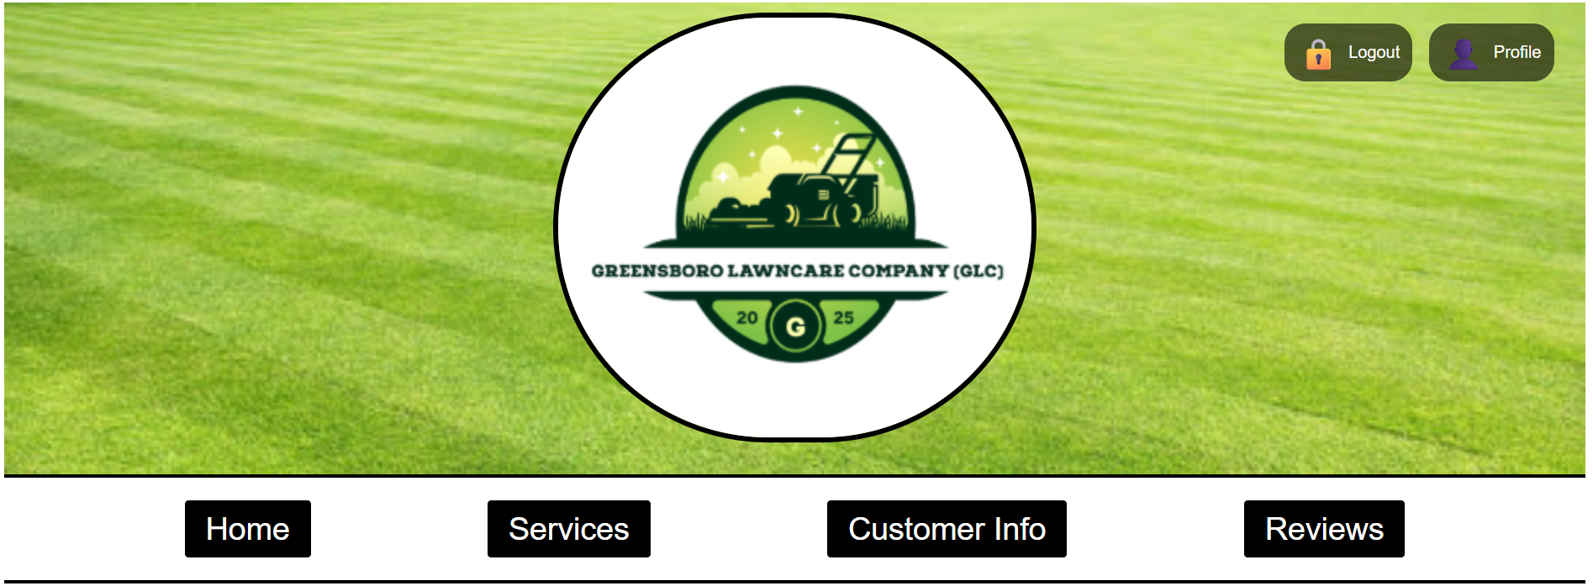
Provider
Add/Delete Services
Modify Existing Services
View Customer Info
Reply to Reviews
Profile Info

Slide 4
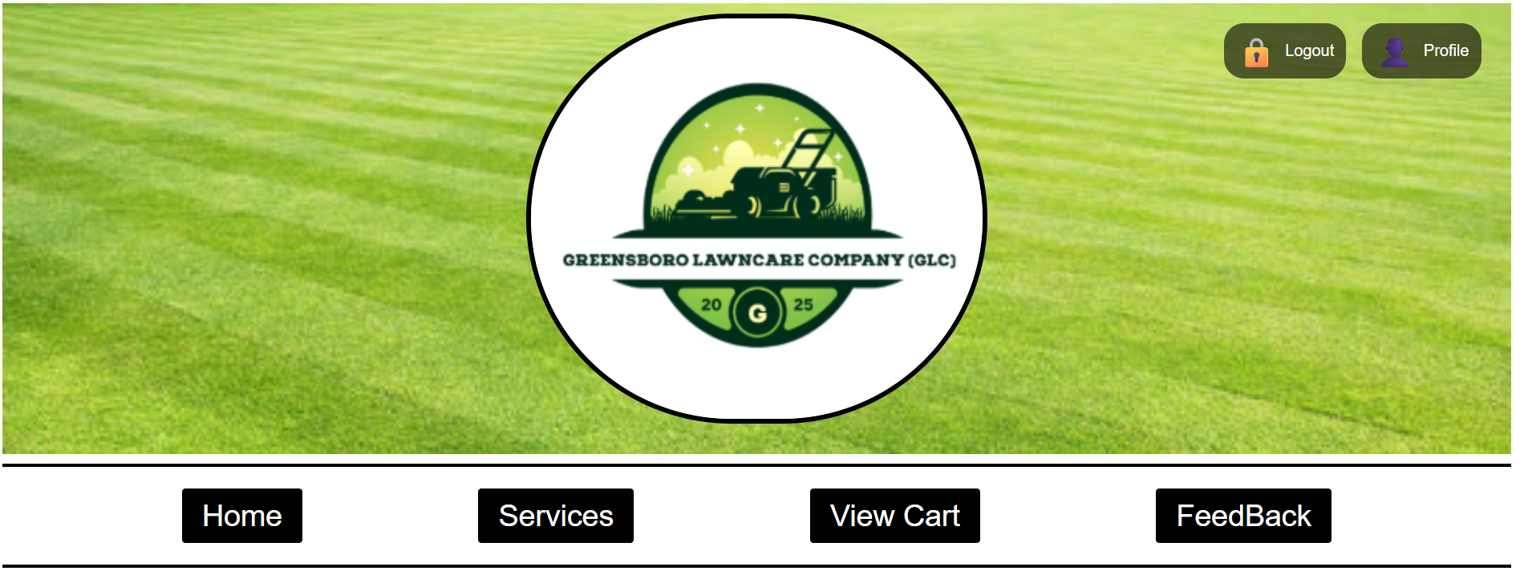
Customer
View Services
Select Services
View Cart
Checkout
Leave Review
Profile Info

