Slide 1
Brady et al. (2017): Emotion shapes the diffusion of moralized content in social networks
Juan López Martín

Slide 2
Goals (I)
The authors are interested in the role of moral-emotional expression on information diffusion over Twitter. Two main hypothesis that we will discuss:
Study 1. Do moral emotions increase the likelihood that a given message would go “viral”?
Study 2. Do messages containing moral-emotional language transcended ideological group boundaries, or do they spread largely within those boundaries?

Slide 3
Goals (II)
Other hypothesis that they have studied:
Is moral contagion simply driven by basic emotional contagion, or does it require a mix of moral appraisal and emotional expression?
What is the role of specific emotions?
Is moral contagion driven by a “negativity bias”?
The results for these questions appeared to be topic-dependent. Therefore, we will focus on exploring the other ones.

Slide 4
Index
Data Collection
Study 1
Measuring Moral-Emotional Language
Data Analysis
Study 2
Measuring Ideology
Data Analysis
Two Regressions
Generalized Estimating Equations
Conclusions

Slide 5
Data Collection
Use Twitter API to collect tweets that contained keywords (Table S1 p. 15) related to three political topics. The final dataset included 313,003 original messages:
48,394 for gun control
29,061 for same-sex marriage
235,548 for climate change
They manually coded a subset of tweets for each category to check the data collection process was accurate. The percentage of tweets classified as not relevant to the topic was 0.5%, 6%, and 1%, respectively (p. 3).

Slide 6
Data Collection
Apart from some fundamental characteristics of these original tweets, they had also collected the corresponding retweets.
ID | Tweet | Author | # Followers | URL | Media
123 | Who is voting for these nut jobs? Nut jobs! | Pjam57 | 540 | 1 | 0
575 | Developed world should take lead in controlling… | chegewamacharia | 3287 | 0 | 0
987 | 'The risk of losing your home is now 4X…. | AidEx2015 | 2464 | 0 | 0
RT Author
TheBrandonMorse
AMAll8976
RT Author
NA
RT Author
ARandomUsername

Slide 7
Study 1
The central hypothesis is that moral emotions will increase the number of retweets a message gets.
This requires defining what moral emotions are and detecting which tweets contain them.

Slide 8
Study 1 > Measuring Moral-Emotional Language
They have a dataset for moral words and another one for emotional words. With these, they identify:
Moral-Emotional Words, that appear in both of them (e.g. attack, bad, blame, care, hate, value)
(Distinctly) Emotional Words, that appear only on the emotional dataset but not on the moral one (e.g. agree, amazing, dear, free, lost, risk, terror).
(Distinctly) Moral Words (e.g. empathy, protect, wound, fair, fairly, justice, lawful, riot)
Then, they tokenize the tweets, removing mentions (e.g. @POTUS) and find the number of moral-emotional, distinctly emotional, and distinctly moral words.

Slide 9
Study 1 > Measuring Moral-Emotional Language
The resulting dataset looks as follows:
RT Author
TheBrandonMorse
AMAll8976
ID | Verified | # Followers | URL | Media | Moral-Emotional | Only Moral | Only Emotional
123 |  | 540 | 1 | 0 | 2 | 0 | 0
575 |  | 3287 | 0 | 0 | 0 | 0 | 1
987 |  | 2464 | 0 | 0 | 1 | 1 | 0
RT Author
NA
RT Author
ARandomUsername

Slide 10
Study 1 > Data Analysis
Study 1 only considers the number of retweets of each original tweets. Therefore, we have:
ID | Verified | # Followers | URL | Media | Moral-Emotional | Only Moral | Only Emotional | # Retweets
123 | 0 | 540 | 1 | 0 | 2 | 0 | 0 | 2
575 | 0 | 3287 | 0 | 0 | 0 | 0 | 1 | 0
987 | 0 | 2464 | 0 | 0 | 1 | 1 | 0 | 1
With this data they used negative binomial regression:
stan_glm.nb(Retweets ~ Moral_Emotional + Moral + Emotional + Verified + Followers + URL + Media, data = df)

Slide 11
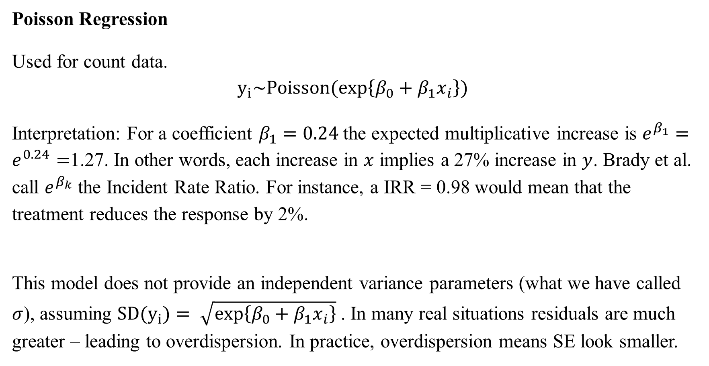
Study 1 > Data Analysis
Poisson Regression
Used for count data.
$$y_{i}\sim Poisson(\exp\left\{β_{0}+β_{1}x_{i}\right\})$$
Interpretation: For a coefficient $β_{1}=0.24$the expected multiplicative increase is $e^{β_{1}}=e^{0.24}=$1.27. In other words, each increase in $x$ implies a 27% increase in $y$. Brady et al. call $e^{β_{k}}$ the Incident Rate Ratio. For instance, a IRR = 0.98 would mean that the treatment reduces the response by 2%.
This model does not provide an independent variance parameters (what we have called $σ$), assuming ${SD(y}_{i})= \sqrt{\exp\left\{β_{0}+β_{1}x_{i}\right\}}$ . In many real situations residuals are much greater – leading to overdispersion. In practice, overdispersion means SE look smaller.

Slide 12

Study 1 > Data Analysis
Negative Binomial
Negative binomial is a generalization of Poisson regressions that does no longer assume that the standard deviation is the square root of the mean.
$$y_{i}\sim NegativeBinomial\left(\exp\left\{β_{0}+β_{1}x_{i}\right\},φ\right)$$
where $φ$ is the overdispersion control.

Slide 13
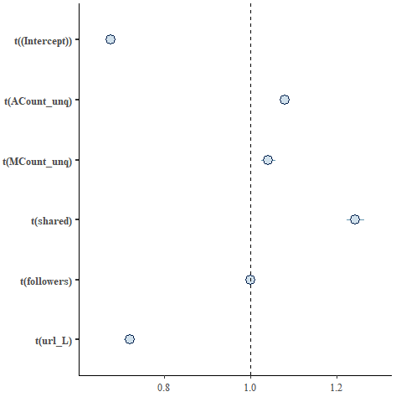
Study 1 > Results
Using stan_glm.nb I obtain basically the exact same results as them (see S5). Note that the Moral, Emotional, Moral-Emotional, and followers variables are centered.
This means tweets that include one more moral-emotional word than average receive 24% more retweets. Similarly, tweets that include two moral-emotional words receive (e^(2*ln(1.24)) = 1.53) 53% more retweets.
 | Coef | SE
Intercept | 0.67 | 0.01
Moral | 1.04 | 0.01
Emotional | 1.08 | 0.01
Moral-Emotional | 1.24 | 0.01
URL | 0.72 | 0.01
Media | 3.02 | 0.01
Verified | 8.25 | 0.02
Followers | 1.00 | <0.01

Slide 14
Study 2
We have now seen that moral-emotional words increase the number of retweets a message gets. The central hypothesis of Study 2 is that this increase of retweets as a product of moral-emotional words will be greater for ingroup members than for outgroup members.
This requires detecting the political ideology of the tweet authors and the retweeters.

Slide 15
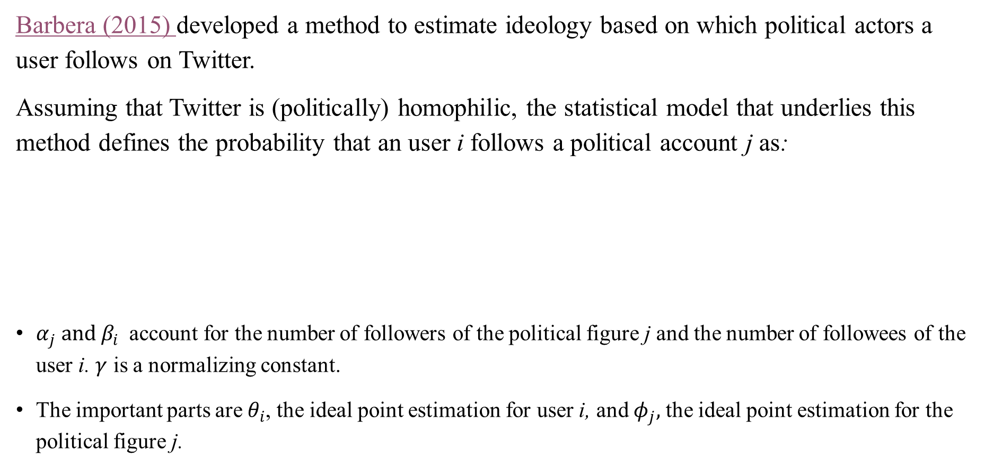
Study 2 > Measuring Ideology
Barbera (2015) developed a method to estimate ideology based on which political actors a user follows on Twitter.
Assuming that Twitter is (politically) homophilic, the statistical model that underlies this method defines the probability that an user i follows a political account j as:
$α_{j} and β_{i}$account for the number of followers of the political figure j and the number of followees of the user i. $γ$ is a normalizing constant.
The important parts are $θ_{i}$, the ideal point estimation for user i, and $φ_{j},$ the ideal point estimation for the political figure j.
$$P\left(y_{\left\{ij\right\}}=1 | α_{j}, β_{i}, γ, θ, φ_{j}\right)=logistic\left( α_{j}+β_{i}−γ{\left(θ_{i}−φ_{j}\right)}^{2}\right)$$

Slide 16
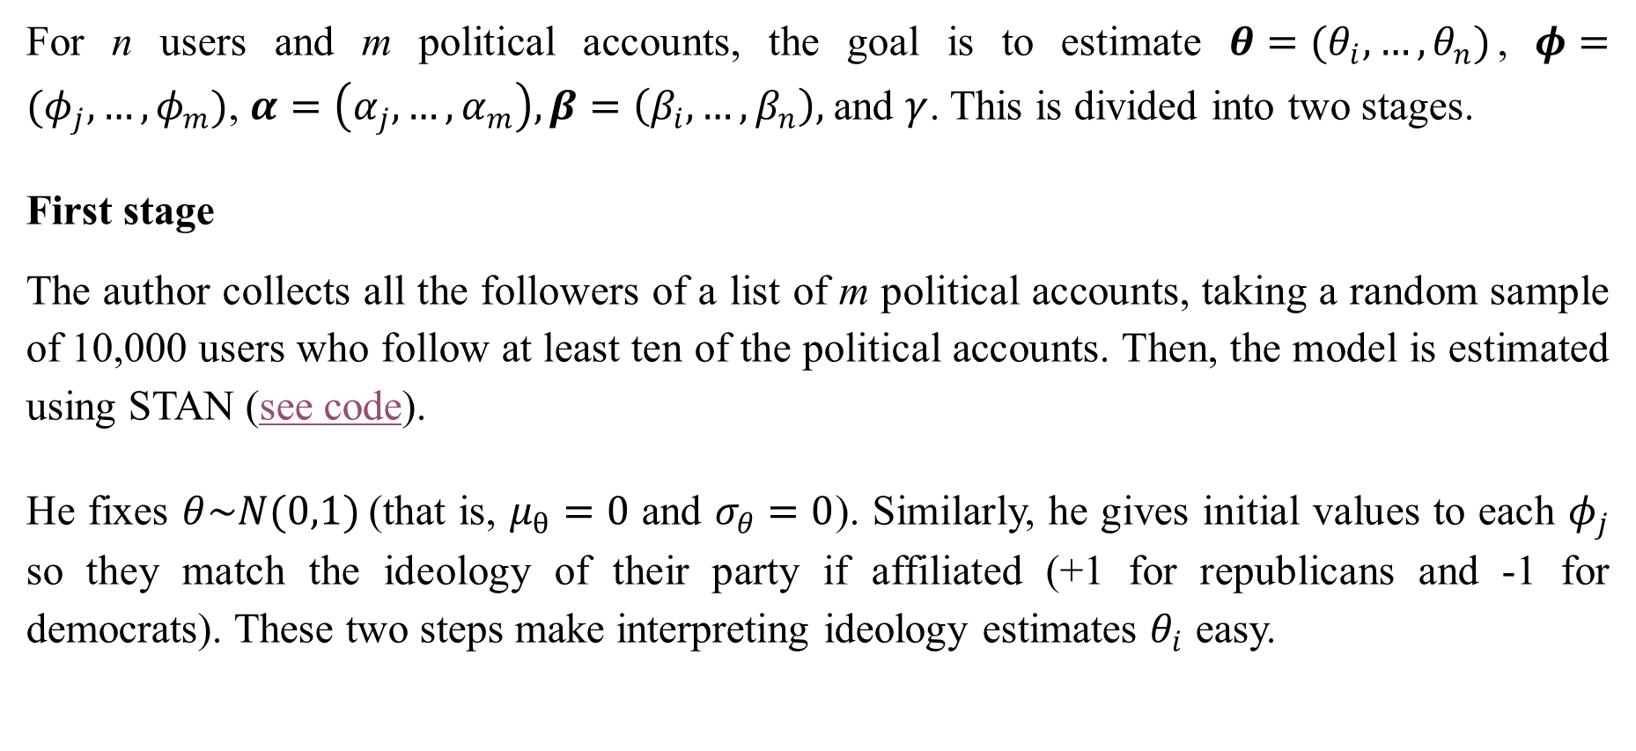
Study 2 > Measuring Ideology
For n users and m political accounts, the goal is to estimate $θ=(θ_{i}, …, θ_{n})$, $φ=(φ_{j}, …, φ_{m})$, $α=\left(α_{j}, …, α_{m}\right), β=\left(β_{i}, …, β_{n}\right),$and $γ$. This is divided into two stages.
First stage
The author collects all the followers of a list of m political accounts, taking a random sample of 10,000 users who follow at least ten of the political accounts. Then, the model is estimated using STAN (see code).
He fixes $θ\sim N(0,1)$(that is, $μ_{θ}=0$ and $σ_{θ}=0$). Similarly, he gives initial values to each $φ_{j}$ so they match the ideology of their party if affiliated (+1 for republicans and -1 for democrats). These two steps make interpreting ideology estimates $θ_{i}$ easy.

Slide 17
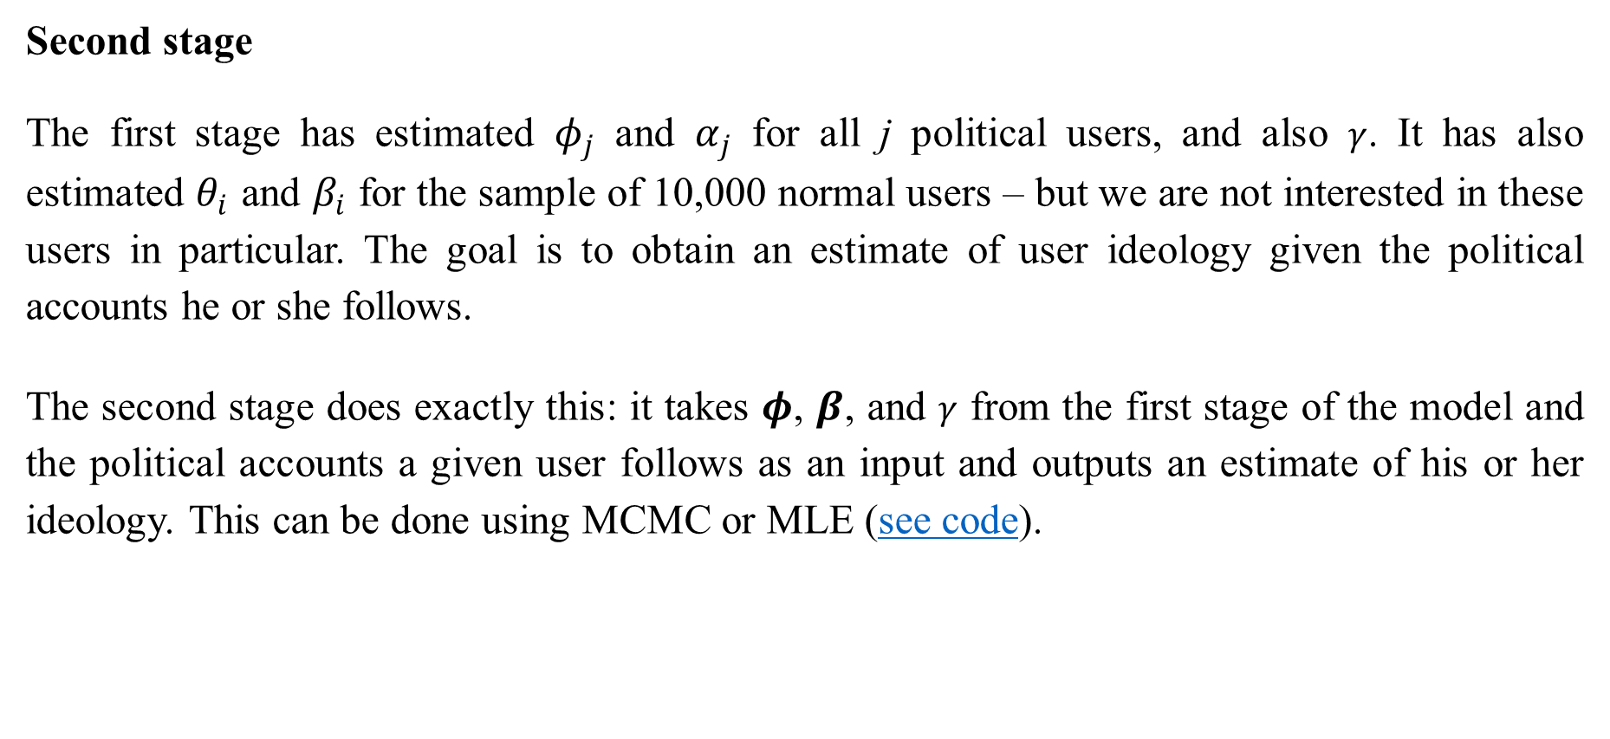
Study 2 > Measuring Ideology
Second stage
The first stage has estimated $φ_{j}$ and $α_{j}$ for all j political users, and also $γ$. It has also estimated $θ_{i}$ and $β_{i}$ for the sample of 10,000 normal users – but we are not interested in these users in particular. The goal is to obtain an estimate of user ideology given the political accounts he or she follows.
The second stage does exactly this: it takes $φ$, $β$, and $γ$ from the first stage of the model and the political accounts a given user follows as an input and outputs an estimate of his or her ideology. This can be done using MCMC or MLE (see code).

Slide 18
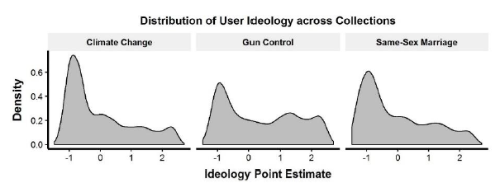
Study 2 > Measuring Ideology
Brady et al. (2017) used the ideology scores that Barbera (2015) obtained. I understand in all the analysis (including Study 1) they only included the tweets and retweets for which the ideology of its author was known.
Density plots of ideology for the different topics (S1).

Slide 19
Study 2 > Measuring Ideology
The resulting dataset looks as follows. Note that the estimated ideology of all the users in this study is publicly available, which I’d expect raised some ethical concerns.
RT Author | Ideology
TheBrandonMorse | 0.93
AMAll8976 | -0.12
ID | Verified | # Followers | URL | Media | Moral-Emotional | Only Moral | Only Emotional | Ideology
123 | 0 | 540 | 1 | 0 | 2 | 0 | 0 | 1.23
575 | 0 | 3287 | 0 | 0 | 0 | 0 | 1 | -0.76
987 | 0 | 2464 | 0 | 0 | 1 | 1 | 0 | 0.16
RT Author | Ideology
NA | -2.1
RT Author | Ideology
ARandomUser | 0.79

Slide 20
Study 2 > Dataset
Brady et al. (2017) are interested in the rates of information diffusion in the ingroup network versus in the outgroup network. Thus, they formed two separate counts for each message: an ingroup count and an outgroup count.
To distinguish between liberal and conservatives they used Ideology = 0 as the cutoff. They also tried excluding the middle 10% and 20%, obtaining similar results (see S14 and S15).

Slide 21
Study 2 > Dataset
Two ways to think about the resulting dataset:
Option 1:
For each tweet we have two outcome variables – count from ingroup and count from outgroup. We want to test if the effect of Moral-Emotional, Emotional, or Moral words varies for the ingroup and the outgroup.
ID | Retweets Ingroup | Retweets Outgroup | Moral -Emotional | Moral Only | Emotional Only | Other Covariates
123 | 1 | 1 | 2 | 0 | 0 | …
575 | 1 | 0 | 1 | 1 | 0 | …

Slide 22
Study 2 > Dataset
Option 2 (what they are using):
We only have one outcome – count – with two repeated measures – one for ingroup and the other for outgroup.
ID | Retweets | Ingroup | Moral -Emotional | Moral Only | Emotional Only | Other Covariates
123 | 1 | 1 | 2 | 0 | 0 | …
123 | 1 | 0 | 2 | 0 | 0 | …
575 | 1 | 1 | 1 | 1 | 0 | …
575 | 0 | 0 | 1 | 1 | 0 | …

Slide 23
Study 2 > Data Analysis > Two Reg.
Using the dataset described in Option 1 we can fit two different models, one for Count_Ingroup and the other for Count_Outgroup.
stan_glm.nb(Retweets_Ingroup ~ Moral_Emotional + Moral + Emotional + Verified + Followers + URL + Media, data = df)
stan_glm.nb(Retweets_Ingroup ~ Moral_Emotional + Moral + Emotional + Verified + Followers + URL + Media, data = df)

Slide 24
Study 2 > Data Analysis > Two Reg.
Ingroup Outgroup
 | Coef | SE
Intercept | 0.42 | 0.01
Moral | 1.05 | 0.02
Emotional | 1.14 | 0.01
Moral-Emotional | 1.40 | 0.01
URL | 0.64 | 0.02
Media | 3.19 | 0.02
Verified | 12.72 | 0.04
Followers | 1.00 | <0.01
 | Coef | SE
Intercept | 0.07 | 0.02
Moral | 1.15 | 0.02
Emotional | 0.89 | 0.01
Moral-Emotional | 1.09 | 0.02
URL | 0.83 | 0.02
Media | 3.97 | 0.03
Verified | 18.36 | 0.04
Followers | 1.00 | <0.01
Including an additional Moral-Emotional word increases 40% the diffusion within the ingroup, but only 9% within the outgroup.

Slide 25
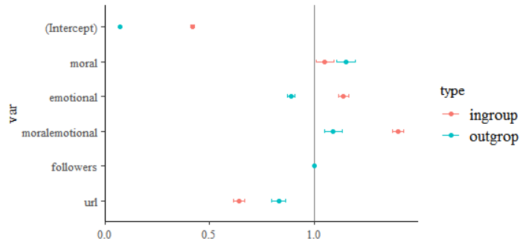
Study 2 > Data Analysis > Two Reg.
*Note that we are not displaying the coefficients for Media and Verified

Slide 26
Study 2 > Data Analysis > GEE
However, another approach is to use the dataset described in Option 2 using Generalized Estimating Equations. This is what the authors did.
Generalized Estimating Equations
GEE are used to estimate the parameters of a GLM with correlated (non-independent) outcomes. Note that OLS assumes no correlation between outcomes:
Independent correlation matrix
 | Retweets received from the ingroup | Retweets received from the outgroup
Retweets received from the ingroup | 1 | 0
Retweets received from the outgroup | 0 | 1

Slide 27
Study 2 > Data Analysis > GEE
Generalized Estimating Equations
This assumption does not make sense in our dataset: there must be some correlation between the number of retweets a message receives from the ingroup and the number of retweets it receives from the outgroup.
ID | Retweets | Ingroup | Moral -Emotional | Moral Only | Emotional Only | Other Covariates
123 | 1 | 1 | 2 | 0 | 0 | …
123 | 1 | 0 | 2 | 0 | 0 | …
575 | 1 | 1 | 1 | 1 | 0 | …
575 | 0 | 0 | 1 | 1 | 0 | …

Slide 28
Study 2 > Data Analysis > GEE
Generalized Estimating Equations
GEE requires to specify the dependence structure. In this case they chose an exchangeable dependence structure, which means we expect a fixed correlation ρ between the number of retweets received from the ingroup and the number of retweets received from the outgroup.
Exchangeable correlation matrix
 | Retweets received from the ingroup | Retweets received from the outgroup
Retweets received from the ingroup | 1 | ρ
Retweets received from the outgroup | ρ | 1
In the estimated model we obtained ρ = 0.111

Slide 29
Study 2 > Data Analysis > GEE
The model was fitted in Python using StatsModels:
import statsmodels.api as sm
import statsmodels.formula.api as smf
fam = sm.families.NegativeBinomial()
ind = sm.cov_struct.Exchangeable()
mod = smf.gee("count ~ ACount_unq + MCount_unq + shared + ingroup + ACount_unq:ingroup + MCount_unq:ingroup + shared:ingroup + followers + userverified + media + url", "twid_first", r.df, cov_struct=ind, family=fam)

Slide 30
Study 2 > Data Analysis > GEE
My results are similar to what they obtained (S12), but there are some discrepancies.
 | Coef | SE
Intercept | 0.09 | 0.04
Moral | 1.12 | 0.06
Emotional | 0.89 | 0.03
Moral-Emotional | 1.07 | 0.07
Ingroup | 4.73 | 0.03
Moral*Ingroup | 0.94 | 0.06
Emotional*Ingroup | 1.29 | 0.04
Moral-Emotional*Ingroup | 1.33 | 0.08
URL | 0.66 | 0.04
Media | 3.07 | 0.04
Verified | 16.33 | 0.04
Followers | 1.00 | <0.01
Moral-emotional language did have a larger impact on retweet rates within ingroup users than outgroup accounts. The result imply a 33% additional retweet rate of moral-emotional language between the ingroup network relative to the outgroup network.
Note, however, than in the paper they reported the interaction was nonsignificant for same-sex marriage. This could be a consequence of the smaller sample size.

Slide 31
Study 2 > Data Analysis > GEE
I fitted an OLS model using stan_glm.nb and obtained similar results to Brady et al. (apart from the smaller SE, which is a consequence of not taking into account the clustering between the outcomes).
 | Coef | SE
Intercept | 0.08 | 0.02
Moral | 1.13 | 0.02
Emotional | 0.88 | 0.01
Moral-Emotional | 1.06 | 0.02
Ingroup | 5.10 | 0.01
Moral*Ingroup | 0.93 | 0.02
Emotional*Ingroup | 1.31 | 0.02
Moral-Emotional*Ingroup | 1.33 | 0.03
URL | 0.70 | 0.01
Media | 3.51 | 0.02
Verified | 15.57 | 0.03
Followers | 1.00 | <0.01

Slide 32
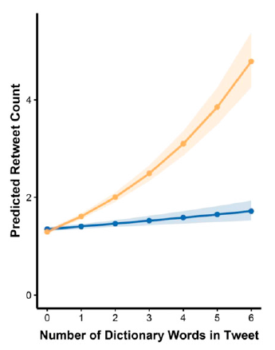
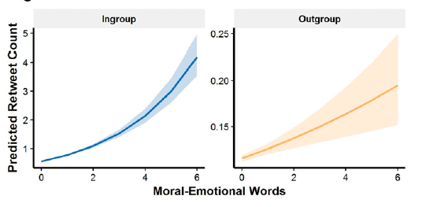

Conclusions
Study 1. The presence of moral-emotional words in tweets increases the retweet rate considerably – around 20% for each additional word.
Study 2. The effect of moral-emotional words on information diffusion is bounded by group membership: moral-emotional language increased diffusion more strongly within liberal and conservative networks, and less between them.

