Slide 1
IM
Mary Grace Juan and Mark Christan Santos

Slide 2
Proving Pythagorean Theorem

Slide 3
The Pythagorean Theorem
The Pythagorean Theorem is one of the earliest theorems known to ancient civilizations. This famous theorem is named after the Greek mathematician and philosopher, Pythagoras.

Slide 4
THE PYTHAGOREAN THEOREM
The Pythagorean Theorem is a statement about right triangles. The Pythagorean Theorem states that: “The area of the square built upon the hypotenuse of a right triangle is equal to the sum of the areas of the squares upon the remaining sides.”

Slide 5
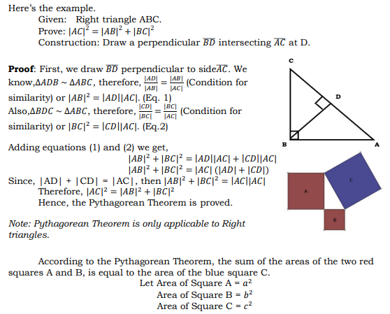
Proving Pythagorean Theorem by Right Triangle Similarity Theorem

Slide 6


Slide 7
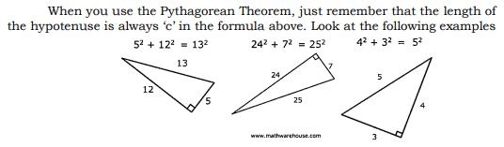
EXAMPLES OF THE PYTHAGOREAN THEOREM

Slide 8
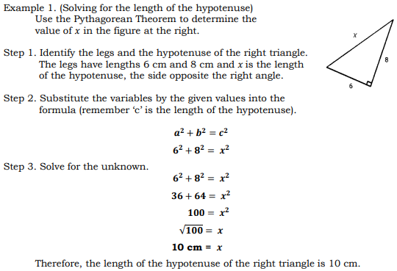
Finding The Length Of A Side Of A Right Triangle Using Pythagorean Theorem

Slide 9
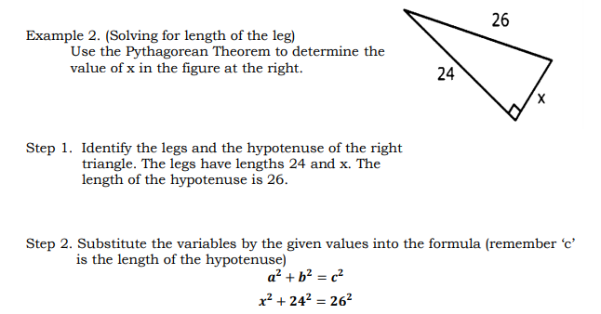

Slide 10
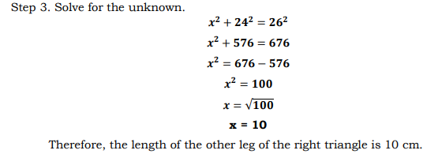

Slide 11
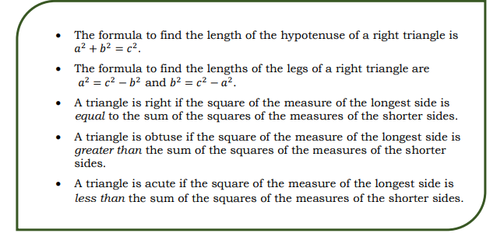
What Have I Learned?

Slide 12
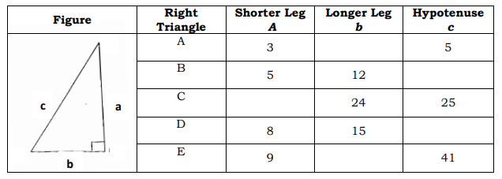
Activities
Activity 1
Directions: Use the Pythagorean Theorem to find the unknown side of the given right triangle if the lengths of its two sides are given.

Slide 13
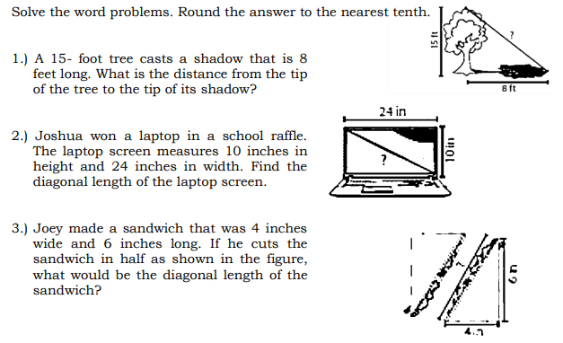
Activity 2

Slide 14
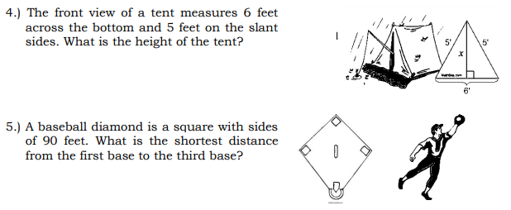

Slide 15
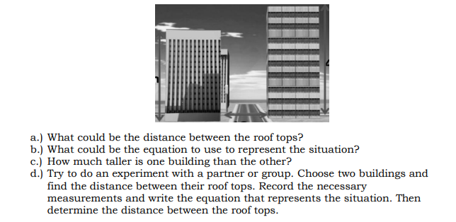
Additional Activities
Directions: Consider the given situation and answer the questions that follow. Use your knowledge of the Pythagorean Theorem. The heights of the two buildings are 41 m and 32 m and they are 12 m apart. A man went to the rooftop of the shorter building and wondered looking at the roof top of the taller building.

