Slide 1

— Machine Learning —
TITANIC

Slide 2
— Introduction —
On April 15, 1912, the Titanic, once considered 'unsinkable,' met a disastrous fate on its maiden voyage, resulting in the loss of 1,502 lives out of the 2,224 passengers and crew members aboard.
This project employs data analytics to delve into the intriguing question: 'What characteristics influenced survival?' We will analyze multiple variables such as age, gender, socio-economic class, and more, with the aim of building a predictive model to shed light on the patterns of survival.

Slide 3
— Table of contents —
1.
3.
Data Cleaning
Machine Learning Models
2.
4.
Visualizations
Deep Learning Models

Slide 4
1.
Data Cleaning

Slide 5
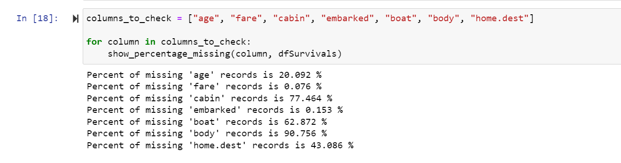

Slide 6
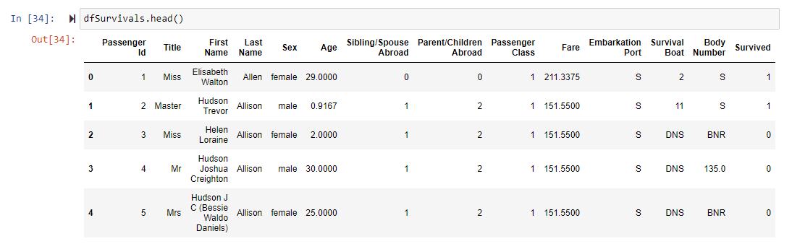

Slide 7
2.
Visualizations
https://public.tableau.com/app/profile/suhani.arjin/viz/Project4TitanicVizs/SexDashboard

Slide 8
Supervised Machine Learning
3.
Random Forest and Logistic Regression

Slide 9
Problem statement
“Predicting Survival on the Titanic”
Binary classification problem

Slide 10
Methodology: Data Overview
Preprocessing
Simple Dataset
Initial cleaning completed for the preliminary analysis
Preprocessing performed:
Dropping columns (non-beneficial)
Creating bins for few occurrences
Converting data types
Converting categorical data to numeric

Slide 11
Methodology: Machine learning algorithms
Random Forest & Logistic Regression
Two different models to compare their performance
Assess which one suits better our dataset
Both algorithms can handle simple classification problems
Random forest can provide feature importance scores

Slide 12
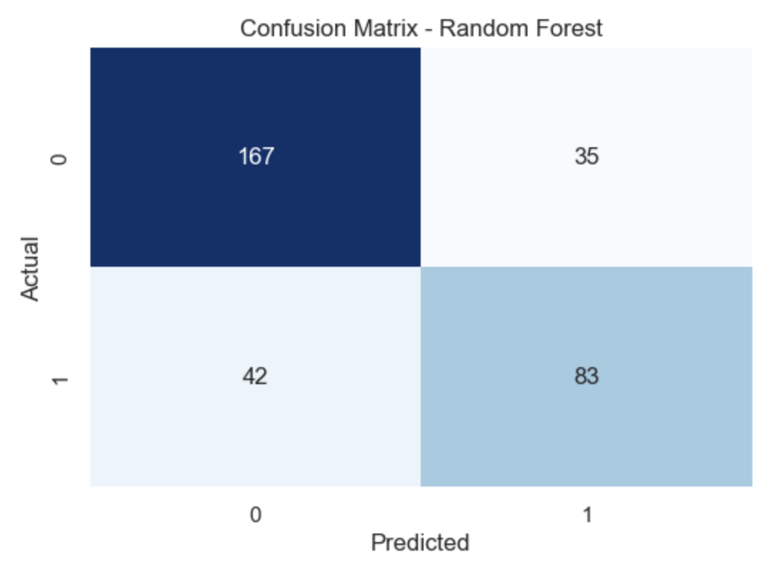
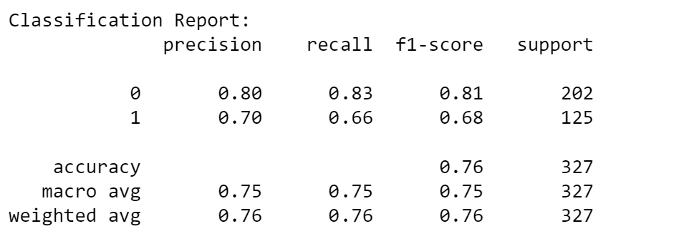
Random Forest : Results

Slide 13
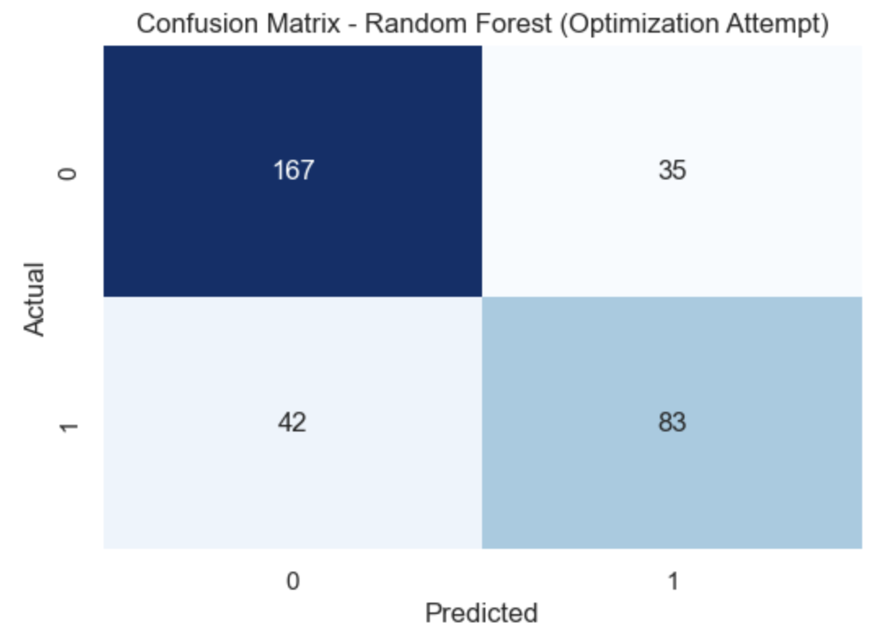
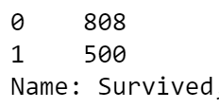
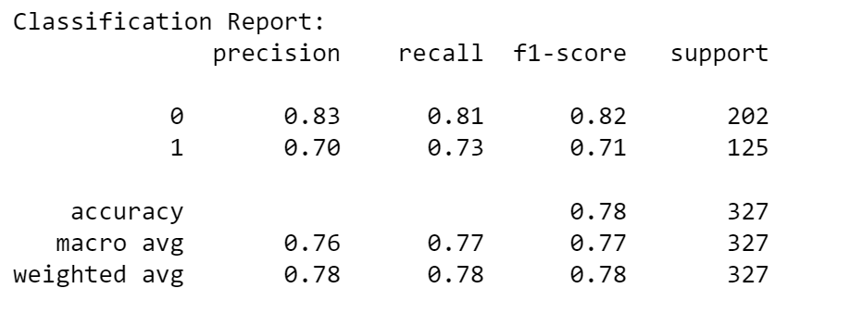
Random Forest : Optimization attempt
Resampling

Slide 14
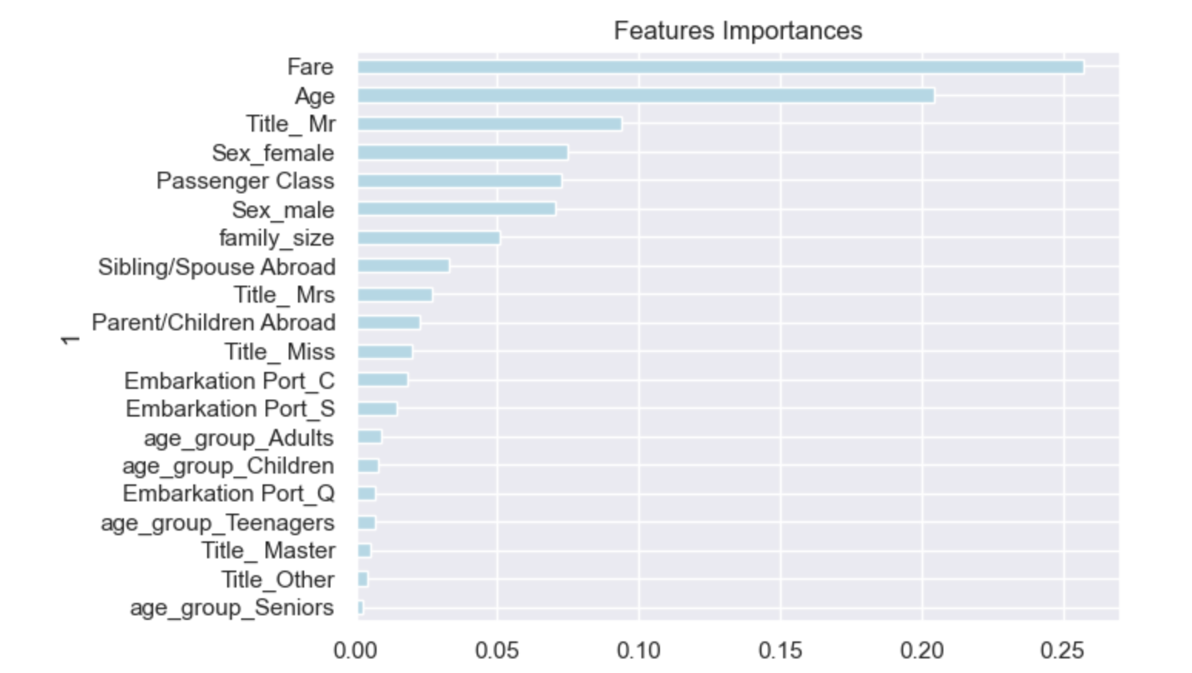
Random Forest : Important Features
1. Fare
2. Age
3. Title - Mr
4. Sex - Female
5. Passenger Class

Slide 15
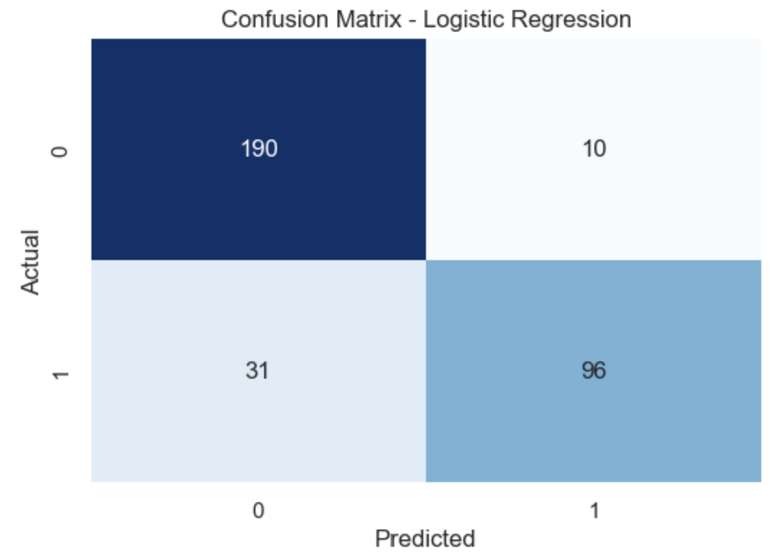
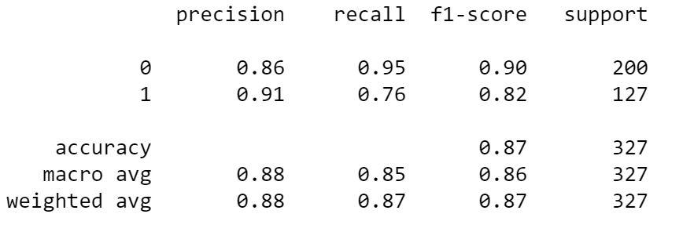
Logistics Regression : Results
Error: STOP TOTAL NO. of ITERATIONS REACHED LIMIT

Slide 16
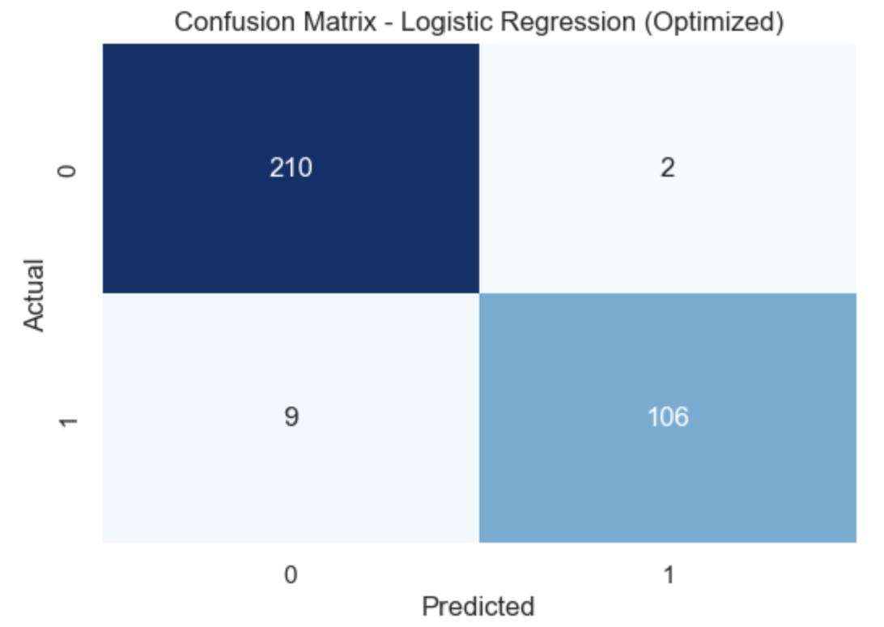
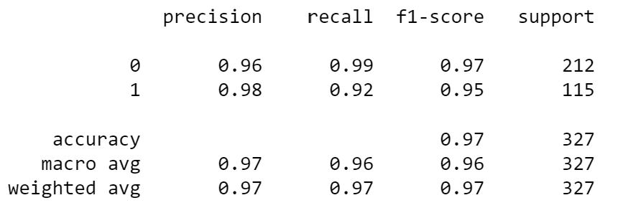
Logistics Regression : Optimization attempt
max_iter=1000
solver='newton-cg'

Slide 17
5.
Deep Learning
Neural Network Models

Slide 18
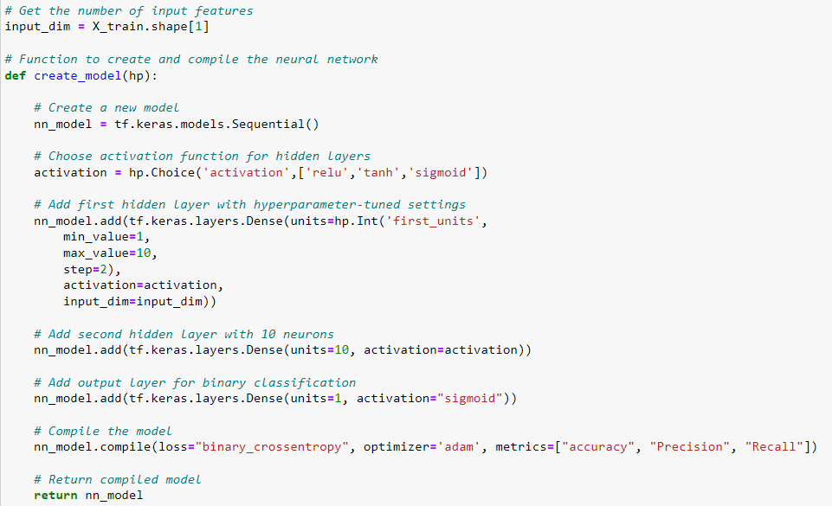
— Deep Learning Models —
Jane Doe
1

Slide 19
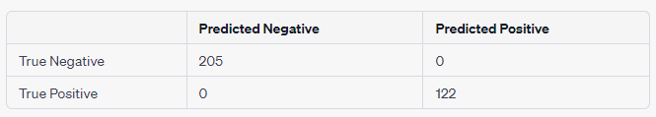
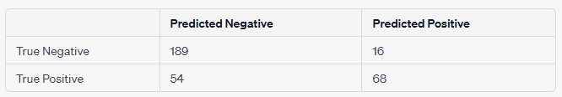
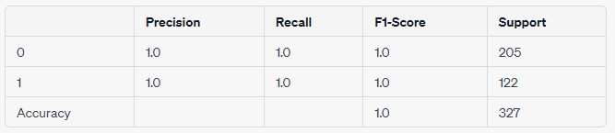
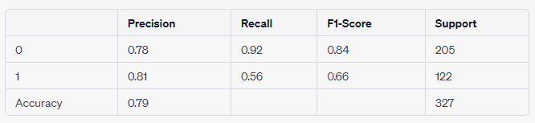
— Deep Learning Models —
Confusion Matrix
Confusion Matrix
Classification Report
Classification Report
1
Optimization
Add L2 Normalization
Add Dropout Layer
Add EarlyStopping callback
Drop Body feature
Notes:
Overfit – applied 3 different measures which still led to overfitting, but dropping the Body column finally corrected the issue. The results weren’t great though.

Slide 20
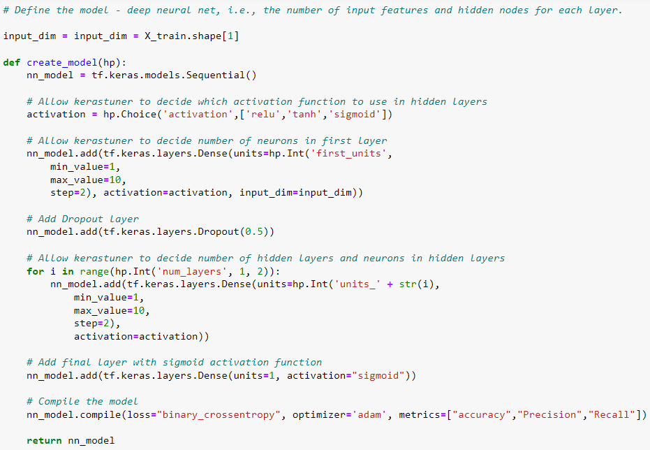
— Deep Learning Models —
2
Notes:
Used more complex model, option for extra hidden layer and allowed kerastuner to determine number of neurons in each. Included dropout layer but not L2, maintained removal of 'body number' feature
Kept dropout layer and early callback, removed L2 optimization – less worried about overfitting since I had determined that it was due to the Body column
Let model determine whether it should have 1 or 2 hidden layers after the first layer, as well as allowing it to determine the number of neurons in each

Slide 21
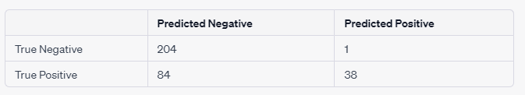

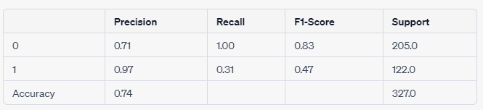
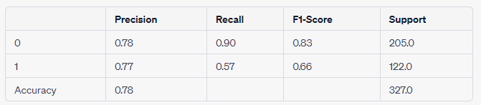
— Deep Learning Models —
Confusion Matrix
Confusion Matrix
Classification Report
Classification Report
2
Optimization
Removed dropout layer
Notes:
Results were not very good. Removed dropout layer to see if it would help and it didn’t, so tried a totally different approach.
This approach hadn’t worked for first model.

Slide 22
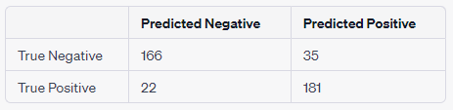
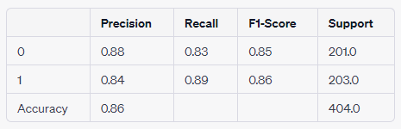
— Deep Learning Models —
Confusion Matrix
Classification Report
2
Optimization
Reprocessed data
Oversampling
Changed encoding type
Notes:
Reprocessed data (different CSV file), kept more columns to create more features, Oversampled minority class in target column (minority survived) to balance dataset – let to significant improvements across the board! Tried the same technique on model 1 as well but model 2 had better results
Used get dummies encoding but also applied it to last name column instead of dropping it

Slide 23
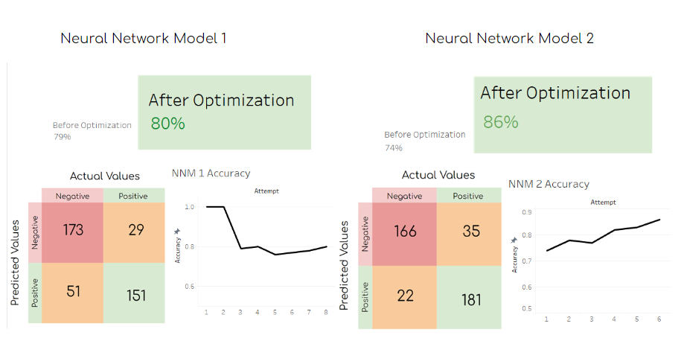
— Model Summary —

Slide 24
Conclusions
What characteristics influenced survival, and can we predict it?

Slide 25
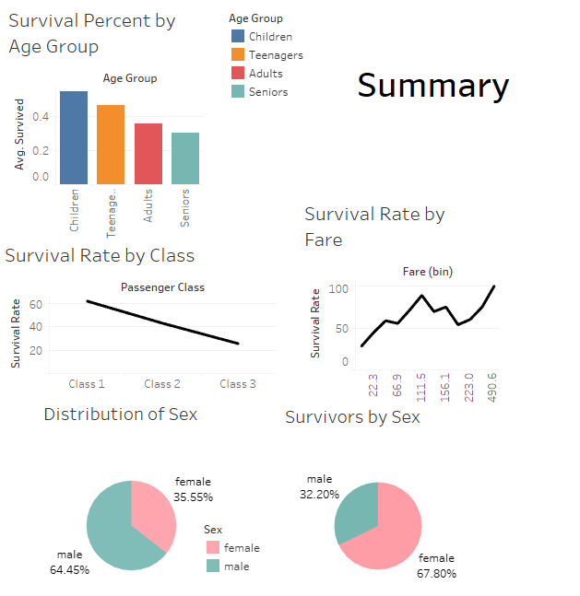
Most influential characteristics

Slide 26
— ML Model Prediction Accuracy —
1.
2.
3.
4.
Logistic Regression
Neural Network 2
Neural Network 1
Random Forest
97%
86%
80%
78%

Slide 27
Thanks!
Time for Q & A!

