Slide 1
Analysis of factors that influence the total supermarket sales
By Juan Nembaopit

Slide 2
Main Objective
Data analyst assigned to find to Increase total supermarket sales by 5% within 6 months through the analytics of historical sales data from 3 branches for the past 3 months to identify key factors influencing sales, thereby formulating effective stategies to profitability in a competitive market.

Slide 3
Problem Breakdown
1. What is the relationship between customer type and their total spending?
2. How is the total sales distributed among the 3 branches?
3. What product caregories contribute the most to total sales in each branch?
4. How is the total sales trend over time for each branches?
5. What is the average transaction amount and how varied are individual transaction from that average across all branches?
6. What is the difference between the average total sales of popular product line with the other product line?

Slide 4
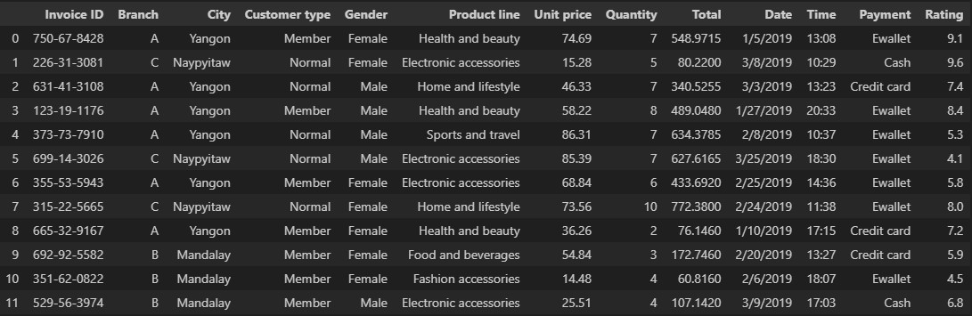
Supermarket Sales Data (preview)

Slide 5
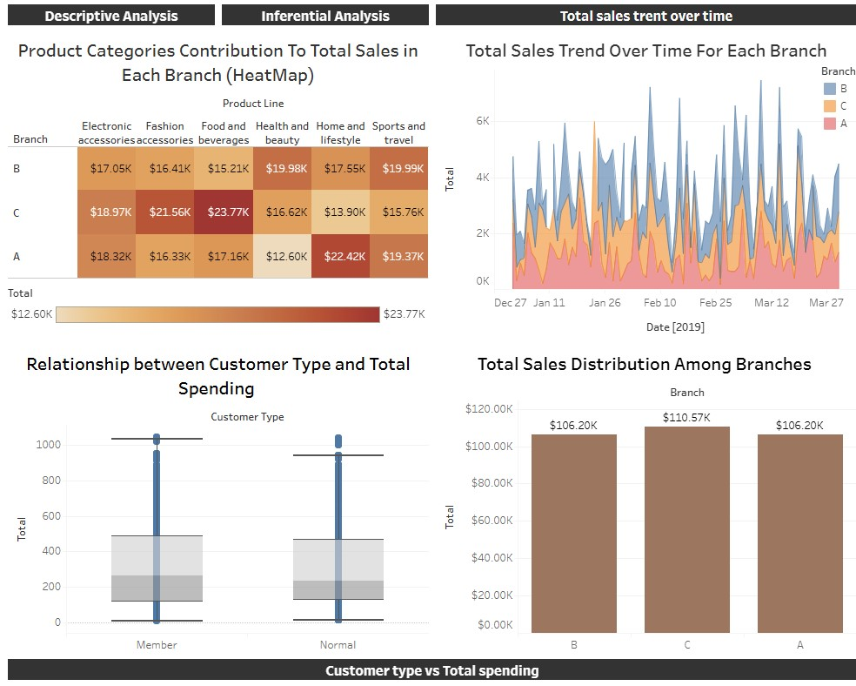
Dashboard Preview

Slide 6
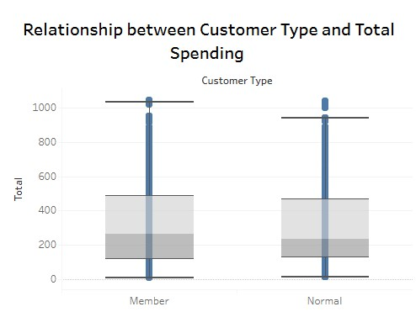
Relationship between customer type and their total spending
We'll take a look at our customers spending behaviour based on their category and see if there is a difference between them to gain insight on how we could increase the sales of our supermarket.
There are two type of customer in this dataset. They are Member and Normal customer. From the box plot we can see that Members ($266) tend to spend slightly more compared to normal customers ($237). This means, to increase the sales, we need to focus on improving the conversion rate of normal customers into member in order to increase our overall profitability and our business performance on the sales.

Slide 7
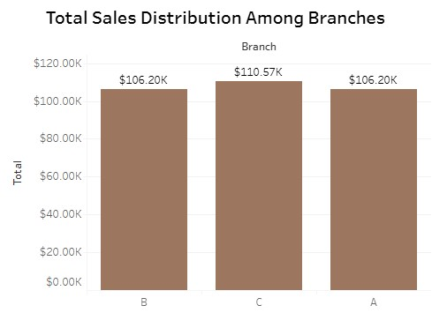
Total overall sales distribution among branches
From the bar chart, the overall sales performance of each branch tells us which branch has the highest total sales volume. Visually analysing through the chart, we can see that branch C has the highest total overall sales, followed by branch B and C. We should investigate on why can branch C perform better than branch B and A. On the next analysis, we'll look through the sales in terms of the categories that are popular in each branches. We can focus on branch C and see what product is popular in branch C so others branch could perform as good as branch C.

Slide 8
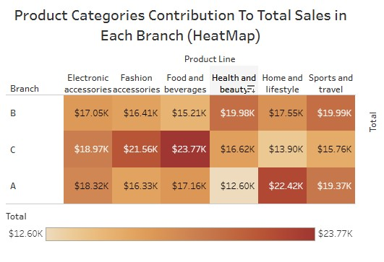
How product Category affect total sales
Each branches have developed expertise or a good reputation for a certain product line.
Branch A: Home and lifestyle.
Branch B: Health and beauty and sport and lifestyle
Branch C: Food and Beverages
To increase the sales, we should focus on each supermarket branch specialty. This could mean ensuring adequate inventory for product line that is popular in each branches; running targeted promotions on these product line; and providing more staff or specialized training for each specific product line that are popular in each branch.

Slide 9
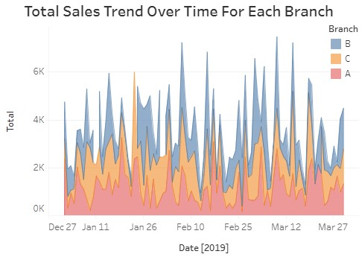
Sales Trendline overtime of each branch
From this trend line of total sales through time for each Branch. We can conclude that each branch have inconsistent total sales for the past three months. This means we should Investigate more on what is the caused of this inconsistency and came up with a solution to make a steady growth on total sales. For example, increase promotions and staff availability on popular product line for each branch.

Slide 10
Central tendencies of transaction amount
Next we’ll analyze the average transaction amount and variation of individual transaction from that average across all branches.
Average Total Transaction: $322.97
Median Total Transaction: $253.848
Standard Deviation: 243.885
IQR : 346.92
we can see that the average total sales of the overall supermarket is significantly higher than its median value. This means the data is right skewed or have a positive skew which is caused by some large transaction that pulls the average up.
From the measures of variance we can see that the standard deviation is high which means the data varies and from the range we can see that IQR is less sensitive to outliers than the std.

Slide 11
Difference between most popular product and other product line
Is the average total sales for the most popular product line significantly higher than the average total sales for all other product line?
In this data, the most popular product line, in terms of total sales, is Food and Beverages.
We will compare this product line with the rest of the product line which are Electronics accessories, fashion accessories, health and beauty, home and lifestyle, and sport and travel
We want to see if we should focus on the most popular product line or not, in order to increase total sales of each branch.
Hypothesis Testing (Independent Two-sample T-Test)
H0 : The difference in average sales between the most popular product line and other product line is statistically significant.
H1: There is no statistically significant difference in average sales between the most popular product line and other product line.

Slide 12
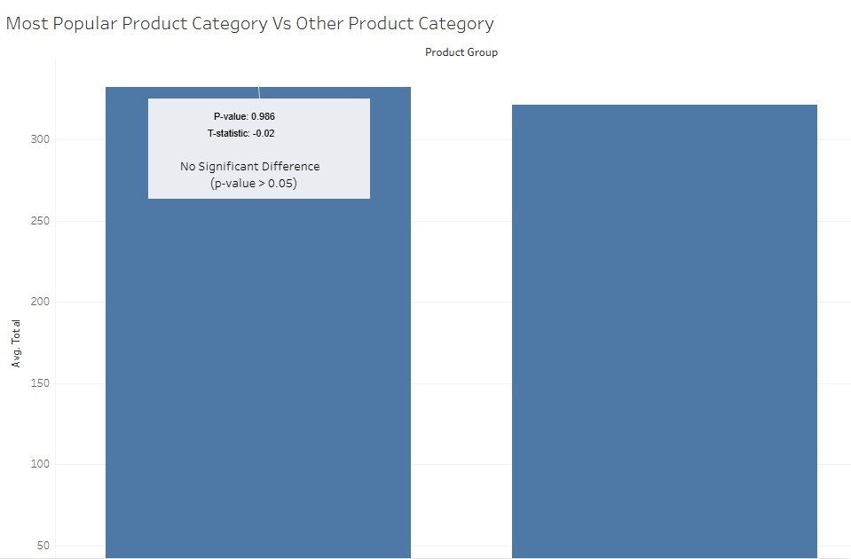
Difference between most popular product and other product line
There is no statistically significant difference in average sales between the most popular product line and other product lines.
The results of the T-test is -0.02 and the p-value is 0.986. The significance level is 0.05 (alpha). Since p-value is more than alpha, we fail to reject the null hypothesis, suggesting that there isn't sufficient evidence to conclude a significant difference in average total sales.

Slide 13
conclusion
To achieve the desired 5% sales increase within six months, the supermarket must do a couple of this. These are my recommendation from my analysis. First is to implement targeted customer loyalty program to increase loyal member on the supermarket. Optimize inventory, promotions, and staff quality on each branch specific product specialty. Lastly, a regular monitoring of sales performance, customer feedback, and market trends at each branch is crucial to ensure an increase in sales. These are suggestion that can be implemented to achieve our objective.

