Slide 1
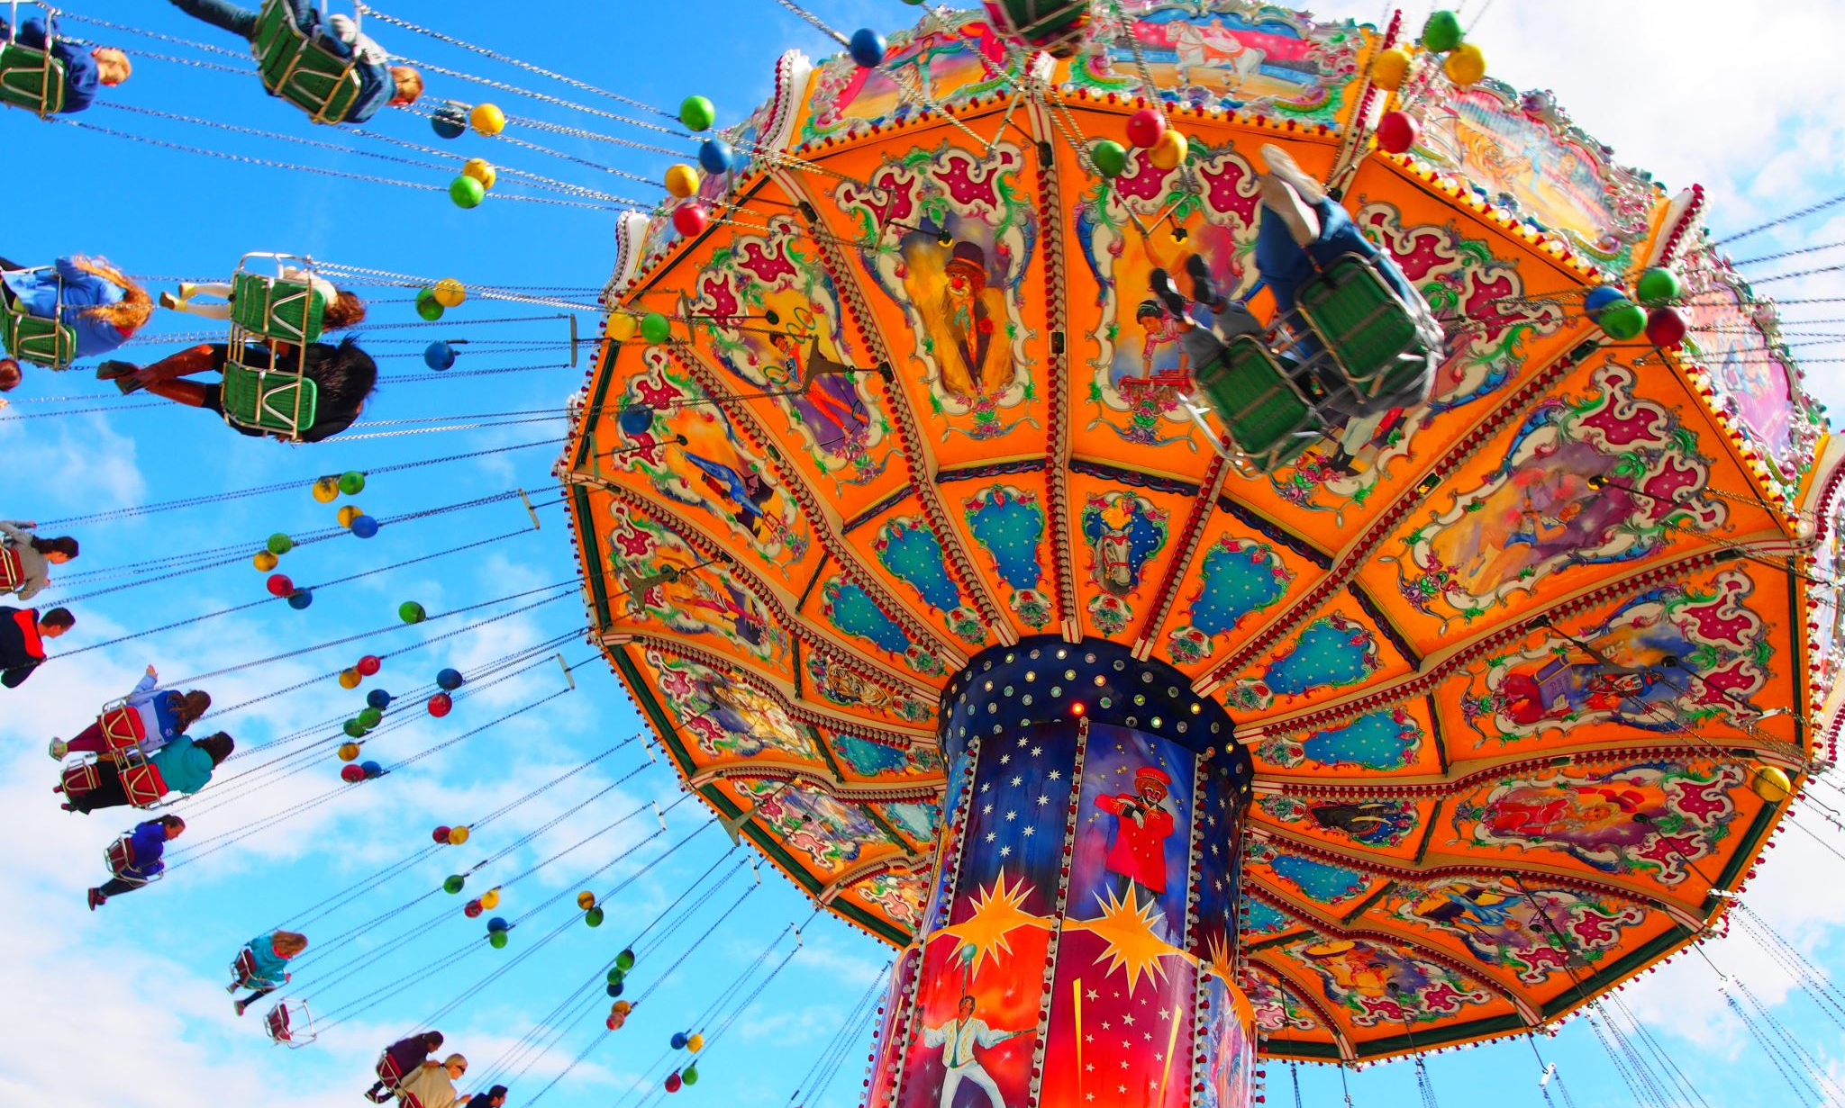
Amusement Park Ride Incidents
Juan de Wet

Slide 2
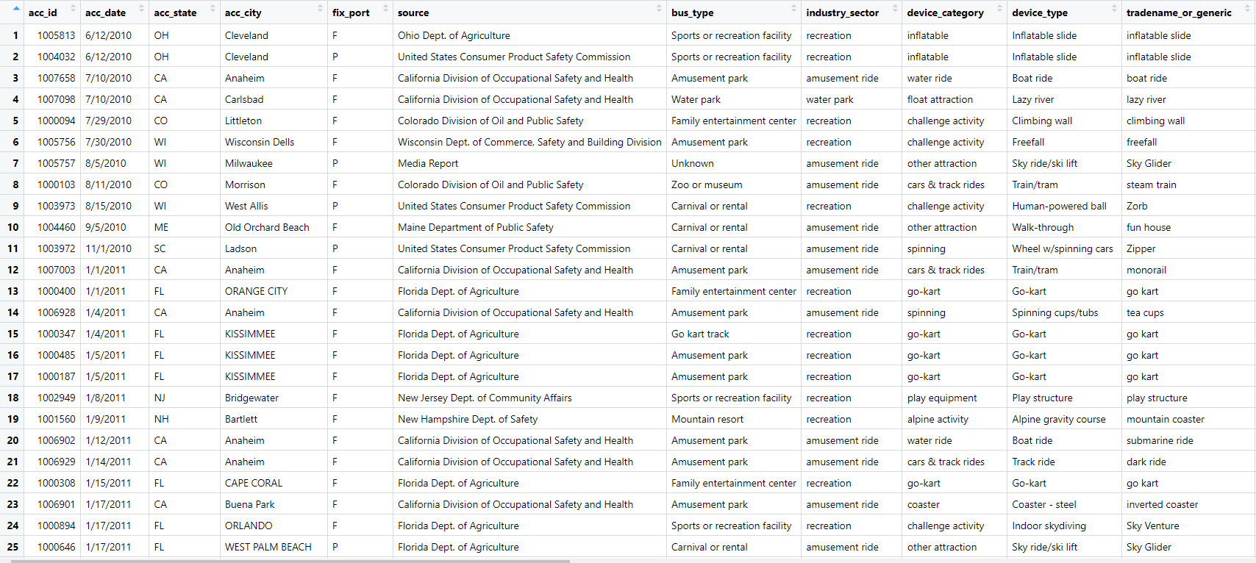
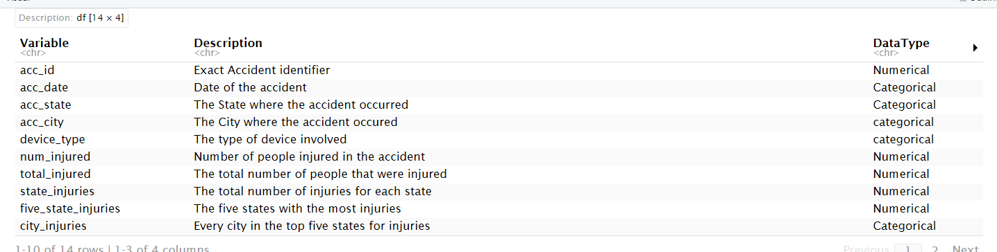
Safe Park’s Amusement Ride Incident Report
In the data table to the right is every reported injury involving some kind of amusement park ride. This data has 8351 observations and 24 and ranges from 2010-2017
This table is 10 of the main variables used throughout the project and had the most applications

Slide 3
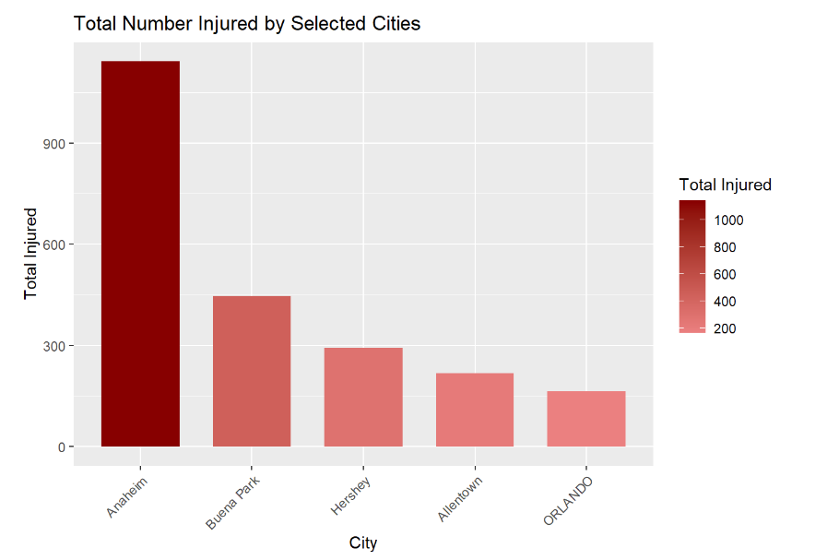
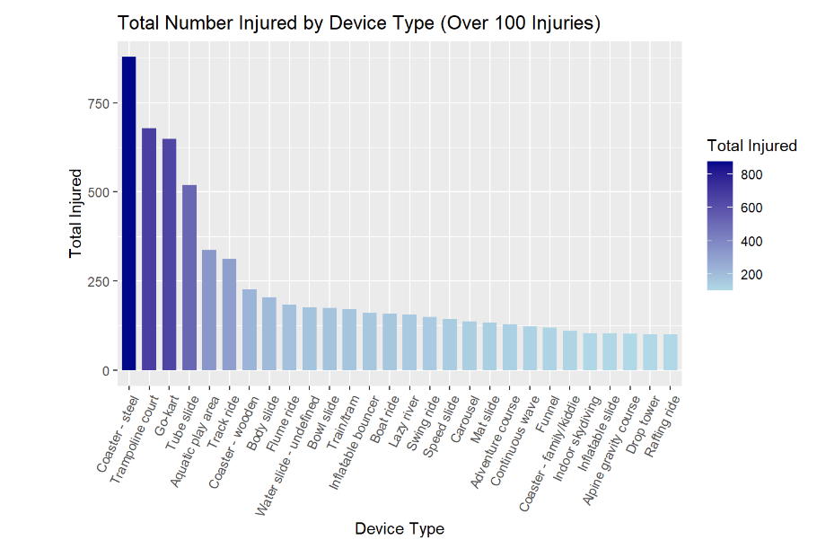
Interesting & Outlier Statistics
Steel Roller Coaster - Known for being the biggest and fastest rides
World‘s fastest amusement park ride is a steel coaster called Formula Rossa in Ferrari World (240 km/hr in 4.90 seconds)
The world‘s tallest amusement park ride is also a steel coaster at Six Flag’s named Kingda Ka (465 Feet)

Slide 4
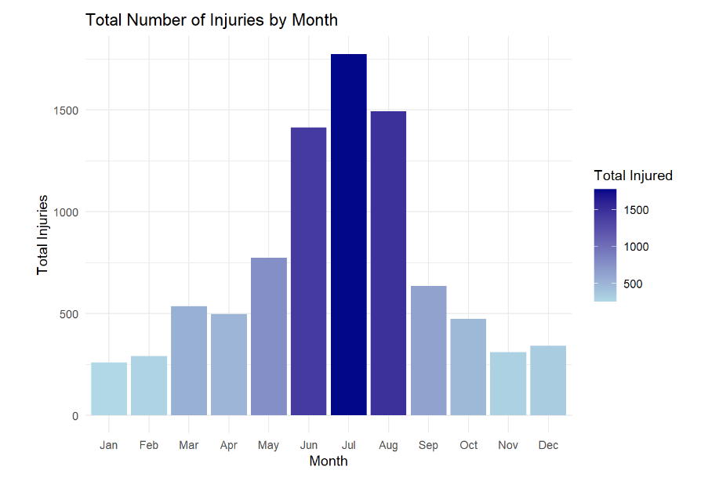
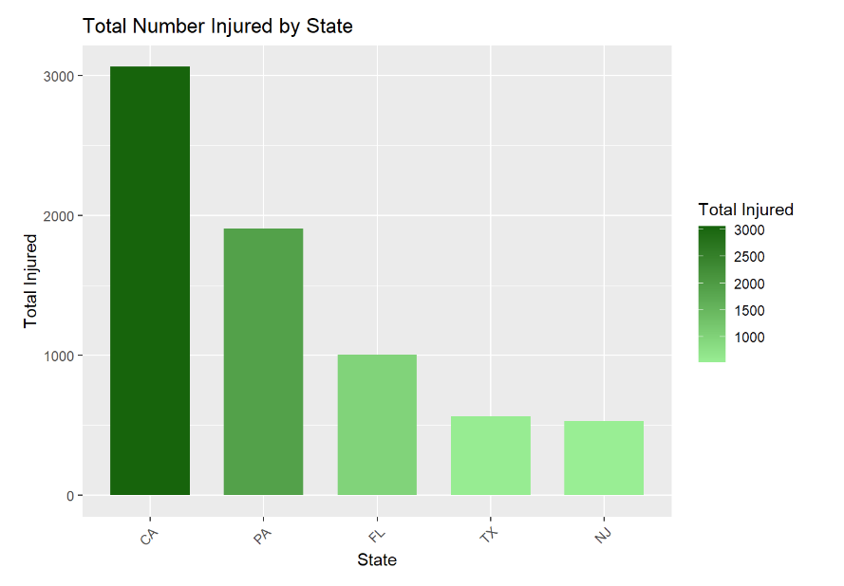
Patterns From Injuries
In the first graph you can see that the summer months of the year have much more injuries than the rest of the year
In the second graph you can see the five states that have the most injuries

Slide 5
Results
Overall the data followed typical seasonal trends and proportions as expected.
Summer months showed many more injuries than other months.
Every state in the top five ranks had one or more major theme parks.
Anaheim’s total injuries was roughly more than the next four highest cities in accidents combined.

