Slide 1
NUMERICAL INVESTIGATION OF SHOCK-INDUCED DEFORMATION OF BUBBLE-LADEN DROPLETS
Juan P. Roldan
Dr. Michael Kinzel
Computational Fluids and Aerodynamics Lab
Dr. Guillermo Jaramillo
IMPETUS INDOMITUS, Universidad del Valle, CO
M.S. Aerospace Engineering Thesis: Defense (Summer 2026)

Slide 2
Presentation Outline
Motivation & Research Question
Background & Knowledge Gaps
Methodology
Clean Baseline Results
Gas-Seeded Parametric Results
Conclusions & Future Work

Slide 3
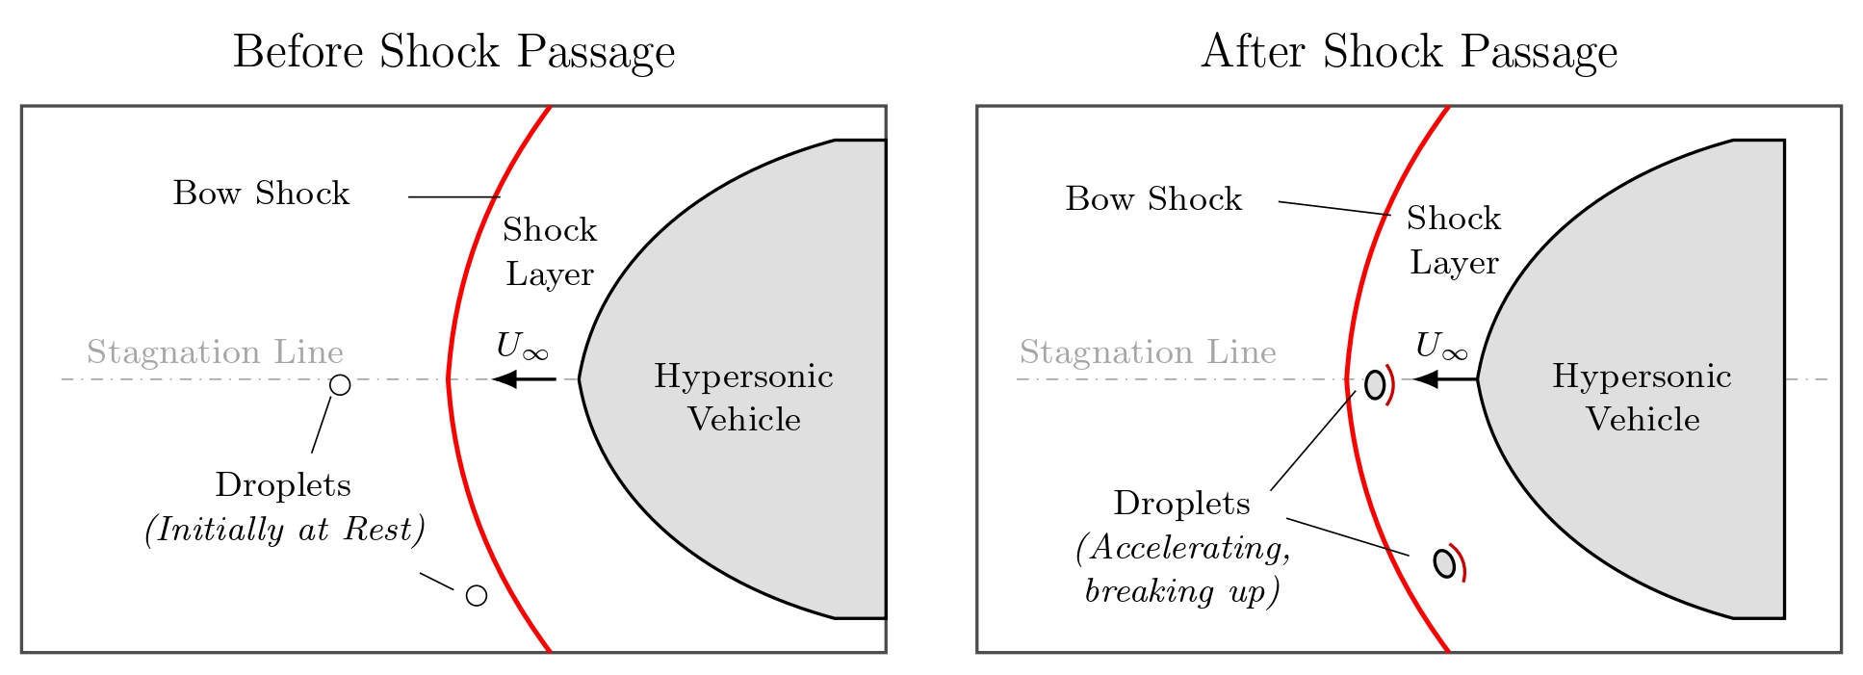
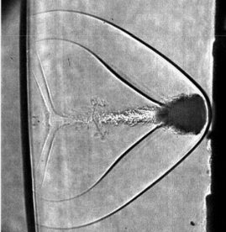
Motivation – Rain Erosion
Hypersonic glide vehicles encounter atmospheric hydrometeors during terminal descent at 0–7 km
Micron cloud droplets to millimeter raindrops
Cumulative droplet impacts roughen the surface → early boundary-layer transition → heating/drag/control-authority penalties
These margins are already thin in air-breathing systems
Dworzanczyk 2025
Figure: Schematic of atmospheric droplets interacting with the bow shock of a hypersonic vehicle before and after shock passage. Adapted from Aguilera 2023.

Slide 4
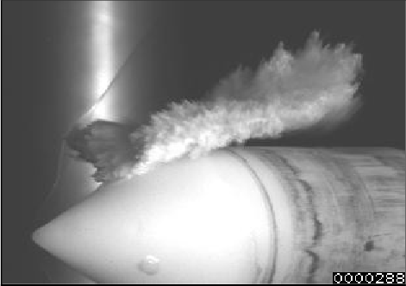
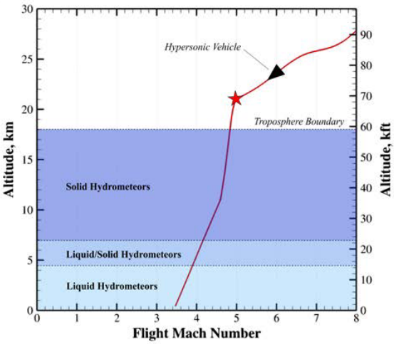
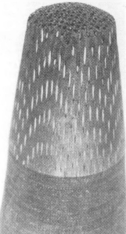
Motivation – Rain Erosion
Impact loading scales with $\sim ρD^{2}V^{2}$
A single 2mm raindrop can exert up to 40kN of force
Figure: 4mm droplet impact on radome at Mach 3 (Moylan 2013).
Figure: Vehicle nosetip post flight through clouds (Sandia National Labs).
Figure: View of hypersonic vehicle terminal dive phase (Aguilera 2023).

Slide 5
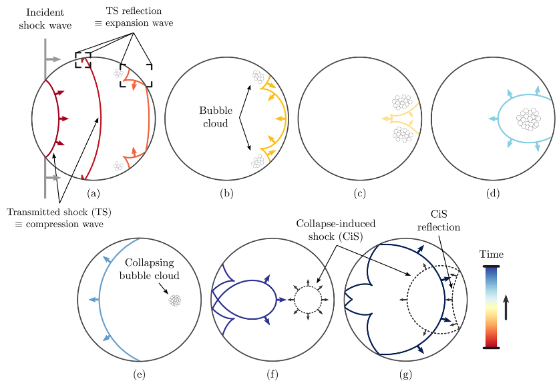
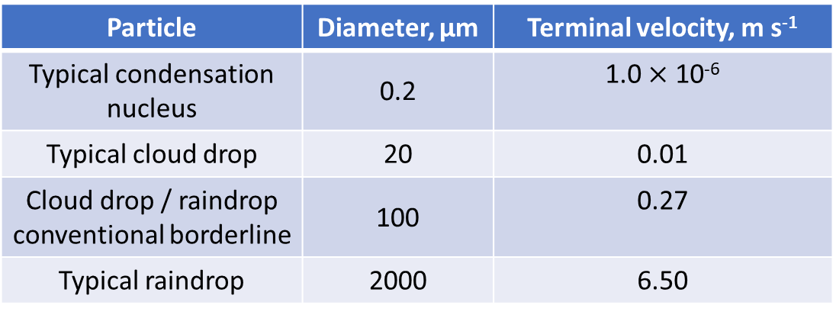
Motivation – Drop Acoustics and Rain Formation
Shock transmission → internal wave dynamics
Reflections / expansion waves
Cloud droplets and raindrops form through condensation on suspended aerosol particles
May trap microscopic gas pockets (heterogenous nuclei)
Particle | Diameter, μm | Terminal velocity, m s⁻¹
Typical condensation nucleus | 0.2 | 1.0 $×$ 10⁻⁶
Typical cloud drop | 20 | 0.01
Cloud drop / raindrop conventional borderline | 100 | 0.27
Typical raindrop | 2000 | 6.50
Table: Typical sizes and terminal velocities of liquid particles in clouds (Aguilera 2023).
Figure: Progression of droplet internal waves (Biasiori-Poulanges 2023).

Slide 6
Scope and Objectives
Can the consideration of pre-existing nuclei measurably affect droplet deformation?
Computationally study the role of pre-existing non-condensable gas nuclei in the early-time response of a shock-loaded liquid droplet.
Objectives:
Develop and verify a cylindrical Euler-Lagrange bubble model
Benchmark the compressible multiphase framework
Characterize the “clean” shock-droplet baseline
Quantify the mechanical response of embedded gas nuclei
Assess the impact of the bubble response on the droplet pressure field and deformation

Slide 7
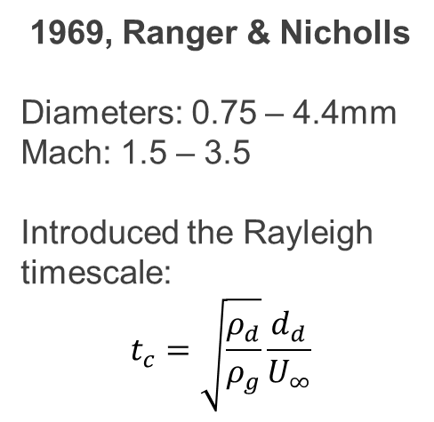
Literature: Classical Shock-Droplet Breakup
Early shock-tube studies established the canonical macroscopic breakup sequence and the characteristic breakup timescale.
1958, Engel
Diameters: 1.4 - 2.7mm
Mach: 1.3 – 1.7
Identified the canonical sequence:
Latency → Flattening → Lateral Stripping → Mist formation → Catastrophic Breakup
1967, Dabora et al..
Diameters: 0.75 - 2.7mm
Mach: 1.5 – 3.5
Distinguished an initial deformation stage from later shear-stripping stage.
Showed breakup time scales with droplet diameter and post-shock gas velocity.
1969, Ranger & Nicholls
Diameters: 0.75 – 4.4mm
Mach: 1.5 – 3.5
Introduced the Rayleigh timescale:
$$t_{c}=\sqrt{\frac{ρ_{d}}{ρ_{g}}}\frac{d_{d}}{U_{∞}}$$

Slide 8
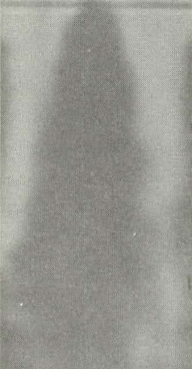
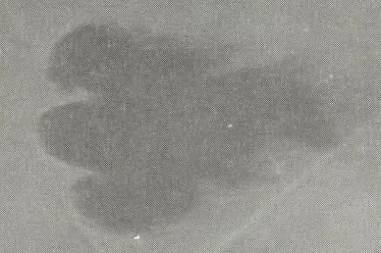
Literature: Classical Shock-Droplet Breakup
Early shock-tube studies established the canonical macroscopic breakup sequence and the characteristic breakup timescale.
1969, Reinecke & McKay
Diameters: 0.5 – 2.5mm
Mach: 3, 6, 9, 11, 12
Discovered breakup mode transition at ~Mach 6.
< Mach 6: Stripped by aerodynamic shear (KH)
> Mach 6: Catastrophic shattering (RT piercing)
Figure: Droplet, Mach 3 (Reinecke-McKay 1969)
Figure: Droplet, Mach 11 (Reinecke-McKay 1969)

Slide 9
Literature: Breakup Mechanisms
Modern interpretations frame droplet breakup as a competition between aerodynamic stripping and surface-instability growth.
Ranger & Nicholls, 1969
Boundary-layer stripping model
Pilch & Erdman, 1987
Emphasized importance of considering surface instability
Funada & Joseph, 1999-2001
Connected droplet deformation to RT and KH instabilities
Theofanous group, 2004-2012
Developed the RTP/ SIE framework
Dworzanczyk et al, 2025
Reconciled high-Mach experiments and simulations using nonlinear instability growth

Slide 10
Literature: Cavitation and Entrained Nuclei
Internal pressure focusing can activate cavitation or gas nuclei, but existing studies have not isolated the mechanical response of pre-existing non-condensable nuclei.
Sembian et al., 2016
Provided direct shock-water-column evidence of internal wave focusing and cavitation
Forehand et al., 2023-2024
Compared simulations with and without cavitation modeling
One-way coupling bubble dynamics
Shannon 2024
Resolved one cavitation bubble near an interface and showed it can seed KH roll-up
Briggs / Aguilera, 2023-2026
Experiments of degassed, ambient, and doped droplets (~Mach 3, D=1-3mm)
Limited diagnostic, little evidence
Cavainolo 2026
One-way cavitation estimate from CFD pressure history

Slide 11
Literature: Knowledge Gaps
Prior work identified cavitation-prone regions and droplet breakup mechanisms, but did not resolve the direct feedback of pre-existing gas nuclei.
Gap 1:
Gap 2:
Gap 3:
Two-way coupled multi-nuclei effects
Early pressure field feedback
Isolated nuclei response
Hypothesis: mechanically responding NCG nuclei modify early internal pressure dynamics before producing visible changes in droplet deformation.

Slide 12
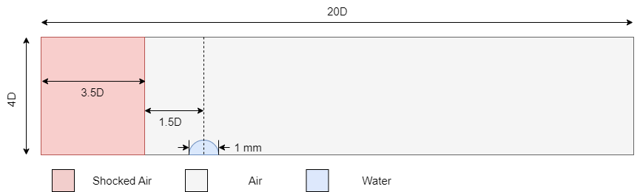



Methodology: Computational Setup
All simulations are performed in cylindrical coordinates $(x,r)$ under an axisymmetric assumption.
Boundary conditions:
The bottom boundary is an axis of symmetry
All other boundaries are non-reflecting boundaries
Initial conditions:
Shocked air set by Rankine-Hugoniot jump conditions into quiescent, ambient air
$$r$$
$$x$$
Figure: Computational domain, normalized by droplet diameter, D.

Slide 13
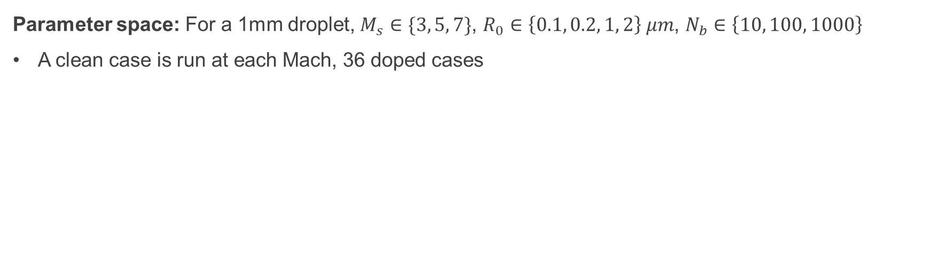

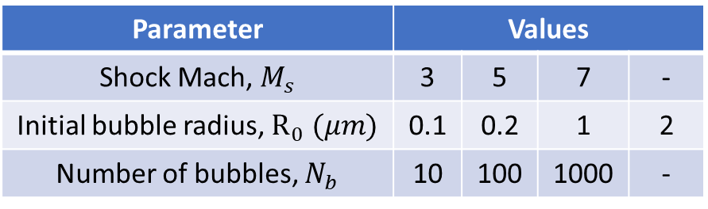
Methodology: Simulation Matrix
Parameter space: For a 1mm droplet, $M_{s}∈\{3, 5, 7\}$, $R_{0}∈\left\{0.1, 0.2, 1, 2\right\} μm$, $N_{b}∈\left\{10, 100, 1000\right\}$
A clean case is run at each Mach, 36 doped cases
Parameter | Values
Shock Mach, $M_{s}$ | 3 | 5 | 7 | -
Initial bubble radius, $R_{0} (μm)$ | 0.1 | 0.2 | 1 | 2
Number of bubbles, $N_{b}$ | 10 | 100 | 1000 | -
Table 3.3 Shock-droplet simulation matrix. This spans the doped cases.
Figure: Sub-grid Lagrangian bubble representation.
: Sub-grid Lagrangian bubble
D = 1 mm
$$Δx$$

Slide 14

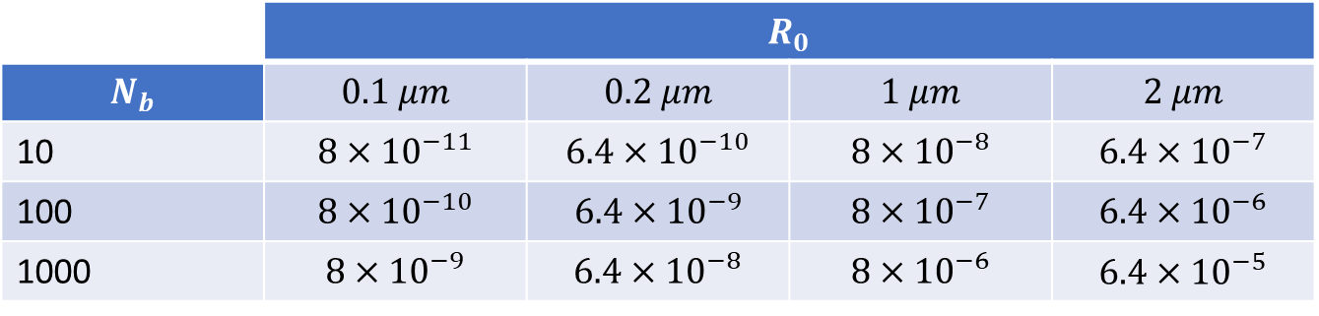
Methodology: Number Density and Void Fraction
Number density:
$$n=\frac{N_{b}}{V_{drop}}, V_{drop}=\frac{4}{3}π{\left(\frac{D}{2}\right)}^{3}$$
For $N_{b}=10, 100, 1000, n$ yields $19, 191, 1910 mm^{−3}$, respectively
Void Fraction:
$$β_{0}=\frac{N_{b}\frac{4}{3}πR_{0}^{3}}{V_{drop}}$$
 | $$R_{0}$$
$$N_{b}$$ | $$0.1 μm$$ | $$0.2 μm$$ | $$1 μm$$ | $$2 μm$$
10 | $$8×{10}^{−11}$$ | $$6.4×{10}^{−10}$$ | $$8×{10}^{−8}$$ | $$6.4×{10}^{−7}$$
100 | $$8×{10}^{−10}$$ | $$6.4×{10}^{−9}$$ | $$8×{10}^{−7}$$ | $$6.4×{10}^{−6}$$
1000 | $$8×{10}^{−9}$$ | $$6.4×{10}^{−8}$$ | $$8×{10}^{−6}$$ | $$6.4×{10}^{−5}$$
Table 3.4 Initial global gas void fraction $β_{0}$ for the bubble-loading parameter sweep.

Slide 15
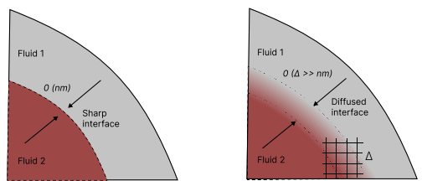

Methodology: The Numerical Model
The present simulations are performed in the Multi-Component Flow Code (MFC)
Open-source, high-order, compressible multiphase solver
Sub-grid bubble models
Highly parallel
Resolved Eulerian phase interface:
Reduced five-equation diffuse-interface formulation of Allaire et al. 2002.
$$\frac{∂(α_{i}ρ_{i})}{∂t}+∇∙\left(α_{i}ρ_{i}u\right)=0, i=1, 2, …N$$
$$\frac{∂(ρu)}{∂t}+∇∙\left(ρu⊗u+pI\right)=0$$
$$\frac{∂(ρE)}{∂t}+∇∙\left[\left(ρE+p\right)u\right]=0$$
$$\frac{∂α_{i}}{∂t}+u∙∇α_{i}=K∇∙u$$
Figure: Sharp and diffuse interface of a multiphase flow (Adebayo 2025).

Slide 16
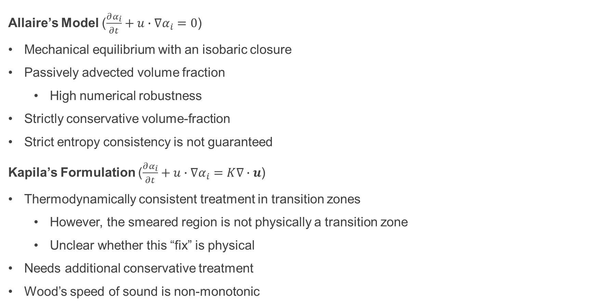
Methodology: Interface Formulation
Allaire’s Model ($\frac{∂α_{i}}{∂t}+u∙∇α_{i}=0$)
Mechanical equilibrium with an isobaric closure
Passively advected volume fraction
High numerical robustness
Strictly conservative volume-fraction
Strict entropy consistency is not guaranteed
Kapila’s Formulation ($\frac{∂α_{i}}{∂t}+u∙∇α_{i}=K∇∙u$)
Thermodynamically consistent treatment in transition zones
However, the smeared region is not physically a transition zone
Unclear whether this “fix” is physical
Needs additional conservative treatment
Wood’s speed of sound is non-monotonic

Slide 17

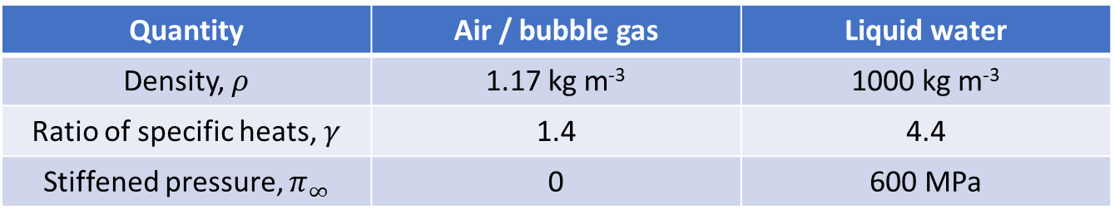
Methodology: The Numerical Model
Each material is closed with a stiffened-gas equation of state
$$p_{i}=\left(γ_{i}−1\right)ρ_{i}e_{i}−γ_{i}π_{∞,i}$$
The material properties are listed below:
Viscous stresses and surface tension are neglected in the resolved Eulerian equations.
Quantity | Air / bubble gas | Liquid water
Density, $ρ$ | 1.17 kg m⁻³ | 1000 kg m⁻³
Ratio of specific heats, $γ$ | 1.4 | 4.4
Stiffened pressure, $π_{∞}$ | 0 | 600 MPa
Table: Equation-of-state and material parameters used in the shock-droplet simulations.

Slide 18
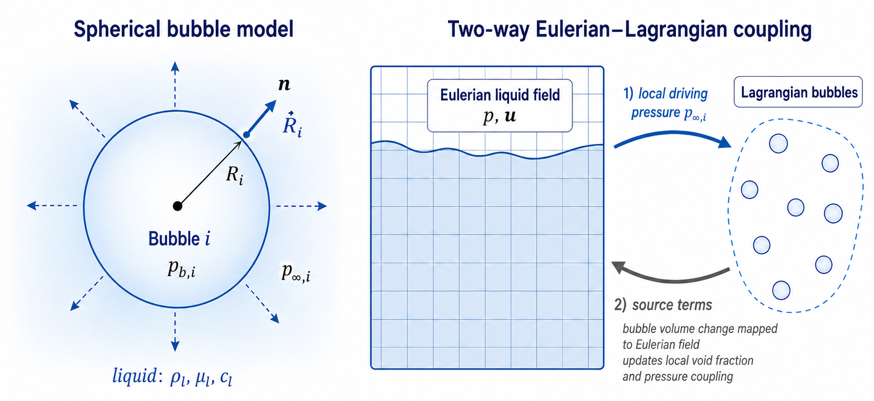
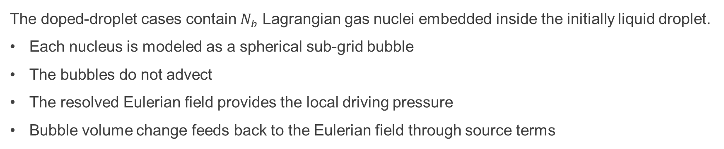
Methodology: Euler-Lagrange Bubble Model
The doped-droplet cases contain $N_{b}$ Lagrangian gas nuclei embedded inside the initially liquid droplet.
Each nucleus is modeled as a spherical sub-grid bubble
The bubbles do not advect
The resolved Eulerian field provides the local driving pressure
Bubble volume change feeds back to the Eulerian field through source terms
Figure: Sub-grid spherical bubble model and two-way Eulerian–Lagrangian coupling used to evolve the embedded gas nuclei.

Slide 19
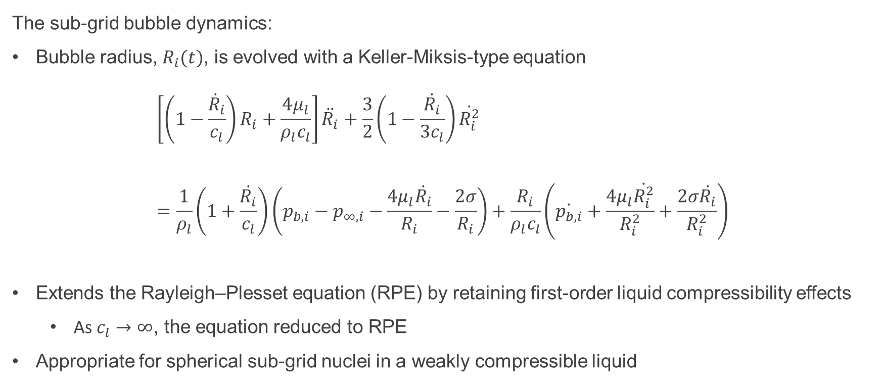
Methodology: Keller-Miksis-Type Model
The sub-grid bubble dynamics:
Bubble radius, $R_{i}(t)$, is evolved with a Keller-Miksis-type equation
$$\left[\left(1−\frac{{\dot{R}}_{i}}{c_{l}}\right)R_{i}+\frac{4μ_{l}}{ρ_{l}c_{l}}\right]\ddot{R_{i}}+\frac{3}{2}\left(1−\frac{\dot{R_{i}}}{3c_{l}}\right)\dot{R_{i}^{2}}=\frac{1}{ρ_{l}}\left(1+\frac{\dot{R_{i}}}{c_{l}}\right)\left(p_{b,i}−p_{∞,i}−\frac{4μ_{l}\dot{R_{i}}}{R_{i}}−\frac{2σ}{R_{i}}\right)+\frac{R_{i}}{ρ_{l}c_{l}}\left(\dot{p_{b,i}}+\frac{4μ_{l}\dot{R_{i}^{2}}}{R_{i}^{2}}+\frac{2σ\dot{R_{i}}}{R_{i}^{2}}\right)$$
Extends the Rayleigh–Plesset equation (RPE) by retaining first-order liquid compressibility effects
As $c_{l}→∞$, the equation reduced to RPE
Appropriate for spherical sub-grid nuclei in a weakly compressible liquid
Liquid inertia + compressibility/viscous correction
Nonlinear radial inertia
Net pressure driving, corrected for finite sound speed
Time-varying pressure/ acoustic radiation correction

Slide 20
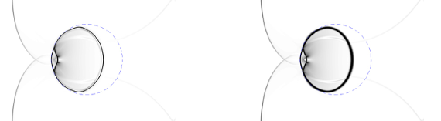
Methodology: Numerical Methods
The Eulerian equations are discretized on a structured grid using a finite-volume formulation.
A constant CFL value of 0.1 is used in all simulations.
Numerical Component | Method Used
Face reconstruction | 2nd order MUSCL + van Leer limiter
Interface treatment | THINC interface sharpening
Riemann Solver | HLLC
Time-integration | SSP-RK3 (TVD)
Flow-bubble coupling | Operator splitting
Table 3.2 Summary of numerical methods used for the Eulerian flow solver and sub-grid bubble dynamics.
Figure: Numerical results for a planar Mach onto a gas bubble. With THINC (left) and without THINC (right) are both shown (Shyue-Xiao 2014).

Slide 21
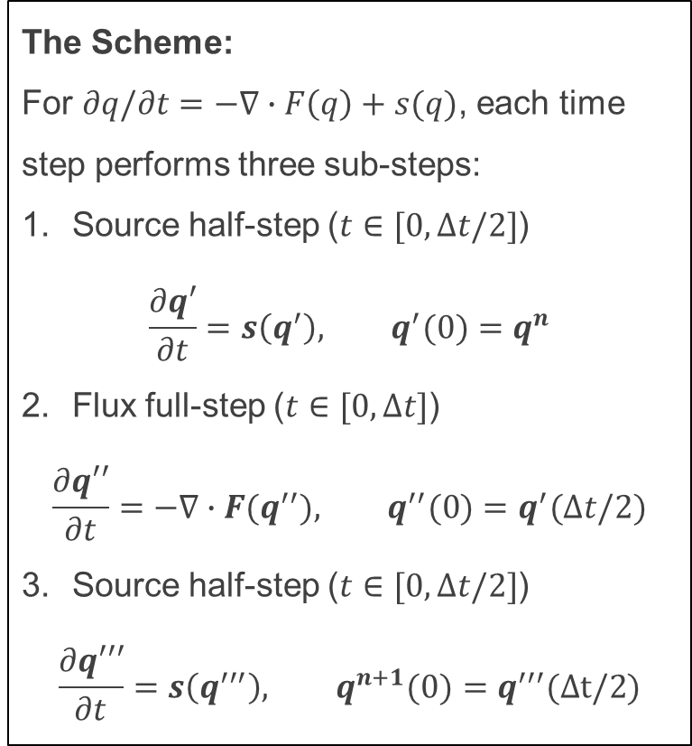
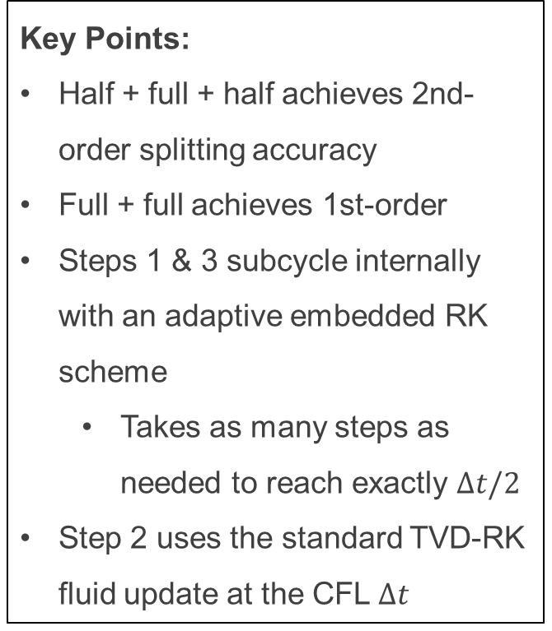
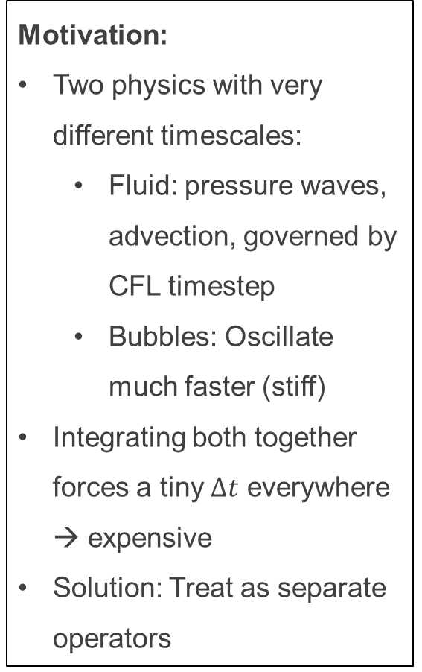
Methodology: Strang Splitting
Motivation:
Two physics with very different timescales:
Fluid: pressure waves, advection, governed by CFL timestep
Bubbles: Oscillate much faster (stiff)
Integrating both together forces a tiny $Δt$ everywhere → expensive
Solution: Treat as separate operators
The Scheme:
For $∂q/∂t=−∇∙F\left(q\right)+s(q)$, each time step performs three sub-steps:
Source half-step ($t∈[0,Δt/2]$)
$$\frac{∂q′}{∂t}=s\left(q^{′}\right), q^{′}(0)=q^{n}$$
Flux full-step ($t∈[0,Δt]$)
$$\frac{∂q′′}{∂t}=−∇∙F(q^{′′}), q^{′′}(0)=q^{′}(Δt/2)$$
Source half-step ($t∈[0,Δt/2]$)
$$\frac{∂q′′′}{∂t}=s\left(q^{′′′}\right), q^{n+1}(0)=q^{′′′}(Δt/2)$$
Key Points:
Half + full + half achieves 2nd-order splitting accuracy
Full + full achieves 1st-order
Steps 1 & 3 subcycle internally with an adaptive embedded RK scheme
Takes as many steps as needed to reach exactly $Δt/2$
Step 2 uses the standard TVD-RK fluid update at the CFL $Δt$

Slide 22
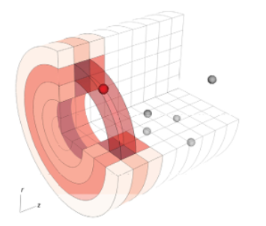
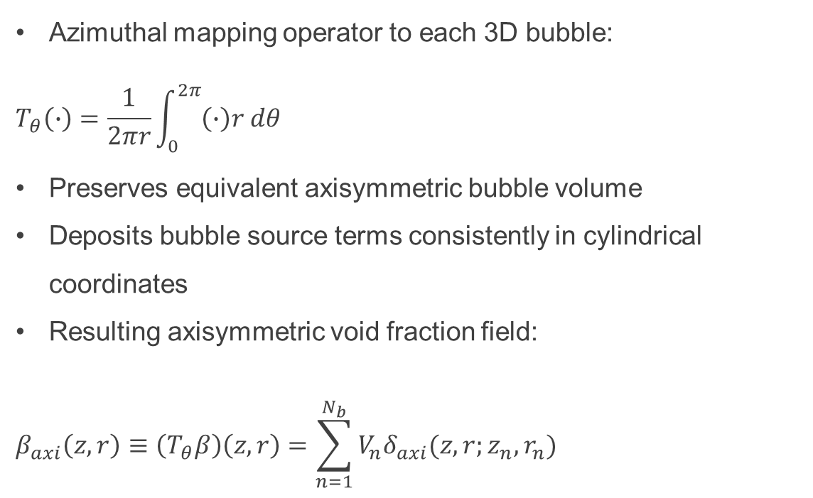
Methodology: Code Extensions
Cylindrical Euler-Lagrange Bubble Model: allows Lagrangian gas nuclei to be used in the axisymmetric formulation used for the simulations
Azimuthal mapping operator to each 3D bubble:
$$T_{θ}\left(∙\right)=\frac{1}{2πr}\int_{0}^{2π}{\left(∙\right)r dθ}$$
Preserves equivalent axisymmetric bubble volume
Deposits bubble source terms consistently in cylindrical coordinates
Resulting axisymmetric void fraction field:
$$β_{axi}\left(z,r\right)≡\left(T_{θ}β\right)\left(z,r\right)=\sum_{n=1}^{N_{b}}{V_{n}δ_{axi}(z,r;z_{n},r_{n})}$$
Figure: Axisymmetric mapping of a 3D Lagrangian bubble kernel onto neighboring FVM cells (Maeda-Colonius 2018).

Slide 23
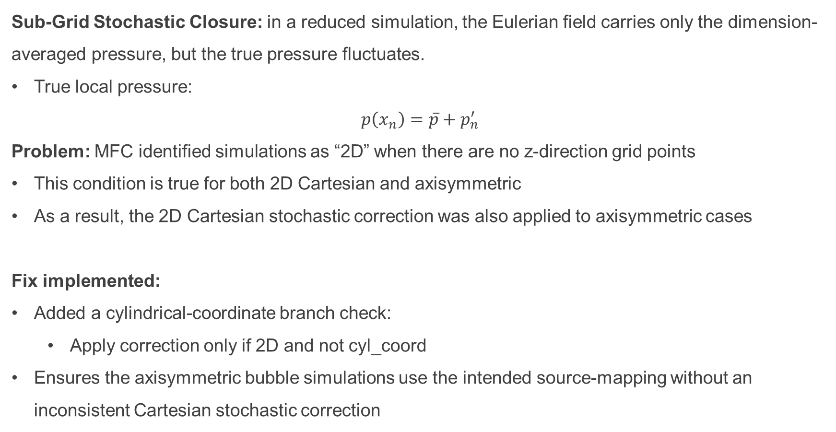
Methodology: Code Extensions
Sub-Grid Stochastic Closure: in a reduced simulation, the Eulerian field carries only the dimension-averaged pressure, but the true pressure fluctuates.
True local pressure:
$$p\left(x_{n}\right)=\overline{p}+p_{n}^{′}$$
Problem: MFC identified simulations as “2D” when there are no z-direction grid points
This condition is true for both 2D Cartesian and axisymmetric
As a result, the 2D Cartesian stochastic correction was also applied to axisymmetric cases
Fix implemented:
Added a cylindrical-coordinate branch check:
Apply correction only if 2D and not cyl_coord
Ensures the axisymmetric bubble simulations use the intended source-mapping without an inconsistent Cartesian stochastic correction

Slide 24
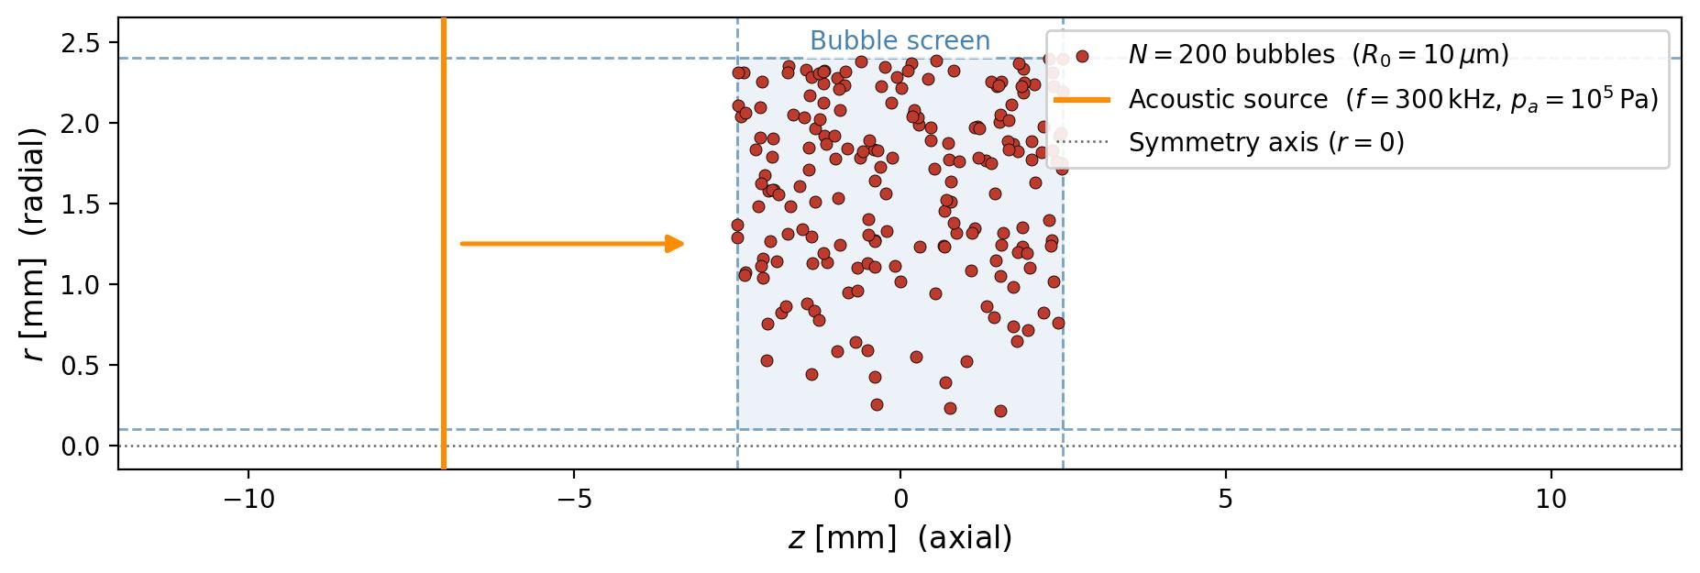
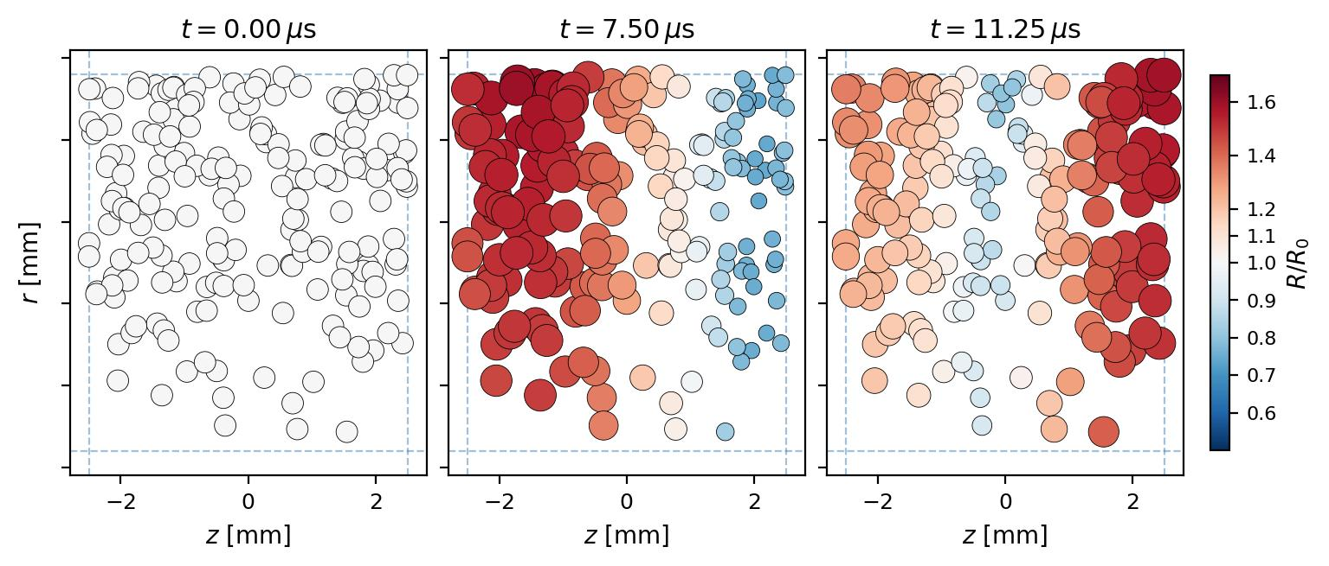
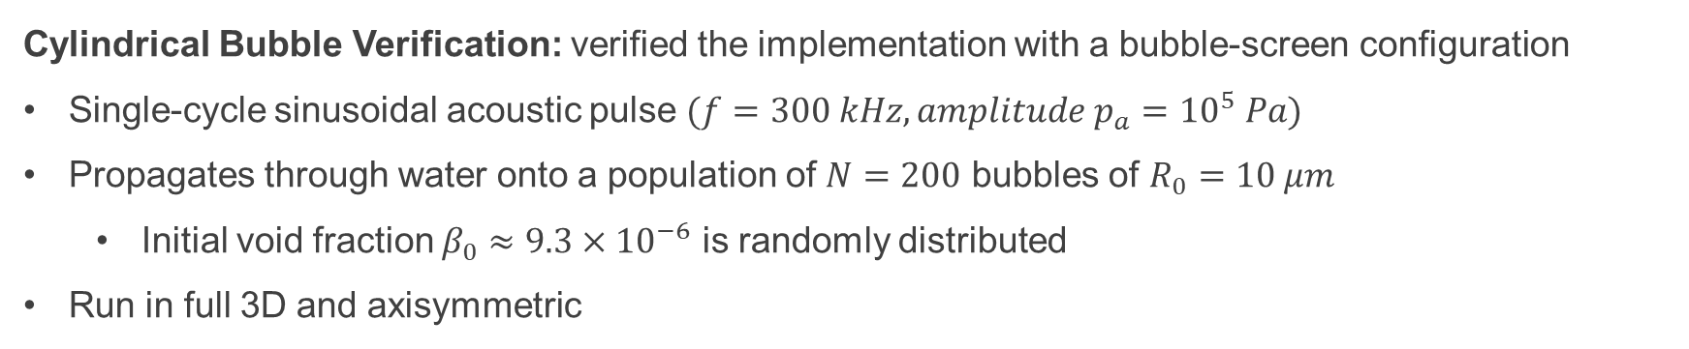
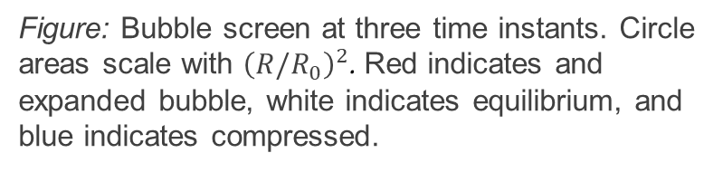
Methodology: Code Extensions
Cylindrical Bubble Verification: verified the implementation with a bubble-screen configuration
Single-cycle sinusoidal acoustic pulse $(f=300 kHz, amplitude p_{a}={10}^{5} Pa)$
Propagates through water onto a population of $N=200$ bubbles of $R_{0}=10 μm$
Initial void fraction $β_{0}≈9.3×{10}^{−6}$ is randomly distributed
Run in full 3D and axisymmetric
Figure: Computational domain for the cylindrical bubble screen test. Acoustic source upstream pulses for a single cycle toward a bubble screen.
Figure: Bubble screen at three time instants. Circle areas scale with ${\left(R/R_{0}\right)}^{2}$. Red indicates and expanded bubble, white indicates equilibrium, and blue indicates compressed.

Slide 25
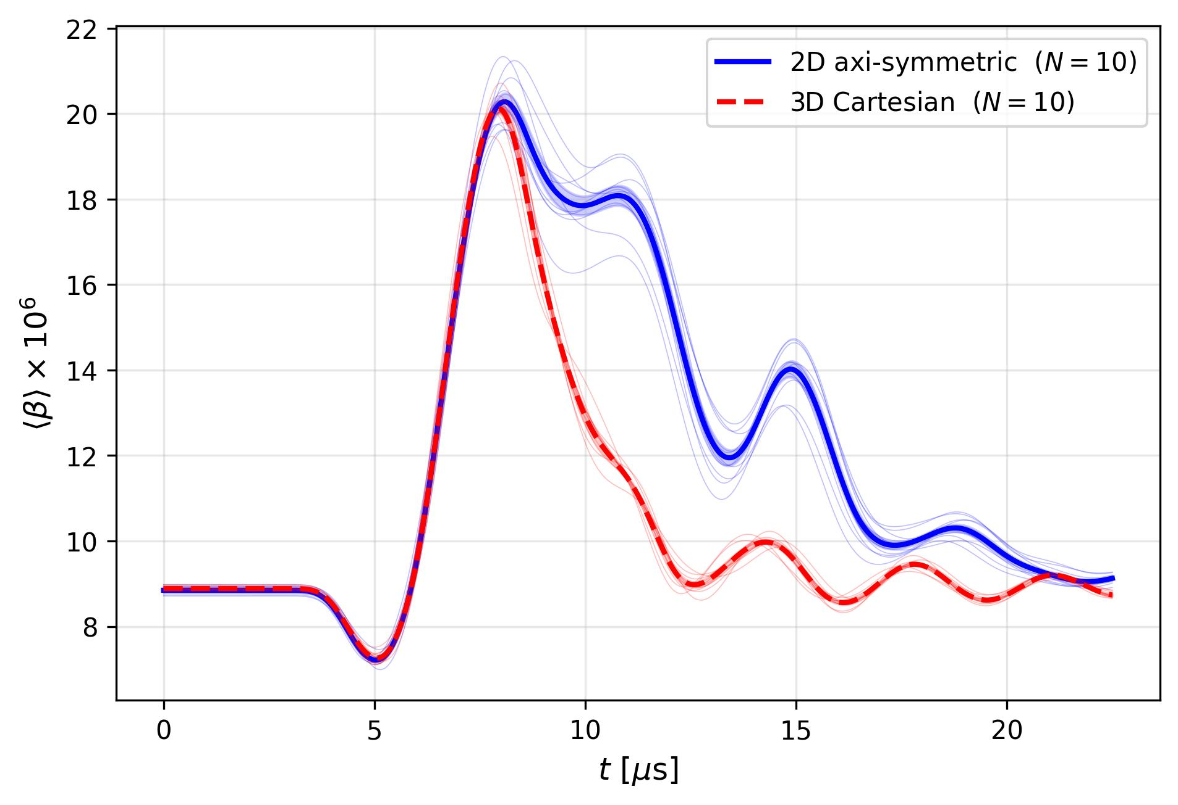
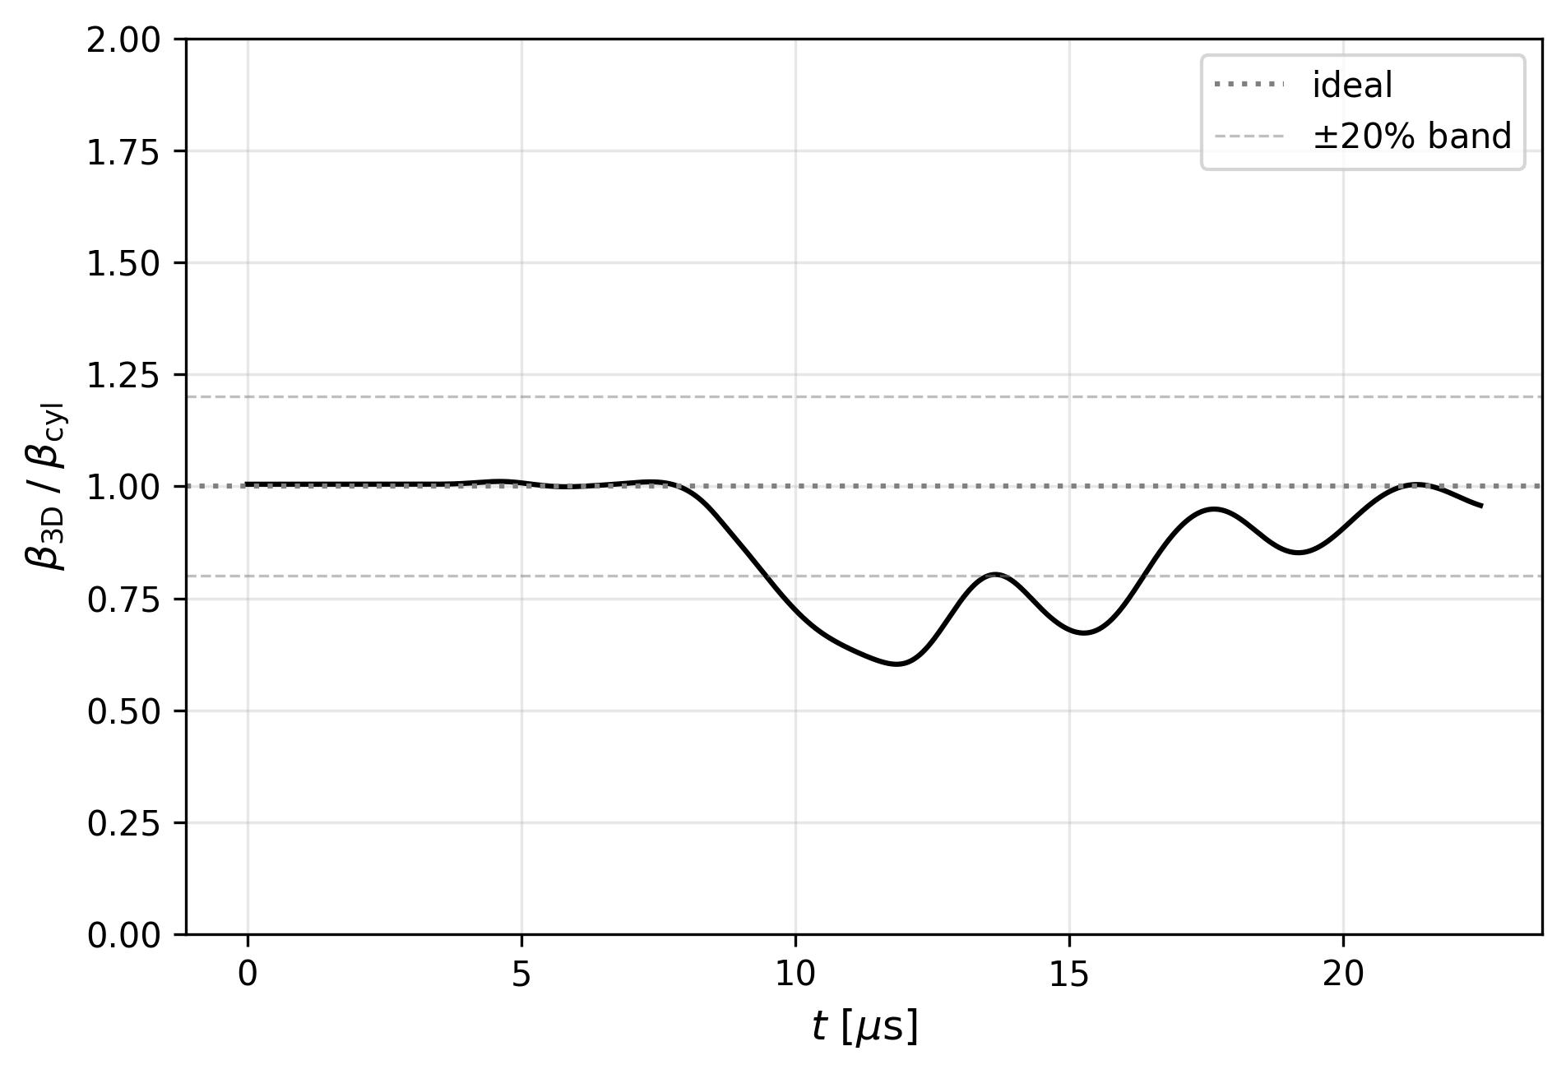
Methodology: Code Extensions
Cylindrical Bubble Verification: verified the implementation with a bubble-screen configuration
Compared between the full 3D and the axisymmetric implementations
Ensemble averaged over 10 realizations
Comparisons show good agreement over the duration of the first pulse
Figure: Ensemble averaged void fraction of the 2D axisymmetric and full 3D Cartesian bubble screen tests.
Figure: Ratio of ensemble averaged void fractions.

Slide 26
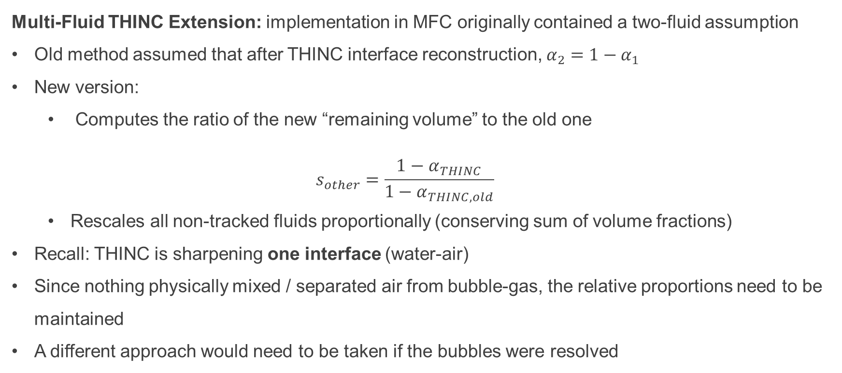
Methodology: Code Extensions
Multi-Fluid THINC Extension: implementation in MFC originally contained a two-fluid assumption
Old method assumed that after THINC interface reconstruction, $α_{2}=1−α_{1}$
New version:
Computes the ratio of the new “remaining volume” to the old one
$$s_{other}=\frac{1−α_{THINC}}{1−α_{THINC,old}}$$
Rescales all non-tracked fluids proportionally (conserving sum of volume fractions)
Recall: THINC is sharpening one interface (water-air)
Since nothing physically mixed / separated air from bubble-gas, the relative proportions need to be maintained
A different approach would need to be taken if the bubbles were resolved

Slide 27
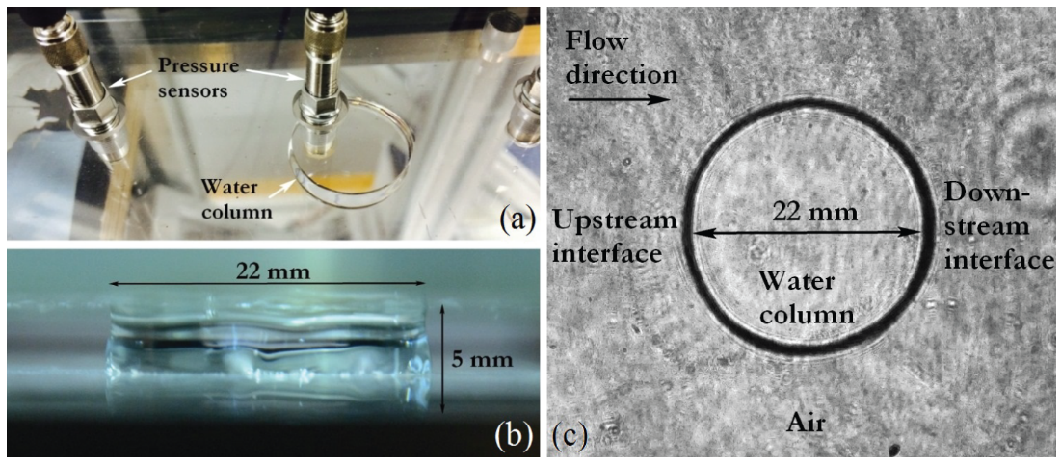
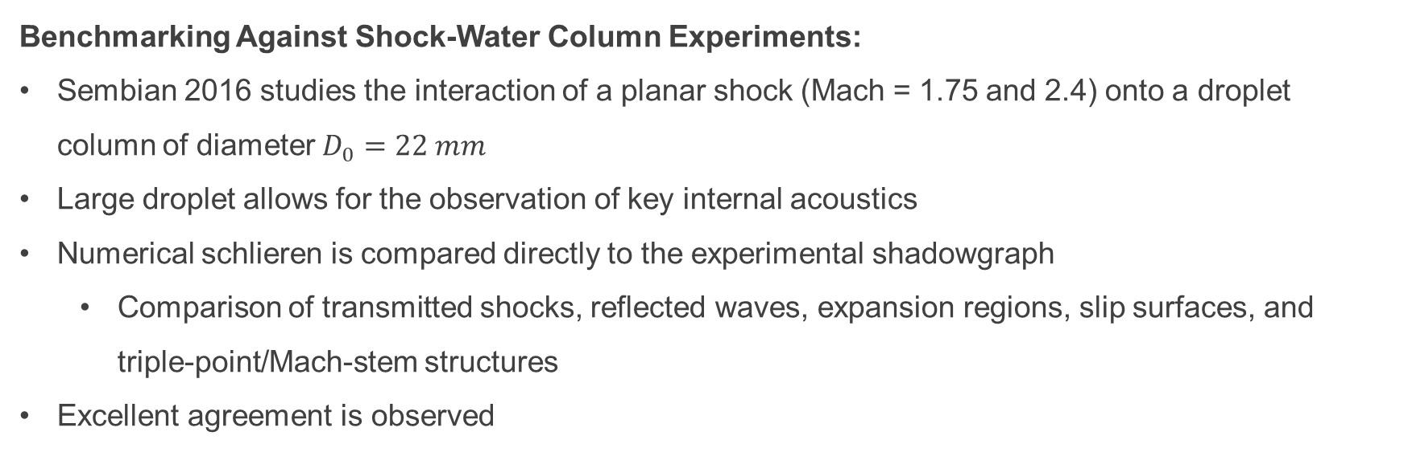
Methodology: Benchmarking
Benchmarking Against Shock-Water Column Experiments:
Sembian 2016 studies the interaction of a planar shock (Mach = 1.75 and 2.4) onto a droplet column of diameter $D_{0}=22 mm$
Large droplet allows for the observation of key internal acoustics
Numerical schlieren is compared directly to the experimental shadowgraph
Comparison of transmitted shocks, reflected waves, expansion regions, slip surfaces, and triple-point/Mach-stem structures
Excellent agreement is observed
Figure: 22mm water column of Sembian 2016.

Slide 28
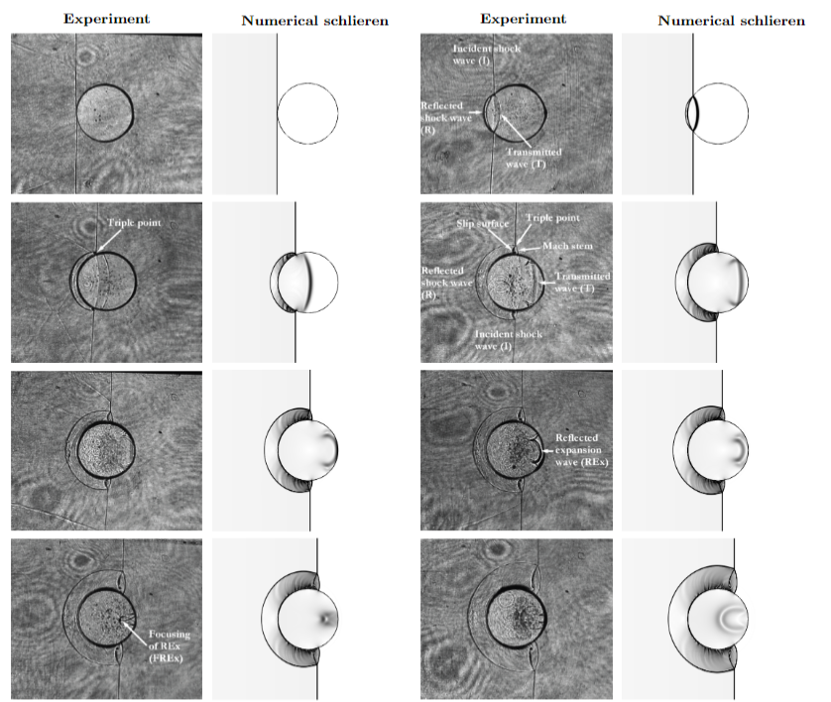
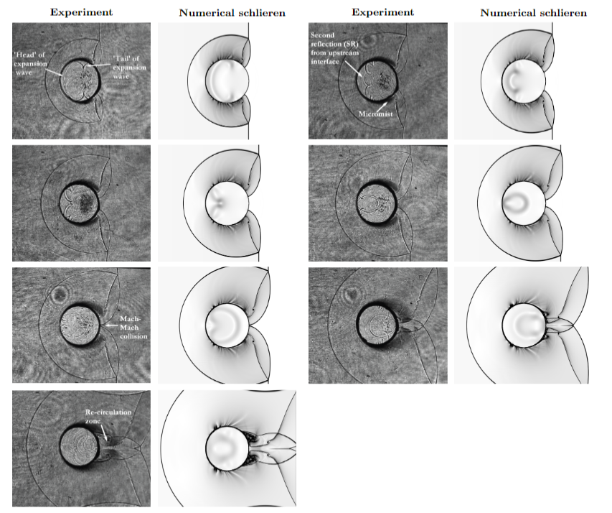
Methodology: Validation / Benchmarking
Benchmarking Against Shock-Water Column Experiments:
Transmitted shock
Secondary Reflection
Reflected expansion waves (REx)
Mach-Mach collision
REx Focusing
Re-circulation zone
Figure: Comparison between experimental shadowgraph images from the Mach 2.4 shock-water-column experiment of Sembian et al. and numerical schlieren fields from the MFC simulation.

Slide 29
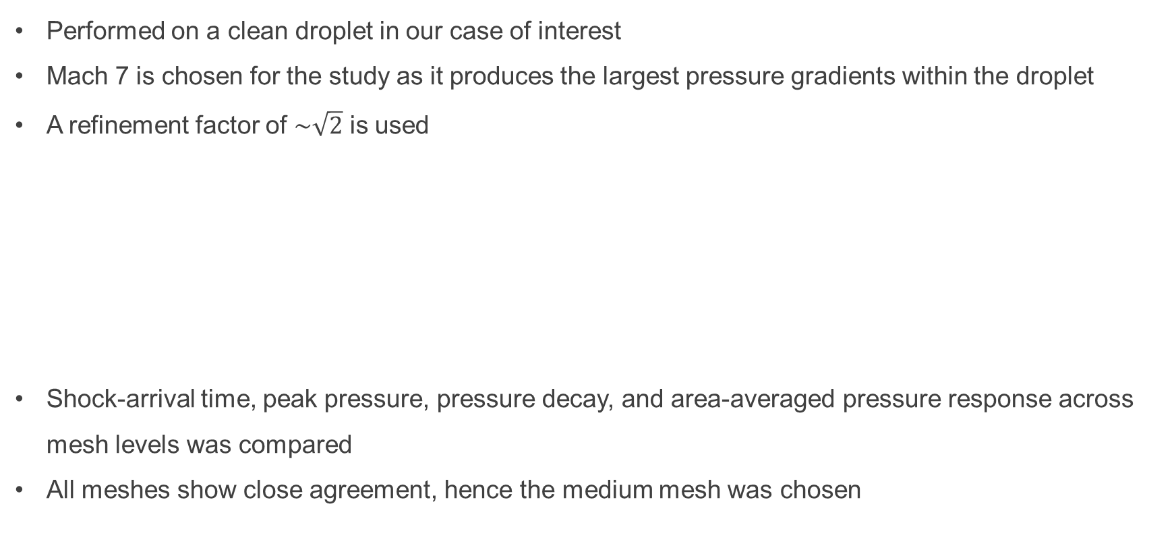
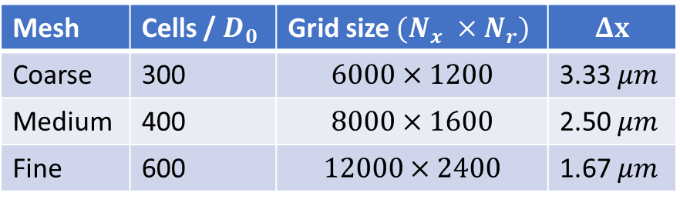
Methodology: Mesh Independence
Performed on a clean droplet in our case of interest
Mach 7 is chosen for the study as it produces the largest pressure gradients within the droplet
A refinement factor of $\sim \sqrt{2}$ is used
Shock-arrival time, peak pressure, pressure decay, and area-averaged pressure response across mesh levels was compared
All meshes show close agreement, hence the medium mesh was chosen
Mesh | Cells / $D_{0}$ | Grid size $(N_{x} ×N_{r})$ | $$Δx$$
Coarse | 300 | $$6000×1200$$ | 3.33 $μm$
Medium | 400 | $$8000×1600$$ | 2.50 $μm$
Fine | 600 | $$12000×2400$$ | 1.67 $μm$
Table 3.5 Mesh levels used in the shock-droplet mesh-independence study.

Slide 30
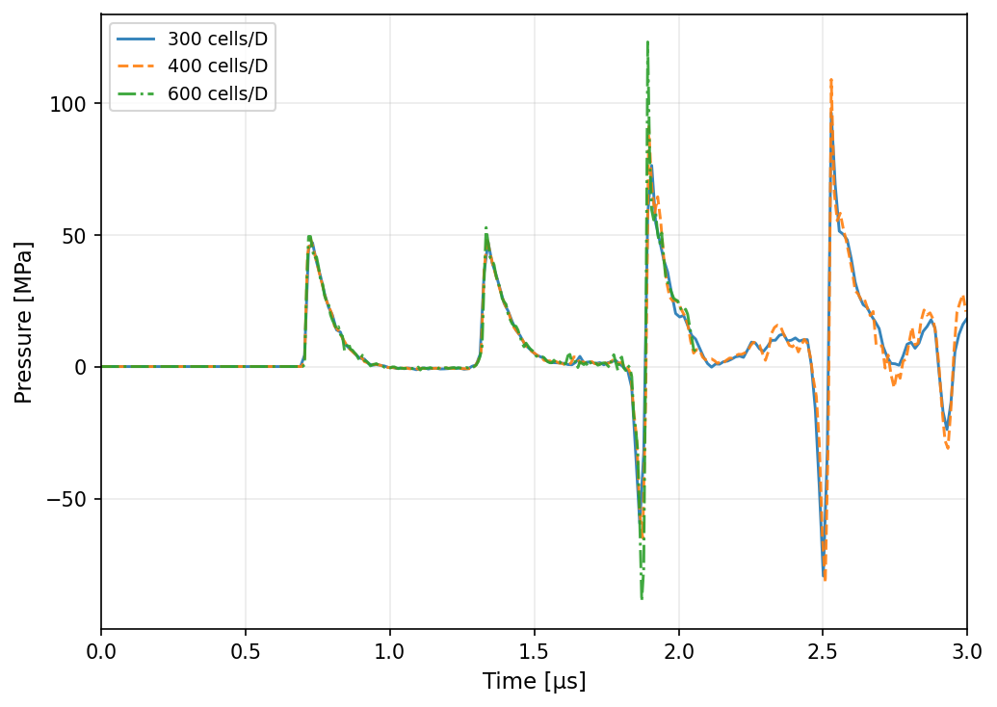
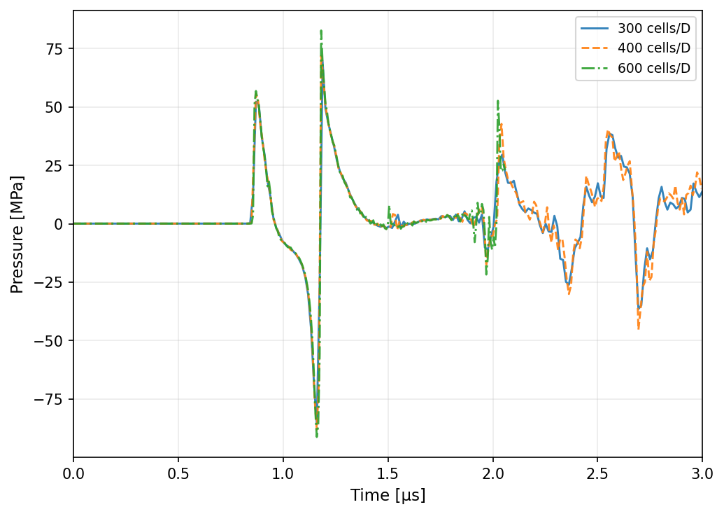
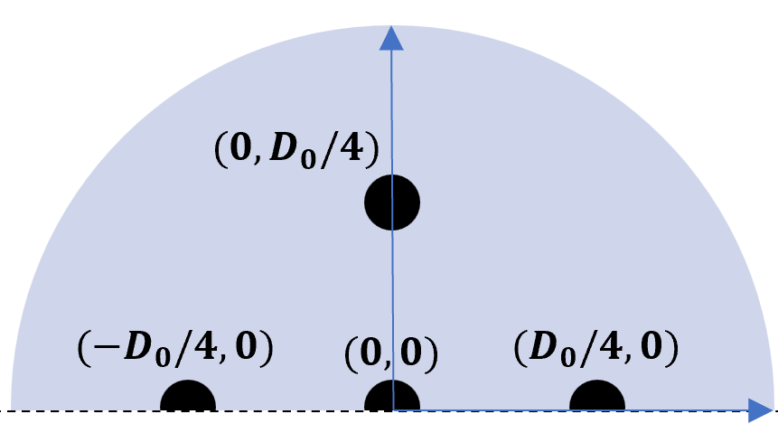
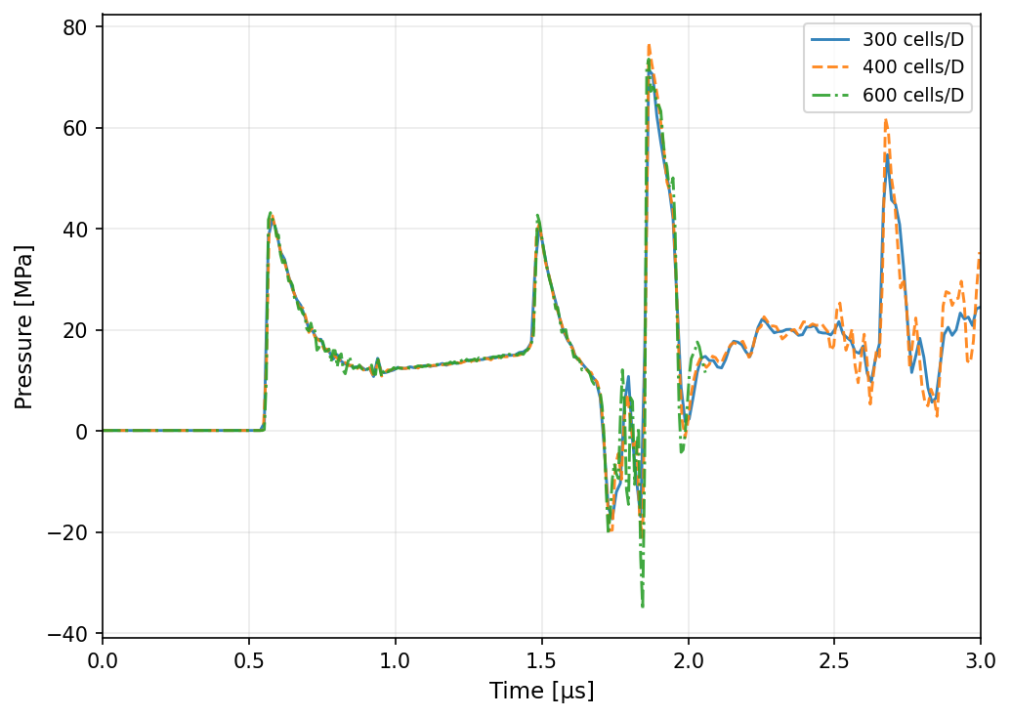
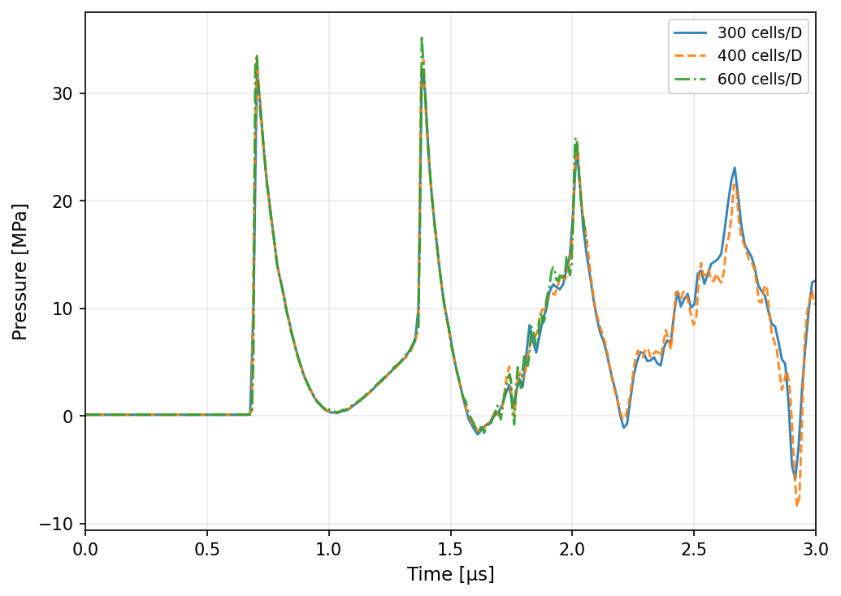




Methodology: Mesh Independence
$$(0,0)$$
$$(D_{0}/4,0)$$
Nearest-cell pressures
$$−(D_{0}/4,0)$$
$$(0,D_{0}/4)$$

Slide 31
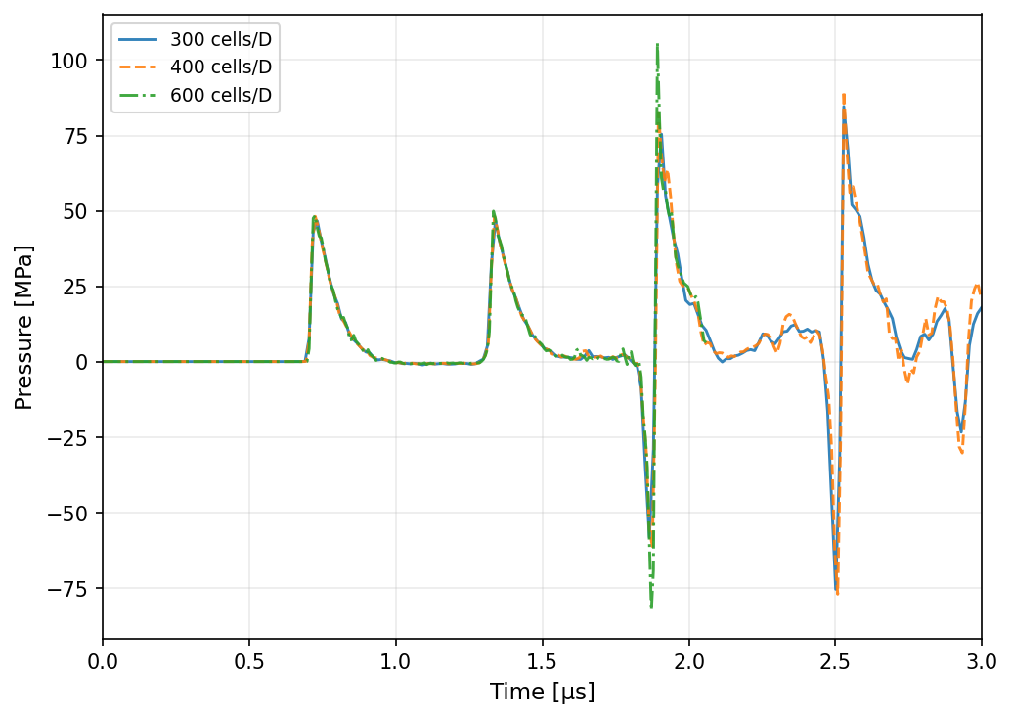








Methodology: Mesh Independence
$$(0,0)$$
$$(D_{0}/4,0)$$
Area-averaged pressures $\left(D_{avg}=D_{0}/40\right)$
$$−(D_{0}/4,0)$$
$$(0,D_{0}/4)$$

Slide 32
Methodology: Summary of Assumptions
Geometry / interface:
Axisymmetric geometry
Diffuse-interface formulation with interface sharpening
Droplet-scale surface tension neglected
Sub-grid nuclei model:
Bubbles are modeled as spherical sub-grid nuclei
Bubbles remain fixed in space; no stochastic correction
No asymmetrical collapse
Bubble-bubble interaction only through the resolved pressure field
Thermodynamic / transport simplifications
Non-condensable gas nuclei
No vapor production, mass transfer, and phase change
Polytropic bubble gas response
Neglecting viscosity in Eulerian phase

Slide 33


Clean Results: Non-dimensionalization
Shock-droplet interaction in the absence of dissolved gas nuclei.
All quantities are presented in the dimensionless time:
$$τ=\frac{t−t_{arr}}{t_{b}}$$
Where $t_{b}$ is the Ranger-Nichols aerobreakup timescale:
$$t_{b}=\frac{D}{U}\sqrt{\frac{ρ_{l}}{ρ_{g}}}$$
Define acoustic crossing time:
$$t_{c}=D/c_{w}$$
$$τ_{c}=t_{c}/t_{b}$$
Quantity | M_{s} = 3 | M_{s} = 5 | M_{s} = 7
$$p_{post} [MPa]$$ | 1.044 | 2.929 | 5.757
$$u_{post} [m s^{−1}]$$ | 772.5 | 1390.6 | 1986.5
$$t_{b} [μs]$$ | 19.27 | 9.40 | 6.31
$$t_{c}=D/c_{w} [μs]$$ | 0.615 | 0.614 | 0.613
$$τ_{c}=t_{c}/t_{b}$$ | 0.0319 | 0.0653 | 0.0971
Table: Key acoustic timescales.

Slide 34

Clean Results: Internal Wave Structure
Figure: Space-time diagram of axial centerline pressure for the three clean-baseline cases. Left: Mach 3; center: Mach 5; right: Mach 7.

Slide 35


Clean Results: Peak Pressure
Figure: Center-probe pressure history plotted against time normalized by the acoustic crossing time. Left: absolute pressure. Right: pressure normalized by case-specific post-shock pressure.

Slide 36

Clean Results: Rarefaction
Each acoustic reflection generates a rarefaction wave that propagates back into the droplet and produces tensile pressures.
Non-dimensional acoustic crossing times reveal the minimum rarefaction on the centerline occur shortly after the first expansion wave reflection
Quantity | M_{s} = 3 | M_{s} = 5 | M_{s} = 7
$$P_{cl,min} [MPa]$$ | -4.53 | -27.5 | -63.7
$$P_{cl,min}/p_{post}$$ | -4.3 | -9.4 | -11.1
$$x/D at P_{cl,min}$$ | 0.33 | 0.34 | 0.38
$$τ at P_{cl,min}$$ | 0.038 | 0.076 | 0.106
$$τ_{min}/τ_{c}$$ | 1.19 | 1.17 | 1.09
Table: Minimum centerline pressure. $P_{cl,min}$ is the global minimum over the centerline.

Slide 37

Clean Results: Rarefaction
Figure: Minimum centerline pressure along the droplet axis, minimized over $τ∈\left[0,0.45\right].$ Left: absolute minimum pressure. Right: normalized by $p_{post}$.

Slide 38


Clean Results: Blake Threshold
The Blake threshold serves as the quasi-static stability limit for nuclei.
If pressure falls well below the threshold, explosive growth is expected
For a spherical gas nucleus in mechanical equilibrium:
$$p_{BLAKE}\left(R_{0}\right)=p_{v}−\frac{4σ}{3}\sqrt{\frac{2σ}{3p_{g0}R_{0}^{3}}}$$
$$R_{0} [μm]$$ | $$p_{BLAKE} [MPa]$$ | Threshold exceed for M_{s} = 3, 5, 7
$$0.1$$ | -0.534 | Yes
0.2 | -0.257 | Yes
1 | -0.040 | Yes
2 | -0.016 | Yes
Table 4.4 Blake threshold pressure for each bubble radius studied.

Slide 39


Clean Results: Underpressure Integral
To quantify the tensile loading experienced by a nucleus, we define the normalized underpressure integral:
$$\hat{I}\left(x;p_{cav}\right)=\frac{1}{p_{post}t_{b}}\int_{0}^{τ_{end}}{\max\left(0,p_{cav}−P\left(x,τ\right)\right)dτ}$$
Concentrated in downstream half
Increases with Mach at every position
Figure: Underpressure integral at centerline over Mach = 3, 5, 7.

Slide 40


Clean Results: Early Droplet Deformation
Early-time droplet deformation:
Noticeable flattening on the windward face
Rim roll-up and lip formation
RTP mode formation
Dimple forming at the aft interface
Numerical artifact*:
Upstream-face dimple
Upstream-face dimple*
Rim roll-up
RT modes
Lip formation
Aft-interface dimple
Figure: Numerical schlieren left and numerical shadowgraph right of the early-time droplet deformation.
Windward face flattening

Slide 41


Doped Results: Spatial Selectivity of Activation
The normalized underpressure integral predicted that bubble activation should be concentrated in the downstream half of the droplet.
The simulations confirm this prediction
Consider the Mach 5, $R_{0}=0.2 μm$, $N_{b}=100$ case:
Bin the 100 bubbles by initial position
Figure: Spatial bins based on initial streamwise nucleus location, showing median and maximum bubble growth.

Slide 42


Doped Results: Spatial Selectivity of Activation
Downstream half of the droplet shows most bubble activation
Figure: Scatter plots of normalized bubble growth at Mach 5. Left: $R_{0}=0.1μm$. Right: $R_{0}=1.0μm$.

Slide 43


Doped Results: Absolute Bubble Growth
Mach number:
Strongest influence on peak bubble growth (Mach ↑, $R_{max}$ ↑)
Initial bubble radius:
Significant effect on $R_{max}/R_{0}$
~constant $R_{abs}$ for a given Mach
Bubble population:
Least effect on peak bubble growth
$N_{b}=1000$ seems to limit peak bubble growth when compared to other population sizes
Figure: Absolute maximum bubble radius in $μm$ for all doped cases.

Slide 44




Doped Results: Pressure Perturbations
The volumetric growth and collapse of the Lagrangian bubbles feeds back onto the Eulerian carrier field
$$ΔP\left(x,τ\right)=P_{doped}\left(x,τ\right)−P_{clean}\left(x,τ\right)$$
The bubble population attenuates the clean acoustic reverberations
Figure: Space-time diagram of axial centerline pressures at Mach 5. Left: Doped ($R_{0}=0.1μm, N_{b}=1000$); Center: Clean; Right: pressure difference.

Slide 45



Doped Results: Pressure Perturbations
The perturbation signal is negligible during the initial shock transmission phase
The pressure perturbation fills the entire droplet
Forms characteristic V-shaped or X-shaped diagonal bands
Figure: Space-time diagram of axial centerline pressure differences at Mach 3 at $R_{0}=1.0 μm$. Left: $N_{b}=10$; center:$N_{b}=100$; right: $N_{b}=1000$.

Slide 46


Doped Results: Pressure Perturbations
Figure: Heat maps of peak positive and negative pressure differences. Left: $ΔP_{max}$; right: $|ΔP_{min}|$.
Peaks are highly dependent on Mach number (Mach ↑, $|ΔP_{max/min}|$ ↑)
Peaks are highly dependent on bubble population ($N_{b}$ ↑, $|ΔP_{max/min}|$ ↑)

Slide 47




Doped Results: Early Droplet Deformation
Mach 3
Mach 5
Mach 7
Attenuation of acoustic reverberations
Figure: Numerical schlieren taken at doped cases with $R_{0}=1.0μm$. Each frame shows comparison of respective clean half (left) and the doped half (right). Left: Mach 3; center: Mach 5; right: Mach 7.
There is nearly no observable difference* in surface deformation at any Mach or bubble density
*Mach 7, $N_{b}=1000$, $τ=0.40$
Noticeable damping of internal acoustics in doped cases with $N_{b}=1000$

Slide 48

Doped Results: Early Droplet Deformation

Slide 49
Principal Findings
Main Conclusion: Pre-existing gas nuclei undergo strong internal activation, but this activation does not measurably alter early droplet-scale deformation over the tested parameter range, given the modeling assumptions.
This result is consistent with Cavainolo 2026 and Briggs 2025 and inconsistent with Shannon 2024.
Clean-droplet cases establish strong internal acoustic focusing
Gas nuclei are activated primarily by reflected tensile waves
Bubble growth is spatially selective
Dense populations produce acoustic attenuation and self-suppression of individual bubble growth
Despite strong local bubble dynamics and pressure perturbations, early interface deformation remains nearly unchanged

Slide 50

Contributions and Limitations
Contributions:
Isolated the purely mechanical response of pre-existing non-condensable gas
Implemented and verified coupled Eulerian–Lagrangian bubbler dynamics for shock-loaded, bubble-laden droplets
Benchmarked the Eulerian shock–water framework against shock–water-column experiments
Mapped bubble activation, pressure feedback, and deformation response across $M_{s}, R_{0}, N_{b}$
Limitations:
Vapor production, condensation, and mass transfer were excluded
Bubble nuclei were fixed in space and did not advect with the liquid
Axisymmetric assumption limits 3D instability development
Conclusions are computational and require targeted experimental validation

Slide 51
Conference Paper Submissions
Abstract Submitted: Juan P. Roldan, Brendon A. Cavainolo, Sheryl M. Grace, Michael P. Kinzel, Guillermo A. Jaramillo, “Initial Perturbation Effects on Surface Instability Wavelength Selection in High-Mach Drop Aerobreakup”, AIAA: SciTech, Jan 2027.
Abstract Submitted: Juan P. Roldan, Sutharsan Satcunanathan, Georgios Goinis “POD Airfoil Dimensionality Reduction for Compressor Cascade Optimization”, AIAA: SciTech, Jan 2027.
Manuscript Submitted: Juan P. Roldan, Brendon A. Cavainolo, Rebecca C. Shannon, Sheryl M. Grace, Michael P. Kinzel, “Effect of Entrapped Non-Condensable Gas on Shock-Driven Droplet Deformation: Implications for Hypersonic Rain Environments”, AIAA: International Space Planes and Hypersonic Systems and Technologies Conference, July 2026.
Eric M. Yoerg, Juan P. Roldan, Donald Tuten, Michael Potash, Rui Harrison, Kassandra J. Durst, Michael P. Kinzel, Surabhi Singh “Development of an Exploding Wire Facility to Study Shock Propagation at Embry-Riddle Aeronautical University”, AIAA: SciTech, Jan 2025.

Slide 52
Future Work
Model extensions:
Add rate-limited phase-change models
Implement the missing θ-direction stochastic correction
Allow nuclei to advect with the liquid
Extend simulations beyond early-time axisymmetric regime
Extend nuclei modeling to solid/particulate inclusions and heterogeneous cavitation sites
Experimental direction:
Perform companion experiments with controlled nuclei populations
Broader research path:
Couple shock-droplet breakup predictions to rain-erosion / surface-damage models
Extend the framework to propulsion-relevant droplets breakup

Slide 53
Brendon A. Cavainolo¹, Rebecca Shannon², Sheryl M. Grace², and Michael P. Kinzel¹ ¹Department of Aerospace Engineering, Embry-Riddle Aeronautical University, Daytona Beach, FL, USA ²Department of Mechanical Engineering, Boston University, Boston, MA, USA This work was partially supported by the Air Force Office of Scientific Research under award number FA9550-22-1-0021. DoD HPCMP and ERAU VEGA HPC use.
Acknowledgements

