Slide 1
CFD-Informed Linear-to-Nonlinear Instability Growth in High-Mach-Number Drop Aerobreakup
Juan P. Roldan
Dr. Guillermo Jaramillo
IMPETUS INDOMITUS
Final Project Presentation
Hydrodynamic Instabilities – 780125
July 2nd 2026

Slide 2
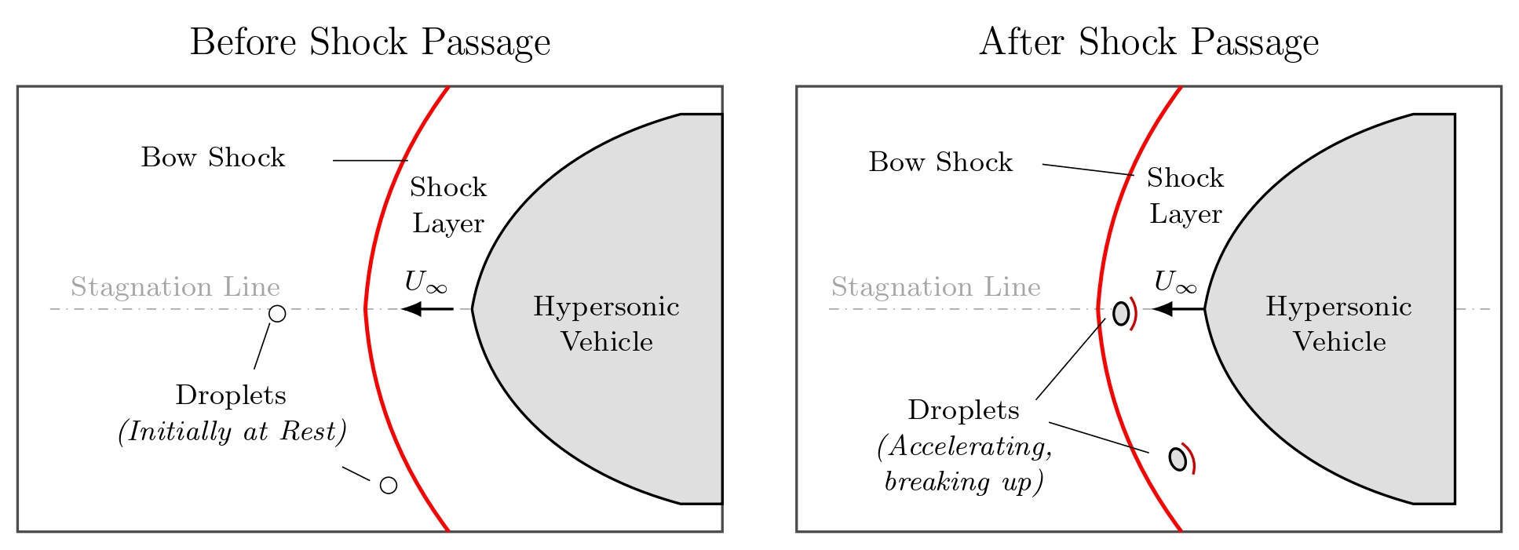
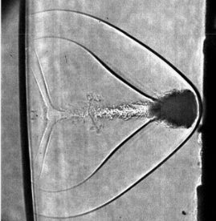
Motivation – Rain Erosion
Hypersonic glide vehicles encounter atmospheric hydrometeors during terminal descent at 0–7 km
Micron cloud droplets to millimeter raindrops
Cumulative droplet impacts roughen the surface → early boundary-layer transition → heating/drag/control-authority penalties
These margins are already thin in air-breathing systems
Dworzanczyk 2025
Figure: Schematic of atmospheric droplets interacting with the bow shock of a hypersonic vehicle before and after shock passage. Adapted from Aguilera 2023.

Slide 3
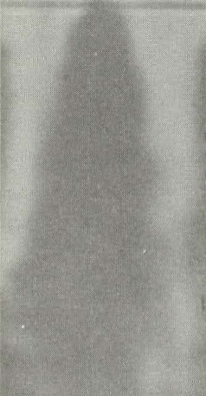
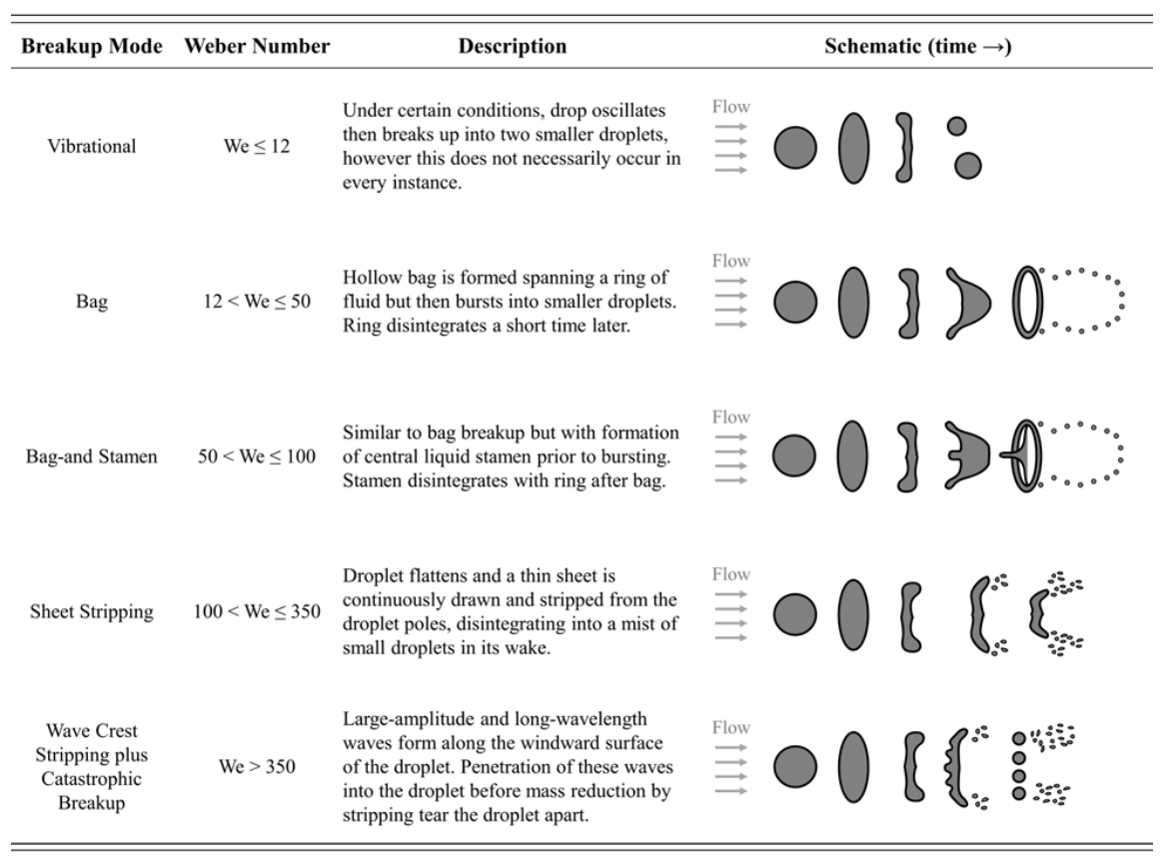
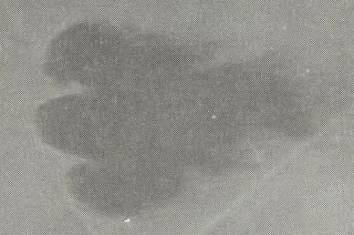
Introduction – Breakup Modes
Droplet breakup is commonly organized by the aerodynamic Weber number: $We_{A}=\frac{ρ_{g}U_{A}^{2}d_{d}}{σ}$
Figure: Droplet, Mach 3 (Reinecke-McKay 1969)
Figure: Breakup modes of water droplets observed experimentally (Aguilera 2023).
Figure: Droplet, Mach 11 (Reinecke-McKay 1969)

Slide 4
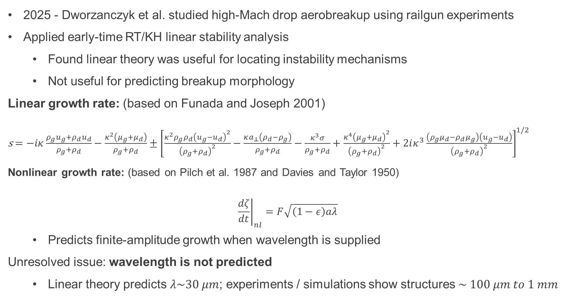
Literature: Linear-to-Nonlinear Instability Growth
2025 - Dworzanczyk et al. studied high-Mach drop aerobreakup using railgun experiments
Applied early-time RT/KH linear stability analysis
Found linear theory was useful for locating instability mechanisms
Not useful for predicting breakup morphology
Linear growth rate: (based on Funada and Joseph 2001)
s $=−iκ\frac{ρ_{g}u_{g}+ρ_{d}u_{d}}{ρ_{g}+ρ_{d}}−\frac{κ^{2}\left(μ_{g}+μ_{d}\right)}{ρ_{g}+ρ_{d}}±{\left[\frac{κ^{2}ρ_{g}ρ_{d}{\left(u_{g}−u_{d}\right)}^{2}}{{\left(ρ_{g}+ρ_{d}\right)}^{2}}−\frac{κa_{⊥}\left(ρ_{d}−ρ_{g}\right)}{ρ_{g}+ρ_{d}}−\frac{κ^{3}σ}{ρ_{g}+ρ_{d}}+\frac{κ^{4}{\left(μ_{g}+μ_{d}\right)}^{2}}{{\left(ρ_{g}+ρ_{d}\right)}^{2}}+2iκ^{3}\frac{\left(ρ_{g}μ_{d}−ρ_{d}μ_{g}\right)\left(u_{g}−u_{d}\right)}{{\left(ρ_{g}+ρ_{d}\right)}^{2}}\right]}^{1/2}$
Nonlinear growth rate: (based on Pilch et al. 1987 and Davies and Taylor 1950)
$${\left.\frac{dζ}{dt}\right|}_{nl}=F\sqrt{\left(1−ε\right)aλ}$$
Predicts finite-amplitude growth when wavelength is supplied
Unresolved issue: wavelength is not predicted
Linear theory predicts $λ\sim 30 μm$; experiments / simulations show structures $\sim 100 μm to 1 mm$

Slide 5
Problem Statement
Can CFD-informed inputs improve the prediction of the linear-to-nonlinear framework proposed by Dworzanczyk et al.?
Use extracted base states from computational simulations to update growth-rate maps, assess other linear mechanisms, and identify simulation requirements needed for future work.
Objectives:
Summarize the linear-to-nonlinear framework
Construct CFD-informed growth-rate maps
Assess wavelength-selection candidates systematically
Diagnose the structural limitation of the simulations

Slide 6

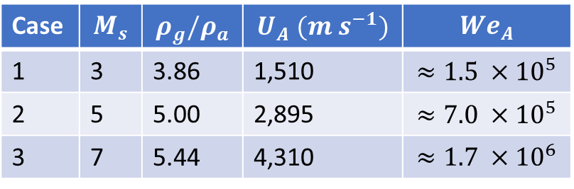
Methodology: Simulation Matrix
Parameter space: 1mm droplet, $M_{s}∈\left\{3, 5, 7\right\}$
All We are well above those for the classical breakup mechanisms
Instability analysis:
At each stored time step:
Extract $ρ_{g}, u_{g}, u_{d},$ and $a_{⊥},$ all $f=f(φ,t)$
Evaluate $s_{r}(κ;φ,t)$ and identify most-amplified wavenumber $κ^{∗}(φ,t)$
Case | $$M_{s}$$ | $$ρ_{g}/ρ_{a}$$ | $$U_{A} (m s^{−1})$$ | $$We_{A}$$
1 | 3 | 3.86 | 1,510 | $$≈1.5 ×{10}^{5}$$
2 | 5 | 5.00 | 2,895 | $$≈7.0 ×{10}^{5}$$
3 | 7 | 5.44 | 4,310 | $$≈1.7 ×{10}^{6}$$
Table: Shock-droplet simulation matrix. Post-shock values from Rankine-Hugoniot relations; $We_{A}$ based on post-shock gas conditions and initial drop diameter.

Slide 7
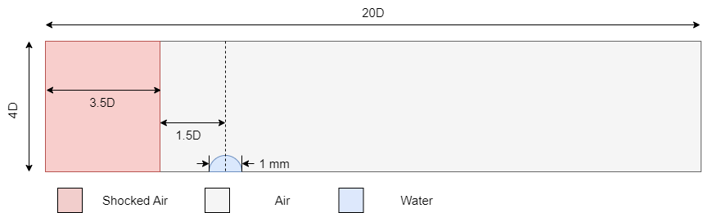



Methodology: Computational Setup
All simulations are performed in cylindrical coordinates $(x,r)$ under an axisymmetric assumption.
Boundary conditions:
The bottom boundary is an axis of symmetry
All other boundaries are non-reflecting boundaries
Initial conditions:
Shocked air set by Rankine-Hugoniot jump conditions into quiescent, ambient air
$$r$$
$$x$$
Figure: Computational domain, normalized by droplet diameter, D.

Slide 8
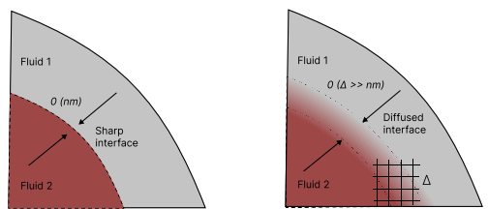

Methodology: The Numerical Model
The present simulations are performed in the Multi-Component Flow Code (MFC)
Open-source, high-order, compressible multiphase solver, highly parallel
Resolved Eulerian phase interface:
Reduced five-equation diffuse-interface formulation of Allaire et al. 2002.
$$\frac{∂(α_{i}ρ_{i})}{∂t}+∇∙\left(α_{i}ρ_{i}u\right)=0, i=1, 2, …N$$
$$\frac{∂(ρu)}{∂t}+∇∙\left(ρu⊗u+pI\right)=0$$
$$\frac{∂(ρE)}{∂t}+∇∙\left[\left(ρE+p\right)u\right]=0$$
$$\frac{∂α_{i}}{∂t}+u∙∇α_{i}=K∇∙u$$
Figure: Sharp and diffuse interface of a multiphase flow (Adebayo 2025).

Slide 9

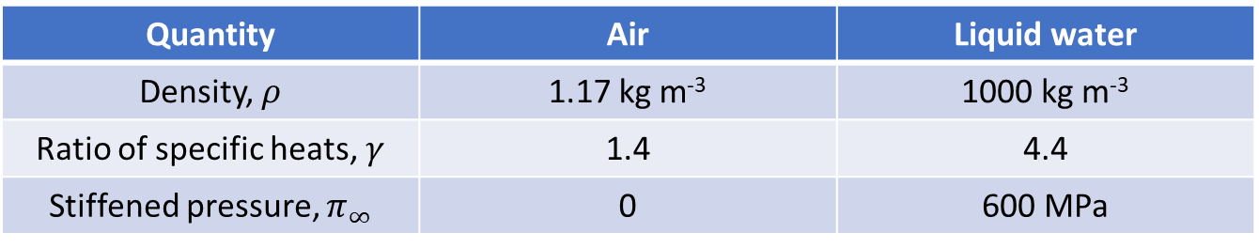
Methodology: The Numerical Model
Each material is closed with a stiffened-gas equation of state
$$p_{i}=\left(γ_{i}−1\right)ρ_{i}e_{i}−γ_{i}π_{∞,i}$$
The material properties are listed below:
Viscous stresses and surface tension are neglected in the resolved Eulerian equations.
Quantity | Air | Liquid water
Density, $ρ$ | 1.17 kg m⁻³ | 1000 kg m⁻³
Ratio of specific heats, $γ$ | 1.4 | 4.4
Stiffened pressure, $π_{∞}$ | 0 | 600 MPa
Table: Equation-of-state and material parameters used in the shock-droplet simulations.

Slide 10
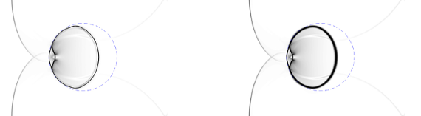
Methodology: Numerical Methods
The Eulerian equations are discretized on a structured grid using a finite-volume formulation.
A constant CFL value of 0.1 is used in all simulations.
Numerical Component | Method Used
Face reconstruction | 2nd order MUSCL + van Leer limiter
Interface treatment | THINC interface sharpening
Riemann Solver | HLLC
Time-integration | SSP-RK3 (TVD)
Table 3.2 Summary of numerical methods used for the Eulerian flow solver and sub-grid bubble dynamics.
Figure: Numerical results for a planar Mach onto a gas bubble. With THINC (left) and without THINC (right) are both shown (Shyue-Xiao 2014).

Slide 11
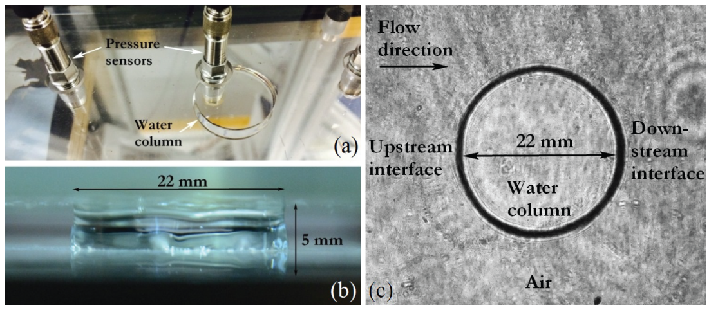
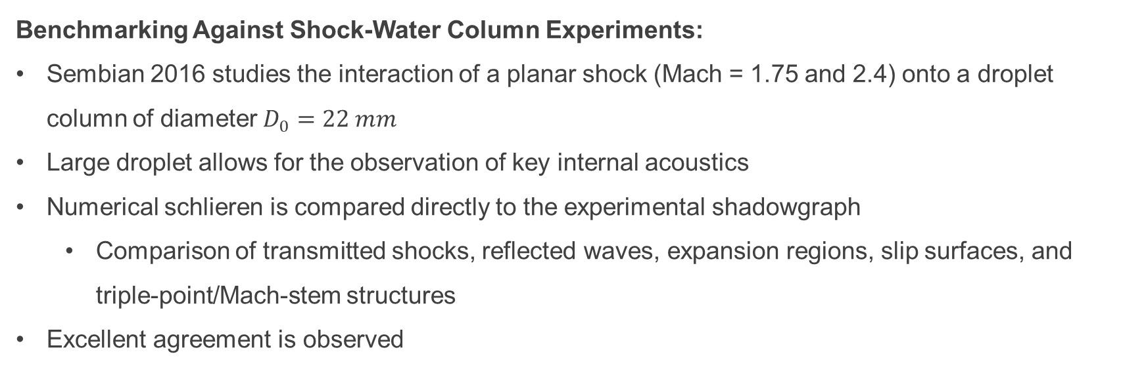
Methodology: Benchmarking
Benchmarking Against Shock-Water Column Experiments:
Sembian 2016 studies the interaction of a planar shock (Mach = 1.75 and 2.4) onto a droplet column of diameter $D_{0}=22 mm$
Large droplet allows for the observation of key internal acoustics
Numerical schlieren is compared directly to the experimental shadowgraph
Comparison of transmitted shocks, reflected waves, expansion regions, slip surfaces, and triple-point/Mach-stem structures
Excellent agreement is observed
Figure: 22mm water column of Sembian 2016.

Slide 12
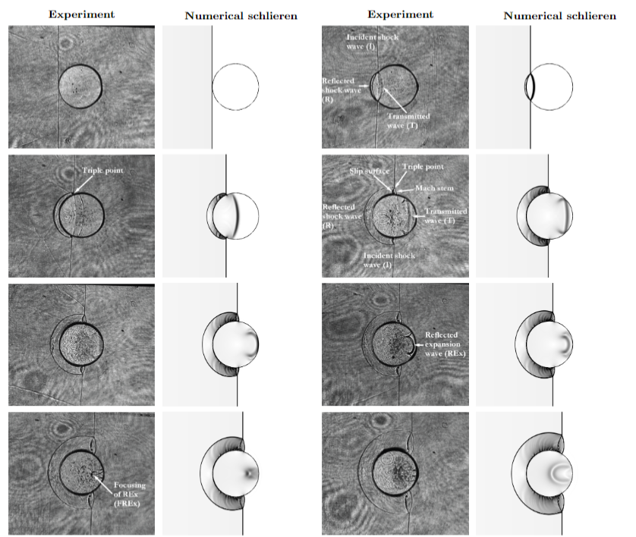
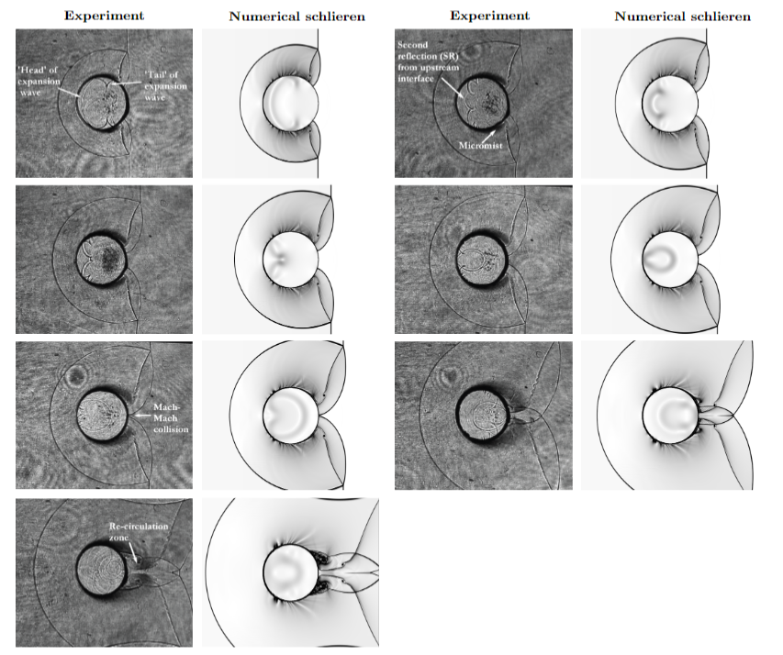
Methodology: Validation / Benchmarking
Benchmarking Against Shock-Water Column Experiments:
Transmitted shock
Secondary Reflection
Reflected expansion waves (REx)
Mach-Mach collision
REx Focusing
Re-circulation zone
Figure: Comparison between experimental shadowgraph images from the Mach 2.4 shock-water-column experiment of Sembian et al. and numerical schlieren fields from the MFC simulation.

Slide 13
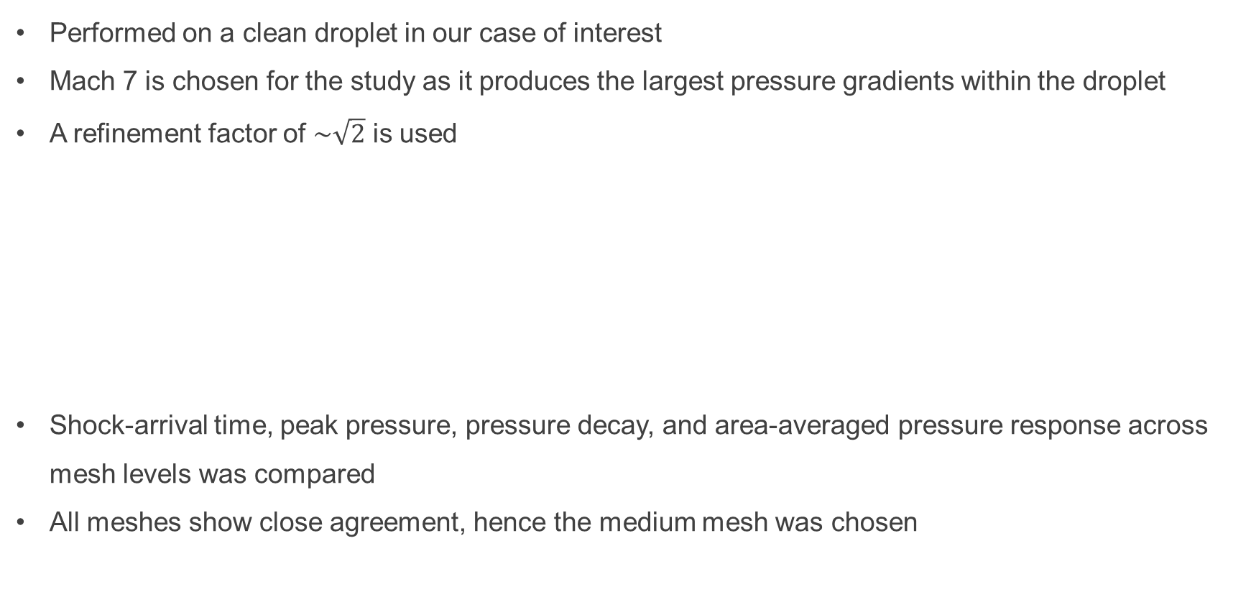
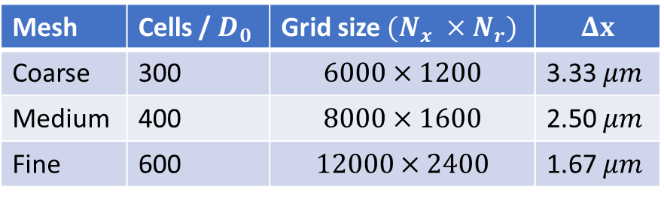
Methodology: Mesh Independence
Performed on a clean droplet in our case of interest
Mach 7 is chosen for the study as it produces the largest pressure gradients within the droplet
A refinement factor of $\sim \sqrt{2}$ is used
Shock-arrival time, peak pressure, pressure decay, and area-averaged pressure response across mesh levels was compared
All meshes show close agreement, hence the medium mesh was chosen
Mesh | Cells / $D_{0}$ | Grid size $(N_{x} ×N_{r})$ | $$Δx$$
Coarse | 300 | $$6000×1200$$ | 3.33 $μm$
Medium | 400 | $$8000×1600$$ | 2.50 $μm$
Fine | 600 | $$12000×2400$$ | 1.67 $μm$
Table: Mesh levels used in the shock-droplet mesh-independence study.

Slide 14
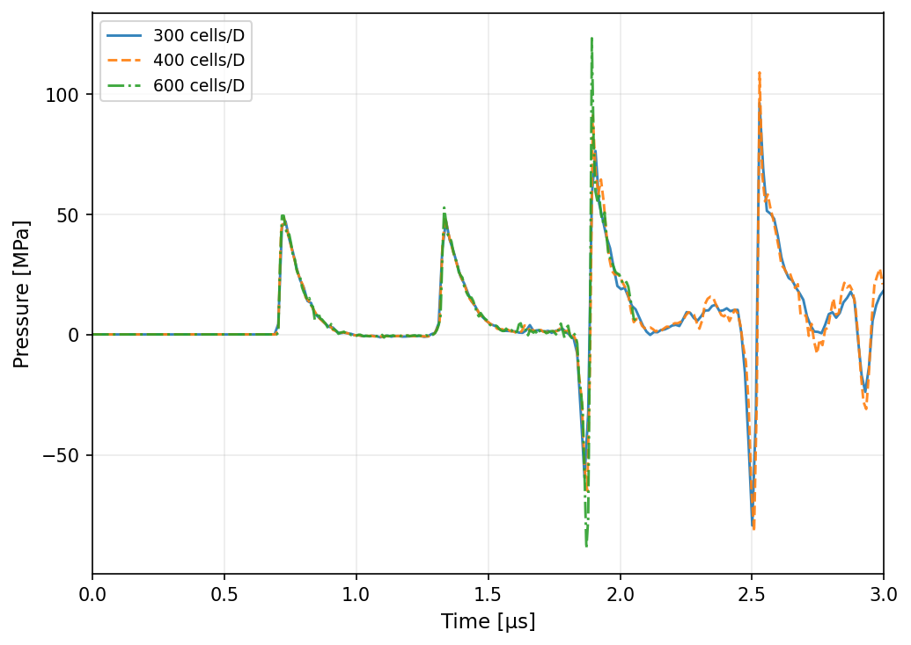
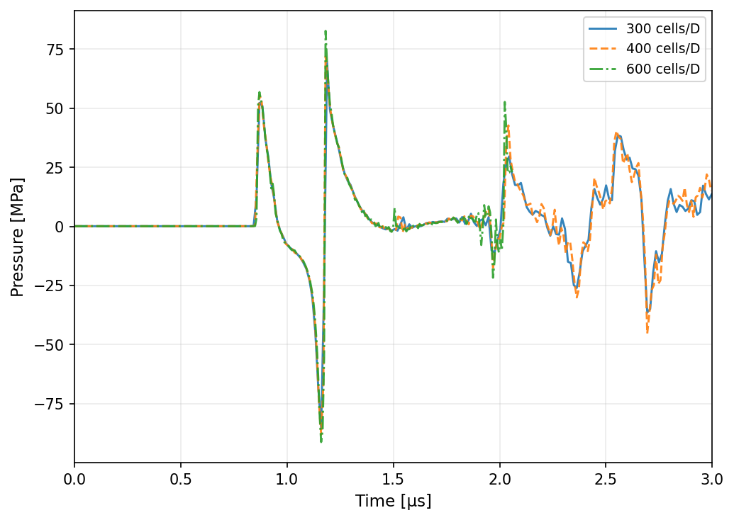
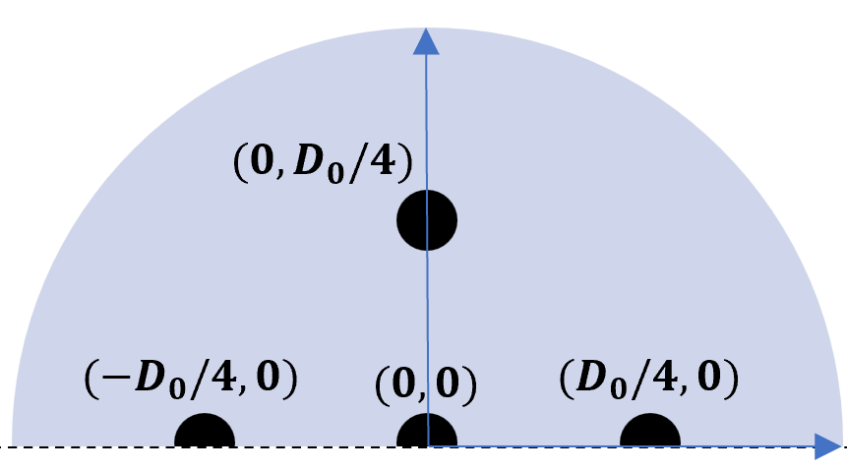
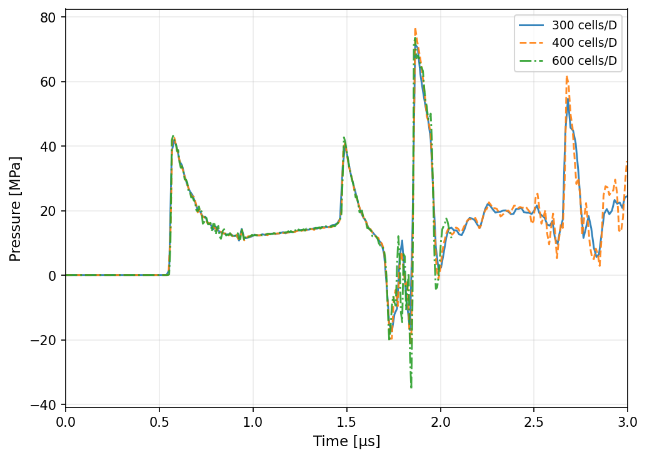
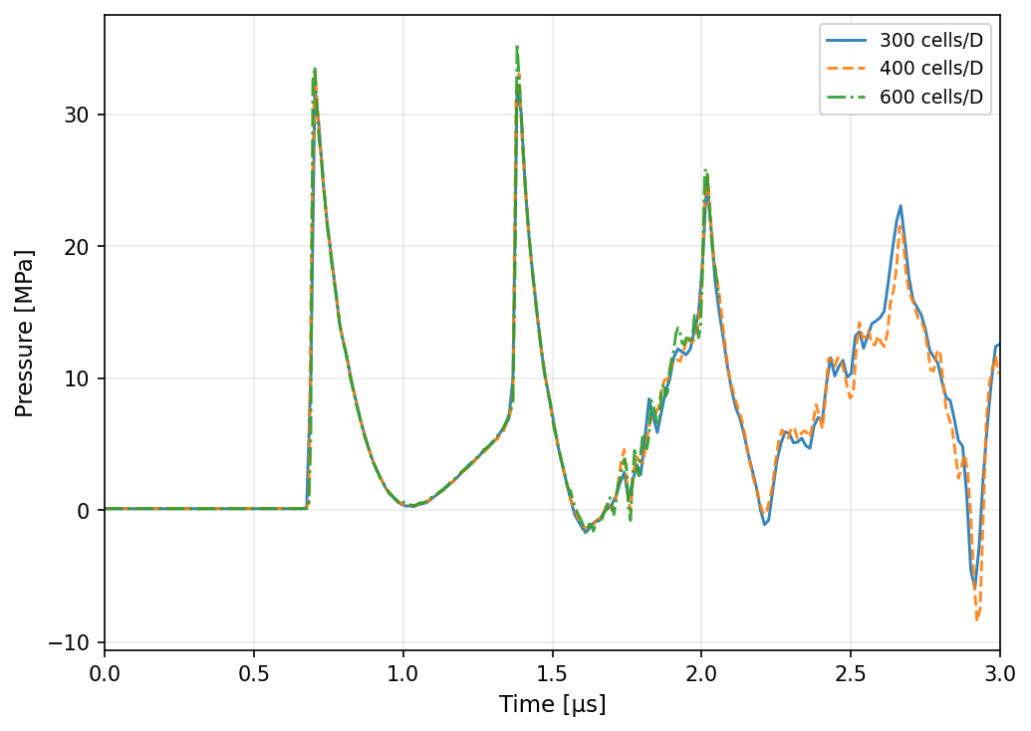




Methodology: Mesh Independence
$$(0,0)$$
$$(D_{0}/4,0)$$
Nearest-cell pressures
$$−(D_{0}/4,0)$$
$$(0,D_{0}/4)$$

Slide 15
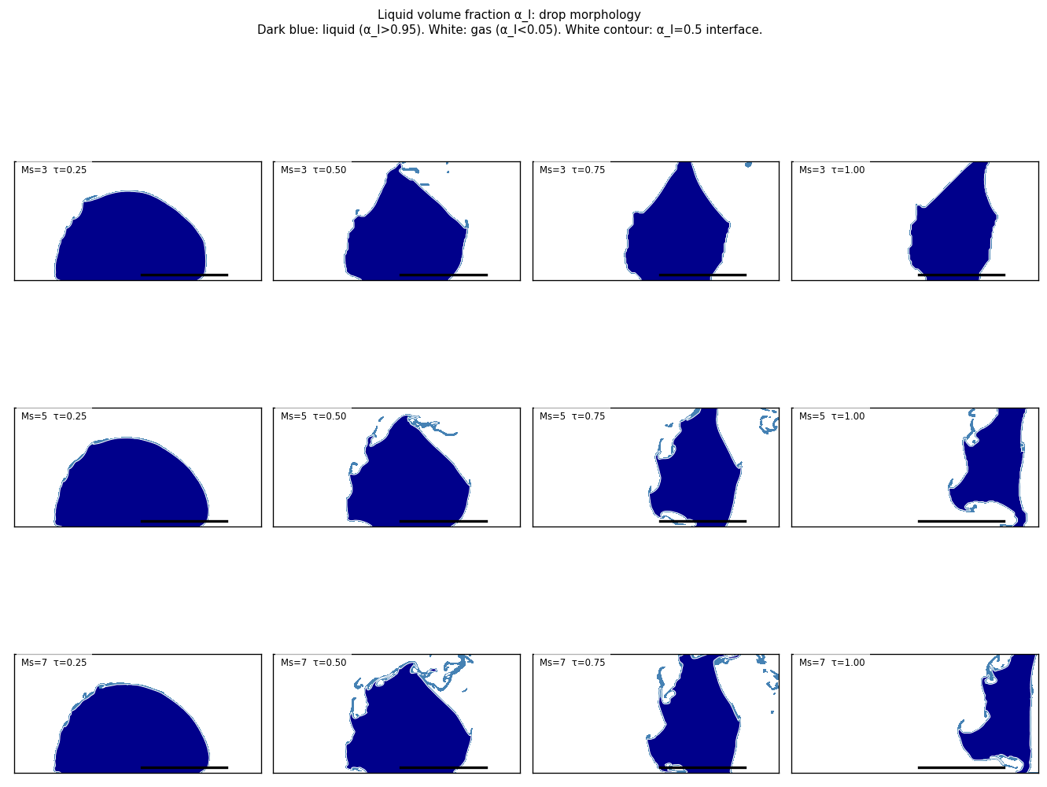
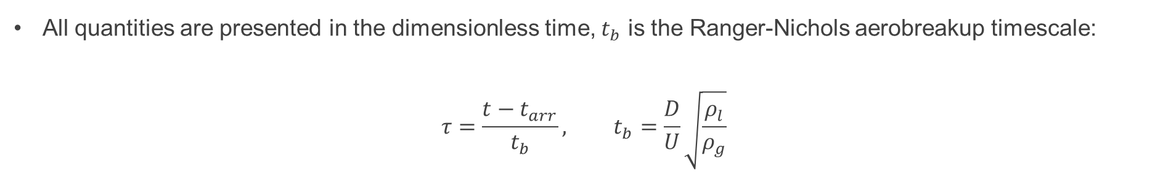
Results: Droplet Morphology
Figure: Liquid volume fraction for $M_{s}=3$ (top), 5 (middle), 7 (bottom) at $τ=0.25, 0.5, 0.75, and 1.00$.
All quantities are presented in the dimensionless time, $t_{b}$ is the Ranger-Nichols aerobreakup timescale:
$$τ=\frac{t−t_{arr}}{t_{b}}, t_{b}=\frac{D}{U}\sqrt{\frac{ρ_{l}}{ρ_{g}}}$$

Slide 16
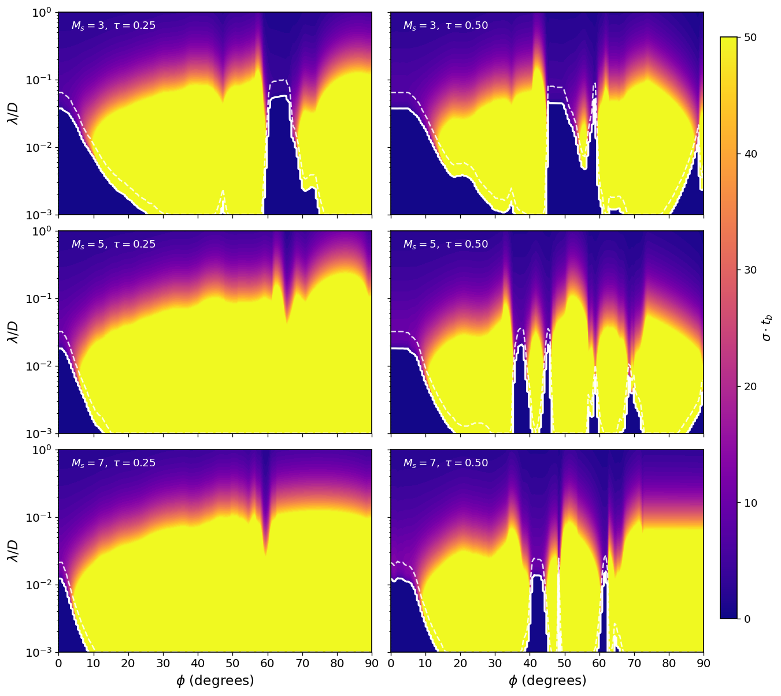
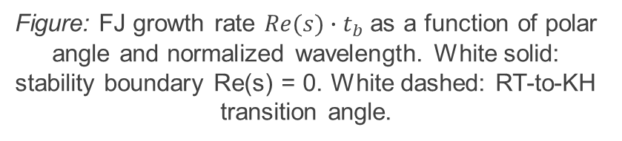
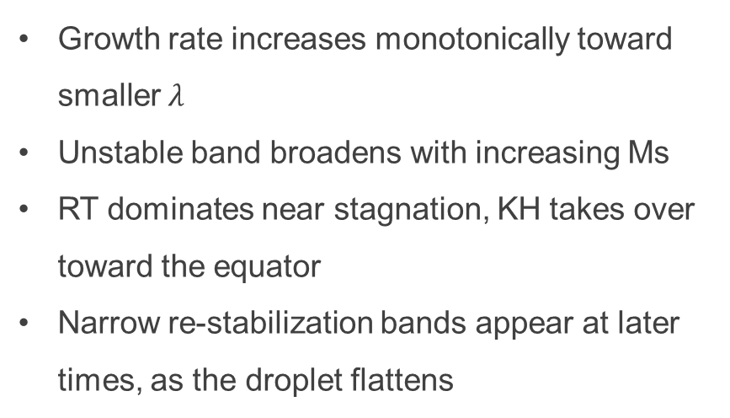
Results: CFD-Informed Growth-Rate Maps
Growth rate increases monotonically toward smaller $λ$
Unstable band broadens with increasing Ms
RT dominates near stagnation, KH takes over toward the equator
Narrow re-stabilization bands appear at later times, as the droplet flattens
Figure: FJ growth rate $Re(s)∙t_{b}$ as a function of polar angle and normalized wavelength. White solid: stability boundary Re(s) = 0. White dashed: RT-to-KH transition angle.

Slide 17
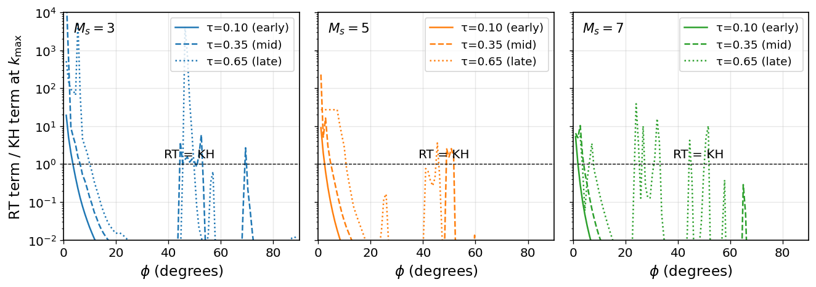
Results: RT to KH Transition
Figure: Ratio of RT acceleration terms to KH shear term evaluated at $κ^{∗}$.
At early times, KH shear dominates over most of the front face
As the droplet flattens over time, RT can dominate over more of the drop surface
KH appears to dominate at higher Machs (likely wrong)

Slide 18
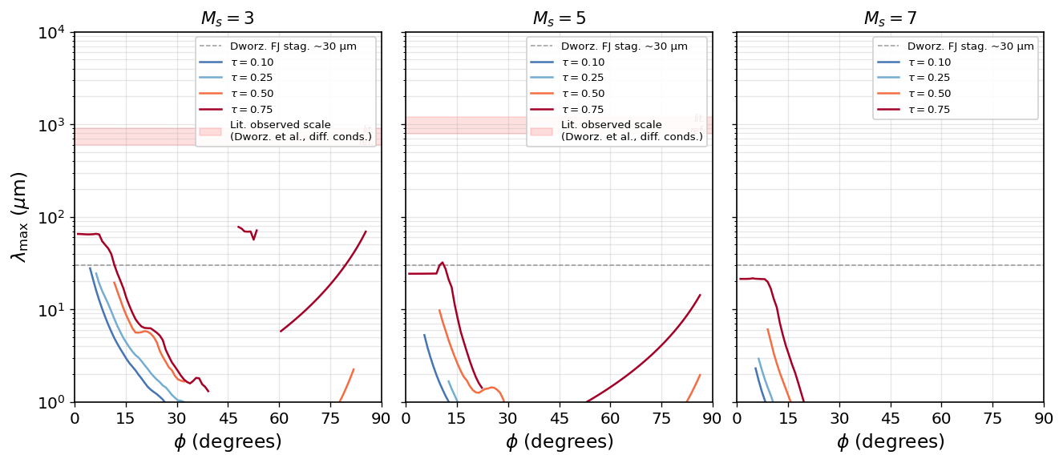
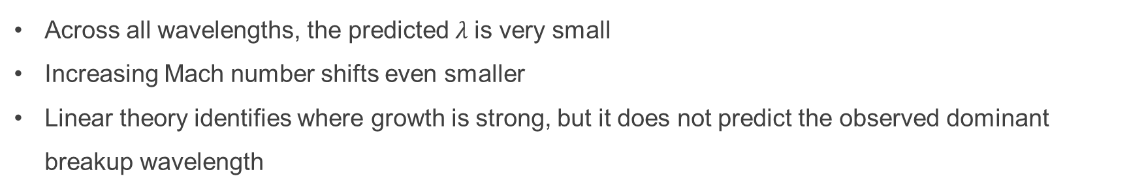
Results: Most-Amplified Wavelength
Figure: Most amplified wavelength $λ^{∗}$ from the FJ dispersion relation.
Across all wavelengths, the predicted $λ$is very small
Increasing Mach number shifts even smaller
Linear theory identifies where growth is strong, but it does not predict the observed dominant breakup wavelength

Slide 19
Discussion: Role of Surface Tension
At large observed structures, surface tension is weak
At small linear instabilities, surface tension strongly damps high-k modes
Although viscosity and surface tension are negligible at the observed wavelength, they may be needed to create the finite linear peak
Without surface tension, the simulation has no physical high-k cutoff
Re(s) increases toward smaller wavelengths
No physical most-amplified wavelength can emerge from the CFD
Finite surface textures likely tied to grid effects

Slide 20
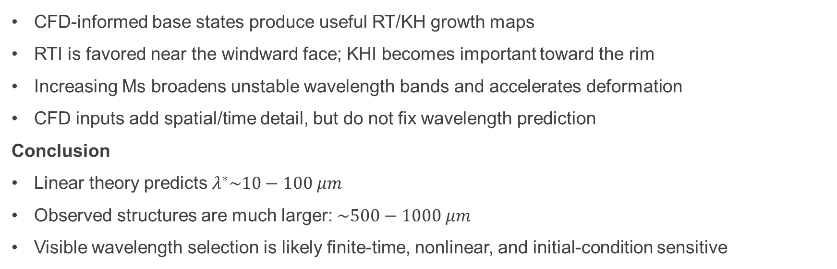
Summary of Findings
CFD-informed base states produce useful RT/KH growth maps
RTI is favored near the windward face; KHI becomes important toward the rim
Increasing Ms broadens unstable wavelength bands and accelerates deformation
CFD inputs add spatial/time detail, but do not fix wavelength prediction
Conclusion
Linear theory predicts $λ^{∗}\sim 10−100 μm$
Observed structures are much larger: $\sim 500−1000 μm$
Visible wavelength selection is likely finite-time, nonlinear, and initial-condition sensitive

Slide 21
Future Work
Run 3D simulations with physical surface tension (and viscosity)
Prescribe controlled single-mode perturbations
Measure transition time and nonlinear growth rate directly
Compare to experimental images more closely
Test mesh effects (resolution, cylindrical vs. Cartesian)
Sharp vs. diffuse interface

