Slide 1
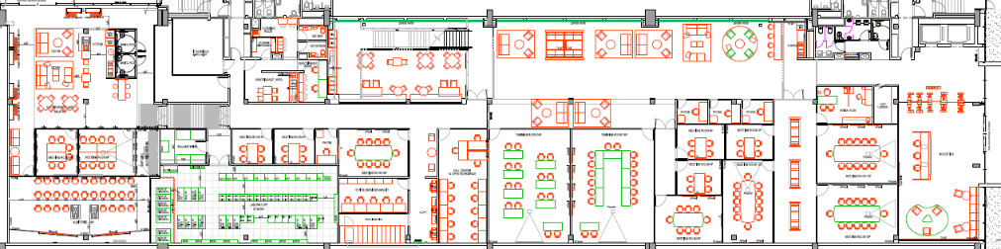
Prédio 19 - Térreo
NOKIA EDU
Serv. Point
WGC

Slide 2
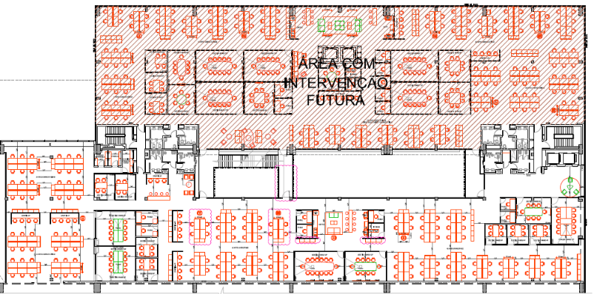
Prédio 19
1º andar
DELIVERY
GOPS
HR
HSSE
-Security
IT
WR

Slide 3
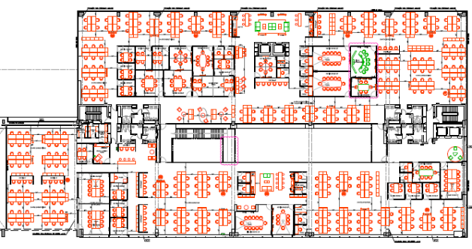
Prédio 19
2º andar
Brazil HUB GEPS
LOGISTICS
LOCOP
SOUTH
OI
MN PPS LAT
VIVO
TIM
MCA
CLARO
FINANCE
FISCAL
Controladoria
GOPS
A&A
DELIVERY
MANAGEMENT
HR
CFO LAT
Compl.
Legal
-Strategy
HoR
04

