Slide 1


GenomeFltr Server

Slide 2
Background
Most of our projects are data analysis
Research include other types of projects:
Development of new methods
Data gathering
Development of servers and packages

Slide 3
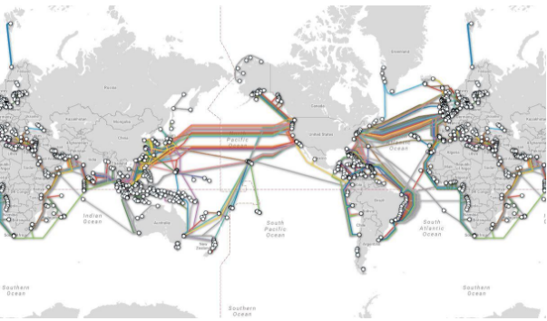
Internet

Slide 4
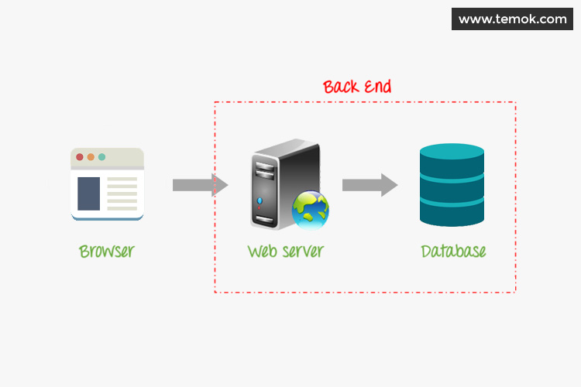
Server Architecture

Slide 5
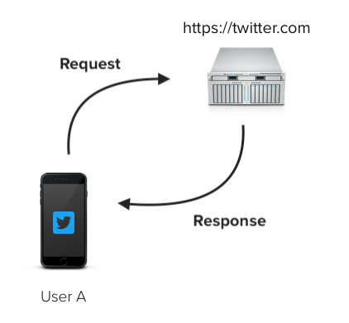
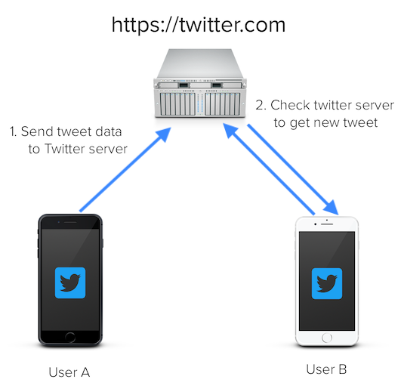
Server Architecture

Slide 6
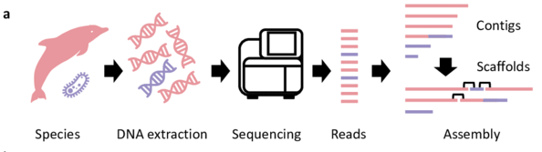
The Problem

Slide 7
The Solution
filter the contamination reads

Slide 8
The Solution
A simple webserver:
No downloading
No hardware requirements
No special skills
No DB updating
User pipeline:
Upload file
Analysis results
Download uncontaminated reads

Slide 9
Webserver Implementation
frontend (client)
Elya
HTML, JavaScript
Response
API
Request
backend
Edo
Python
Listener
Create Jobs
processes
Python, Bash
Michael

Slide 10
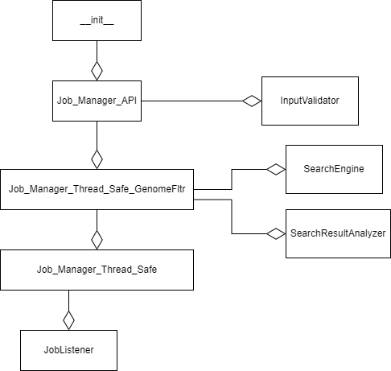
Webserver Implementation

Slide 11
Webserver Implementation: __init__
Route API requests to backend
Verify

