Slide 1


GenomeFltr Server

Slide 2
Background
Types of academic projects :
New protocols
Data analysis
New methods
Packages
Webservers
Etc.

Slide 3
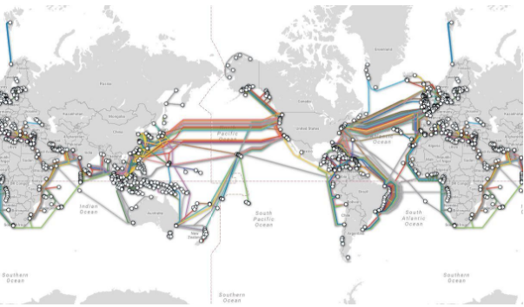
Internet

Slide 4
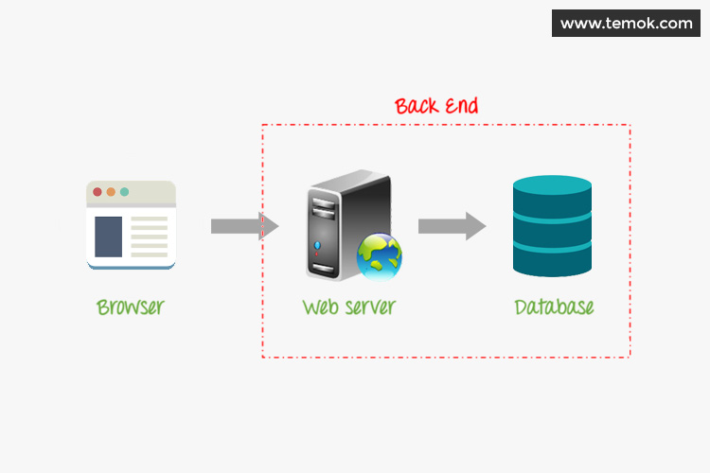
Server Architecture

Slide 5
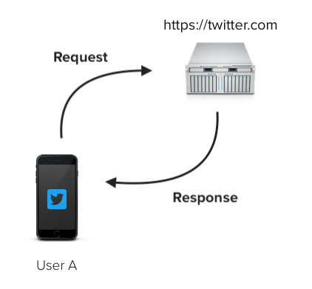
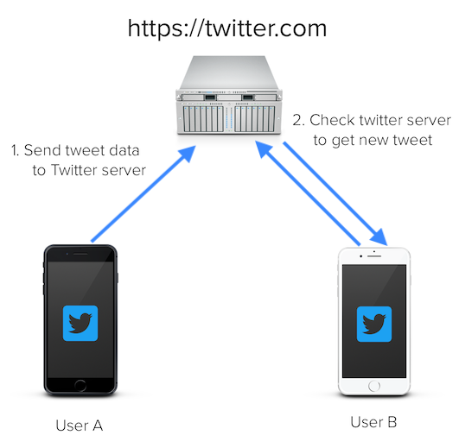
Server Architecture

Slide 6
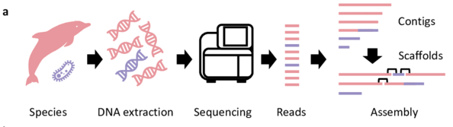
The Problem

Slide 7
The Solution
filter the contamination reads

Slide 8
The Solution
A simple webserver:
No downloading
No hardware requirements
No special skills
No DB updating
User pipeline:
Upload file
Analysis results
Download uncontaminated reads

Slide 9
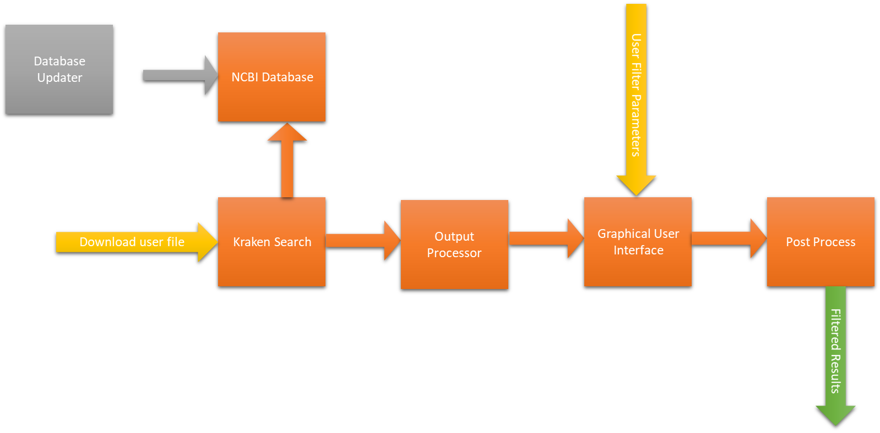
Webserver workflow

Slide 10
Webserver Implementation
frontend (client)
Elya
HTML, JavaScript
Response
API
Request
backend
Edo
Python
Listener
Create Jobs
processes
Python, Bash
Michael

Slide 11
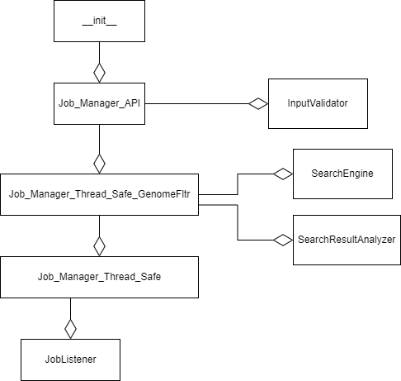
Webserver Implementation
Webserver specific
Generic Code

Slide 12
Generic Code
What do I get when using this implementation?
Processes manager
PBS listener (update process state)
Processes waiting list
Server state saved between shutdowns
Support different types of processes!

Slide 13
Specific Code
So, what should I implement myself?
The process itself
UI
Endpoints (what should happen when user does something?)

Slide 14
Switch to Notepad

Slide 15
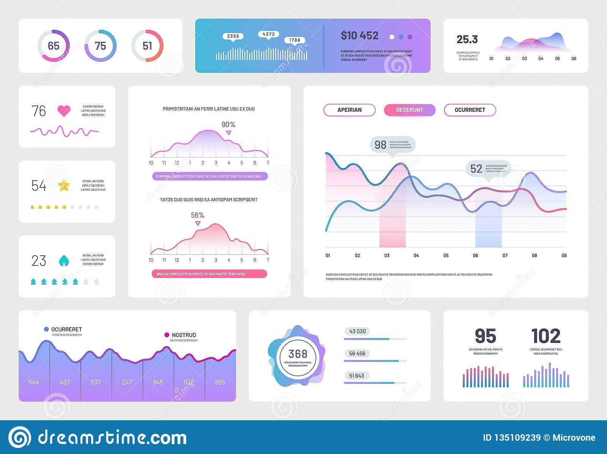
Interactive GUI (Graphical User Interface)
We wanted to build an interactive page
Users can analysis and see the filtration change

Slide 16
But how can we display data of millions of reads?
And make it interactive?
Options 1 – use API requests to analysis the data at the backend
Options 2 – summarize the data to a small matric and load it in the client side

Slide 17
The Matrix
Reads Similarity | Species 1 | Species 2 | Species 3 | …
0.00 | 0 | 0 | 0 | …
0.01 | 0 | 0 | 0 | …
0.02 | 0 | 0 | 2 | …
0.03 | 10 | 8 | 5 | …
0.04 | 8 | 10 | 0 | …
0.05 | 0 | 15 | 17 | …
… | … | … | … | …

Slide 18
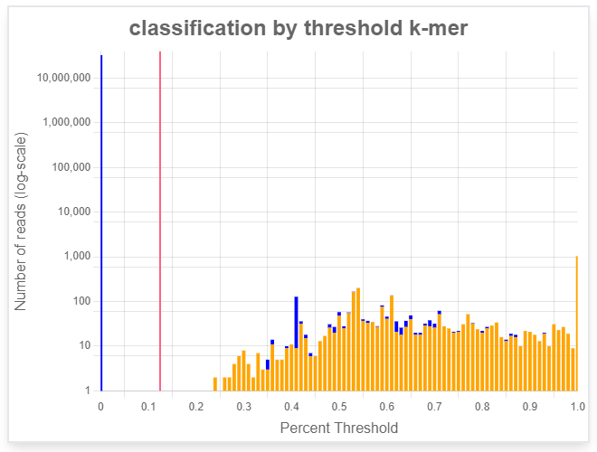
Graph 1
Histogram of reads’ similarly to DB
Tap to change threshold
Row sums are the histograms values
Reads Similarity | Species 1 | Species 2 | Species 3 | …
0.00 | 0 | 0 | 0 | …
0.01 | 0 | 0 | 0 | …
0.02 | 0 | 0 | 2 | …
0.03 | 10 | 8 | 5 | …
0.04 | 8 | 10 | 0 | …
0.05 | 0 | 15 | 17 | …
… | … | … | … | …

Slide 19
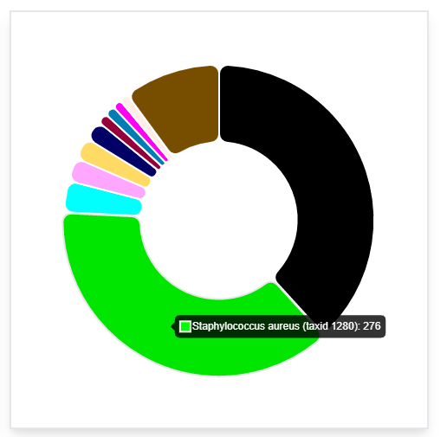
Graph 2
Distribution of reads by taxonomy id
Choose species to filter
Columns sums are the pie-chart values
Reads Similarity | Species 1 | Species 2 | Species 3 | …
0.00 | 0 | 0 | 0 | …
0.01 | 0 | 0 | 0 | …
0.02 | 0 | 0 | 2 | …
0.03 | 10 | 8 | 5 | …
0.04 | 8 | 10 | 0 | …
0.05 | 0 | 15 | 17 | …
… | … | … | … | …

Slide 20


Switch to Interactive Page

Slide 21
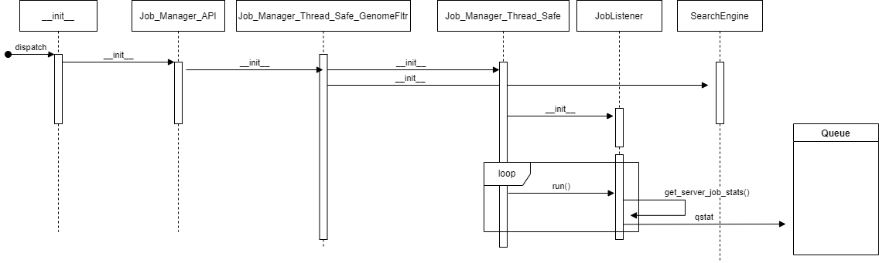
Init Flow

Slide 22
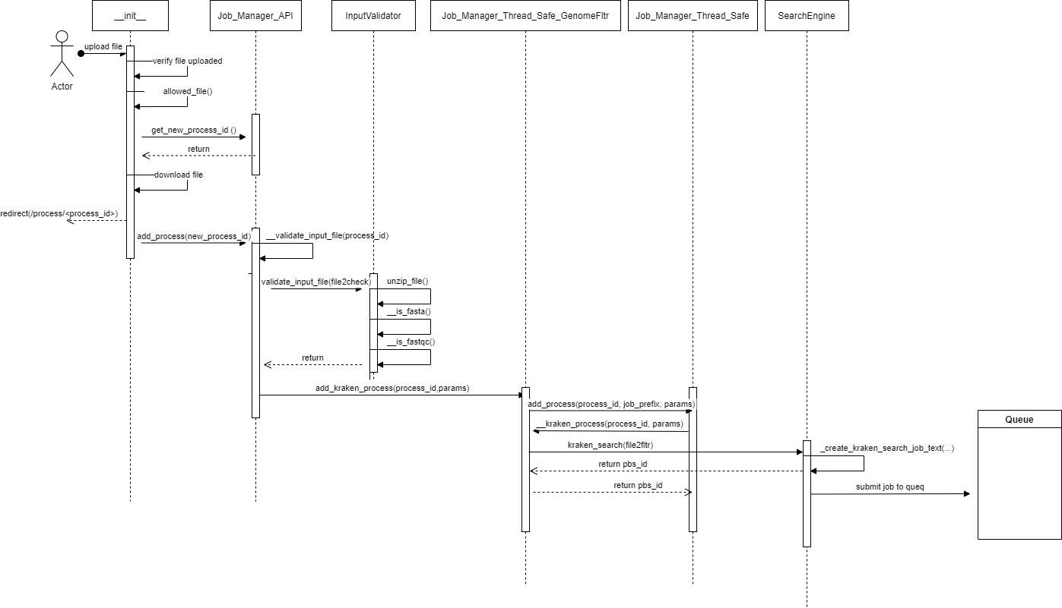
Upload File Flow

Slide 23
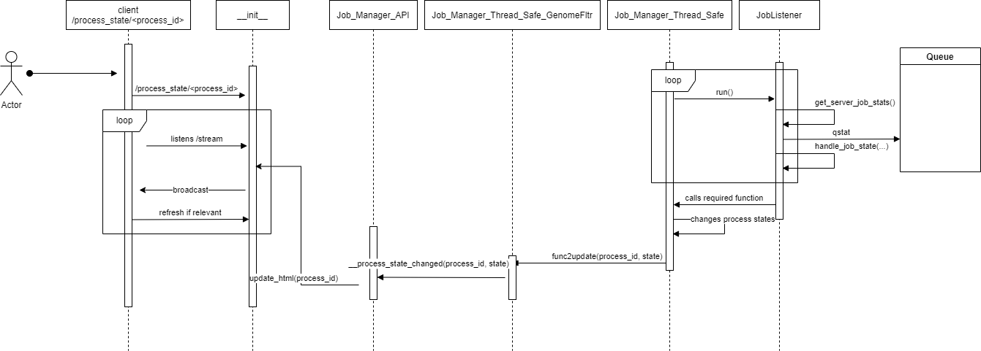
Job State Update Flow

Slide 24
Switch to Design Document

Slide 25
Webserver Implementation: __init__
Route API requests to backend
Verify

