Slide 1

Day-Ahead Renewable Energy Forecasting
Reducing Penalty Costs in German Energy Auctions
Juan Fernandez – 10/11/2025

Slide 2
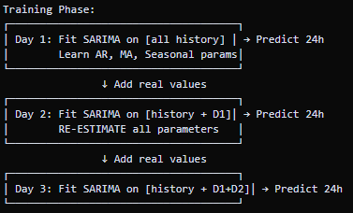
Business Problem & Current Situation
Client Challenge:
- Owns renewable capacity in Germany
- Must nominate hourly production for next day (12:00 CET deadline)
- Penalty: EUR 50 per MWh prediction error
Current Approach: Naive Baseline
- Assumes tomorrow = yesterday
- Simple but suboptimal
Objective:
Build forecasting model to reduce penalty costs
SARIMA is modeling how the time series evolves, not learning a static input-output mapping!
Learns autocorrelations, moving averages, seasonal patterns
Retrains completely each iteration
Day-ahead auction: Grid operators require 24-hour production nominations to balance supply and demand

Slide 3
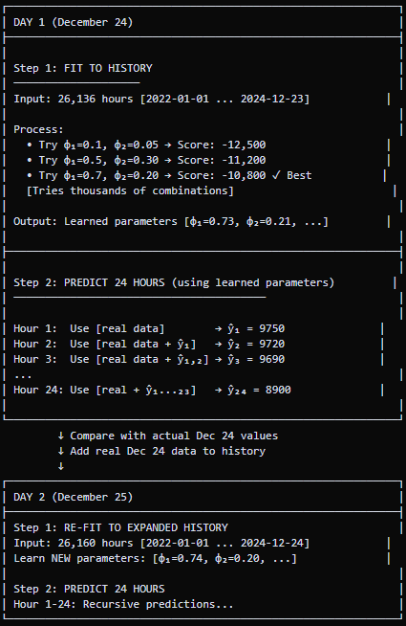

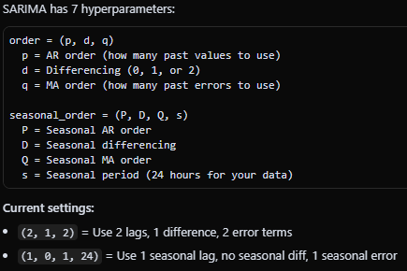

Slide 4
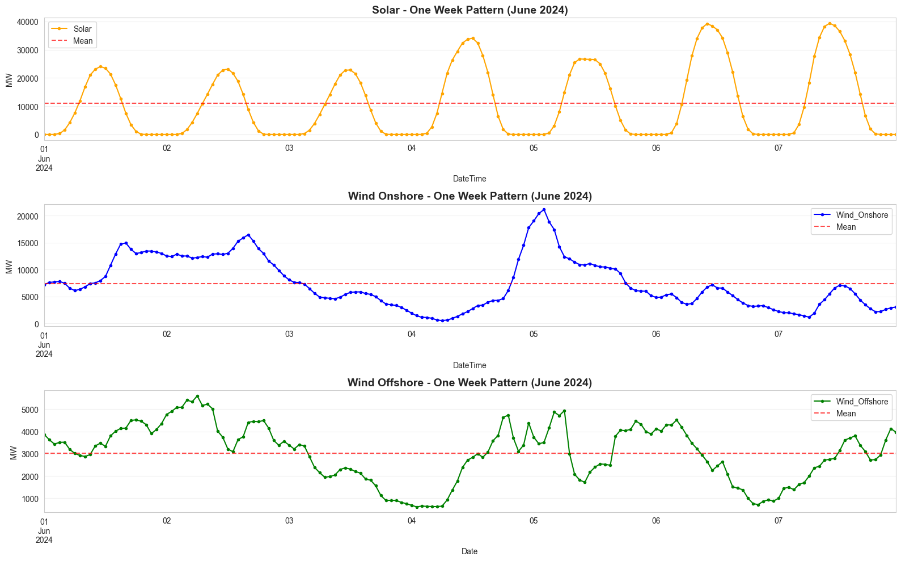
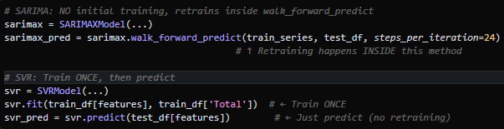
Data & Methodology
Dataset:
- Source: Energy-charts.info (German grid data)
- Period: 2022-2024 (3 years, 26,000+ hours)
- Technologies: Solar, Wind Onshore, Wind Offshore
Approach:
- SARIMAX model with 24-hour day-ahead predictions
- Walk-forward validation (7-day backtest)
Key Pattern: Strong 24-hour daily cycles (especially solar)
Walk-forward validation: Predict tomorrow, evaluate, move forward, repeat. Prevents data leakage

Slide 5
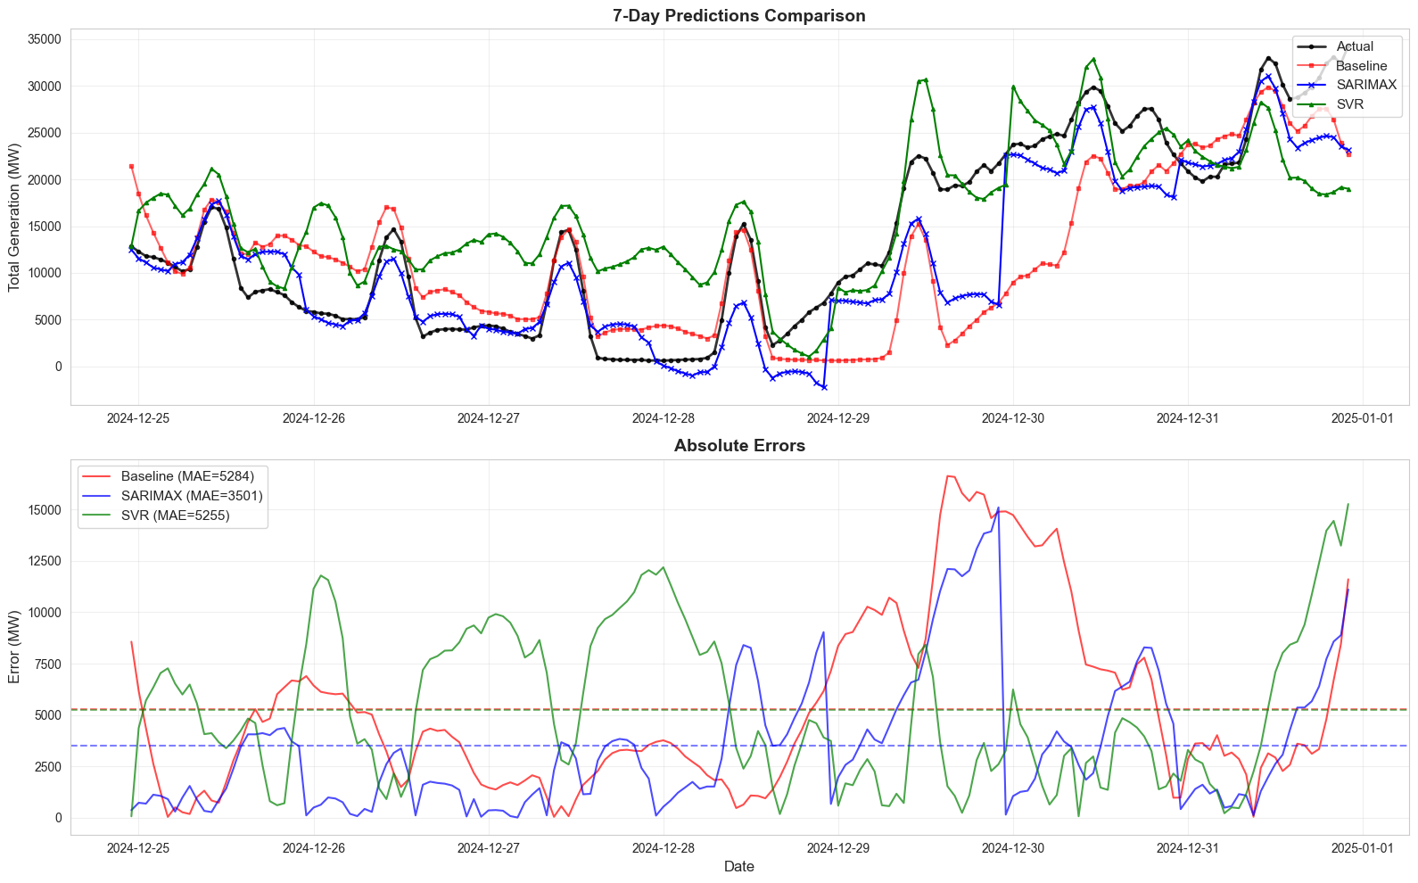
Results - Cost Reduction Achieved
Model Performance (7-Day Backtest):
- Baseline: EUR 6.3 million/day
- SARIMAX: EUR 4.2 million/day
Savings:
- Daily: EUR 2.1 million
- Improvement: 34%
- Yearly projection: EUR 781 million
Model | Daily Cost
Baseline (Yesterday=Tomorrow) | €6.3 million
SARIMAX (Our Model) | €4.2 million
MAE: Baseline 5,284 MW vs SARIMAX 3,501 MW. SARIMAX with walk-forward (predict 24h, retrain, repeat)

Slide 6
Missing Key Data: Weather Forecasts
Critical Missing Data: Weather forecasts
- Wind speed, solar irradiance, cloud cover
- Direct drivers of generation
Impact on Evaluation:
- Obtain historical weather (DWD archives)
- Add as model features
- Expected improvement: +5-30%
Production Integration:
- Fetch forecasts at 10:00 CET daily
- Feed into model as exogenous variables
- Generate predictions by 12:00 CET
Train “SARIMAX”
DWD = German Weather Service. Weather integration would capture day-to-day changes missed by pattern-based models

Slide 7
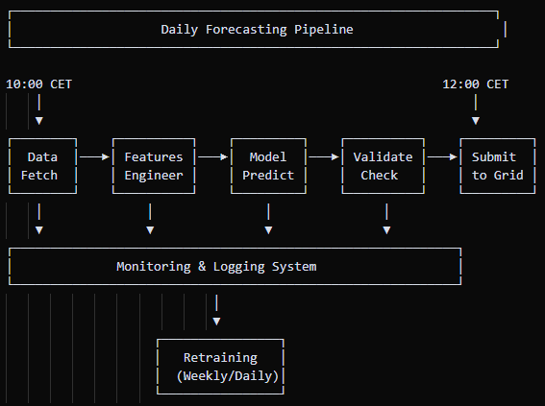
Production Deployment Plan
Architecture: Docker containers, PostgreSQL storage, Grafana monitoring, weekly retraining. See DEPLOYMENT.md

