Slide 1
Input Modeling (Arrival Process)
Dolors Sala
First Quarter
2017-18

Slide 2
Bibliography
“The Art of Computer Systems Performance Analysis”, R. Jain, Ed. John Wiley Sons Inc, 1991. (Chapters 4, 5, 28, 29)
“Simulation Modeling and Analysis”, A. Law, Ed McGraw Hill, 5th Edition (Chapter 8)
Some of these slides are based on the instructor’s slides (version 2010) supplied by Prof. Raj Jain, the Author of the book “The Art of Computer Systems Performance Analysis”
Notes:
“Simulation Modeling and Analysis”, A. M. Law, W. D. Kelton, Ed. McGrawHill, 3rd Ed. 2000. (Chapters 7, 8)

Slide 3
Why?
To model the arrivals in the simulation:
  Costumers in a supermarket:
  Packets in a network
  Jobs/Processes to a CPU
How can they be generated?
  With a known distribution function: How to implement it?
  With a process modeling the behavior of the user

Slide 4
Outline
Workload Types
  Traces
  Real Workloads – Real Traces
  Synthetic workloads
    Analytical Programs
    Synthetic Programs
    Applications benchmarks
Workload Selection and Considerations
Generating Random Variates (for Analytical Programs)
Recognize Some Common Input Distribution Functions

Slide 5
Terminology
Test workload: Any workload used in performance studies. It can be real or synthetic
Real workload: Observed on a system being used for normal operations
  It needs a real system running
  It freezes/records for a particular time period the operation of a system
  It produces a long stream of real events
Synthetic workload: Generated by a special purpose program or process
  A program that builds a particular scenario to test and it is used as a reference to compare different alternative designs
  It designed based on the use or expected use of the system under study
    It needs knowledge or sets assumptions of the use of the system
  It produces a model of the real stream according to the known model or expectations

Slide 6
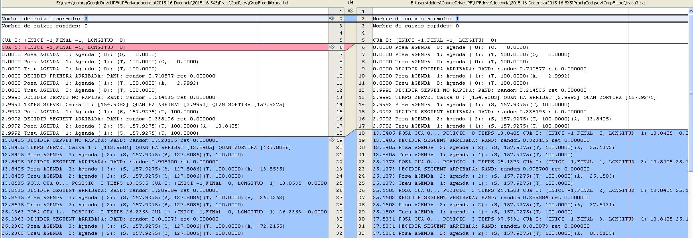
Traces
A trace is a time ordered record of events on a system
Traces can be collected from real systems or from synthetic programs
Example of a trace produced by our supermarket simulator (earlier code version)
Example of a real workload in networks: a real trace captured with tcpdump from a network in operation (recording all packets transmitted in the network)
22:00:11.625995 IP (tos 0x0, ttl 128, id 30917, offset 0, flags [none], proto: UDP (17), length: 81) 192.168.1.2.1034 > valve-68-142-64-164.phx3.llnw.net.27014: UDP, length 53
22:00:20.691903 IP (tos 0x0, ttl 128, id 31026, offset 0, flags [none], proto: UDP (17), length: 81) 192.168.1.2.1034 > valve-68-142-64-164.phx3.llnw.net.27014: UDP, length 53
22:00:21.230970 IP (tos 0x0, ttl 114, id 4373, offset 0, flags [none], proto: UDP (17), length: 64) valve-68-142-64-164.phx3.llnw.net.27014 > 192.168.1.2.1034: UDP, length 36
22:00:26.201715 arp who-has 192.168.1.2 tell 192.168.1.1
22:00:26.201726 arp reply 192.168.1.2 is-at 00:04:11:11:11:11 (oui Unknown)
22:00:29.706020 IP (tos 0x0, ttl 128, id 31133, offset 0, flags [none], proto: UDP (17), length: 81) 192.168.1.2.1034 > valve-68-142-64-164.phx3.llnw.net.27014: UDP, length 53
22:00:38.751355 IP (tos 0x0, ttl 128, id 31256, offset 0, flags [none], proto: UDP (17), length: 81) 192.168.1.2.1034 > valve-68-142-64-164.phx3.llnw.net.27014: UDP, length 53

Slide 7
Traces
  A trace represents the operation of the system at a particular time period (one snapshot)
    When the trace represents the arrivals it is a workload trace
    But a trace can include more details of the operation of a system
The design of the traces includes:
  Identifying what events are relevant to record
  What information must be recorded for each event
Producing good quality traces is not trivial
  It must represent well the target operation to study (exact detailed needed, no more no less)
  It must be easy to follow this operation (for manual and/or automatic search inspection)

Slide 8
Real Workload
When the real system exists we can register the workload operation of the system to feed it to a simulation model
  The stored trace is called a real workload trace
The real trace represents a real operation of the system at a particular time period
  One needs to guarantee the recording process does not modify/affect the operation under study
  A real trace needs to go through polishing process before it can be published & used in a model
  A different trace may be needed for each stochastic process (arrival process and service process)
There are well known databases of real traces that are well accepted by the community
  Relevance depends on the speed the systems change, they can get easily outdated
Steps involved in real workload
  Capturing the data
  Polishing and Publishing the real trace
  Using a (published) real trace

Slide 9
Synthetic Workload
A special purpose program or process to generate load
It can be applied repeatedly in a controlled manner
  Can decide the load and vary it to test different conditions
  No need of large real-world data files
  No sensitive data
  Easily modified without affecting operation
  Easily ported to different systems due to its small size
  May have built-in measurement capabilities
Different types of special purpose programs (*)
  Analytical Programs
  Synthetic programs
  Application Benchmarks
(*) NOTE: different terminology as the one given in the book

Slide 10
Analytical Programs
The analytical programs implement raw mathematical models (equations) to produce the workload (events)
  The equations produce a sequence of numbers that are used to trigger events in the program
Real systems are studied to identify what mathematical models fit the real workload
  Not always is possible to find an accurate enough model easy to implement
  Only some statistical characteristics can be solved mathematically
Examples:
  Exponential distribution to generate memoryless systems
  Pareto distribution to generate long-range dependence processes
It mimics only particular statistical characteristics
  Pros: It does not depend on the system it operates and can be used with any
  Cons: If the assumption of load characteristic is wrong the conclusions can be wrong
Analytical models can be fed to any system
  Typically done in simulation programs to implement check points to confirm the correct implementation (in simplistic scenarios solvable mathematically)

Slide 11
Synthetic Program
A program that performs certain actions to generate the load and exercise the system
  Used when the load characteristics cannot be represented by mathematical equations
It is a procedural approach to generate workload
  It can implement the necessary use actions of the system as needed
  It defines scenarios and implements the corresponding actions (does not try to model them)
Example: a synthetic program of web page viewing implements the action of viewing a page with the following actions:
  Requesting a page: decide a new page is requested
  Receiving a page: wait for the system to transport this page
  Reading page: decide how long it takes to read the page
  Requesting a new page: decide when the next new page is requested
Important to choose well the actions to implement (not to many but enough) so that it represents well the part of the target operation
Notes:
These procedures can become the reference for study the systems and hence the programs can be easily shared and imported in other simulations
The programs can incorporate additional measurement capabilities that produce “standard” and comparable measures
But they can be limited to a particular view of a system and need to be upgraded/modified with additional functionalities when the system extends
Negligible (not modeled) system parts can become important and new ones may appear

Slide 12
Application Benchmarks
When a system is to be used by a particular application, a representative set of functions for that application may be used. Such benchmarks are specified in terms of functions to be performed and make use of almost all resources of the system under study
We’ll consider an application benchmark a synthetic program that implements some application functionality/knowledge to generate workload and it becomes a widely used program/process by the community

Slide 13
The Art of Workload Selection: Workload Model
Alice “Would you tell me, please, which way I ought to go from here?”
Cat: “That depends a good deal on where you want to get to,”
Alice “I don’t much care where –”
Cat: “Then it doesn’t matter which way you go”
Quote in the book chapter from:
-- Lewis Carroll, Alice’s Adventures in Wonderland
What workload model to use
in the simulation
depends on the study
you want to do

Slide 14
Workload Selection
The workload is the most crucial part of any performance evaluation project
When conclusion results are found unacceptable the inappropriateness of the workload is typically the criticism
Appropriate selection of workload requires many considerations and judgments and experience is the basis → this is the “art” part
Considerations to take into account in the model selection:
Services exercised
Level of detail
Loading level
Impact of other components
Timeliness
Repeatability
This course focuses on how to implement an analytical model more than selecting a model

Slide 15
Workload Selection:
Considerations in this Course
Loading Level: A workload may exercise a system to its:
  Full capacity (best case)
  Beyond its capacity (worst case)
  At the load level observed in real workload (typical case)
  For procurement purposes ⇒ Typical
  For design ⇒ best to worst, all cases
Repeatability: workloads with highly random demand on resources would need to make more runs to get a meaningful estimate of performance (avoid them if possible)
Notes:
Impact of External Components:
Do not use a workload that makes external component a bottleneck ⇒ All alternatives in the system give equally good performance
Select workload that makes a different in the system design

Slide 16
Analytical Programs: Random-Variate Generation
How to create random variates following a particular distribution function?
Notes:
We see: Inverse Transform Method
(there are more methods, not studied in this course)

Slide 17
Random Number Generators (Recall)
Random numbers are generated in two steps:
  1. Random-number generation
    Generate a uniform random number between [0..1]
    Previous chapter (Random Number Generators)
  2. Random-variate generation
    Transform this number to match a desired distribution function
    In this Chapter, the following slides

Slide 18
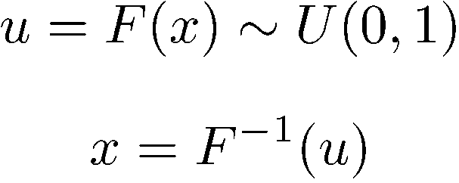
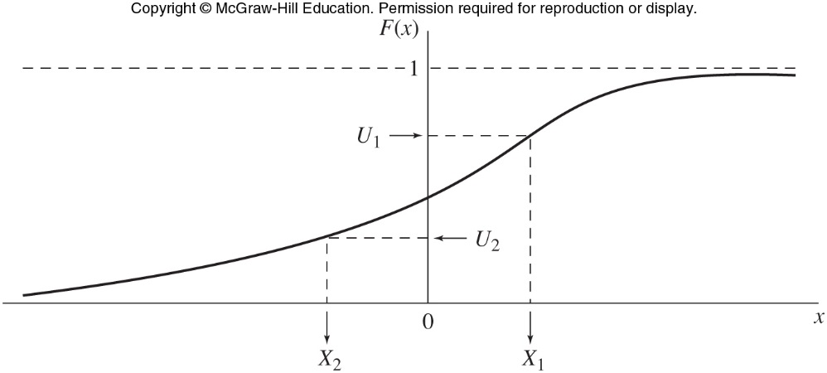
Inverse Transformation Method
CDF: cumulative distribution function
  F(x) is the sum of probabilities of all values smaller than x
  CDF is a monotonically increasing continuous function with values between 0 and 1 (probabilities)
It can be shown: u = F(x) is uniformly distributed between 0 and 1
Therefore x can be generated by x = F⁻¹(u)
This method is used when F⁻¹ can be determined analytically or empirically

Slide 19
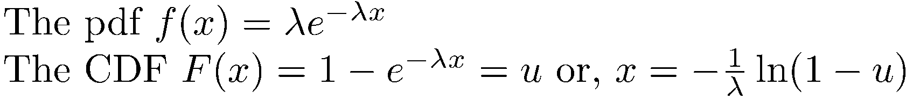
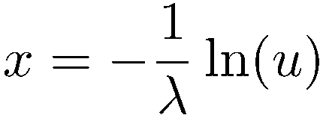
Example: Exponential Distribution
For exponential variates:
= F⁻¹(x)
If u is U(0,1), 1-u is also U(0,1)
Thus, exponential variables can be generated by:
Example: exponencial λ = 0.5
u | 0.0356 | 0.8392 | 0.3982 | 0.3801 | 0.0023 | …
x | 6.6708 | 0.3506 | 1.8412 | 1.9346 | 12,1495

Slide 20
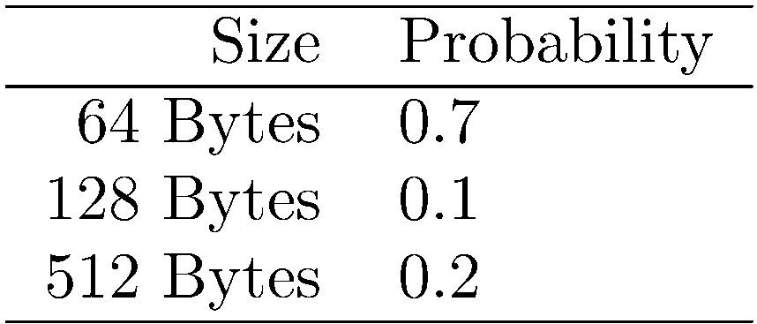
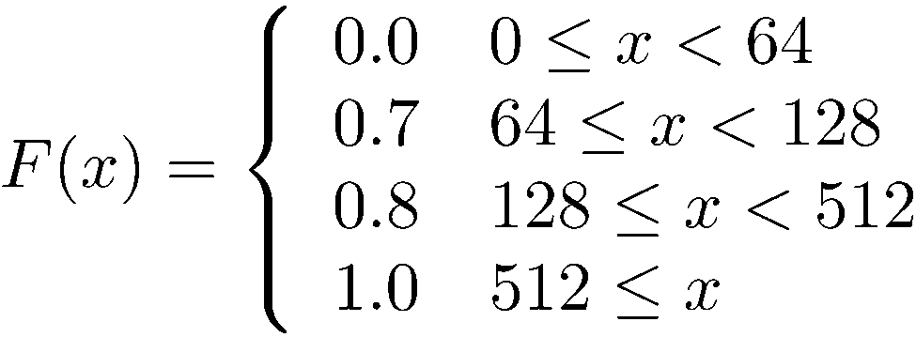
Example Trimodal Distribution
The packet sizes (trimodal) probabilities:
The CDF for this distribution is:

Slide 21
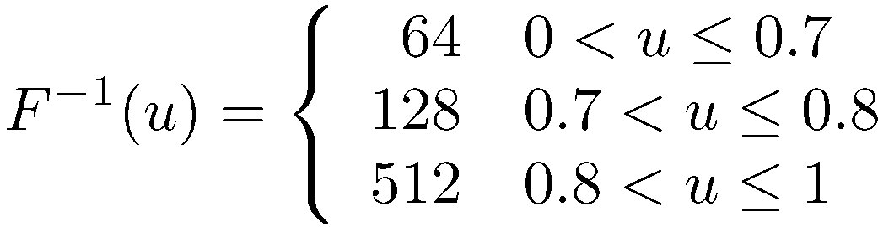
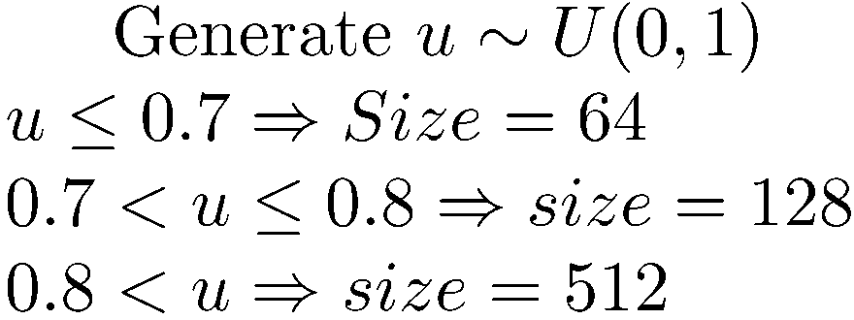
Example Trimodal Distribution (Cont)
The inverse function is:
Note: CDF is continuous from the right
⇒ the value on the right of the discontinuity is used
⇒ The inverse function is continuous from the left
⇒ u=0.7 ⇒ x=64

Slide 22
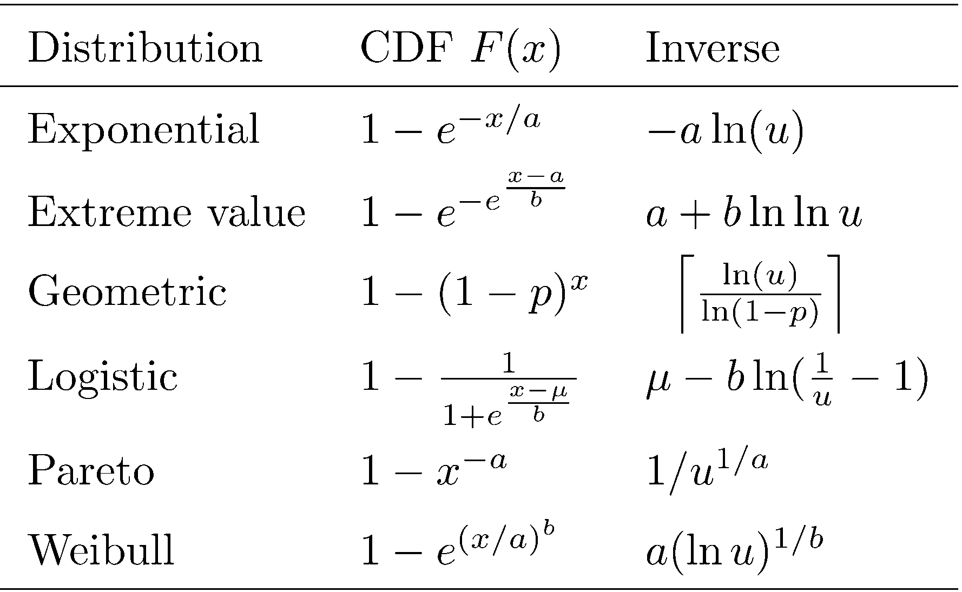
Applications of the Inverse-Transformation Method

Slide 23
Other Methods
The inverse of a function can be difficult to compute or may be easier to apply other methods
(Not done in this course)

Slide 24
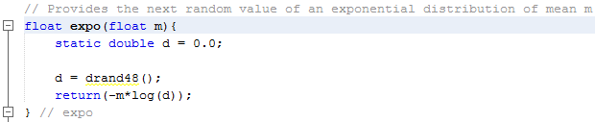
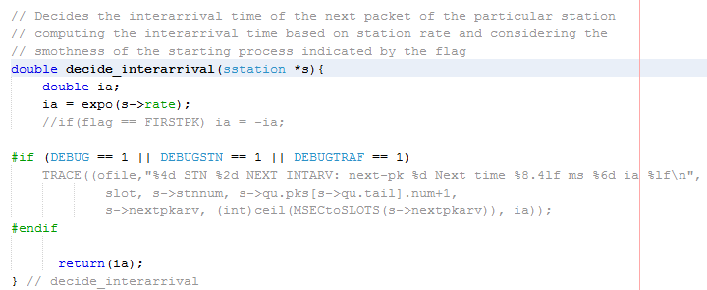
saloha : Random Generator
Random number generator: drand48()
Random variate generator
Packet generator

Slide 25
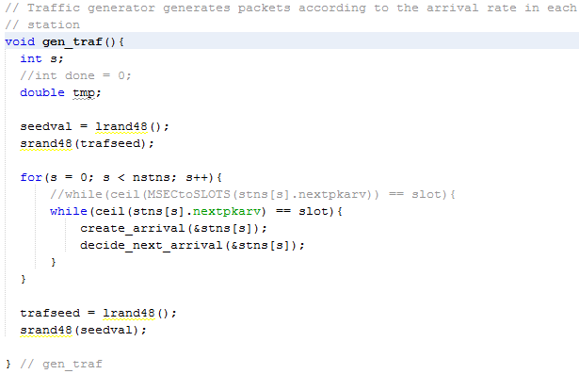
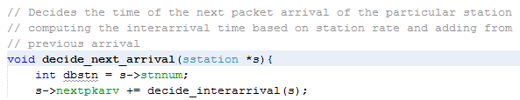

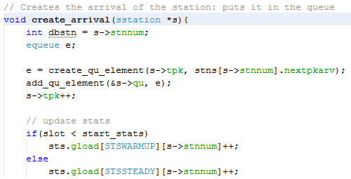
saloha : Packet Generator (cont)

Slide 26
Annex: Important Distribution Functions
Useful when looking for the model that matches our data
Be familiar with the shapes and formulas of common ones is useful
(Consult this or corresponding references when need it)

Slide 27
Typical Distributions
A set of distribution functions are commonly used:
  Due to statistical properties/results:
    Poisson, Exponential, Normal, χ², F, t
  They model particular real world behaviors simply and accurately enough: pareto
You need to be familiar with these typical distributions and be able to identify shape and/or formula (depending the case)

Slide 28


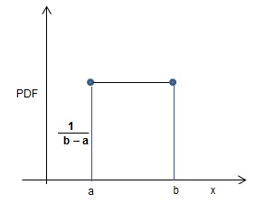
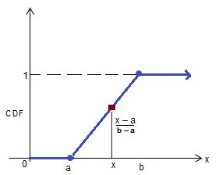
Uniform Distribution U(a,b)
Used when the value is assumed equally likely over a bounded range of values
Range (continuous): -∞ < a ≤ x ≤ b < +∞
E(X) = (a+b)/2, Var(X) = (b-a)²/12
F(x) =

Slide 29
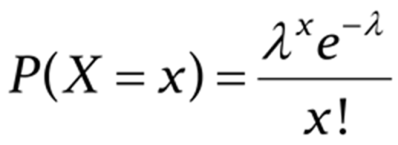


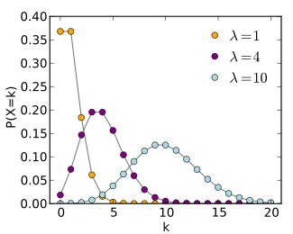
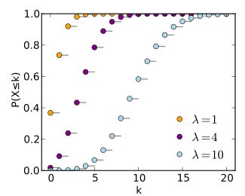
Poisson Distribution (discrete)
Used extensively in queuing systems (number of arrivals per unit of time)
  Range (discrete): x = 0,1,2, …., ∞
  E(X) = λ, Var(X) = λ

Slide 30
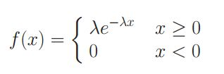
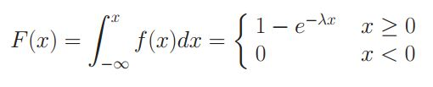
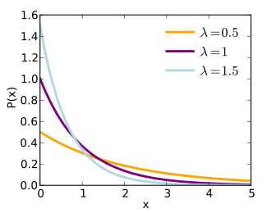
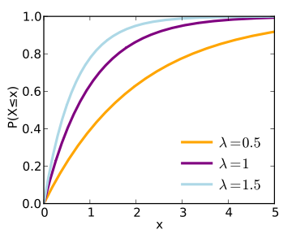
Exponential Distribution
Used extensively in queuing models (time between consecutive events)
The only continuous distribution with memoryless property:
  Range (continuous): 0 ≤ x ≤ +∞
  E(X) = 1/λ, Var(X) = 1 / λ², σ = 1/λ
  F⁻¹(x) = - 1/λ ln(u) where u is a U(0,1) random variate

Slide 31
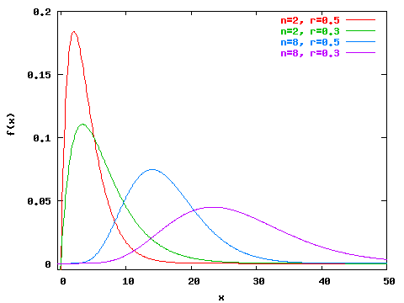
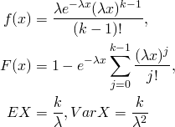
Erlang Distribution: Erlang(k,λ)
Used as an extension of exponential distribution
Model the behavior of the blocking probability of telephone systems
Parameters: λ > 0 scale, k shape positive integer
Range: 0 ≤ x ≤ ∞
k = 2, λ = 0.5
k = 2, λ = 0.3
k = 8, λ = 0.5
k = 8, λ = 0.3

Slide 32
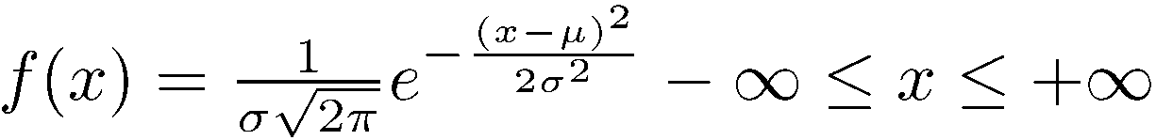

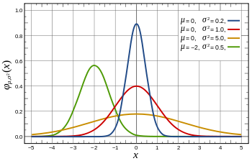
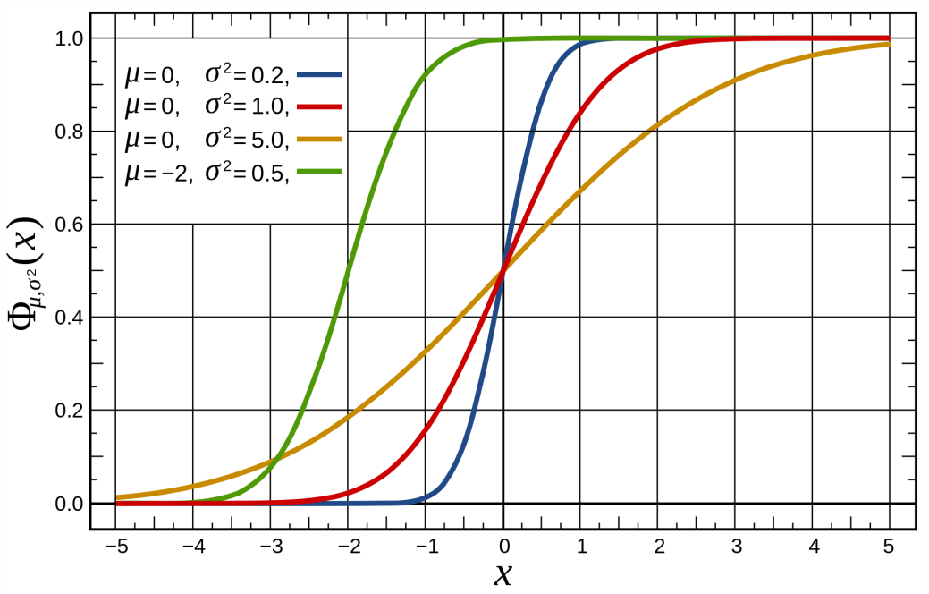
Normal Distribution N(µ, σ)
Very important because the central limit theorem
Range: -∞ ≤ x ≤ ∞
E(X) =μ Var(x) =σ²

Slide 33
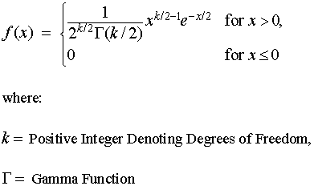
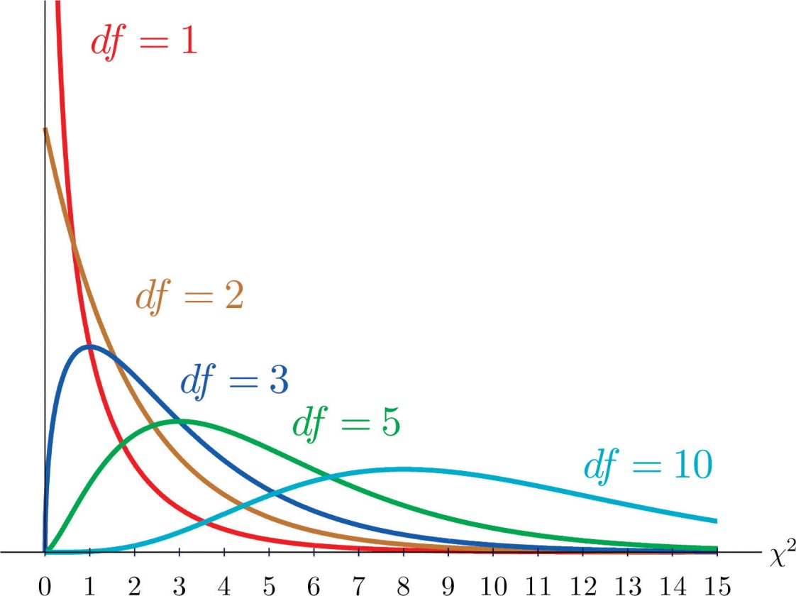
Chi-Square Distribution (ν)
χ²
The sum of squares of normal distribution is chi-square (sample variances). Used in the t-test
  ν Number of degrees of freedom, positive integer
  Range: 0 ≤ x ≤ ∞
  E(X) = ν Var(x) = 2ν
0.5
0.4
0.3
0.2
0.1

Slide 34
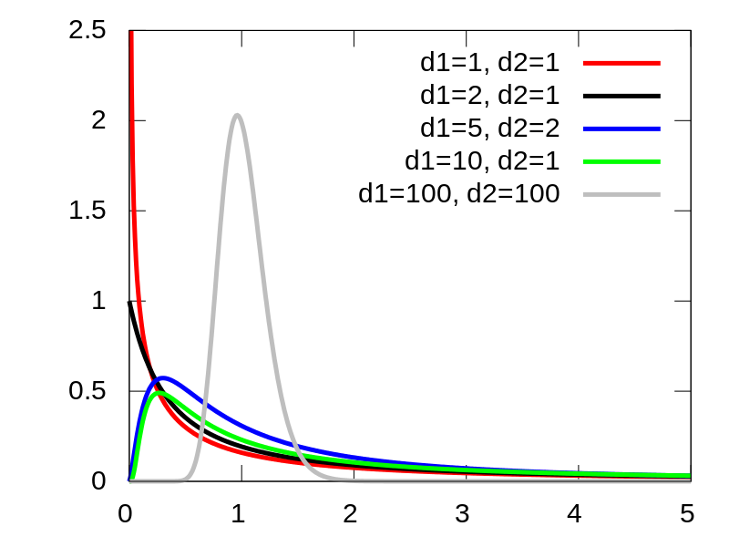

F Distribution F(n,m)
The ratio between two chi-square has an F distribution (ratio of variances)
  Used in F-test for regression & analysis of variance
  n numerator degrees of freedom, positive integer, also d₁
  m denominator degrees of freedom, positive integer, also d₂
  Range: 0 ≤ x ≤ ∞
  E(X) = m/(m-2)
χ²(n)/n
F(n,m) =
χ²(m)/m

Slide 35
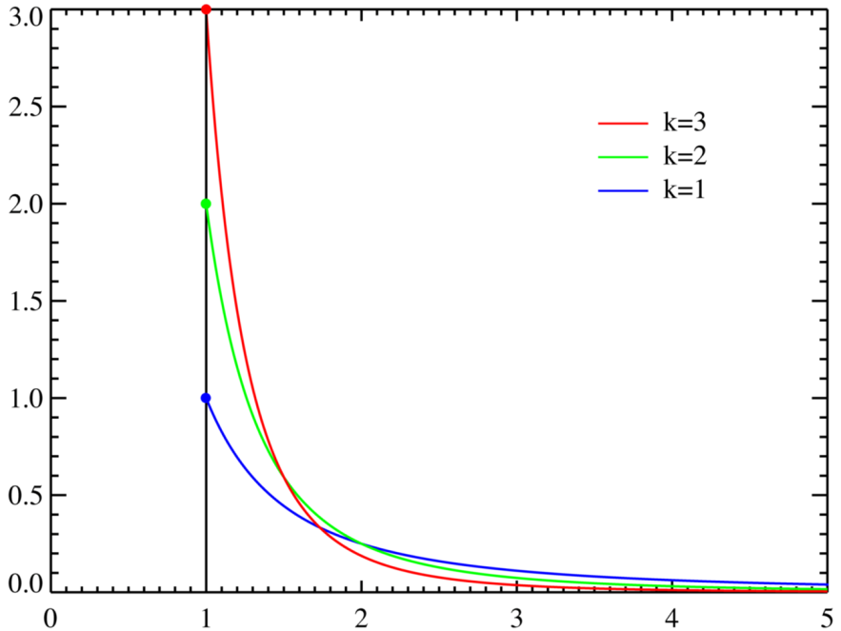
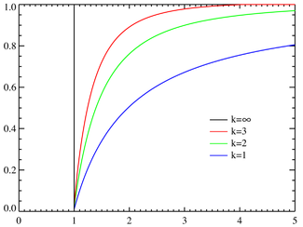
Pareto Distribution
  Parameter: a > 1 shape
  Range: 1 ≤ x ≤ ∞
  f(x) = ax^{–(a+1)}
  F(x) = 1 – x^{–a}
  E(X) = a/(a-1)
f(x)
a
Var(X) =
, a > 2
(a-1)² (a-2)
F(x)

Slide 36
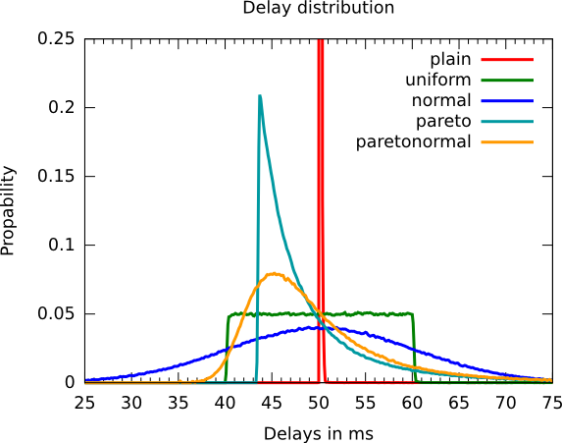
A High Level Shape Identification: An Example
(Neglect Plain and paretonormal distributions)

Slide 37
Summary
Workload model is a crucial part in the interpretation of the real problem and hence on the accuracy of the conclusions
The workload model summarizes the part of the system not implemented (a model is used instead)
  Real model: traces (injects output of a real system)
  Synthetic workload: Analytical, synthetic or benchmarks
Many important considerations when modeling workload
  Determine/implement the settings and scenarios to use for the study of the system
How to implement analytical workload programs
  One method (of several): inverse transform method
It is important to be familiar with typical distributions

Slide 38
Next Steps
Understand the workload model in saloha (lab RNG)

