Slide 1
Migration Data 2022 - 2025
Juan Rodriguez
Finance Operations

Slide 2
Introduction
The data being reviewed is coming from the US Custom and Border Protection, US Department of Transportation and the International Organization for Migration (IOM)
Research Questions:
Is there a specific time of the year where the number of encounters is higher? What is the specific type of demographic?
What is the number of migrants that go missing?
What is the main method of legal border crossing?

Slide 3
Methodology
Libraries used:
Pandas
Motplotlib.pyplot
Seaborn
Plotly.express
Data Manipulation Used:
Combine files into a single Dataframe using Concat
Renamed Columns
Converted Field to numbers and dates
Replace and Split data into multiple columns
Reviewed and clean-up data for ISNA
Used unstack and pivot_table function to display data on specific way

Slide 4
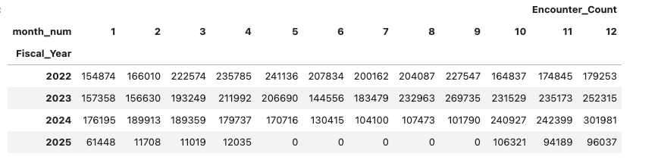
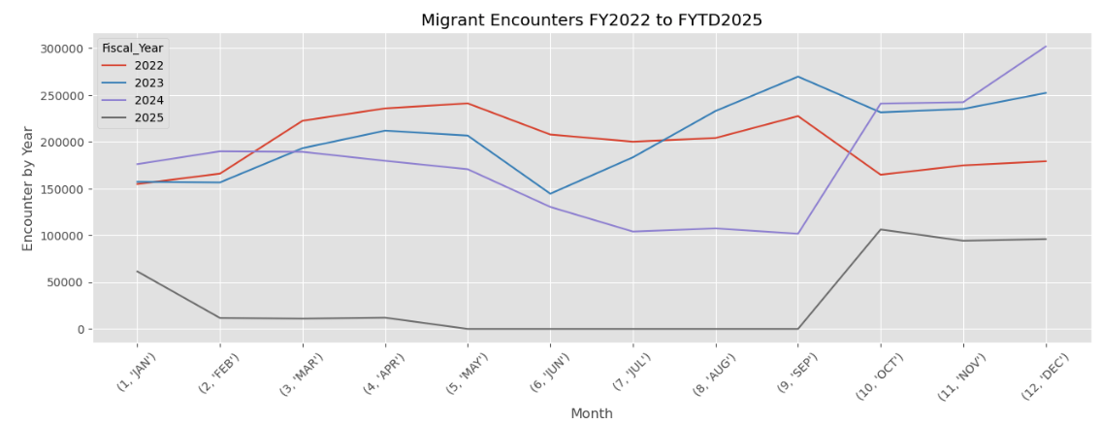
US CBP Encounters FY2022-FY2025

Slide 5
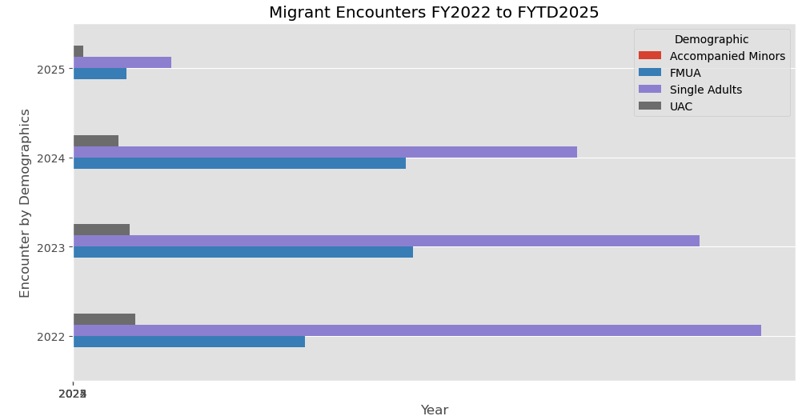
Encounters by Demographics

Slide 6
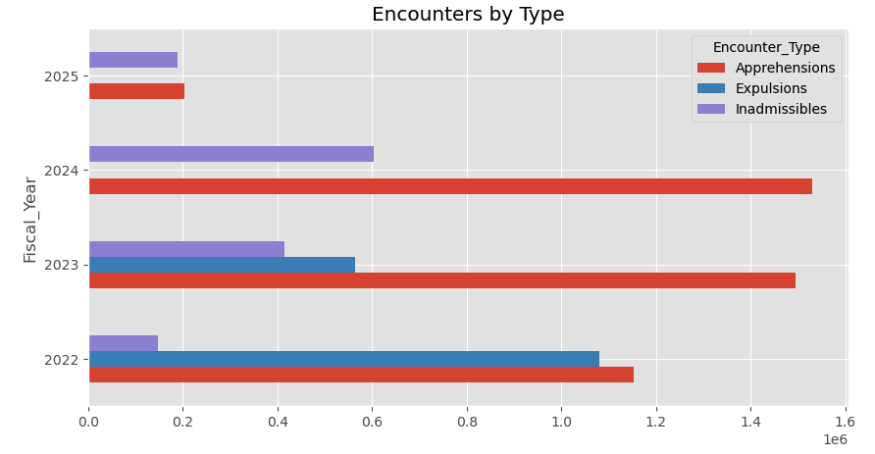
Encounters by Type

Slide 7
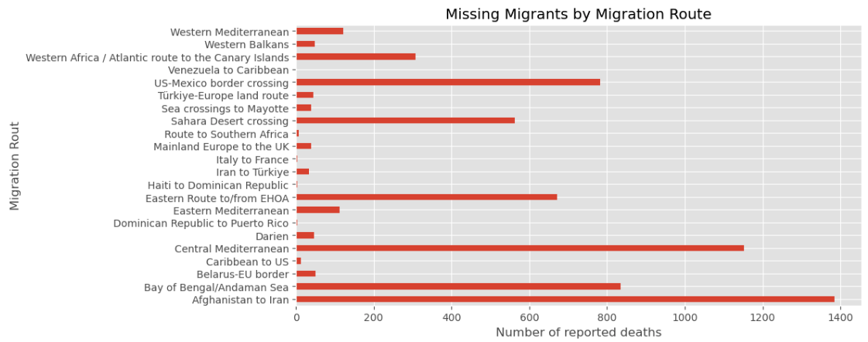
Missing Migrants

Slide 8
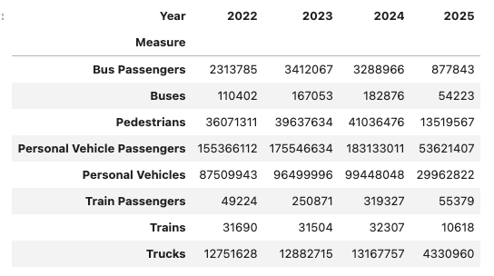
US DOT – Border Crossings 2022 - 2025

Slide 9
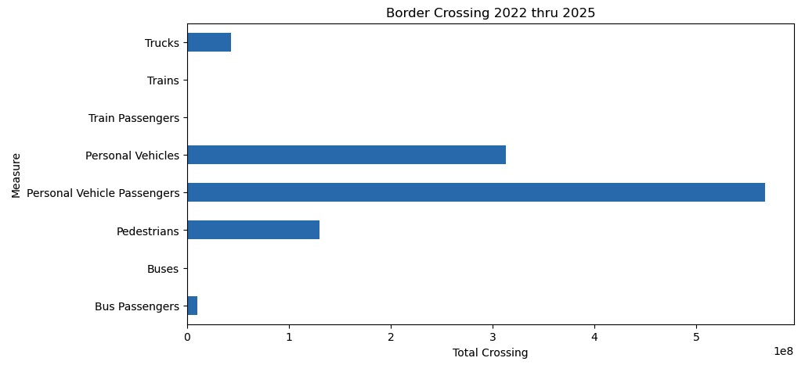
US DOT Border Crossing 2022 thru 2025

Slide 10
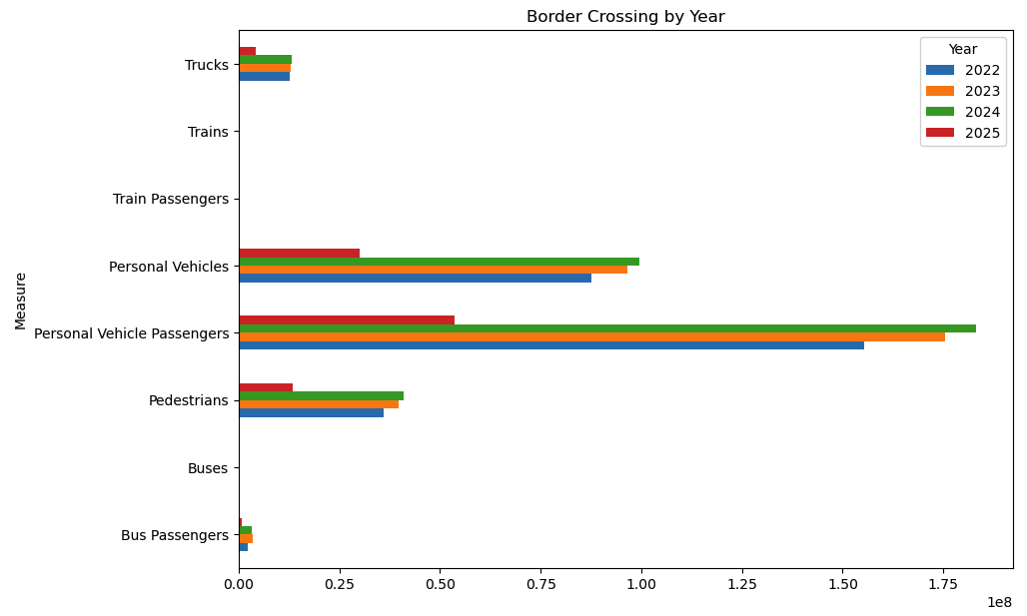
US DOT Border Crossing by Year

Slide 11
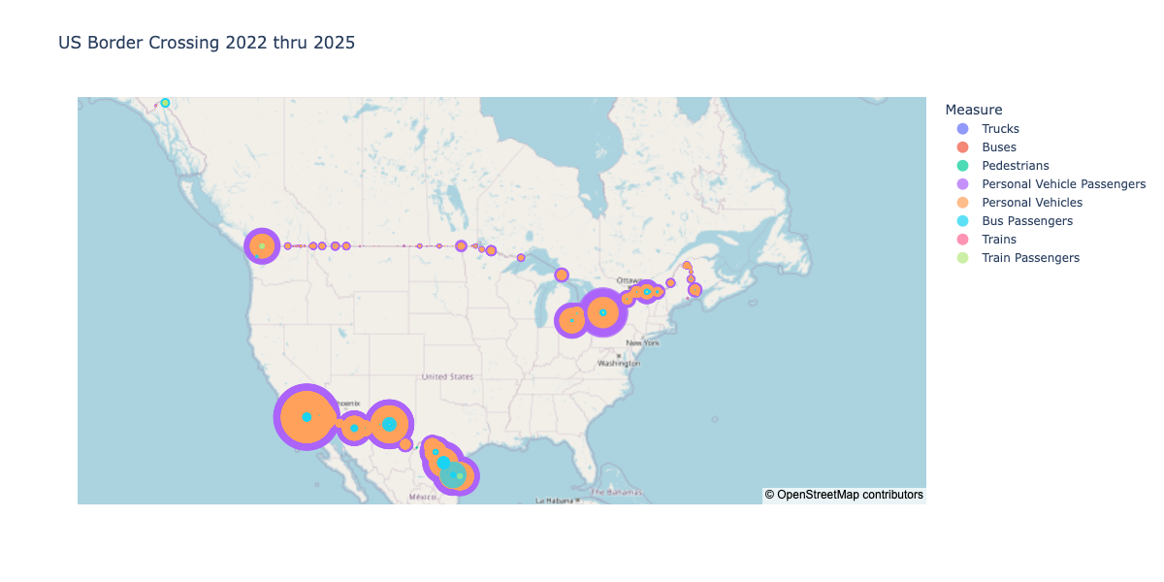
US DOT Border Crossings 2022 - 2025

Slide 12
Conclusion
Based on the US CBP data, the main demographic attempting to enter the United States are single adults followed by individuals in a family unit. We see that in 2025 the number on encounters have been reduced.
Reviewing the number of deaths reported, we can see the US-Mexico Border crossing route had the 3rd higher number of reported deaths. The number of deaths reported seem small. This leads me to think that many deaths are not reported.
Also when it comes to legal crossing into the US, we can see the main method for legal crossing is via personal vehicle and personal vehicle passengers.

