Slide 1
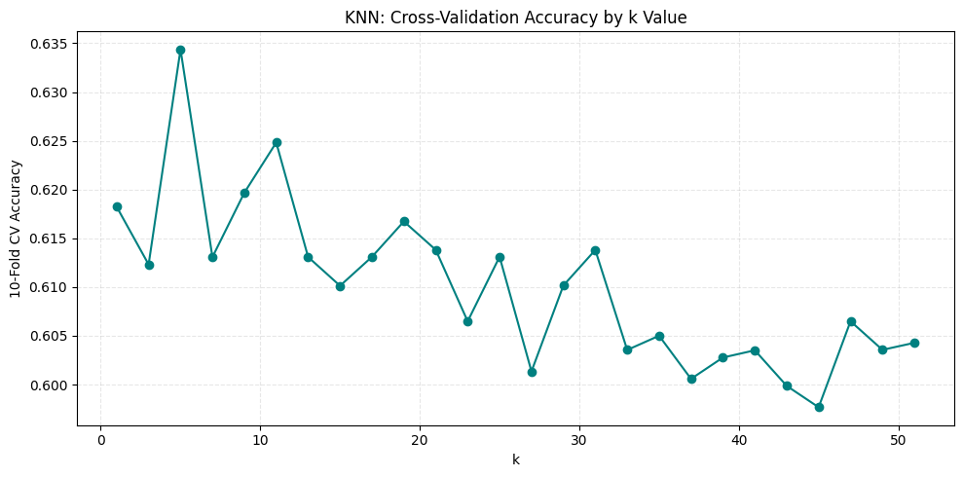
CLASSIFICATION · PART I
K-Nearest Neighbors — Predicting Workspace Amenity
Target & Predictors
CV accuracy peaks sharply at k = 5, declines gradually thereafter
Target: has_workspace — binary flag built from the amenities column (56% / 44% split — reasonably balanced)
Predictors: 10 numerical features spanning price, size, geography, demand, host scale
Sample: 1,946 rows after dropping missing values (588 dropped from 2,534)
Method
70/30 stratified train-test split
StandardScaler fit on training set only (distance-based model)
10-fold CV over odd k ∈ {1, 3, … 51} to avoid tied votes
k = 5
BEST k VALUE
10-fold CV accuracy: 63.4%
Predictor set (10 features)
price · accommodates · beds · latitude · longitude · number_of_reviews · availability_365 · minimum_nights · review_scores_rating · host_listings_count
AD 699 · Team 5 · Zurich Airbnb Listings

Slide 2
CLASSIFICATION · PART I
KNN Results — Modest Lift Over Baseline
60.8%
58.7%
+2.1pp
KNN test accuracy
Naïve benchmark (majority class)
Improvement over baseline
Confusion Matrix (test set, n = 584)
Per-Class Performance
 | Pred: No | Pred: Yes
Actual: No | 88 | 153
Actual: Yes | 76 | 267
Class | Precision | Recall | F1 | Support
No workspace | 0.54 | 0.37 | 0.43 | 241
Has workspace | 0.64 | 0.78 | 0.70 | 343
Weighted avg | 0.59 | 0.61 | 0.59 | 584
TAKEAWAY
The model beats the majority-class baseline by only ~2 percentage points. Recall on listings WITH a workspace is strong (0.78), but recall on listings WITHOUT one is weak (0.37) — the model leans toward the majority class when the feature pattern is ambiguous. KNN provides some predictive signal, but limited.
AD 699 · Team 5 · Zurich Airbnb Listings

Slide 3
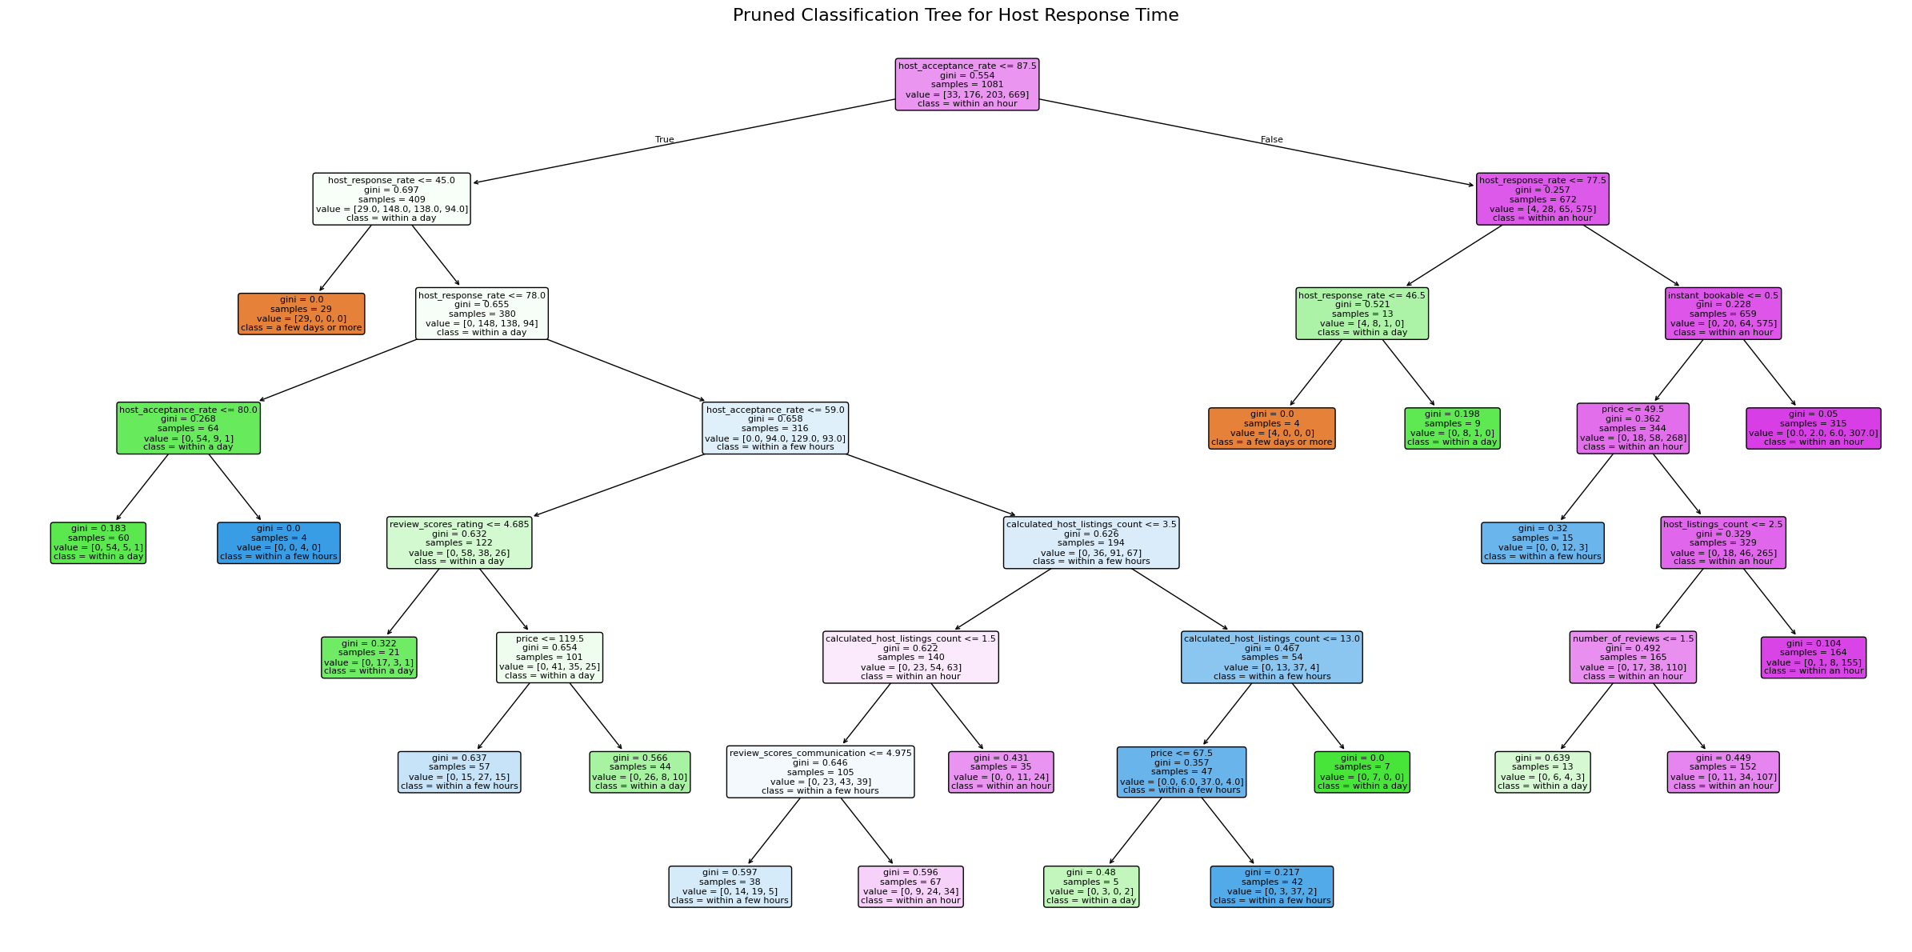
CLASSIFICATION · PART II
Classification Tree — Predicting Host Response Time
Target & Predictors
Pruned tree — two host behavior variables drive the early splits
Target: host_response_time — 4 classes, imbalanced (62% 'within an hour')
Predictors: 16 numerical features — host behavior, listing traits, demand, review scores
Sample: 1,545 rows; booleans mapped t/f → 1/0 for numerical splits
Tuning Strategy
Grew full unrestricted tree on training data
Extracted ccp_alpha candidates via cost_complexity_pruning_path()
10-fold CV over every alpha — picked the one maximising mean accuracy
0.004
7
19
75.8%
10-FOLD CV ACCURACY
at the optimal pruning level — strong enough to generalise, simple enough to avoid overfitting
Best pruning α
Tree depth
Leaf nodes
AD 699 · Team 5 · Zurich Airbnb Listings

Slide 4
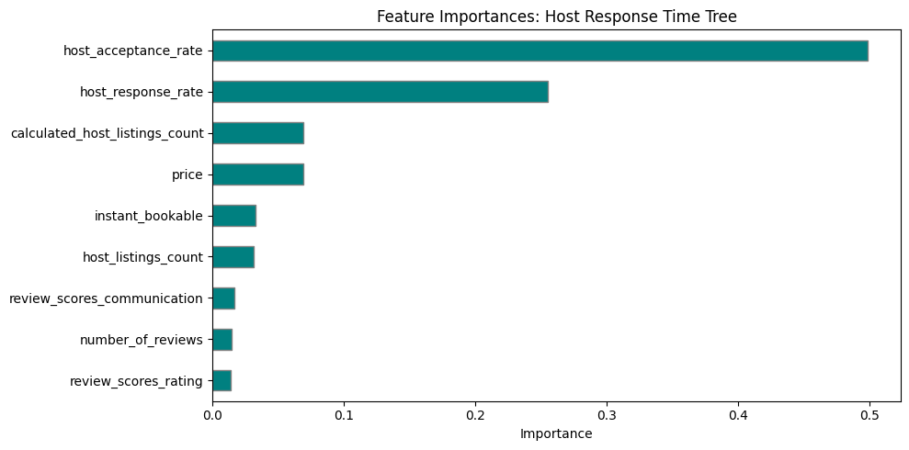
CLASSIFICATION · PART II
Tree Results — 12-Point Lift and a Two-Variable Story
73.9%
61.9%
+12pp
Tree test accuracy
Naïve benchmark
Improvement over baseline
Per-Class Performance (test set, n = 464)
Feature Importances
Class | Precision | Recall | F1 | Support
a few days or more | 1.00 | 1.00 | 1.00 | 14
within a day | 0.59 | 0.56 | 0.58 | 75
within a few hours | 0.46 | 0.26 | 0.33 | 88
within an hour | 0.80 | 0.92 | 0.86 | 287
TAKEAWAY
host_acceptance_rate (49.9%) and host_response_rate (25.5%) together drive 75%+ of all splits. The tree excels at the two extreme classes (F1 = 1.00 and 0.86) but struggles to separate the two middle categories — a common pattern with imbalanced ordinal targets.
AD 699 · Team 5 · Zurich Airbnb Listings

