Slide 1
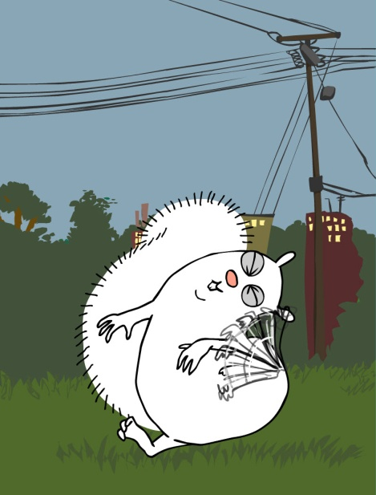
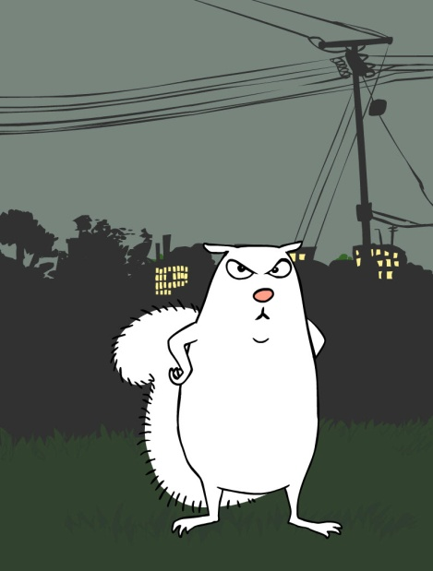
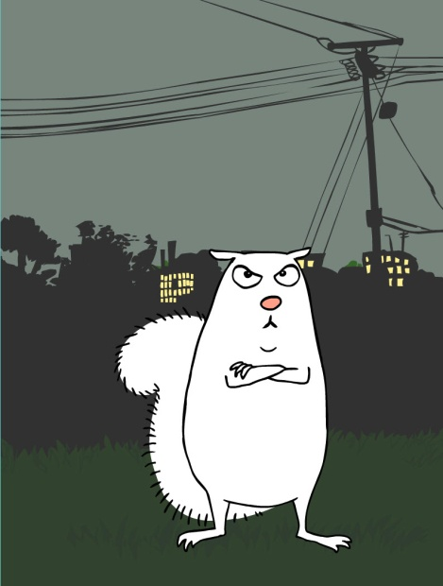
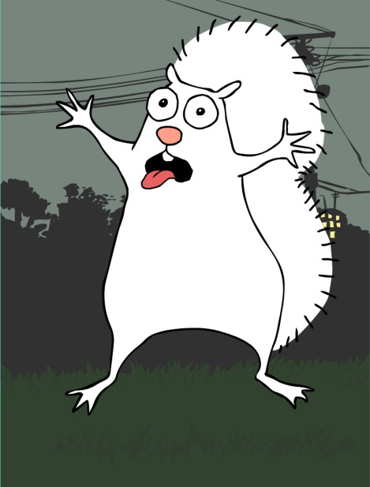
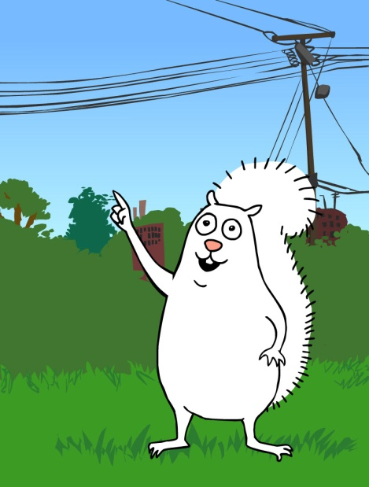




Oberlin College Dorm Resource Reduction Competition 2010
Oberlin College Dorm Resource Reduction Competition 2010
Oberlin College Dorm Resource Reduction Competition 2010
Resource Reduction
November 1-19
November 1-19
November 1-19
Competition 2010
Oberlin College Dorm
_{www.oberlin.edu/dormenergy}
_{www.oberlin.edu/dormenergy}
November 1-19
_{www.oberlin.edu/dormenergy}
_{www.oberlin.edu/dormenergy}
I’m working to conserve water & electricity
in my dorm!
I’m working to conserve water & electricity
in my dorm!
I’m working to conserve water & electricity
in my dorm!
I’m working to conserve water & electricity
in my dorm!
Oberlin College Dorm Resource Reduction Competition 2010
Oberlin College Dorm Resource Reduction Competition 2010
Oberlin College Dorm Resource Reduction Competition 2010
Oberlin College Dorm Resource Reduction Competition 2010
November
1-19
November
1-19
November
1-19
November
1-19
_{www.oberlin.edu/dormenergy}
_{www.oberlin.edu/dormenergy}
_{www.oberlin.edu/dormenergy}
_{www.oberlin.edu/dormenergy}
I’m working to conserve water & electricity
in my dorm!
I’m working to conserve water & electricity
in my dorm!
I’m working to conserve water & electricity
in my dorm!
I’m working to conserve water & electricity
in my dorm!
Oberlin College Dorm Resource Reduction Competition 2010
Oberlin College Dorm Resource Reduction Competition 2010
Oberlin College Dorm Resource Reduction Competition 2010
Oberlin College Dorm Resource Reduction Competition 2010
November
1-19
November
1-19
November
1-19
November
1-19
_{www.oberlin.edu/dormenergy}
_{www.oberlin.edu/dormenergy}
_{www.oberlin.edu/dormenergy}
_{www.oberlin.edu/dormenergy}
I’m working to conserve water & electricity
in my dorm!
I’m working to conserve water & electricity
in my dorm!
I’m working to conserve water & electricity
in my dorm!
I’m working to conserve water & electricity
in my dorm!

Slide 2
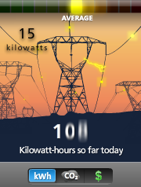
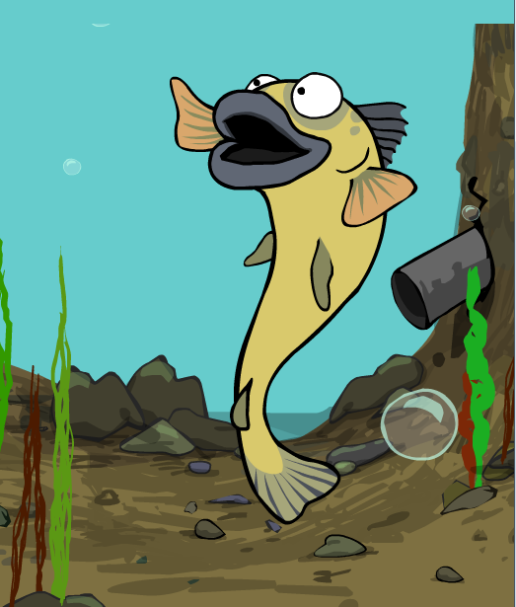
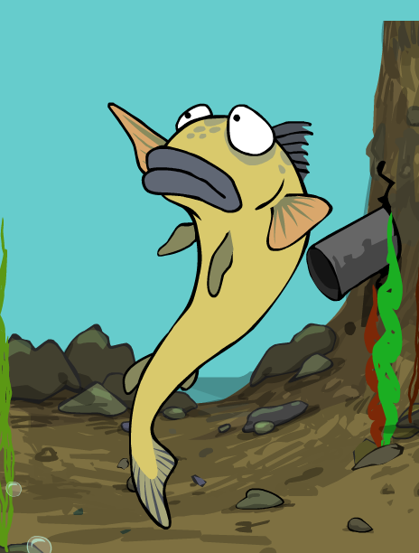
Oberlin College Dorm Resource Reduction Competition 2010
November
1-19
_{www.oberlin.edu/dormenergy}
I’m working to conserve water & electricity
in my dorm!

