Slide 1
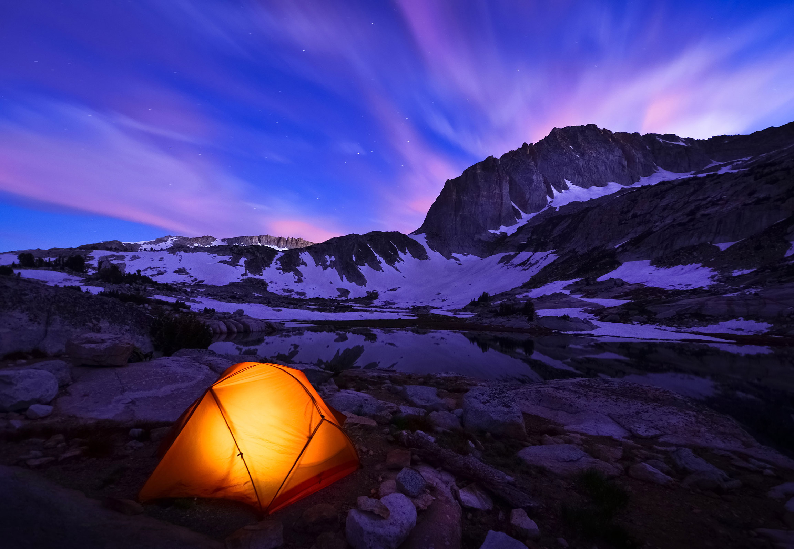
HARRY POTTER
Camping in a tent ON A MOUNTAIN with

Slide 2
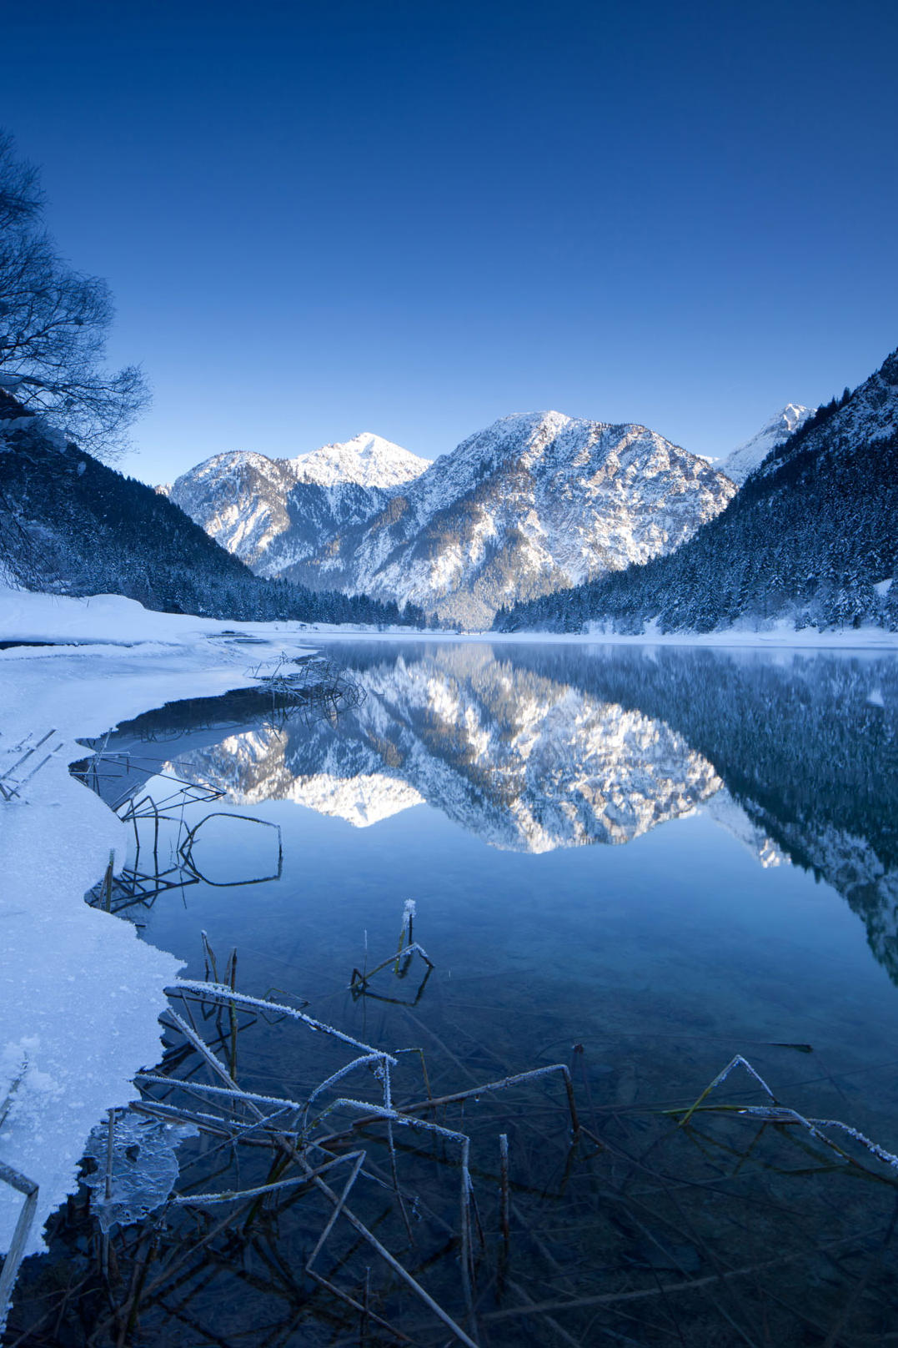
The sword
Here is where Harry found the sword of Gryffindor

Slide 3
Snape is a dweeb

