Slide 1
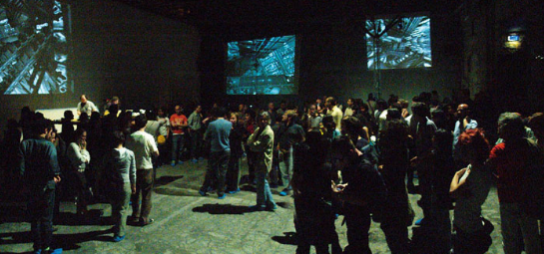
VIRGO MA49 – 100/04

Slide 2
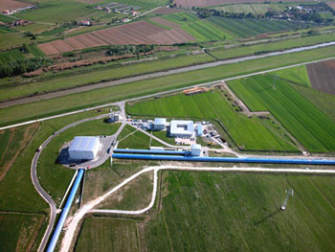
L’interferometro per le onde gravitazionali
VIRGO a Cascina (Pisa)

Slide 3
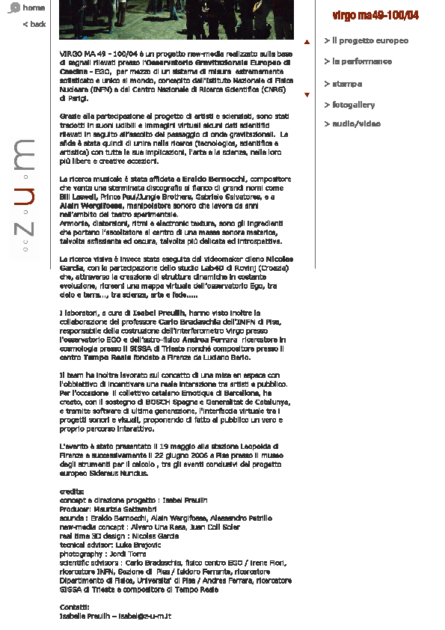
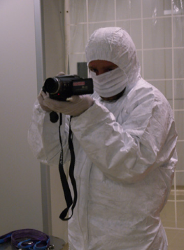
VIRGO MA49 – 100/04

Slide 4


GRAVITATIONAL PSALMS
ANDREA FERRARA
(2006)
for VIRGO MA49 – 100/04 @ Fabbrica Europa

Slide 5
What is it
A TALK
1. Scientific contents and topic
2. Speaker-to-audience format
3. Content organization
A SHOW
1. Complete understanding not essential
2. Sound environment
3. Multilingual communication
4. Speaker as performer
A 10’ Talk/Show introductory to VMA49

Slide 6
What is it for
GENERAL AIMS
1. Provide scientific background for VMA49 main event
2. Link to EGO science (g-waves)
3. Audience collection and warm-up
SPECIFIC AIMS
1. Improve the science – art links
2. Science and art are human, creative activities
3. Scientific contents are esthetically valuable

Slide 7
What is the concept
Science – religion paradigm revisited
Scientific explanations are inherently difficult
Theories are often counterintuitive and very technical
Scientific knowledge highly fragmented
SCIENTISM
A form of dogma: "In essence, scientism sees science
as the absolute and only justifiable access to the truth."
Scien-tism “IS” religion
Scientific conferences the new liturgy
Scientists are the officiants

Slide 8
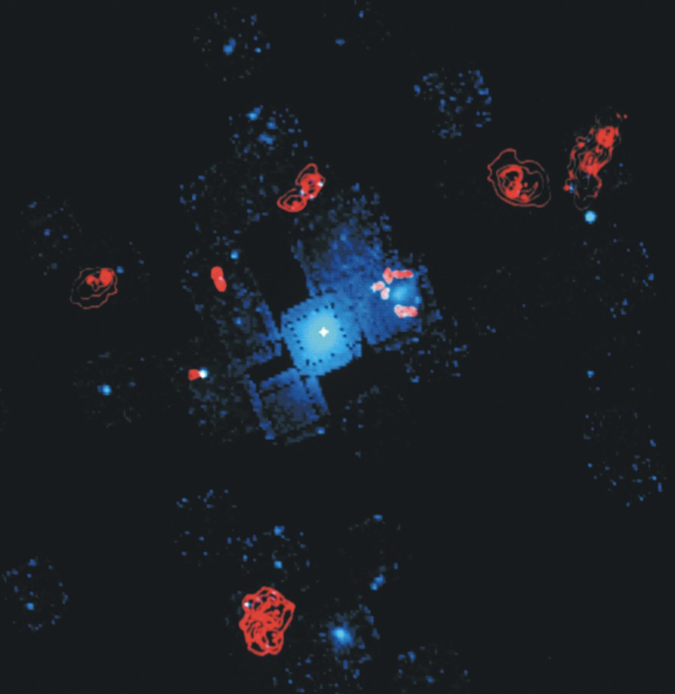






What is the set-up
Video
Sound
Digital projector
Performer
DVD
Audience

Slide 9
Video/images
CONTENTS
1. Numerical simulations of cosmic structure formation,
supernova explosions, NS/BH merging, galaxy clusters
2. Data Images
3. Scientific statements (Psalms)
4. Gravitational wave mathematical formalism
DURATION: 11’ 15”
Rigorous/quantitative presentation, but not self-explanatory

Slide 10
Soundscape
SOUND CLASSES | GWAVE SOURCES
Wide-band noise | Stochastic background generated @ Big Bang
Impulsive events | SN/GRB explosions, BH formation
Continuous events | NS/BH Mergers, SMBH encounters

Slide 11
Performer/actions
TEXT
1. Galilei’s Nuncius Sidereus
2. Selection from the medicean satellites discovery
(gravitational link)
LANGUAGE
1. Alternate historical/original (latin) with present (english/globish) scientific languages
RELIGIOUS FLAVOR
1. Obtained by reverberated repetition of final parts
of text sentences

Slide 12
Set-up details
Radiomic
DVD
Laptop
Video
Audio
Receiver
DSP Unit
Digital projectort
Audio control
L-Loudspeaker
R-Loudspeaker

Slide 13
Technicalities
Suspended projector
High screen (audience should look up)
Audio/Video Cabling (large distance)
Dark and silent room
Real time voice processor
Performer amplification and mixing with audio track

Slide 14
Cabling
Headphones
Loudspeaker
Radiomic
Receiver
Output (AES/EBU)
FX22
Guitar in (jack)
Control room out (jack)
KPAD
BCA2000
Stage light
Line out (RCA)
Line in (jack)
Laptop
Analogic ouput (minijack)
Loudspeaker

