Slide 1
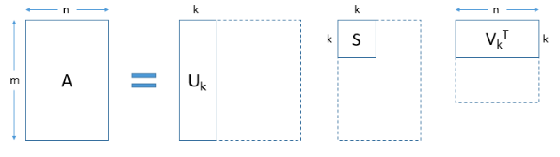


n
t
t
n
A
U
S
$$V^{T}$$
t
t
$$=$$
m
m

Slide 2
n
t
n
A
U
V
t
$$=$$
m
m

Slide 3

Output
Topic 1
Topic 2
Topic 3
…........
Topic t
Input
Data preprocessing
Topic Modelling
Algorithm
Paper-topic classification
Papers

Slide 4
Topic 1 {word 1..n}
Topic 2 {word 1..n}
Topic 3{word 1..n}
…........
Topic t {word 1..n}
Papers
NLP Annotation
Paper-Topic classification
Papers & their key words (codes)
Human Annotation
Compare

Slide 5
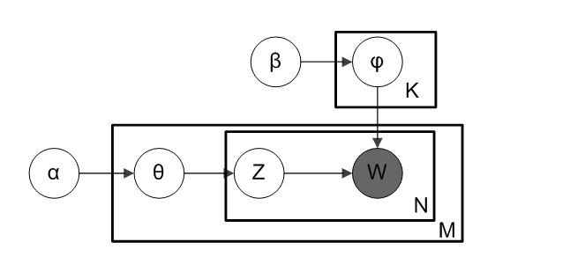
T

