Slide 1




Slide 2

Time Travel en Snowflake
Francis Griguol

Slide 3
¿Qué es Time Travel?
Snowflake Time Travel enables accessing historical data (i.e. data that has been changed or deleted) at any point within a defined period. It serves as a powerful tool for performing the following tasks:
Restoring data-related objects (tables, schemas, and databases) that might have been accidentally or intentionally deleted.
Duplicating and backing up data from key points in the past.
Analyzing data usage/manipulation over specified periods of time.
Fuente: https://docs.snowflake.com/en/user-guide/data-time-travel.html

Slide 4
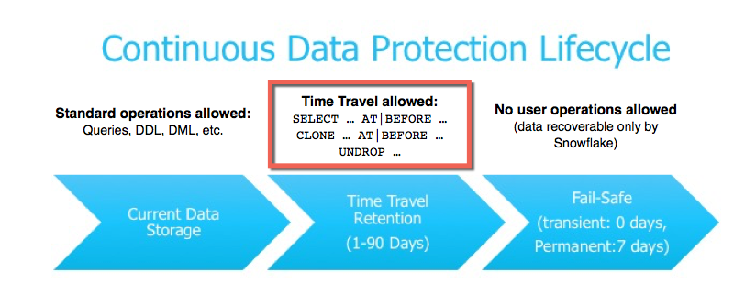

Slide 5
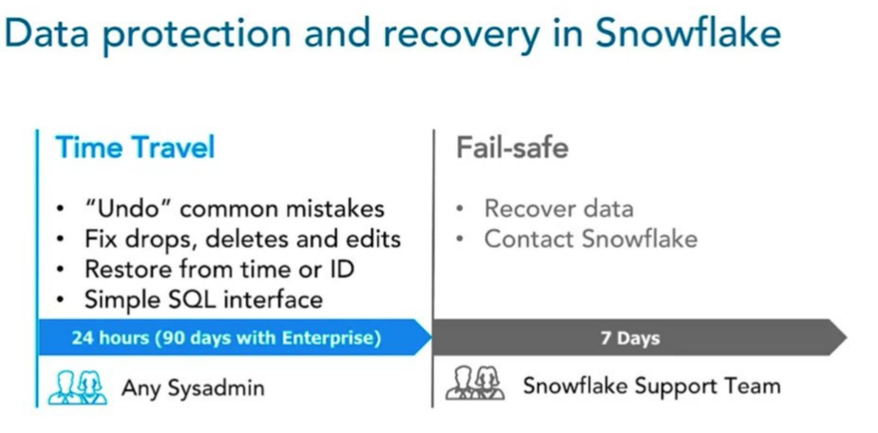

Slide 6
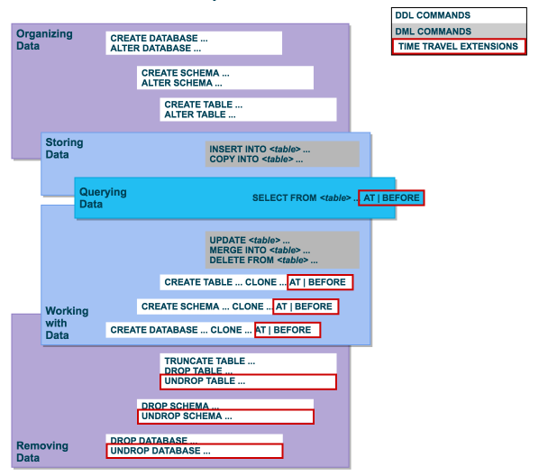

Slide 7
Demo
--setear parametro de retencion en dias
show parameters for database timetravel_test;
show parameters for table country;
alter database timetravel_test set data_retention_time_in_days = 2;
--drop/undrop
drop table country;
undrop table country;

Slide 8
Demo
--restaurar tabla a un tiempo anterior
delete from country;
--offset en segundos
insert into country(select * from country at (offset => -60*2));
--timestamp
insert into country(select * from country at (timestamp => '2022-03-09 14:25:13.537 +0000'::timestamp_ntz))
select current_timestamp
--antes de un statement
insert into country(select * from country before(statement => '01a2cfe7-0601-c9a4-0002-be030e1d2a8e'));

Slide 9
Demo
--restaurar clonando
create table restored_country clone country at(offset => -3600);
select * from restored_country;
--restaurar algunas filas
update country set default_currency = 'USD' where country_nk = 'argentina’;
select * from country where country_nk = 'argentina';
delete from country where country_nk = 'argentina';
insert into country (select * from country at (offset => -3600) where country_nk = 'argentina')

