Slide 1






Lab Meeting #2 SQL vs NoSQL: Which DB Store’s housing data most efficiently?
By Juan Villegas
4/19/23

Slide 2



Background
DB Performance Testing:
Query speeds
Insertion speed
Update speed
Delete Speeds
Load Testing: See how database performs under multiple users (1, 10, 100, 1000)
JMETER: A DB Performance testing application made by Apache

Slide 3
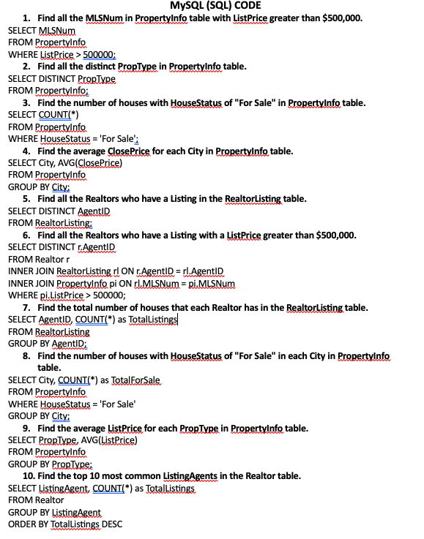
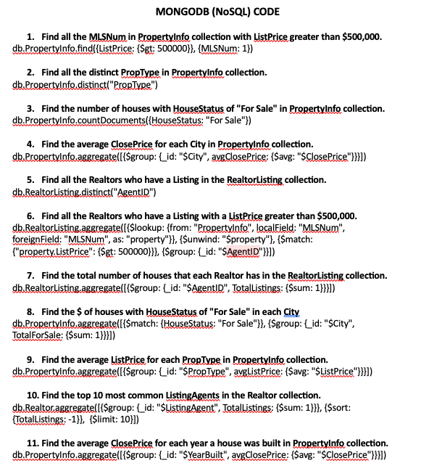
SQL & NoSQL Practice
Fig1: SQL Practice code
Fig2: NoSQL Practice code

Slide 4
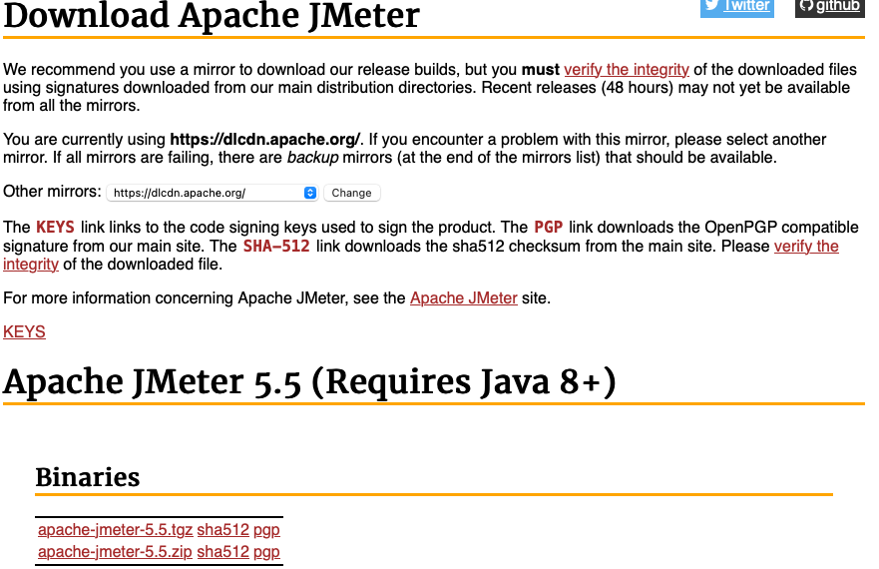
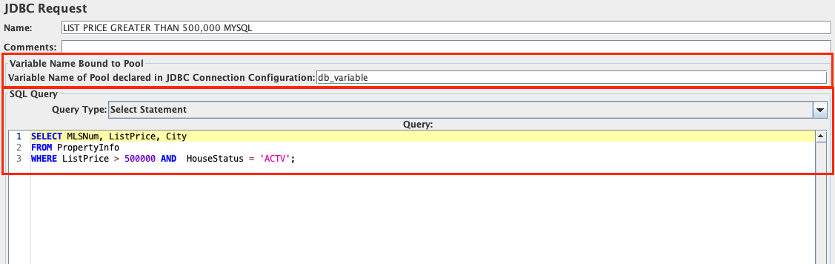
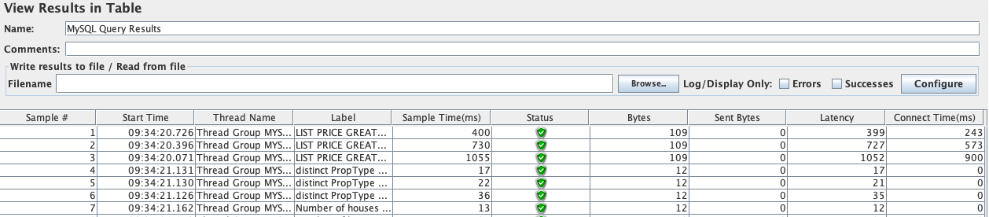
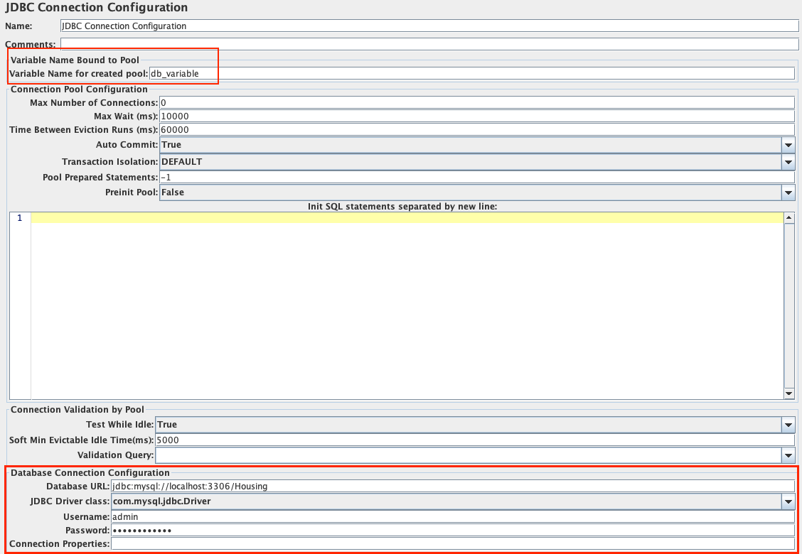
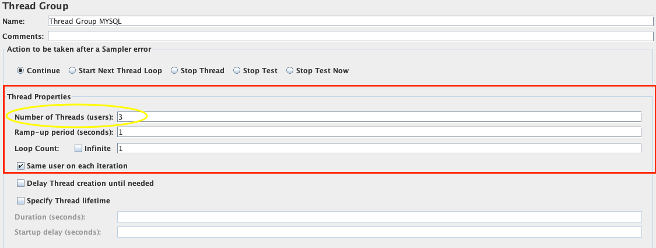
JMeter Performance Testing (MySQL)
Fig1: Go to jmeter.apache.org & download JMeter
Fig 3: Create a Java Database Connectivity (JDBC) Request
Fig 5: Run Test & See Results
Fig 2: Establish Connection to MySQL & JMeter
Fig 4: Choose threading specifications

Slide 5
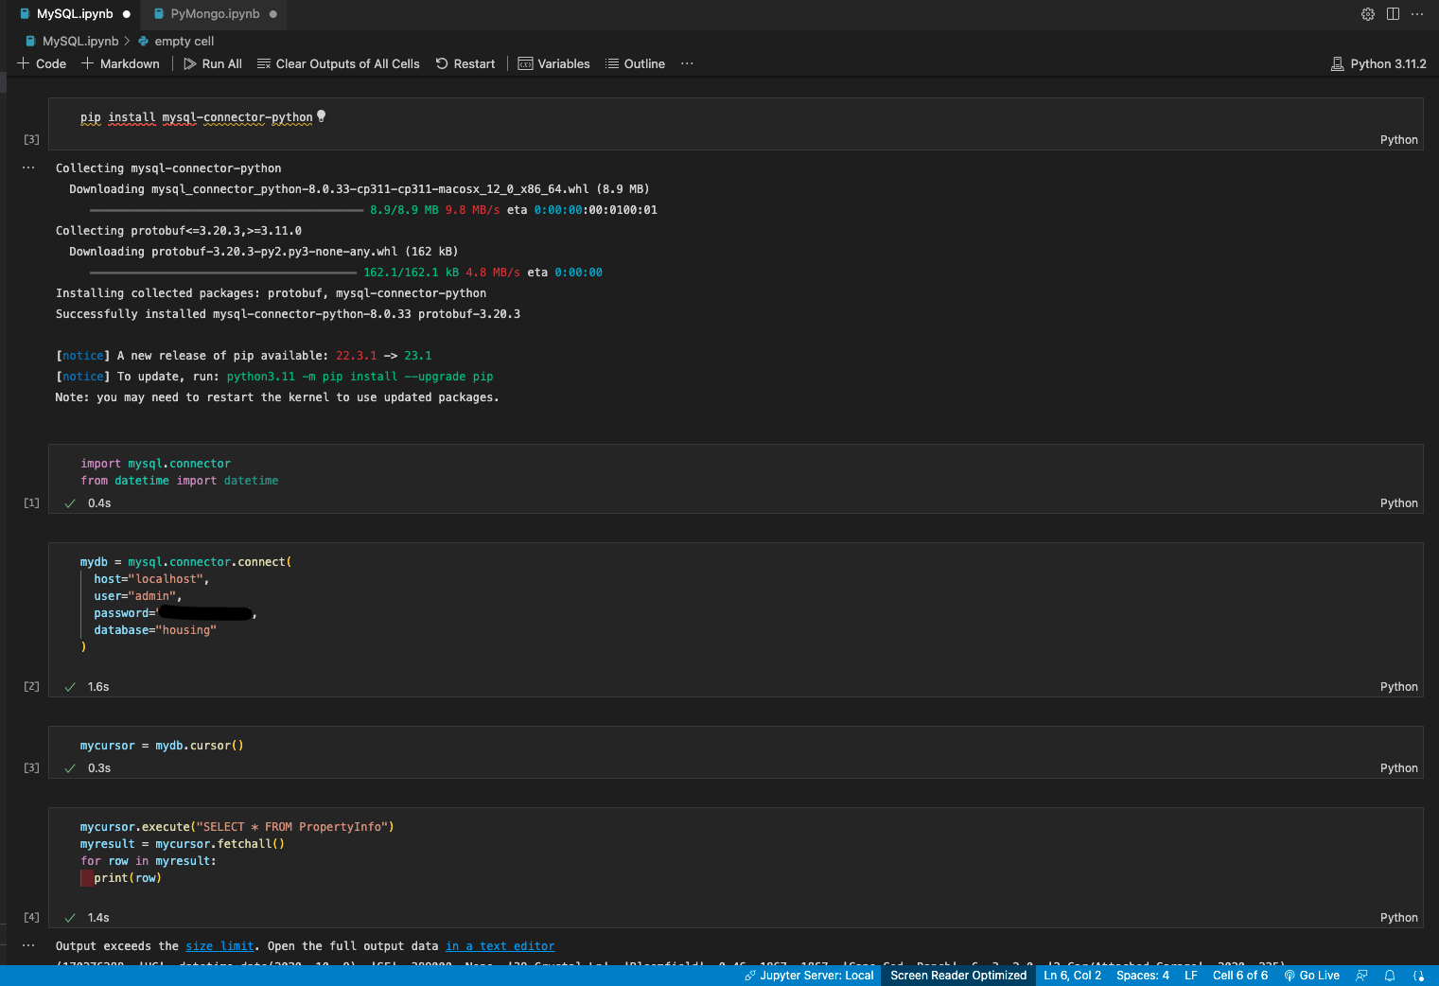
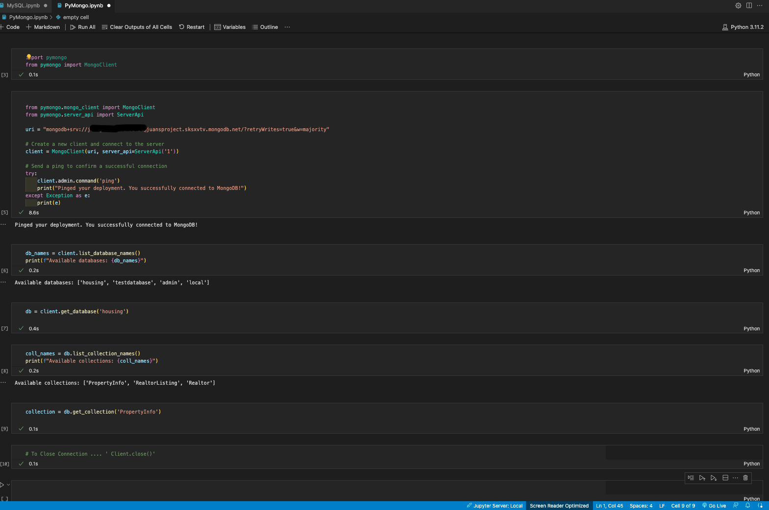
Potentially Performing Testing on Python
Fig 1: MySQL Connector on Jupyter Notebook (VSCcode)
Fig 2: MongoDB Connector on Jupyter Notebook (VSCode)

Slide 6
Next Steps: Performance Testing (Continue) + EDA
Finish Using Jmeter:
1
Compare the Performance testing:
Query speeds
Insertion speed
Update speed
Load Testing (Concurrent Users)
Conduct EDA on the DB:
2
Use a connector on python to extract data from the DB & Preform EDA
Figure out how to Connect to MongoDB

Slide 7
Questions
I’ve already gotten results ”SELECT/READ” Results from JMETER, I’m having a hard time establishing a connection with MongoDB to perform tests, how long should I do before I switch to Python to perform tests?
I’ve been recommended to only test the performance on the “SELECT/READ” operation for my housing DB. What are your opinions?
If I have more time, do you think it would be beneficially to do a complete CRUD (CREATE/INSERT , READ/SELECT, UPDATE, DELETE) Performance test?

