Slide 1
EXPOSYS
DOMAIN : WEB DEVELOPMENT
JUANITA MELOSHA K
meloshajuanita@gmail.com
B. E . Computer Science and Engineering
SATHYABAMA INSTITUTE OF SCIENCE AND TECHNOLOGY

Slide 2
PROJECT MEMBERS:
JUANITA MELOSHA K
39110417
meloshajuanita@gmail.com
B. E. computer science and engineering
Sathyabama institute of science and technology

Slide 3
PROJECT NAME : BUSINESS WEBSITE
A food business website to order homemade food online.
“business website” is the name of our webpage.
This is food business website focused on to satisfy customers with healthy and yummy food.

Slide 4
LANGUAGES USED :
HTML
CSS
JAVASCRIPT

Slide 5
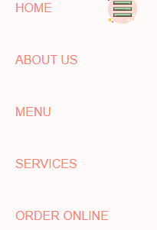
FEATURES :
HOME
ABOUT US
MENU
SERVICES
ORDER ONLINE

Slide 6

HOME PAGE :
A short overview of the business.
The user can scroll through the toggle menu.
The toggle menu shows different page button the user could click the desired section

Slide 7

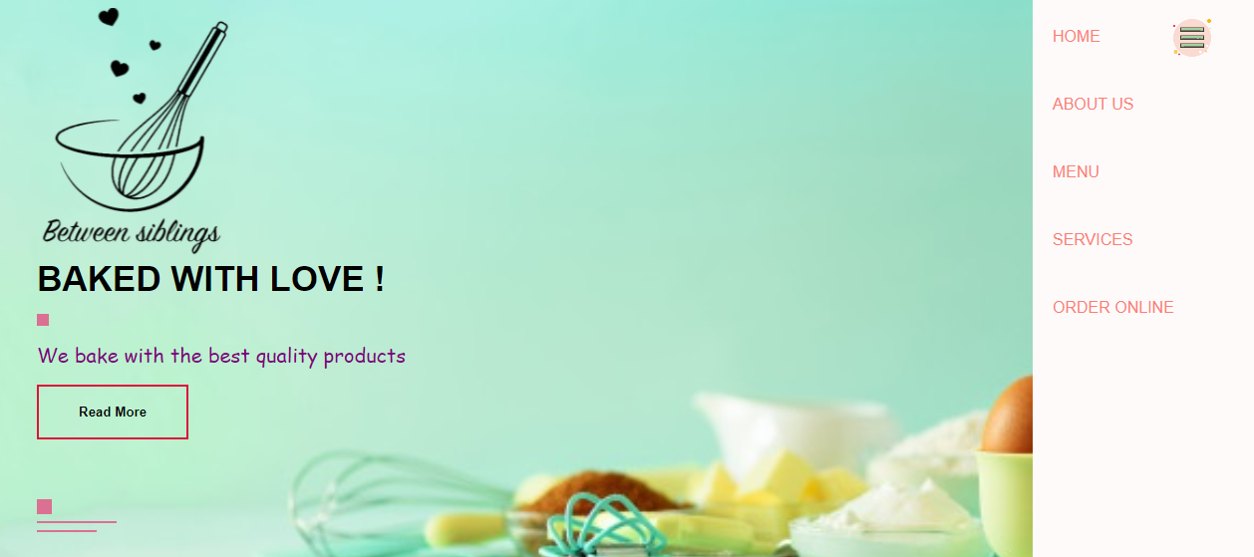
BUTTON:
The user can select their desired section using Button toggle between different sections .

Slide 8

ABOUT US :
The user can scroll through this section and know about the food business.

Slide 9
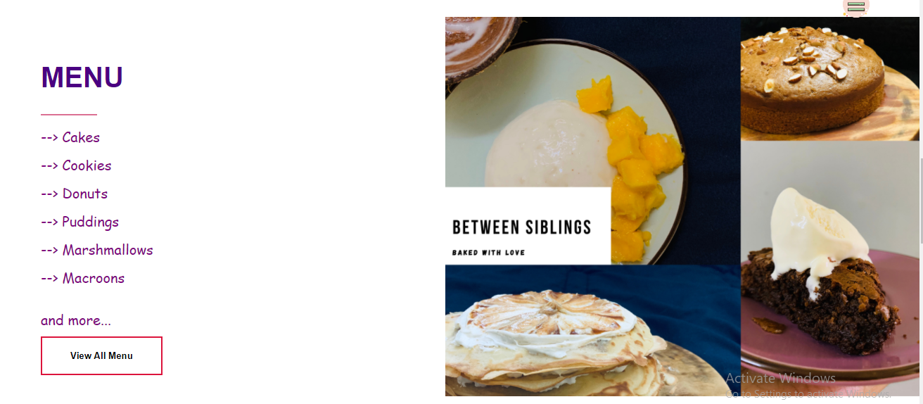
MENU:
This section shows about the menu we have and a know more button to explore everything.

Slide 10

SERVICES :
This page displays the services we provide and a know more button is provided.

Slide 11
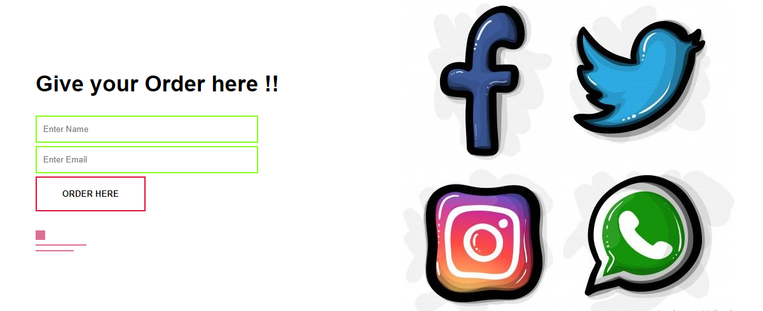
Contact us :
The user can order food online and checkout for recipes by filling the details.

Slide 12
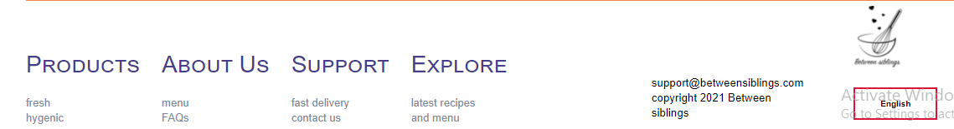
FOOTER :
This footer sections provides add on insights and solutions

Slide 13
THANK YOU !!!

