Slide 1


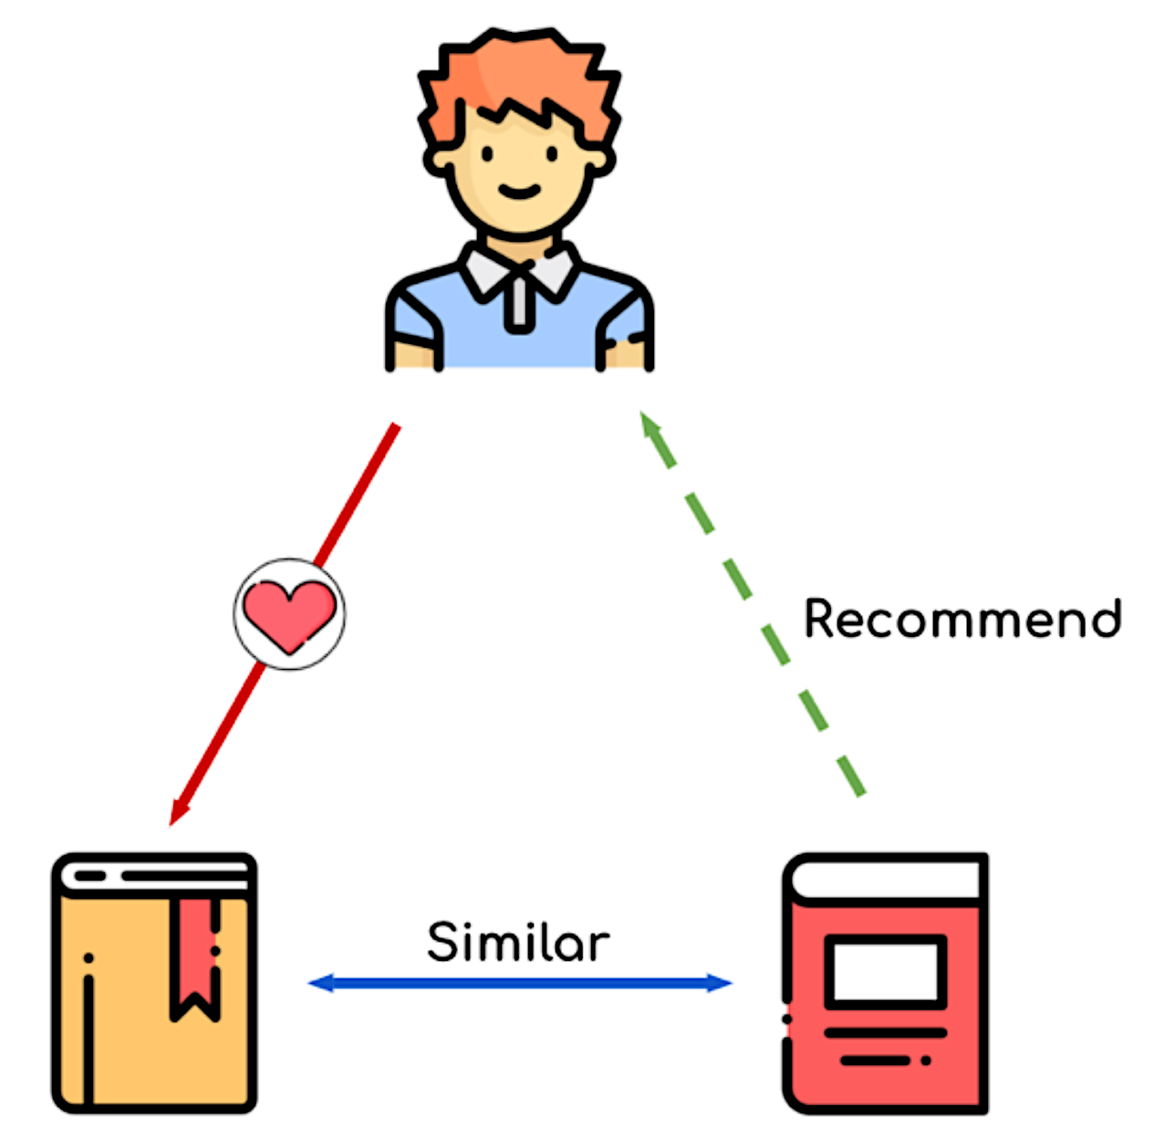
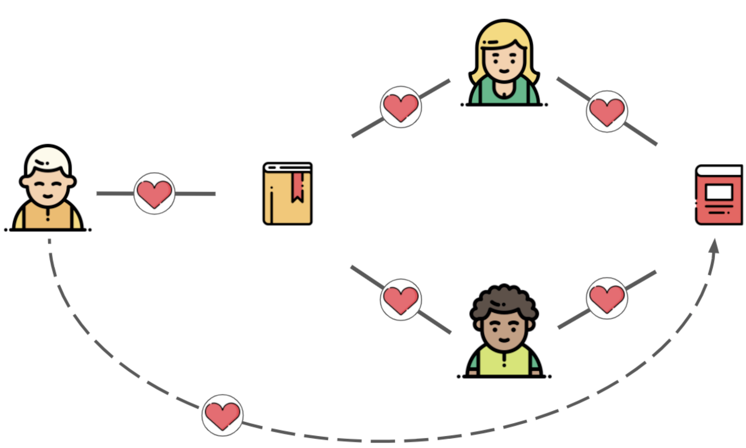
Web App Design
Enter User Id
Ranked-Based
Content-Based
Collaborative filtering
New user - no or < 20 interactions
Search text entered by user or
User have < 20 interactions
User have 20 interactions or more
1
2
3
4
5
6
7
9
10
Top ranked movies rated the most
Suggestions contains similar text as input text provided by the user
Find users with the most similar preferences and suggest their articles the user did not yet read.

Slide 2
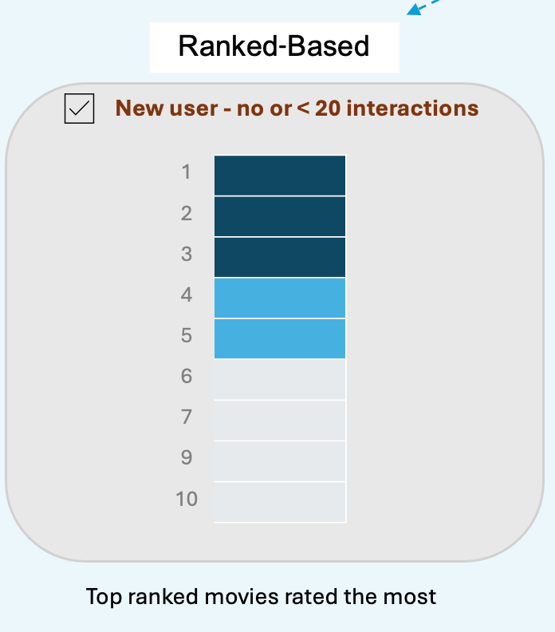

Slide 3
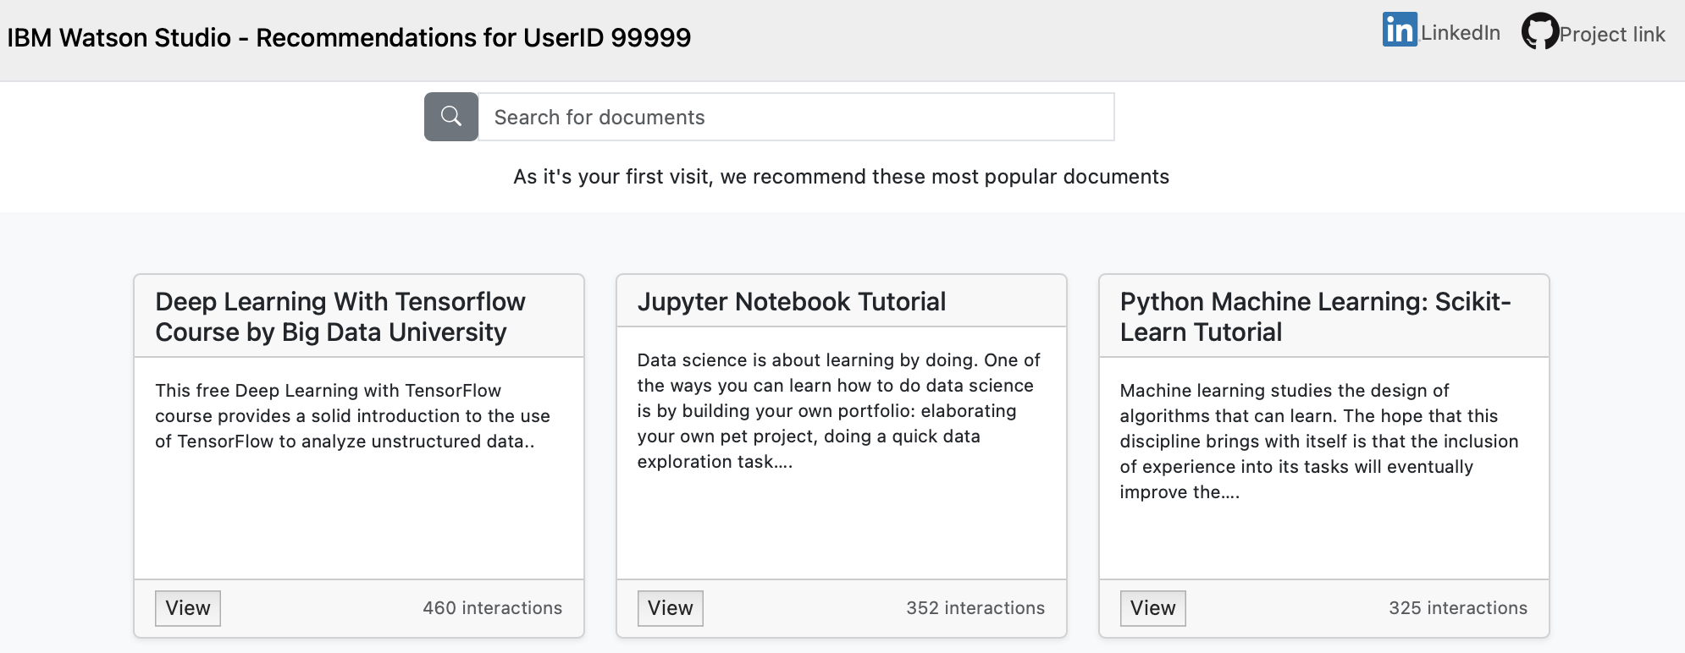

Slide 4
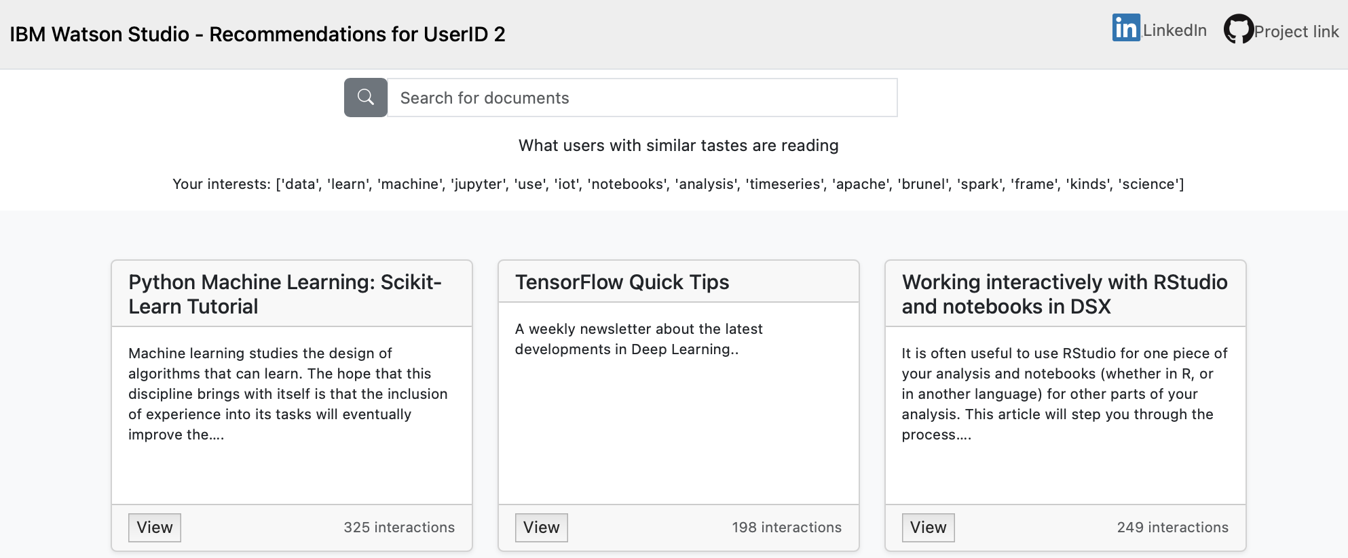

Slide 5
