Slide 1


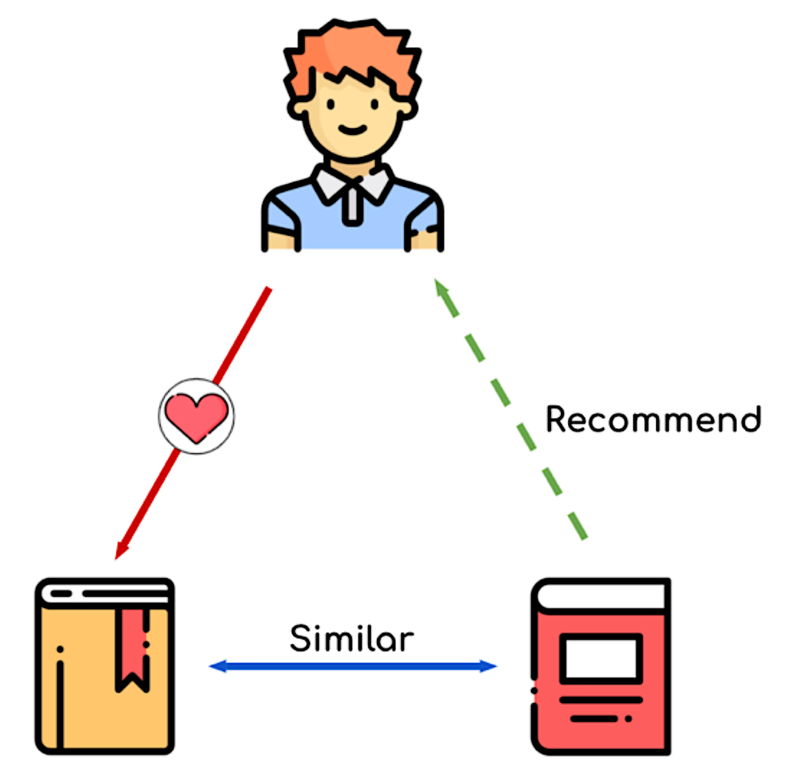
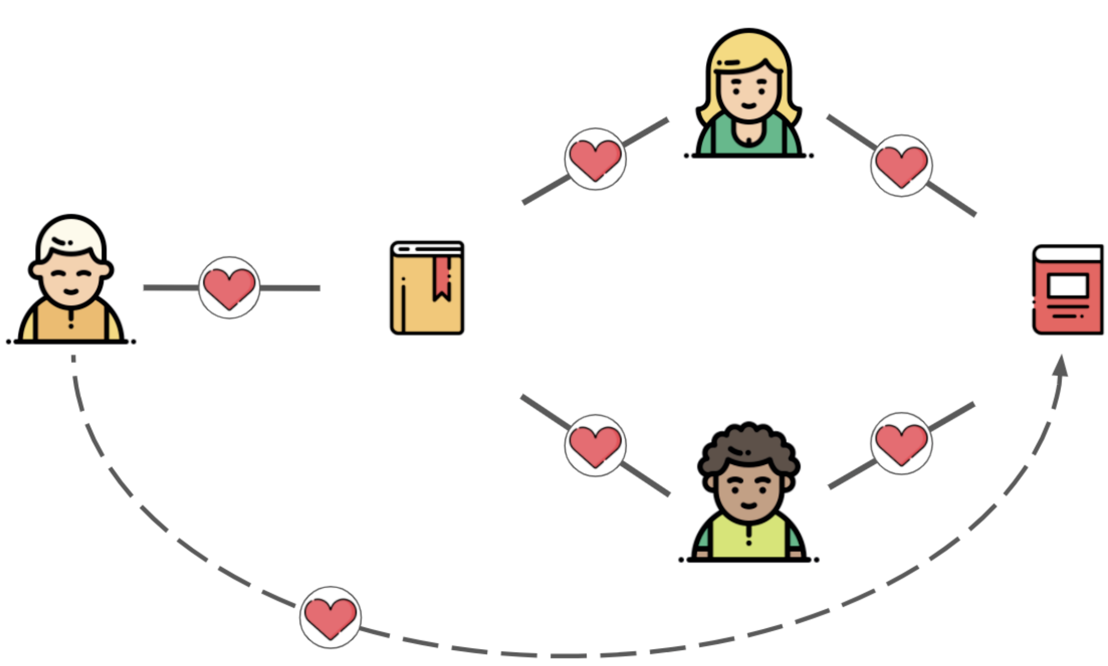
Movie Recommender
Web Application Design
Enter User Id
Ranked-Based
Content-Based
Collaborative filtering
New user: no or < 20 reviews
Search text entered by user
Example: ‘batman’, ‘animal-based superhero’
User have at least 20 reviews
1
2
3
4
5
6
7
9
10
Input search text
Top ranked movies
Highest number of reviews in IMDB
Suggestions contains similar text as input text provided by the user
Find users with the most similar preferences and suggest their movies the user did not yet watched.

Slide 2
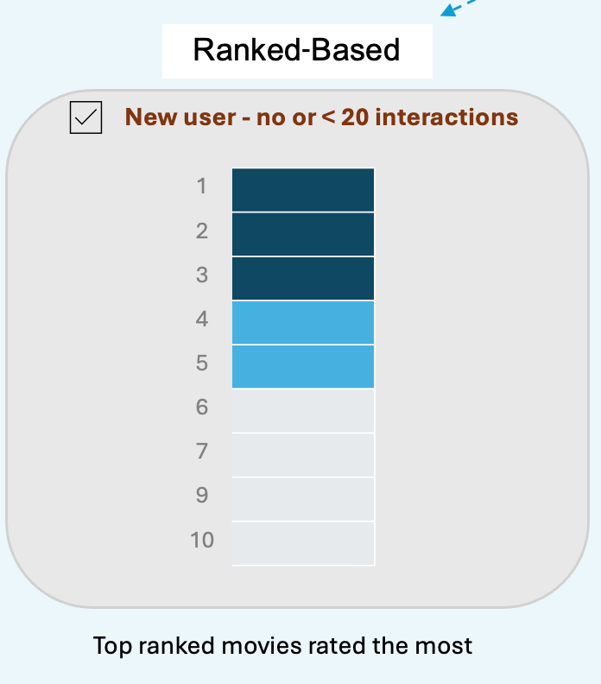

Slide 3
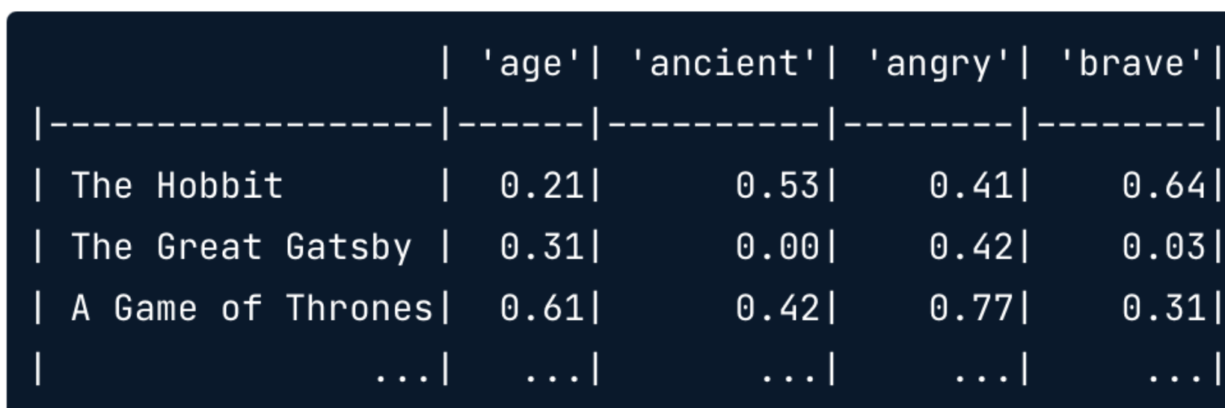

Slide 4
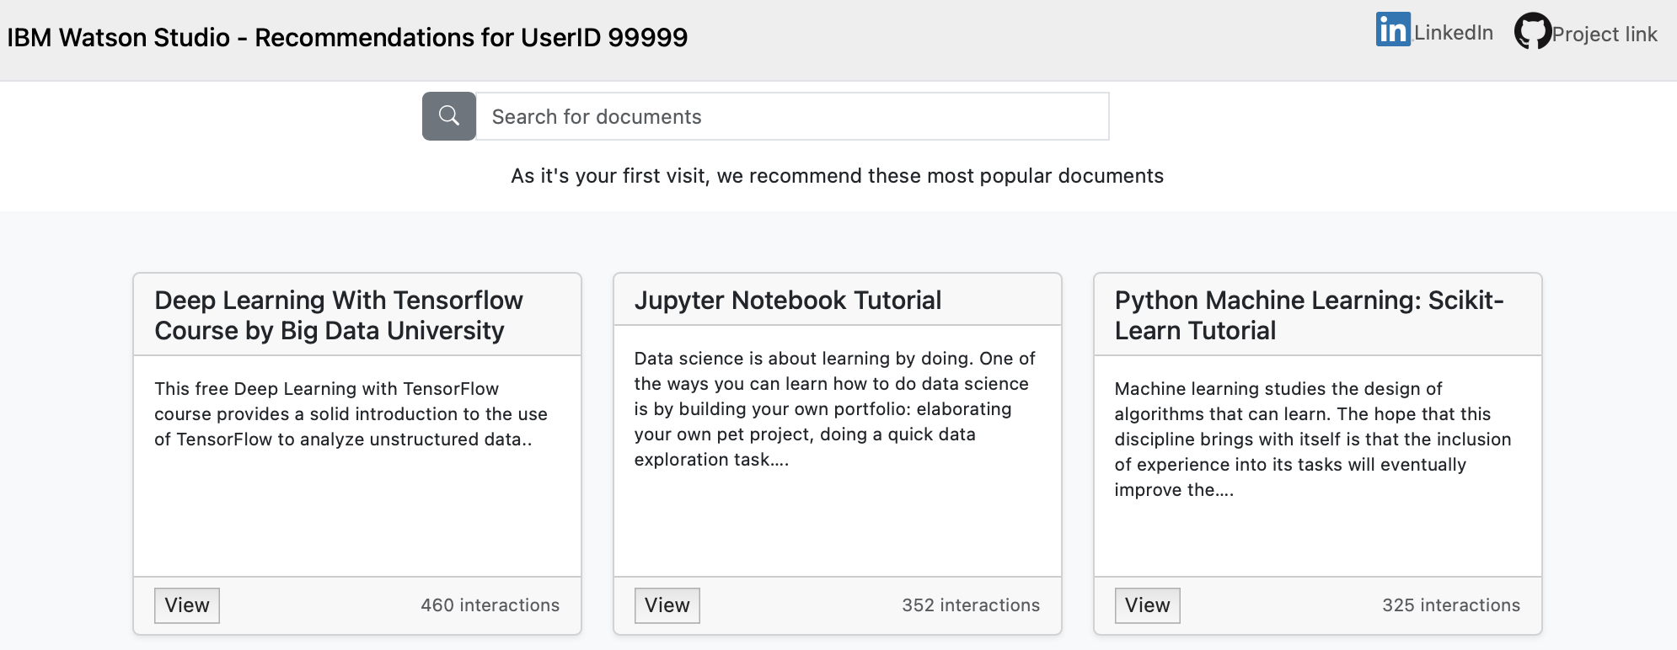

Slide 5
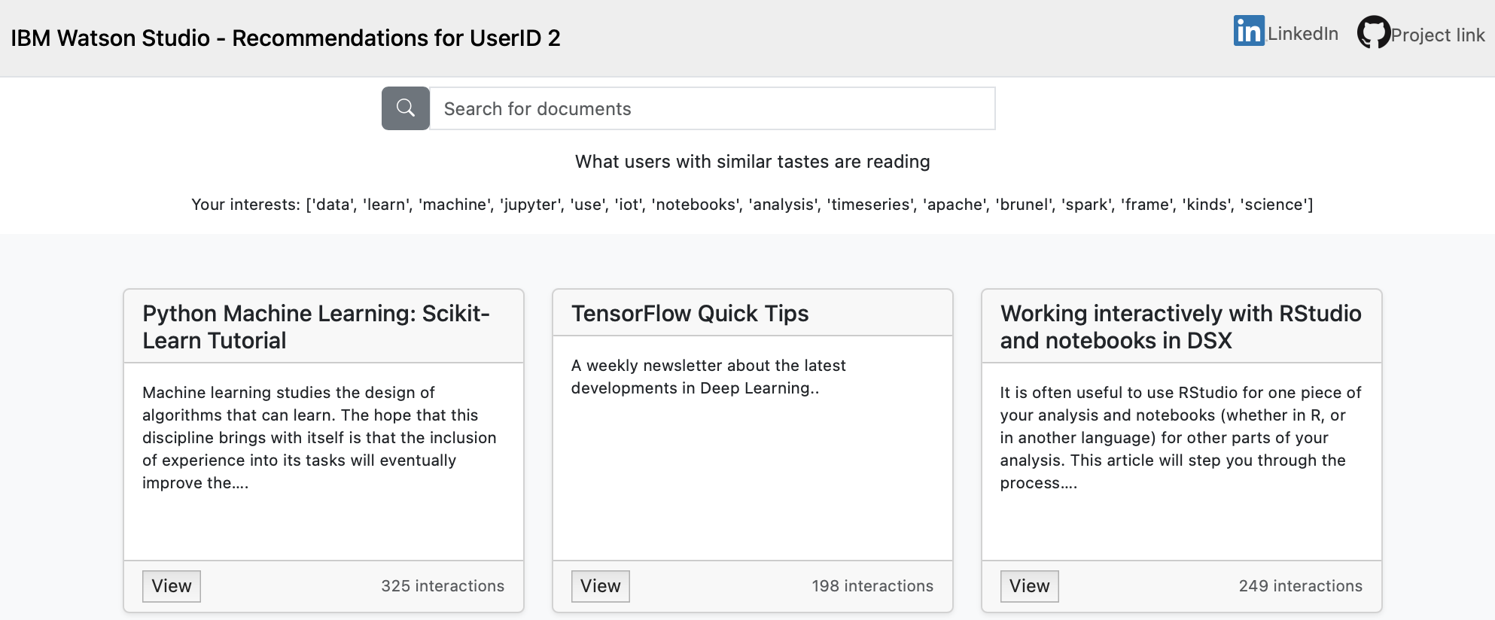

Slide 6
