Slide 1

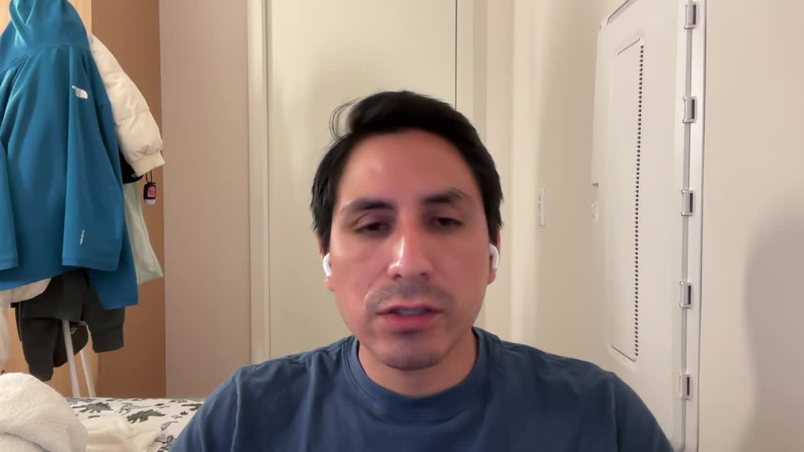
RENAISSANCE TECHNOLOGIES
Portfolio Optimization
A data-driven analysis of Jim Simons' top 6 holdings
and a quantitative rebalancing recommendation
What we will cover:
01
02
03
04
05
Client & Portfolio
Data Management
Performance & Methodology
Sharpe & Optimization
Recommendation
Team 2 | Hult MBA | Data Management & SQL | June 2026
Notes:
Hi, we are Team 2, and today we present our portfolio optimization analysis for Renaissance Technologies. We analyzed Jim Simons' top 6 holdings using 5 years of daily price data and built a data-driven recommendation.

Slide 2
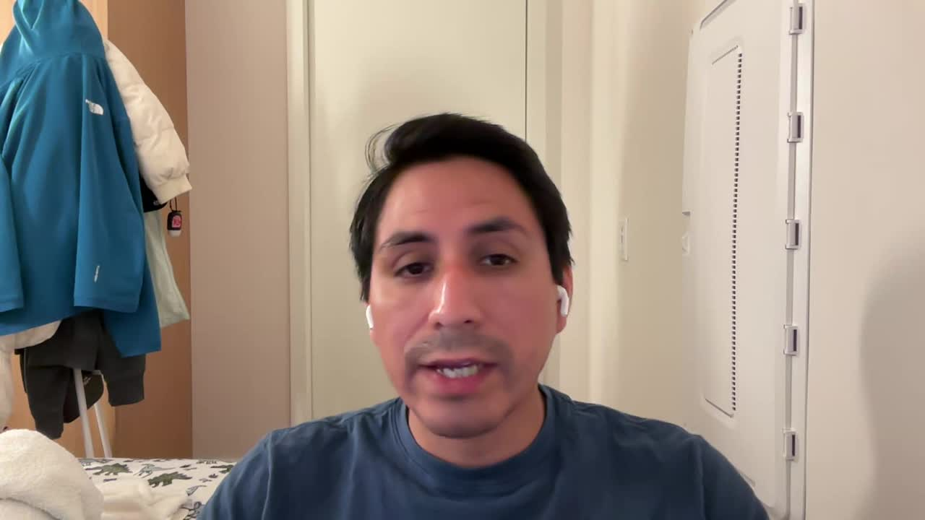
Client & Portfolio Overview
We focus our analysis on these 6 holdings.
FUND
Renaissance Technologies
MU
Micron Technology
Current weight: 34.59%
MANAGER
PLTR
Palantir Technologies
Jim Simons | Mathematician & Quant Pioneer
Current weight: 27.86%
OUR FOCUS
AUM
Top 6 holdings
by portfolio weight
(~10% of total AUM)
UTHR
United Therapeutics
$63.9 Billion (Q1 2026, GuruFocus 13F filing)
Current weight: 13.33%
KGC
Kinross Gold
TOTAL HOLDINGS
Current weight: 12.74%
3,200+ holdings across all asset classes
AAPL
Apple Inc
Current weight: 8.06%
VRSN
VeriSign Inc
Current weight: 3.42%
Current weight = market price × shares held / total value of top 6 holdings | Source: GuruFocus 13F Q1 2026, prices as of 2026-05-29
Notes:
As I mentioned, our client is Renaissance Technologies — a quantitative hedge fund founded by Jim Simons, a world-renowned mathematician. This fund manages $63.9 billion in Assets Under Management across over 3 thousand holdings. However, we focused on the top 6 holdings because they represent around 10% of total AUM. In this slide we also show the current weights of each of them within our analysis

Slide 3
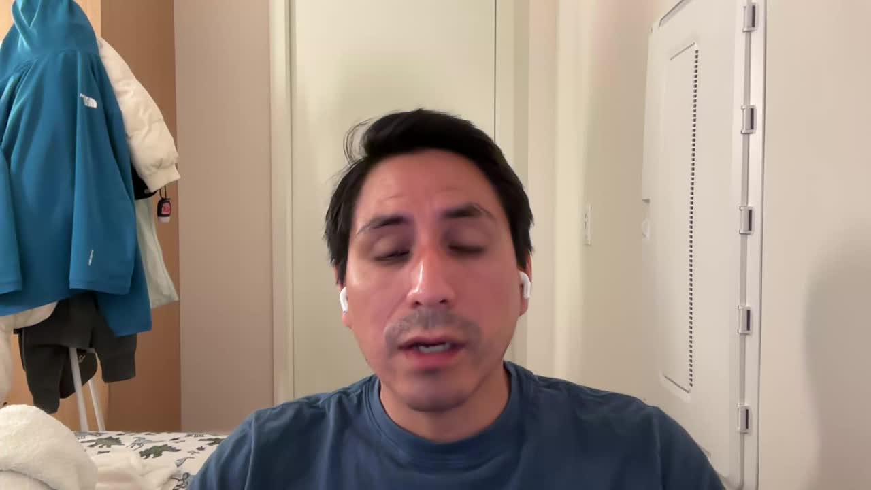
From Business Processes to Data
Every table in our database reflects a real business process. This is the foundation of good data management.
Business Process
Table
Type
What it stores
Register the client
dim_customer
Dimension
Jim Simons — name, email, location
Define the tickers
dim_ticker
Dimension
6 holdings + SPY benchmark, asset class, type
Record stock purchases
fct_holdings
Fact
Purchase date, adjusted price per share, quantity held
Load daily market prices
fct_pricing_daily
Fact
Adjusted close price per holding per day, 2021–2026
Calculate daily returns
fct_daily_ror
Fact
LAG function: ror = (price today / price yesterday) − 1
Generate analytical insights
rpt_stats / rpt_stock_detail
Report
Expected return, risk, Sharpe Ratio, current & optimal weights
Notes:
Before showing our analysis and recommendation, we'd like to briefly explain how we structured and used the data, in order to be replicated to any other client. Every table in our schema reflects a real business process, like registering the client, defining the holdings, or loading daily market prices. Then we calculated daily returns and stored them in report tables which contain all the analytical insights you will see in the next slides.

Slide 4
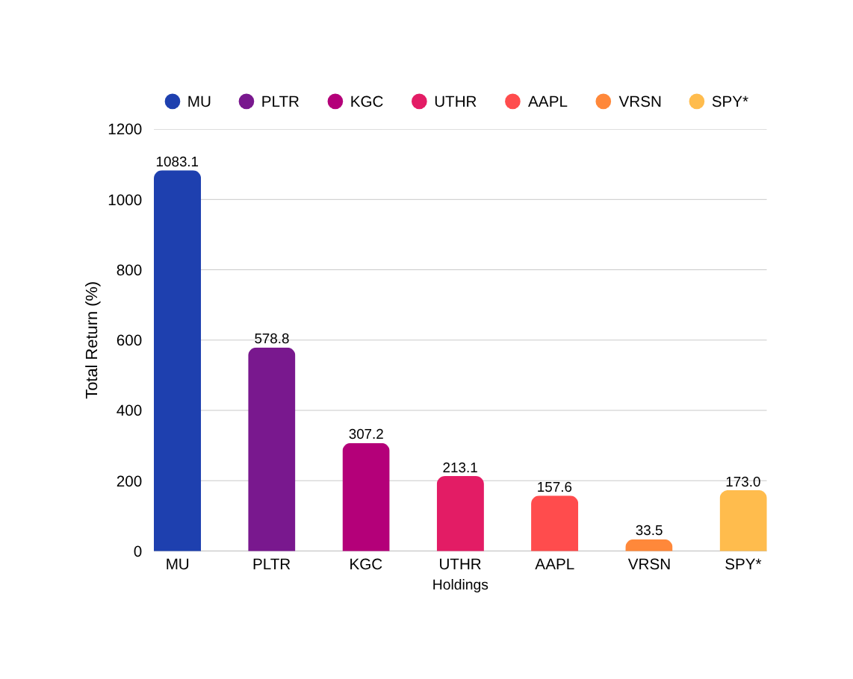
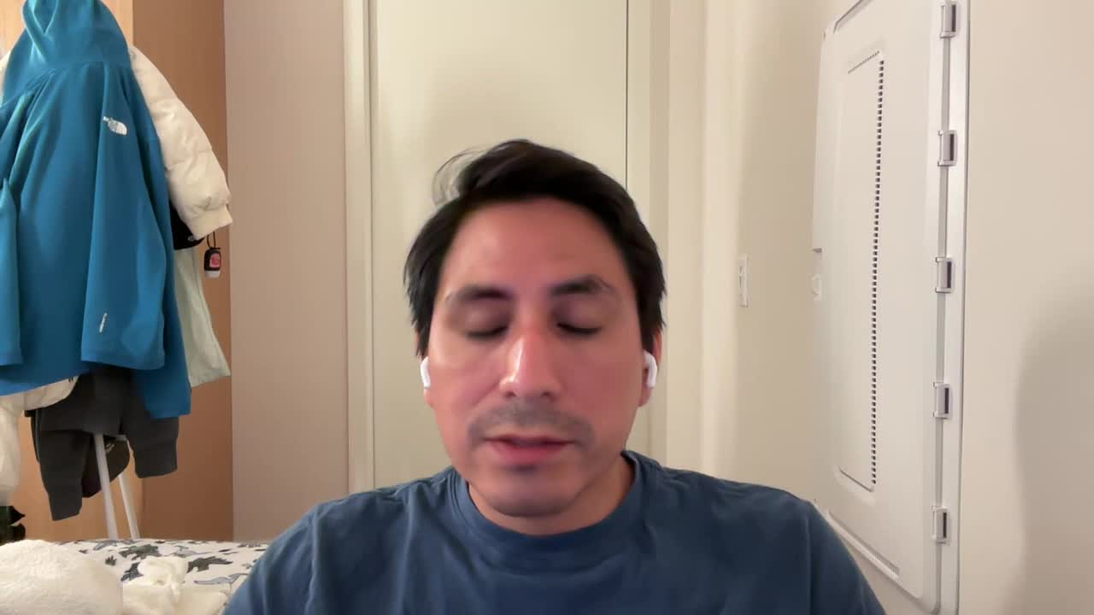
Performance since purchase & methodology
How we built the analysis
Adjusted Close prices
Accounts for stock splits and dividends, required for accurate return calculations.
5-year period: June 2021 – May 2026
Captures a full market cycle: COVID rally, 2022 bear market (Fed rate hikes), and 2023-2026 recovery. Full-cycle data gives more robust risk estimates.
3 metrics per holding
Expected Return = AVG(ror)
Risk = STD(ror)
Sharpe Ratio = Return / Risk
SPY as benchmark
Every holding is compared against the S&P 500 ETF to evaluate whether it earns its place.
Total return (%) from purchase date to May 29, 2026 | * SPY shown as market benchmark
Notes:
Now let's look at the performance since we assumed Renaissance purchased these 6 holdings in June 2021. In the graph we can see MU achieved the highest return — over 1,000%. Five of the six holdings beat SPY's return. The only exception is VRSN at just 33 percent.
For the methodology, we used Adjusted Close prices — required for accurate return calculations. We also included SPY as a market benchmark to compare with our holdings return. The metrics we used to evaluate each holding are: Expected Return, Risk, and Sharpe Ratio.
In the next slide, we will use those metrics to determine the optimal weights for each holding

Slide 5

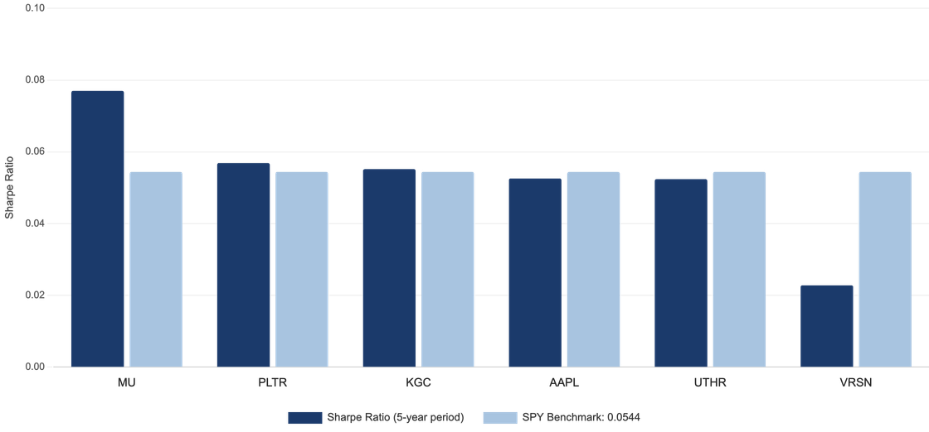
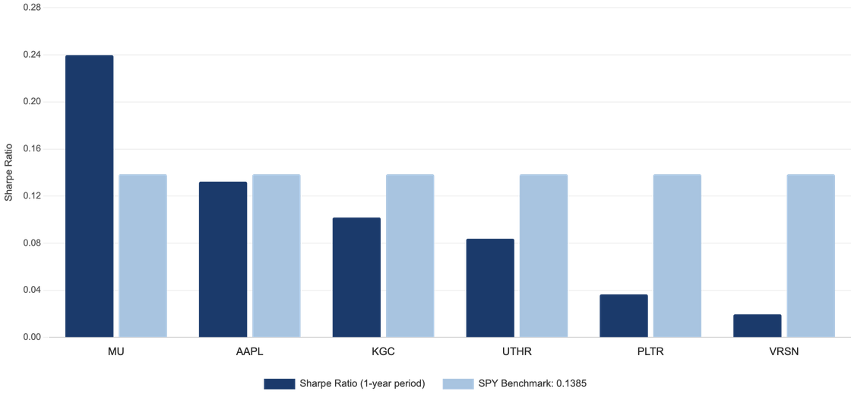
Sharpe Ratio Analysis & Optimal Rebalancing
Sharpe Ratio = Return / Risk, Higher = better
Optimal weight by period
Optimal weight = Sharpe of holding / sum of all Sharpes in that period
Ticker
Current
1YR★
2YR
3YR
4YR
5YR
Signal
MU
34.6%
37.9%
21.3%
23.9%
22.8%
24.2%
INCREASE
PLTR
27.9%
7.0%
21.9%
21.2%
21.9%
18.2%
REDUCE
UTHR
13.3%
13.5%
12.3%
14.2%
12.1%
16.5%
HOLD
KGC
12.7%
16.6%
19.0%
22.4%
20.5%
17.3%
INCREASE
AAPL
8.1%
21.1%
11.9%
11.9%
12.8%
16.6%
INCREASE
VRSN
3.4%
3.9%
13.6%
6.4%
9.9%
7.2%
HOLD
Key insight: Reduce PLTR concentration risk and increase exposure to MU and AAPL based on recent risk-adjusted performance. We use the 1-year optimal weights because they better reflect current market trends
Notes:
5
In the bar charts on the left, the top chart compares the 5-year Sharpe Ratios of each holding, while the bottom chart shows the 1-year Sharpe Ratios.
In five year chart, only VSRN falls noticeably below SPY, shows that portfolio's overall risk-adjusted performance are reasonable.
In one year chart we can see that MU is the only holding that significantly outperforms SPY in terms of Sharpe Ratio, while all other holdings fall below the market benchmark.
Although SPY delivered an exceptionally strong return of 26.9% this year, what deserves our attention is that PLTR and VRSN have extremely low Sharpe Ratios of 0.0365 and 0.0196, yet together they account for nearly 31% of the portfolio.
Although we calculated Sharpe Ratios using each year historical data, we ultimately chose to use the 1-year Sharpe Ratio as the basis for future portfolio rebalancing.
The main reason is that the market environment today is significantly different from five years ago. We are currently in an AI-driven technology cycle, where many technology stocks have remained strong despite market ups and downs
For example, Micron (MU) only began to show meaningful outperformance over the last one to two years as AI-related demand accelerated. Using a 5-year lookback period would dilute this recent trend and may not accurately reflect the company's current fundamentals or market position.
Therefore, we believe that the 1-year Sharpe Ratio better captures current market dynamics and recent performance trends, making it a more relevant metric for portfolio rebalancing decisions at this stage.
Based on the considerations above, the chart on the right shows our recommended portfolio allocation adjustments going forward

Slide 6

Key Findings & Recommendation
KEY FINDINGS
OUR RECOMMENDATION
1
The Portfolio's Main Strength is Downside Protection
Based on 1-year optimal weights
The portfolio took about three times more risk than SPY, but delivered similar risk-adjusted returns. Its key strength was downside protection, losing only 4.23% during the 2022 bear market versus SPY's 17.20% decline.
Immediate Action: Rebalance Based on 1-Year Optimal Weights
We recommend reducing PLTR and reallocating part of the position into AAPL. Based on the simulation, this adjustment improves expected return and Sharpe Ratio while adding only a modest increase in portfolio risk
2
Recent Performance Has Been Strong, but MU Drives Most of It
The portfolio delivered a strong 1-year return of 77.58%. However, a large portion of this performance came from MU, which gained over 1,000% since purchase. MU is also the only holding that consistently outperforms SPY on a risk-adjusted basis across both the 1-year and 5-year periods.
Medium-Term: Monitor MU Closely
MU has been the primary driver of portfolio performance over the past year. Since semiconductor cycles can be volatile, investors should continue monitoring both AI demand and memory market conditions.
3
PLTR Appears Overallocated Relative to Its Recent Performance
Long-Term: Improve Diversification
PLTR currently represents 27.86% of the portfolio, making it the largest holding. However, its 1-year Sharpe Ratio has fallen to 0.0365, one of the lowest among all holdings. This suggests that the current allocation may be too high relative to its recent risk-adjusted performance.
The portfolio remains heavily concentrated in technology-related stocks. Increasing exposure to assets with lower correlation, such as fixed income or defensive sectors, could help improve long-term portfolio stability.
Notes:
6
our first key finding is that the portfolio's main strength is downside protection. While it took about three times more risk than SPY, it only declined 4.23% during the 2022 bear market, compared to SPY's 17.2% decline.
Second, recent performance has been very strong, but MU drives most of the gains. MU is the only holding that consistently outperforms SPY on a risk-adjusted basis across both the 1-year and 5-year periods.
Third, PLTR appears to be overallocated(over ra le cated). It represents nearly 28% of the portfolio, but its 1-year Sharpe Ratio has fallen to just 0.0365, suggesting that the current position size may not be justified by its recent performance.
Moving to our recommendations on the right side, our immediate action is to rebalance based on the 1-year optimal weights by reducing PLTR and increasing AAPL. We believe the 1-year weights better reflect current market conditions and the ongoing AI trend.
In the medium term, we recommend closely monitoring MU(Micron), since recent portfolio performance is highly dependent on it.
Finally, for the long term, we recommend improving diversification by increasing exposure to assets outside the technology sector to reduce concentration risk.

