Slide 1
PharmaPedia
The informatic pill storage system

Slide 2
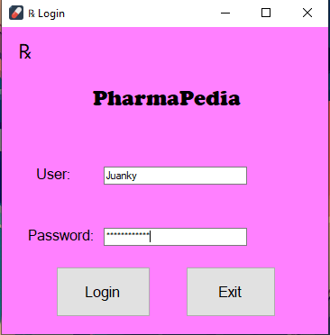
Login Page
Input is tied to what is store in the database

Slide 3
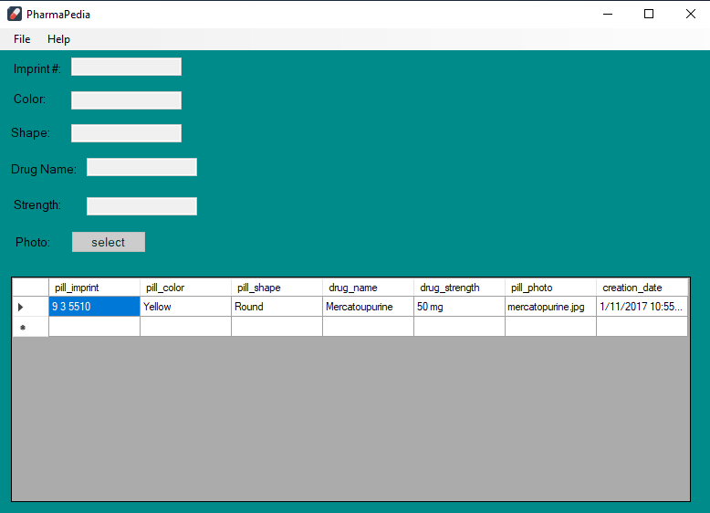
Main Page
Before a selection has been made, all fields will be disabled.
The “File” tab will host the options available to you:
* Add
* Modify * Identify
*Report
The Data Grid will be up to date with the lasted entries.

Slide 4
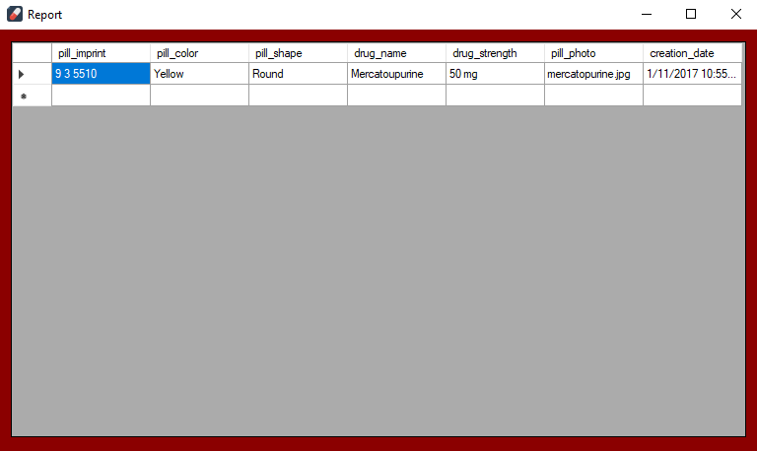
Report
The Pill Report under the “File” tab will open a separate window with only the Data Grid detailing every pill.

Slide 5
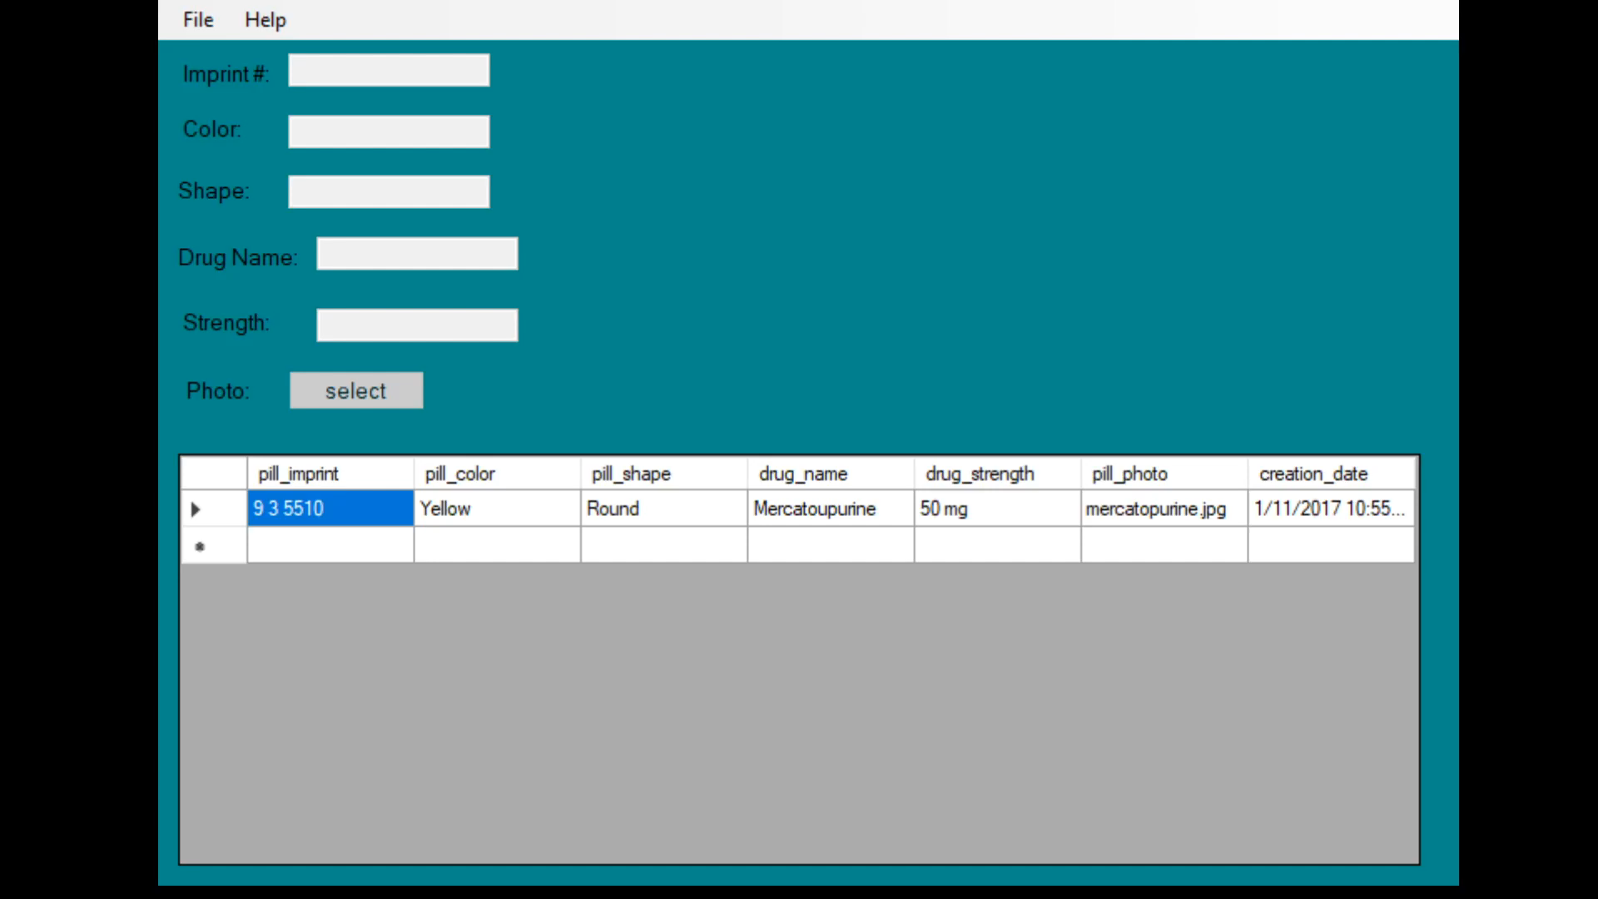
Add/Modify Demo

Slide 6
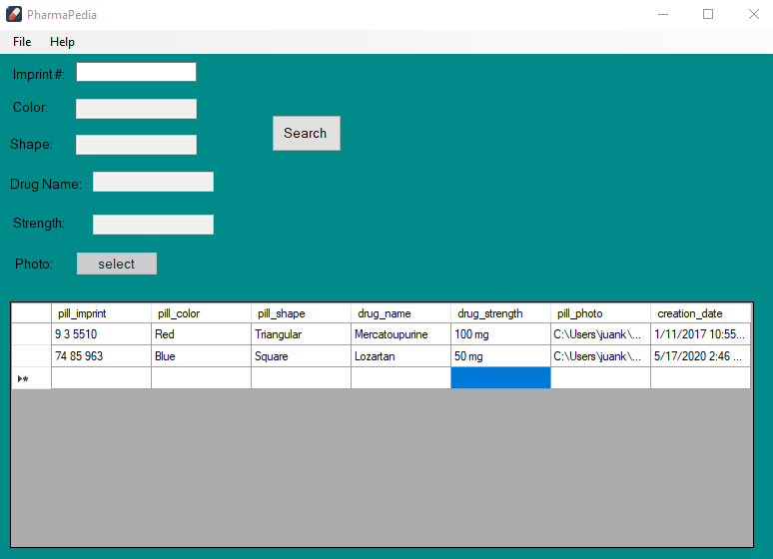
Pill Identifier
When the Pill Identifier is clicked under the “File”.
User will enter the pill’s imprint # to get a message box with its details.

Slide 7
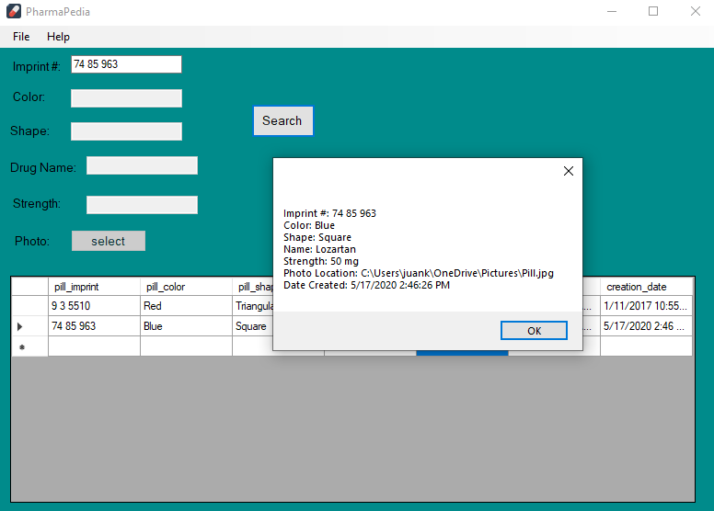
Pill Identifier
When the Pill Identifier is clicked under the “File”.
User will enter the pill’s imprint # to get a message box with its details.

Slide 8
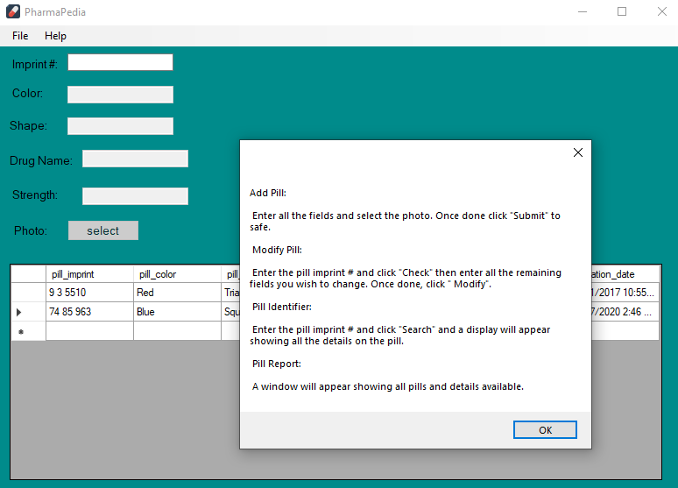
Help Contents

Slide 9
Thank you!
By: Juancarlos Moldes

