Slide 1

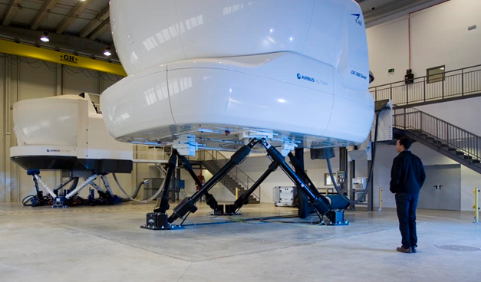
Project Reference
Maintenance and Operation of Flight Simulators - Airbus DS Training Centres
(2017 – Today)
The main tasks and requirements of the Maintenance and Operation of Flight Simulators team:
Support the operation of the devices (including power-up and shutdown, lesson preparation, etc.).
Perform preventive and corrective maintenance, and AOG management.
Identify and solve technical problems.
Cleaning, lubrication, startup, replacement of consumables, and fault diagnostics.
Creation and updating of technical documentation and maintenance procedures and provide training in maintenance activities.
Support is also provided to device manufacturers and other entities interacting with them.
Maintenance of training facilities: classrooms, computer rooms and services facilities.
EASA FSTD certifications and ARINC recommendations 433 and 434
Development and maintenance of digital management tools for simulators and digital planning tools for operators
24/7 service type.
ATEXIS maintains a wide range of training devices:
Full flight simulators (EASA Level C and D)
Integrated procedures trainers (IPT)
Flat panel flight training devices (FP-FTD)
Cargo hold (CHT-E) and LoadMaster Workstation trainers (LMWS)
Cockpit maintenance (CMOS) and FMS trainers, ARO part task trainer (PTT), ACTs, Boom desktop trainers, and Computer-Based Training (CBTs).
Project Manager
Project Management Officers (PMOs)
Engineers and technicians for simulator maintenance
2D/3D technical designers and software developers and web applications
The Maintenance and Operation of Flight Simulators project was created at the ITC (International Training Centre), the training center of Airbus Defence and Space, with the objective of ensuring the continuous and proper operability of various training devices.
During the execution of the service, tasks are carried out on training devices related to the aircraft A330, A400M, CN235, and C295.
ARINC 433/434/662
EASA FSTD
ISO 9001
ISO 9100
ISO 27001
ISO 14001
+1000 sessions per year
+4500 learners per year
+30 training rooms
Operational availability > 98% of devices
AIRBUS DS Premises: Sevilla, Zaragoza, Albacete (Spain)
France, UK, Germany, Saudi Arabia, Oman, UAE, Poland, Belgium, Luxembourg, Singapore, India

Slide 2
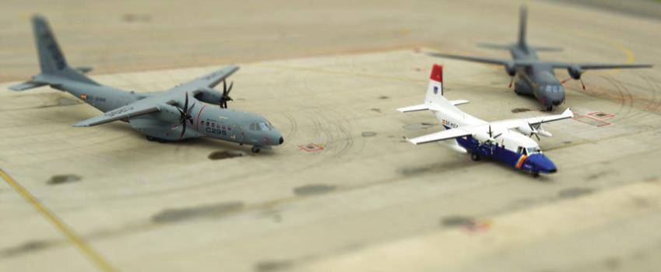
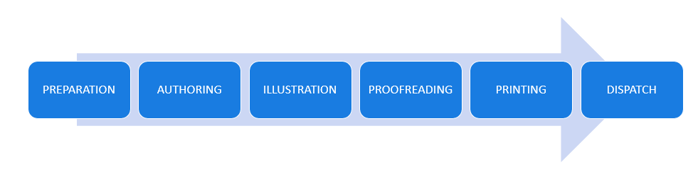
Project Reference
Operational Documentation - C-295, CN-235, C-212 & P3
(2015 – 2023)
Aircraft operations manuals are technical documents that integrate maintenance procedures, system checks, and emergency protocols, all supported by rigorous engineering analysis.
For the aircraft models of Airbus Defence and Space, the technical documentation is adapted to the specific characteristics of each platform. For example, the C-295 stands out for its focus on system redundancy and the integration of advanced avionics fly-by-wire in hybrid configurations; the CN-235 for its optimization in logistical missions and load management; and the C-212 for its procedures designed for operations in complex environments.
These manuals are essential for both operation and maintenance engineering, as they incorporate simulation data and real tests. Their continuous updating ensures regulatory compliance and the incorporation of technological improvements in the life cycle of each platform.
Additionally, support is provided for questions related to these activities (Queries) from both customer personnel and end users (operators).
Main Operational Documentation Manuals
AOM (Aircraft Operations Manual): Consolidates operational procedures and emergency protocols, providing a comprehensive technical guide for the crew during each phase of flight.
QRH & CKL (Quick Reference Handbook & Checklist): Offers an immediate reference tool with checklists and critical procedures, enabling quick and accurate responses in high-demand operational situations.
PDM (Performance Data Manual): Compiles and updates performance data and technical configurations, facilitating analysis and optimization of the aircraft’s operational parameters
And many others: FOT (Flight Operations Transmission), FOBN (Flight Operations Briefing Notes), AFM (Airplane Flight Manual), WBM (Weight and Balance Manual), etc.
Project Manager
Project Management Officer
Documentation Developers
Technical AI14Illustrator
Subject Matter Experts (SMEs)
Administrative
Linguistic Validator
Authoring and revision of Operational Documentation of Airbus Defence & Space over all ATA chapters in the following aircrafts: Civil and military operation: C-295, CN-235, C-212 & P3
Printing and Publication Service
Ensure Technical Completion and Quality of deliveries for military customers
Result Commitment
ADOPS
Samanta Suite
Configuration Management Tool
IDS
PTC Arbortext
Samanta Suite
Illustro
Sidie
Sprint.net
EPD-Connect
Qualico
S1000D
ATA iSpec 2200
ATA 100
ASD-STE100
RFT 98.5%
QSI 99.94%
Top 10 Pareto
On time for queries;
Sevilla, Spain
Madrid, Spain

