Slide 1

Credit score classification
Juan Manuel Mesa
2022

Slide 2
Outline
Summary
Introduction
Methodology
Results
Conclusion

Slide 3






Summary
Summary of all Methodologies:
Data extracted from Kaggle
Data wrangling : Python, Pandas, NumPy,
- Exploratory Data analysis: Python: Matplotlib, Seaborn, Tableau
Machine learning modeling: Python, Scikit-learn
Summary of all results:
Exploratory Data analysis result
Visualization
Predictive modeling

Slide 4

Introduction
A credit score is a numerical summary of a consumer’s apparent creditworthiness. It’s calculated taking into consideration the consumer’s payment history, salary, amount owed, and other financial information.¹
What is a credit score?
In this case, we need to develop a model that could predict consumer’s apparent creditworthiness. We have access to a 100000 rows data set. The data set also has 27 descriptors and a multiclass label (Poor, Standard and Good) to identify creditworthiness.
What is the problem?
¹Consumer Financial Protection Bureau of the United States

Slide 5

Methodology
Data
Data was extracted form Kaggle and load as a DataFrame
Extensive data manipulation was made: Removing symbols and spaces, extracting information from categorical features, dropping columns, fixing data types, handling missing values and reassigning outliers.
Remaining categorical feature were one hot encoded
Figure.- Data manipulation of some features

Slide 6
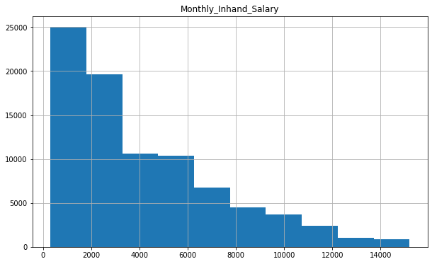
Methodology
Data visualization
Matplotlib, Seaborn and Tableau were used to visualize data.
Due to the categorical nature of the target feature, bar chart were used in most cases.
Possible relationships between variables were analyzed, as well as relationship between feature and target.
Figure.- Histogram of Monthly Inhand Salary

Slide 7
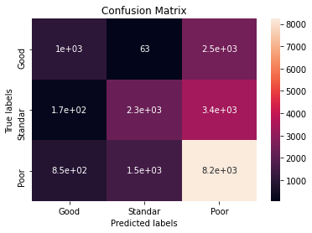
Methodology
Modeling
Scikit-learn was used to build the models.
The data set was scaled with StandarScaler
The data was split between Train set and Test set (80% and 20%)
4 models were deployed : Logistic Regression, Decision Tree, K-Nearest neighbors and XGBoost.
In most cases, GridSearch was used to find the bests hyperparameters
A confusion matrix was done for LogReg due to poor results.
Figure.- Confusion Matrix for LogReg

Slide 8

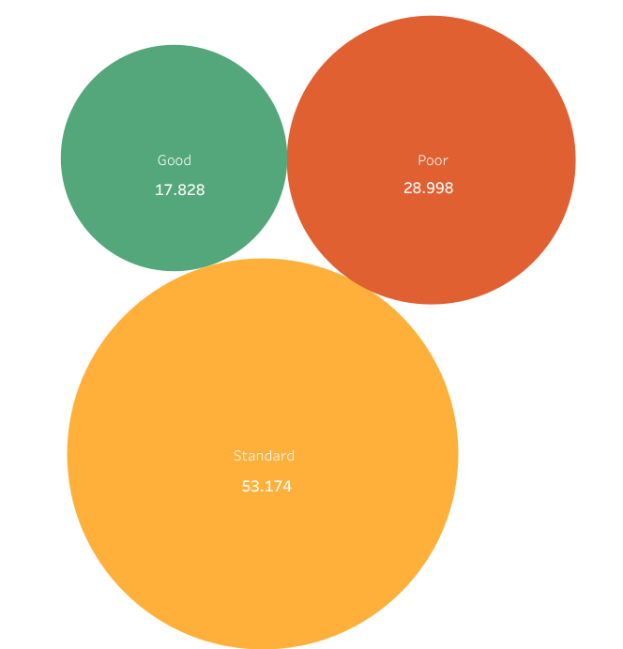
Results
Exploratory Data Analysis
53% of our data have a ‘Standard’ Credit Score, 30% is described as ‘Poor’ , and only 18 as ‘Good’

Slide 9
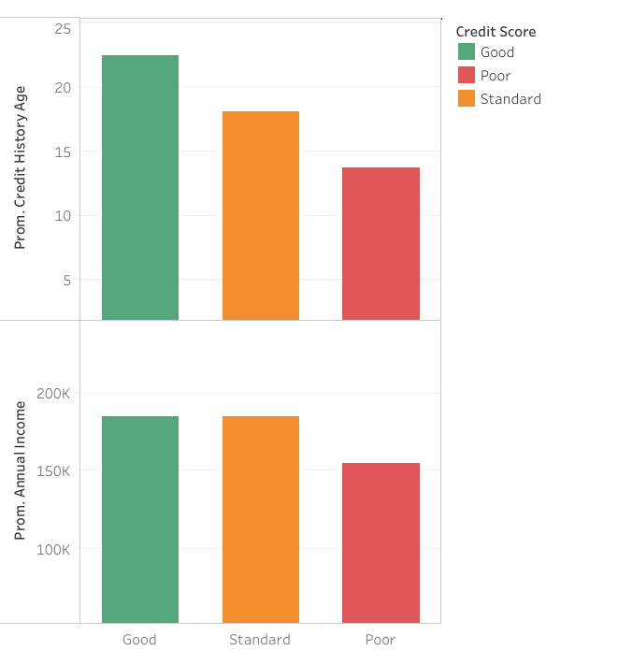
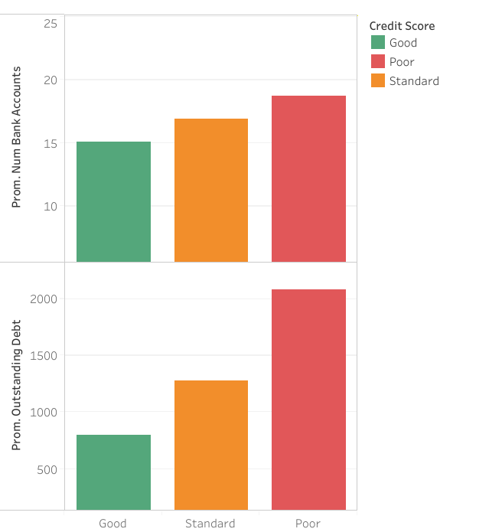
Results
Exploratory Data Analysis
Most of the feature show a clear relationship with Credit Score (target features)

Slide 10
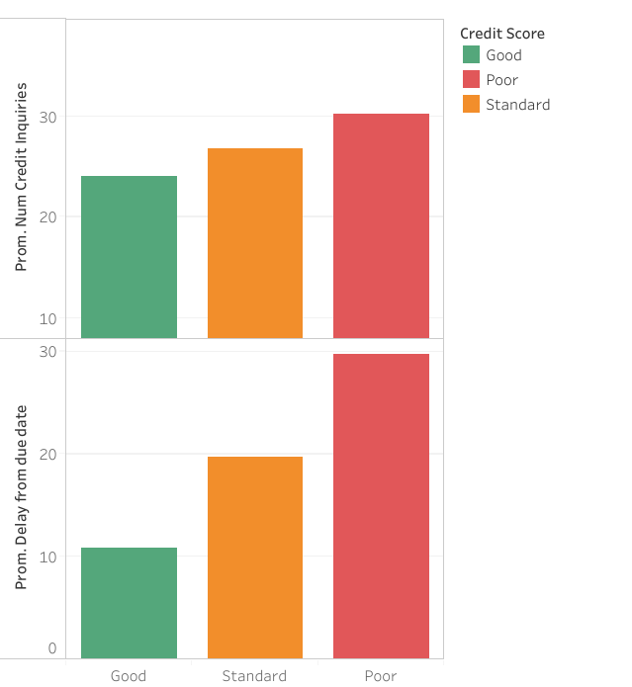
Results
Exploratory Data Analysis
‘Delay from due date’ shows a strong correlation with the Credit Score classification

Slide 11
Results
Exploratory Data Analysis
‘Delay from due date’ shows a strong correlation with the Credit Score classification

Slide 12
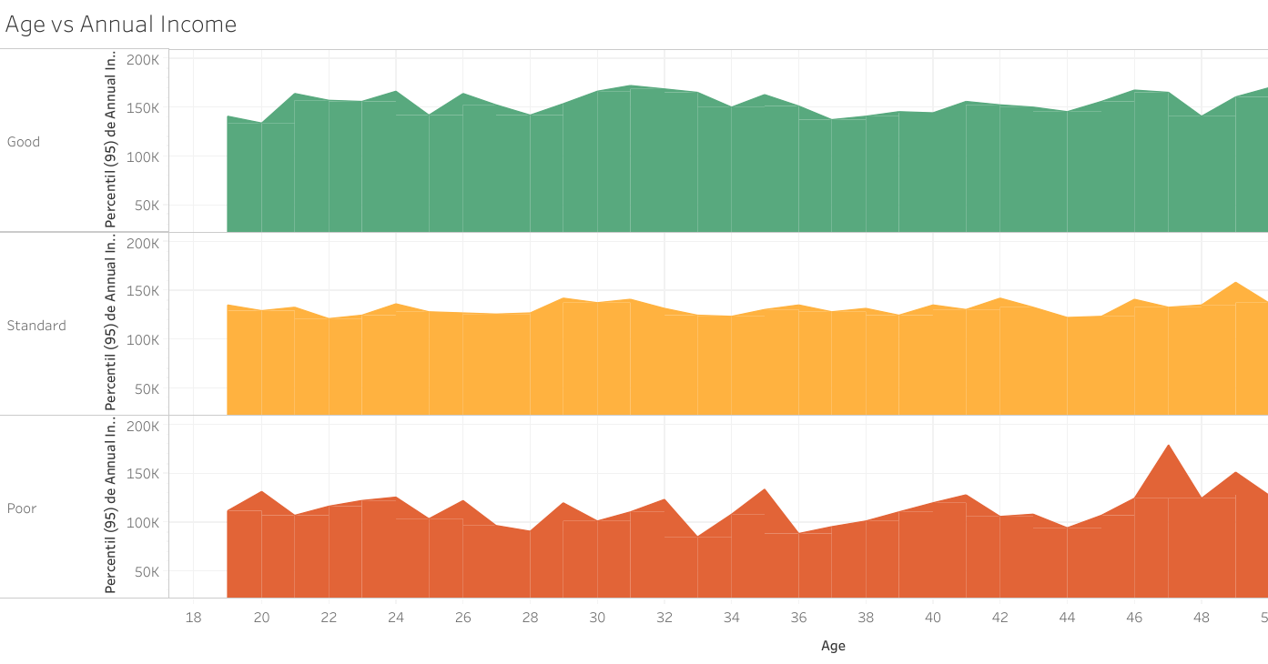
Results
Exploratory Data Analysis
Interdependence between the Age and the Annual income was study. No clear dependence was found

Slide 13
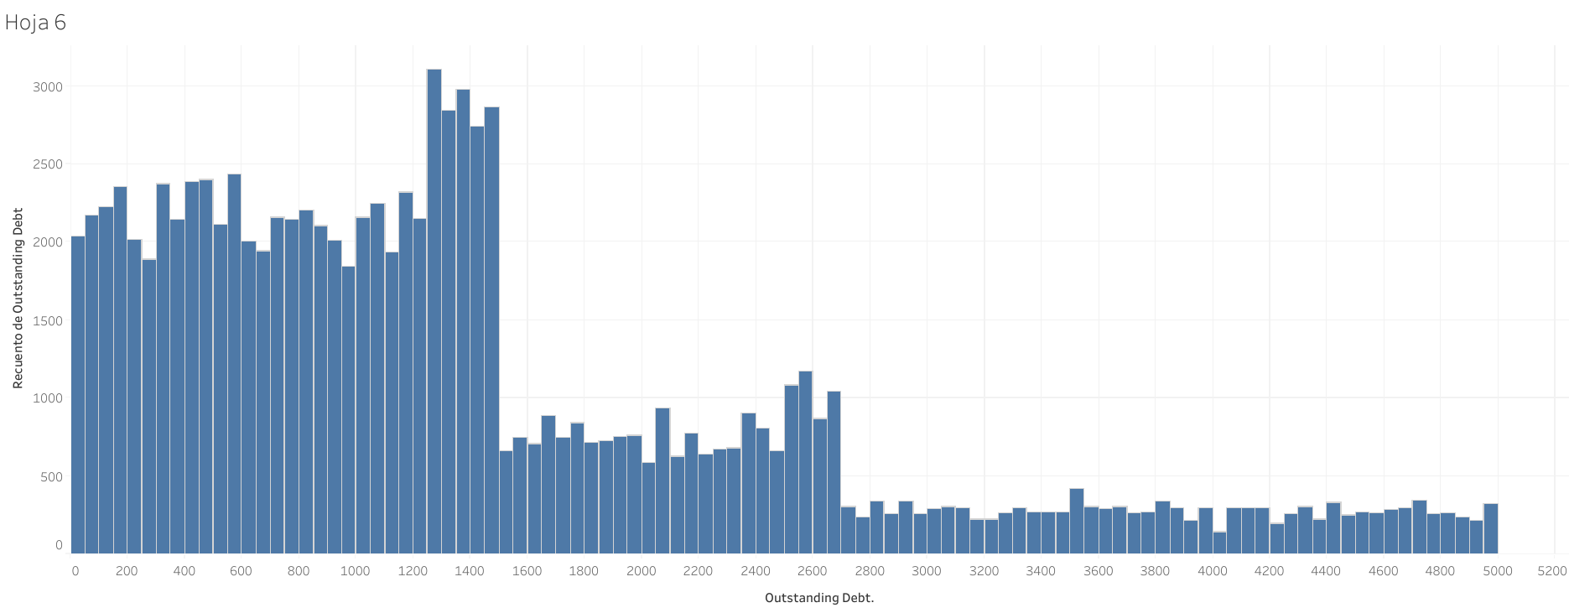
Results
Exploratory Data Analysis
Distribution of the variables was study using Histograms. Most of the variables show a non normal distribution. Because of this, missing values were replaced by the median, not the mean.

Slide 14
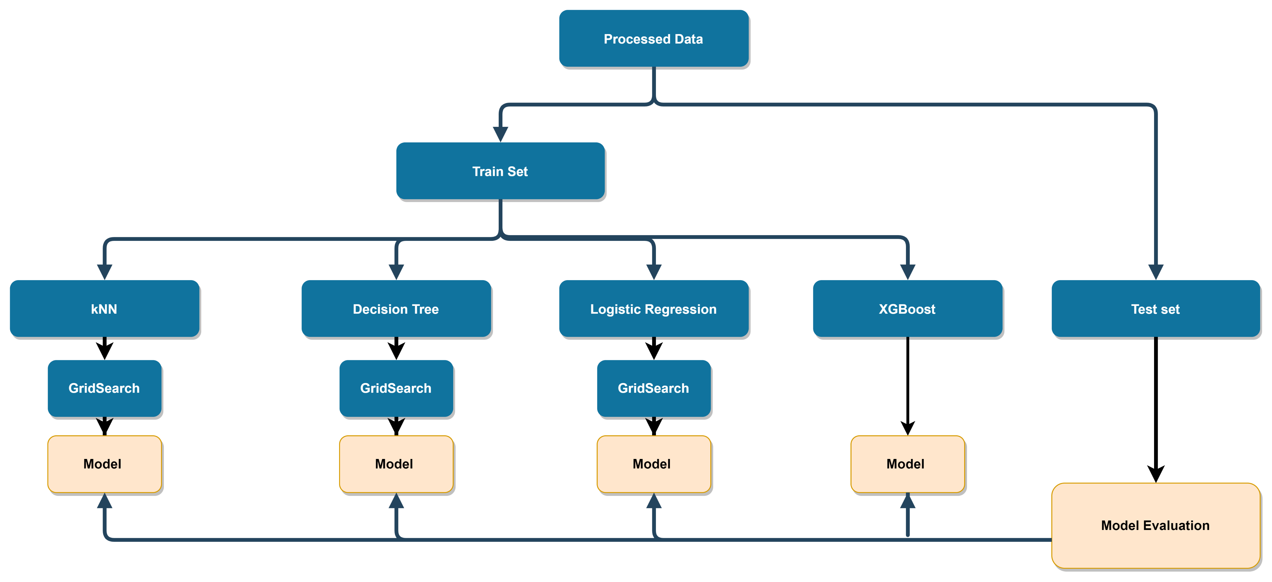
Results
Modeling
Score function and the test set were used to evaluate the models.

Slide 15
Results
Model evaluation
Model | Score
Logistic Regression | 57.7 %
k-Nearest Neighbors | 71.6 %
Decision Tree | 68.8 %
XGBoost | 74.4 %
XGBoost is the model with the Highest Score: 74.4 %

Slide 16

Conclusion
A data set was cleaned and processed using data analysis tools
EDA was done with Python libraries and Tableau
A predictive model for the classification of Credit Score was developed
XGBoost was de best model with a Score of 74.4%

Slide 17


Sources
Raw Data set: https://www.kaggle.com/datasets/parisrohan/credit-score-classification
Github: https://github.com/Juanma814/Credit_Score_Classification
Tableau: https://public.tableau.com/app/profile/juan.manuel.mesa.bruno

