Slide 1

PyCitySchools Pandas-Challenge
Chief Data Scientist - helping the school board and mayor make strategic decisions regarding future school budgets and priorities

Slide 2
School Name | School Type | Total Students | Total School Budget | Per Student Budget | Average Math Score | Average Reading Score | % Passing Math | % Passing Reading | % Overall Passing
Bailey High School | District | 4976 | $3,124,928.00 | $628.00 | 77.048432 | 81.033963 | 66.680064 | 81.933280 | 54.642283
Cabrera High School | Charter | 1858 | $1,081,356.00 | $582.00 | 83.061895 | 83.975780 | 94.133477 | 97.039828 | 91.334769
Figueroa High School | District | 2949 | $1,884,411.00 | $639.00 | 76.711767 | 81.158020 | 65.988471 | 80.739234 | 53.204476
Ford High School | District | 2739 | $1,763,916.00 | $644.00 | 77.102592 | 80.746258 | 68.309602 | 79.299014 | 54.289887
Griffin High School | Charter | 1468 | $917,500.00 | $625.00 | 83.351499 | 83.816757 | 93.392371 | 97.138965 | 90.599455
Hernandez High School | District | 4635 | $3,022,020.00 | $652.00 | 77.289752 | 80.934412 | 66.752967 | 80.862999 | 53.527508
Holden High School | Charter | 427 | $248,087.00 | $581.00 | 83.803279 | 83.814988 | 92.505855 | 96.252927 | 89.227166
Huang High School | District | 2917 | $1,910,635.00 | $655.00 | 76.629414 | 81.182722 | 65.683922 | 81.316421 | 53.513884
Johnson High School | District | 4761 | $3,094,650.00 | $650.00 | 77.072464 | 80.966394 | 66.057551 | 81.222432 | 53.539172
Pena High School | Charter | 962 | $585,858.00 | $609.00 | 83.839917 | 84.044699 | 94.594595 | 95.945946 | 90.540541
Rodriguez High School | District | 3999 | $2,547,363.00 | $637.00 | 76.842711 | 80.744686 | 66.366592 | 80.220055 | 52.988247
Shelton High School | Charter | 1761 | $1,056,600.00 | $600.00 | 83.359455 | 83.725724 | 93.867121 | 95.854628 | 89.892107
Thomas High School | Charter | 1635 | $1,043,130.00 | $638.00 | 83.418349 | 83.848930 | 93.272171 | 97.308869 | 90.948012
Wilson High School | Charter | 2283 | $1,319,574.00 | $578.00 | 83.274201 | 83.989488 | 93.867718 | 96.539641 | 90.582567
Wright High School | Charter | 1800 | $1,049,400.00 | $583.00 | 83.682222 | 83.955000 | 93.333333 | 96.611111 | 90.333333

Slide 3
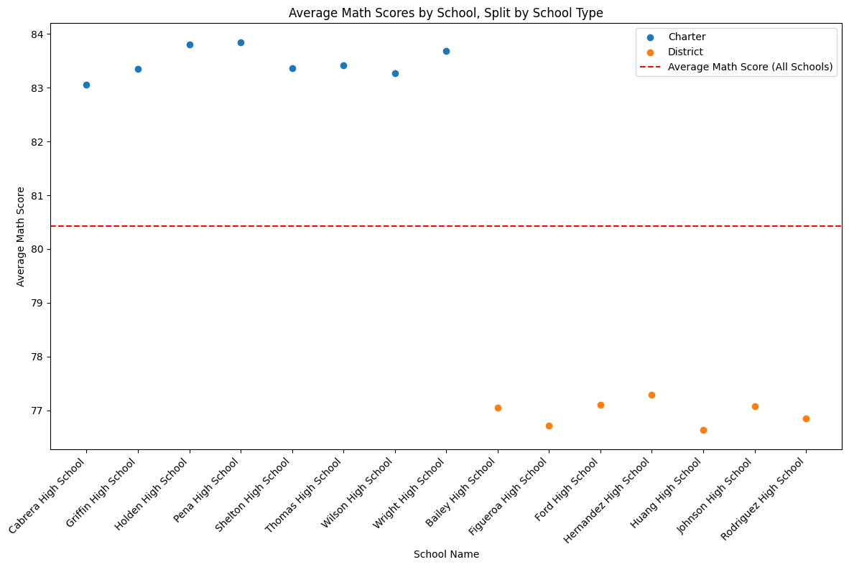
On average regardless of student effort the chart suggests that if they are not in charter, there will be at a minimum, a 5-point deficit.

Slide 4
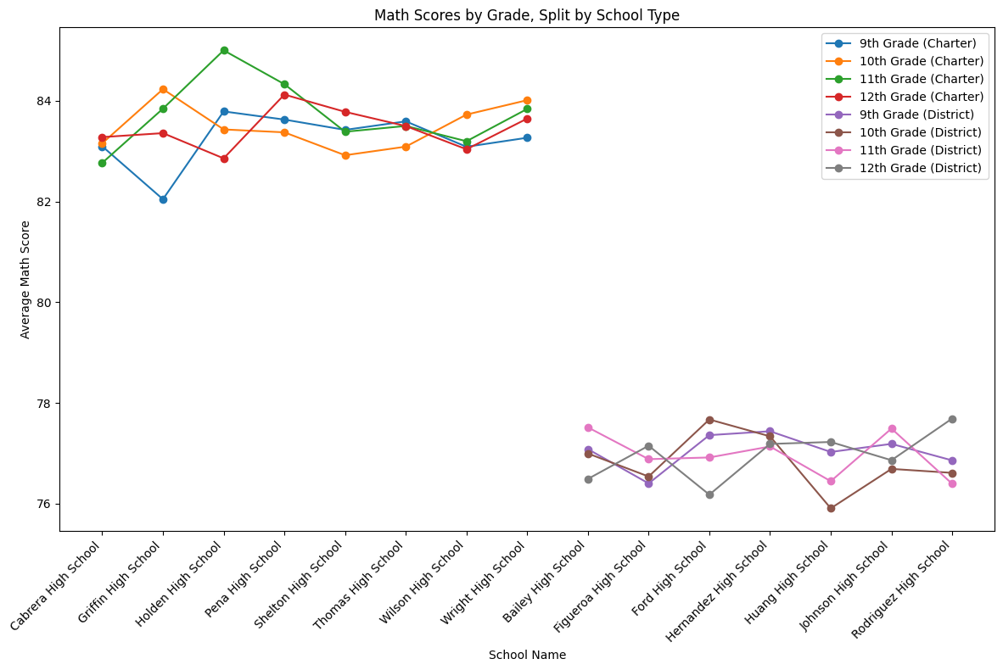
Dramatic differences are found in the last two years of high school, where the charter students really take a large lead on the district students.

Slide 5
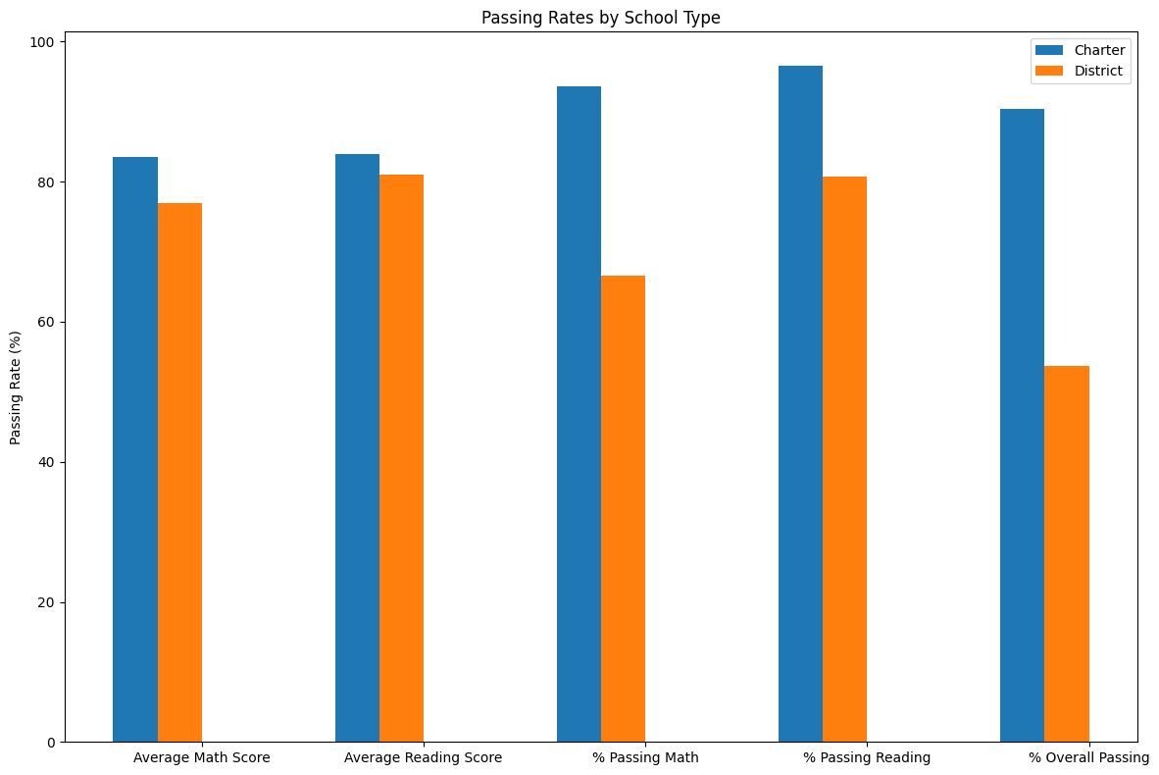
Although the averages are nearly identical the extremes are more consistently negative on the district students than the charter students.

Slide 6
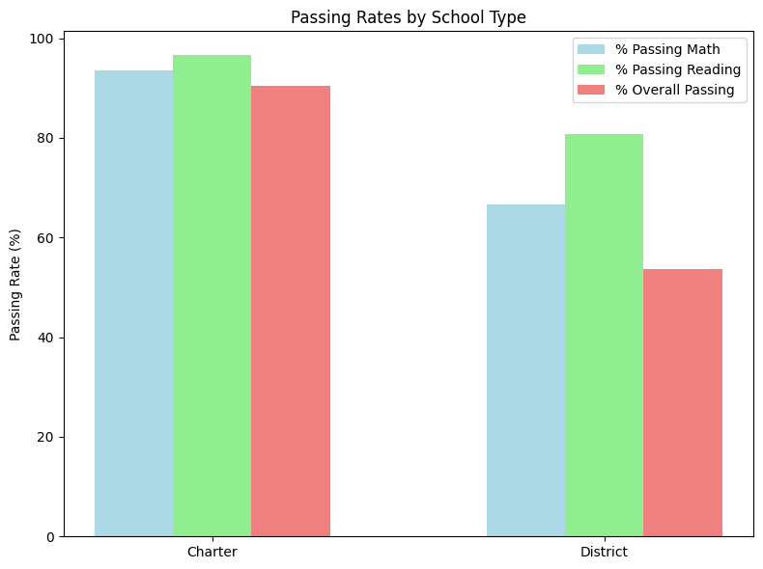
Large indicator that the students desire for reading is far higher than any other subjects considered during this sampling.

Slide 7
Spending Summary
Spending Ranges (Per Student) | Average Math Score | Average Reading Score | % Passing Math | % Passing Reading | % Overall Passing
<$585 | 83.455399 | 83.933814 | 93.460096 | 96.610877 | 90.369459
$585-630 | 81.899826 | 83.155286 | 87.133538 | 92.718205 | 81.418596
$630-645 | 78.518855 | 81.624473 | 73.484209 | 84.391793 | 62.857656
$645-680 | 76.997210 | 81.027843 | 66.164813 | 81.133951 | 53.526855
Lower budget per student seems to correlate with higher average math and reading scores.
Charter schools outperform district schools across all metrics.

Slide 8
School Size Summary
School Size | Average Math Score | Average Reading Score | % Passing Math | % Passing Reading | % Overall Passing
Small (<1000) | 83.821598 | 83.929843 | 93.550225 | 96.099437 | 89.883853
Medium (1000-2000) | 83.374684 | 83.864438 | 93.599695 | 96.790680 | 90.621535
Large (2000-5000) | 77.746417 | 81.344493 | 69.963361 | 82.766634 | 58.286003
Smaller the school, the better they perform
Exceeding volumes of 2000 students at a school guarantees failure

