Slide 1
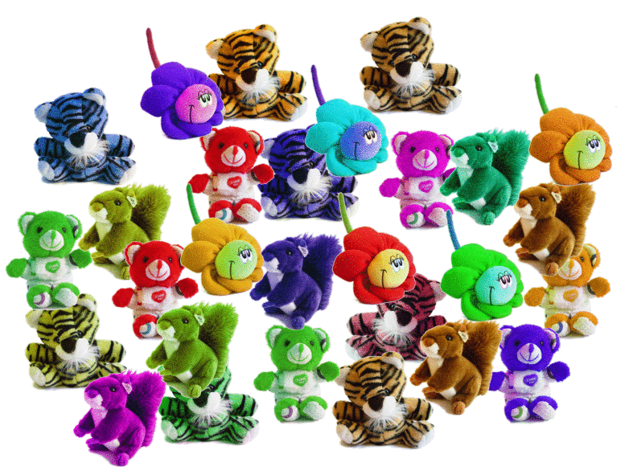
Clustered P2P
Problems to solve
  How can I define my interests?
  How can I find people with my same interests?
  Security, especially anonymity
Notes:
We do not want to find concrete resources (such as “Peret que levante el dedo”), but any resource that matches our interests (“rumba catalana” matches Peret, but also Dusminguet and Estopa)
To solve this search, we create a clustered P2P: nodes join in dynamic clusters and find each other. The slide shows several problems to solve in this scenario.

Slide 2
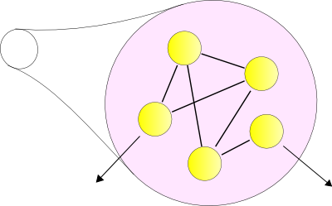
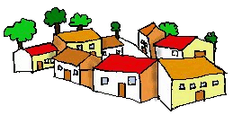
Clustered P2P
Notes:
An example of a clustered, small world network. Each little town is a cluster of interests. Clusters connect each other but have diffuse barriers. Inside any town, everybody know nearly everybody, but some citizens have long aquentainces to other towns. The person that holds the resource that I want could be in a far away town. How can I contact him?

Slide 3
Clustered P2P
Resource discovering in P2P
  Using diffuse clustering
  Small world behaviour of nodes
  Soft Distributed Hash Tables
  A secure scenario.
Notes:
Lines of research in clustered P2P:
- Diffusse clustering: dynamic creation of groups, different group view for each node, discovering of groups...
- Small world behaviour of social networks: any two nodes are connected through a small number of hops (under ten), even in networks with hundred of millions of nodes.
- Soft DHTs: light and quick DHTs to help in the discovering of clusters.
- And security, of course, to preserve anonymity and privacy of each node.

Slide 4
Secured Distributed File Sytem
File distribution over structured P2P. Services:
  Ubiquitous computing: common desktop
  Group documents
  Version control
  Secure environment
Notes:
Another line of research: the secured distributed file system. Over a ring structured P2P we build a DHT
Clients create documents and store them in the DHT. Each client has a private key to store their documents. According to this key, strip down and store the document parts in the DHT. In order to retrieve the document parts, he needs his private key.
This scenario provides ubiquitous computing by means of common desktop,, sharing groups documents, replication, instant backups and a system of version control.

Slide 5


Secured Distributed File System
Notes:
Clients create documents and store them in the DHT. Each client has a private key to store their documents. According to this key, strip down and store the document parts in the DHT. In order to retrieve the document parts, he needs his private key.

