Slide 1

Presentation on_
Automatic Car Parking System
Presented by:
Mst. Jubaida Begum
Sanjana Rahman Nowrin
Tisha Bala Pop
Mst. Ishrat Jahan Muhiba
Gitoshree Dhar

Slide 2
Contents
Introduction
Working Principle
Key Features Implemented
Results and Challenges
Hardware Components
Future Improvements
System Architecture

Slide 3
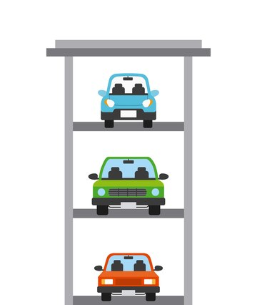
Introduction
Rapid vehicle growth makes parking management challenging in cities.
Manual parking is inefficient, time-consuming, and causes congestion.
Our project automates entry, slot allocation, and exit using Arduino, IR sensors, and controlled gate.
Detects fire to improve parking safety.
Provides a secure, efficient, and user-friendly parking solution.

Slide 4
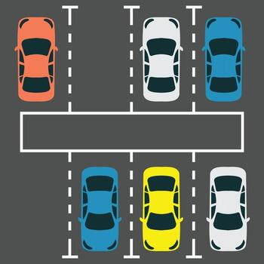
Key Features Implemented
Slot availability tracking (3 slots)
ID-based access control
Automatic gate operation
Fire/gas detection with confirmation time
Emergency siren and relay activation
LCD real-time status display

Slide 5
Hardware Components
Arduino Uno
IR Sensor(vehicle sensor)
MQ-2 Gas Sensor(fire detection)
4x4 Keypad(ID input)
Servo Motor(Gate Control)
LCD Display With I2C
LEDs(green,red,white)
Buzzer(alarm)
Relay Module

Slide 6
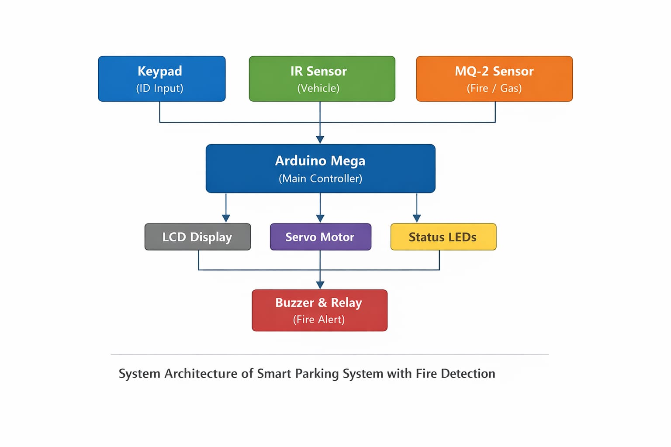
System Architecture
Input Devices: Keypad, IR Sensor, MQ-2 Gas Sensor.
Controller: Arduino Mega processes all inputs.
Output Devices: LCD, Servo Motor, Buzzer, Relay, LEDs.

Slide 7
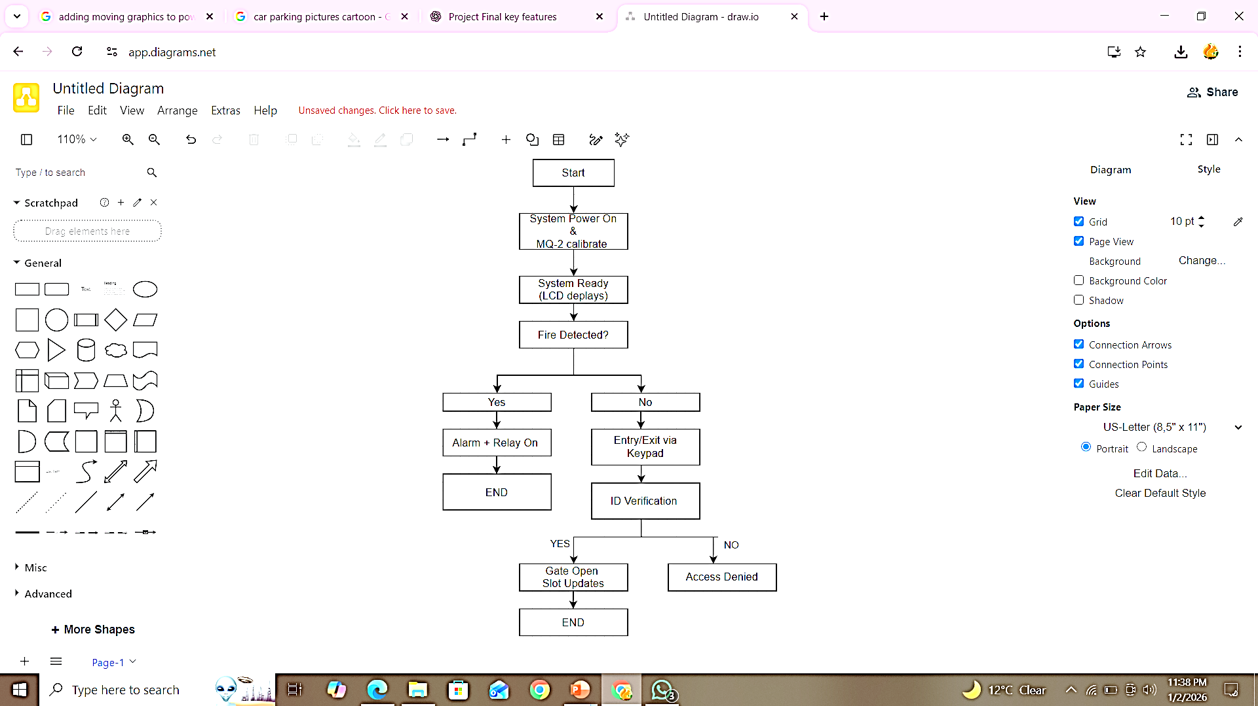
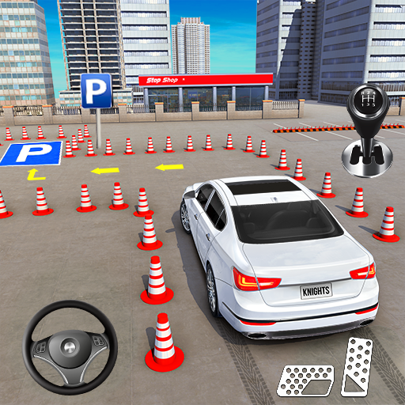
Working Principle

Slide 8
Results & Challenges
Results:
Challenges:
System correctly manages parking slots.
Unauthorized access is prevented.
Fire/gas is detected quickly.
Emergency alerts function properly.
Sensor calibration issues.
Timing management.
Hardware synchronization.
Debugging keypad & servo conflicts.

Slide 9
Future Improvements
🚗
Increase Parking Slots
RFID / Mobile App Integration
📲
Expand the system to manage more vehicles using additional sensors and slots.
Enable faster and contactless access using RFID cards or a mobile application.
SMS / App-Based Fire Alerts
Cloud - Based Monitoring
🚨
☁️
Send instant fire or gas alert notifications to users and authorities.
Monitor parking status and system activity remotely through cloud connectivity.

Slide 10
Thank You

