Slide 1
Emotion Detection Using Facial Expression
A Deep learning project for my cse465 course
Submitted by: Jubair Mahmud pulock
Id: 193 1111 042
Section: 4

Slide 2
Objective:
The project aims to develop a deep learning model for facial expression detection.
Facial expression detection involves identifying and categorizing facial expressions, such as happiness, sadness, anger, surprise, etc.
The main objective is to accurately classify and recognize different facial expressions in real-time or from videos.

Slide 3
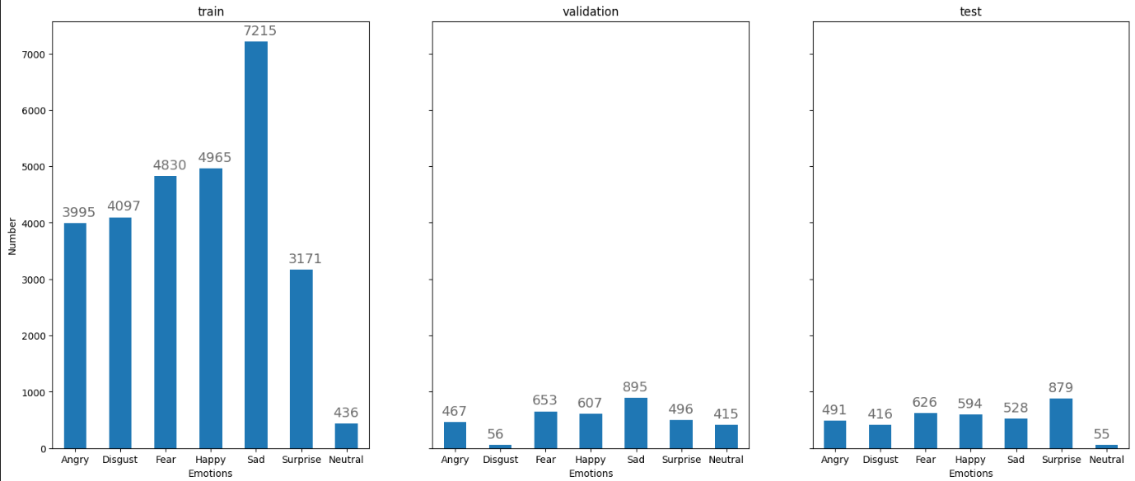
About my dataset:
Data Size: 35887
(Train 80% + Test 20% + Validation 20%)
Classes: 7
(Happy, Sad, Angry, Neutral, Surprise, Fear, Disgust)

Slide 4
Has the project I am showing been discussed with you initially? Yes, I have already discussed the idea with you. You advised me to concentrate on an emotion detection project because I am already developing a "Lip Reading App" project for my CSE499A. Since I am working on this project by myself, it is somewhat similar and simpler for me.

Slide 5
Related Works:
"Deep Face Recognition" by Taigman et al. (2014)
This paper introduced the DeepFace model, which achieved impressive performance in facial expression recognition by leveraging deep convolutional neural networks (CNNs) and large-scale training datasets.
"Facial Expression Recognition Using Convolutional Neural Networks: State of the Art" by Mollahosseini et al. (2019)
This paper provides an overview of state-of-the-art approaches in facial expression recognition using CNNs. It discusses different architectures, data augmentation techniques, and training strategies employed in various models.
"Emotion Recognition in the Wild from Videos Using Images" by Kollias et al. (2019)
The authors proposed a method for emotion recognition from videos by extracting facial features from images. They employed deep neural networks, including CNNs and recurrent neural networks (RNNs), to capture temporal dependencies and achieve robust emotion recognition.
"Facial Expression Recognition with Deep Learning: A Survey" by Wang et al. (2020)
This survey paper provides a comprehensive review of various deep learning approaches for facial expression recognition. It covers different network architectures, feature extraction methods, and datasets commonly used in the field.
"Facial Expression Recognition: A Survey and Real-World User Experiences" by Zhang et al. (2021)
This survey paper discusses recent advancements in facial expression recognition, including deep learning techniques, feature extraction algorithms, and real-world applications. It also highlights challenges and future directions in the field.

Slide 6
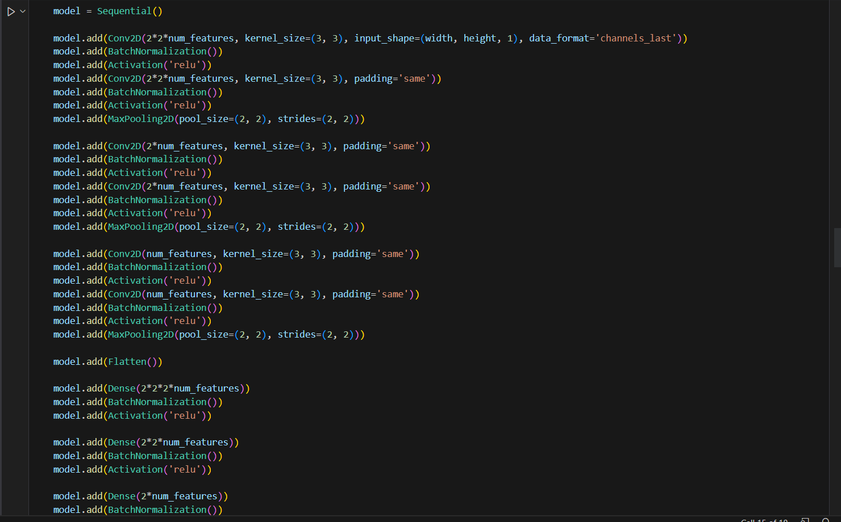
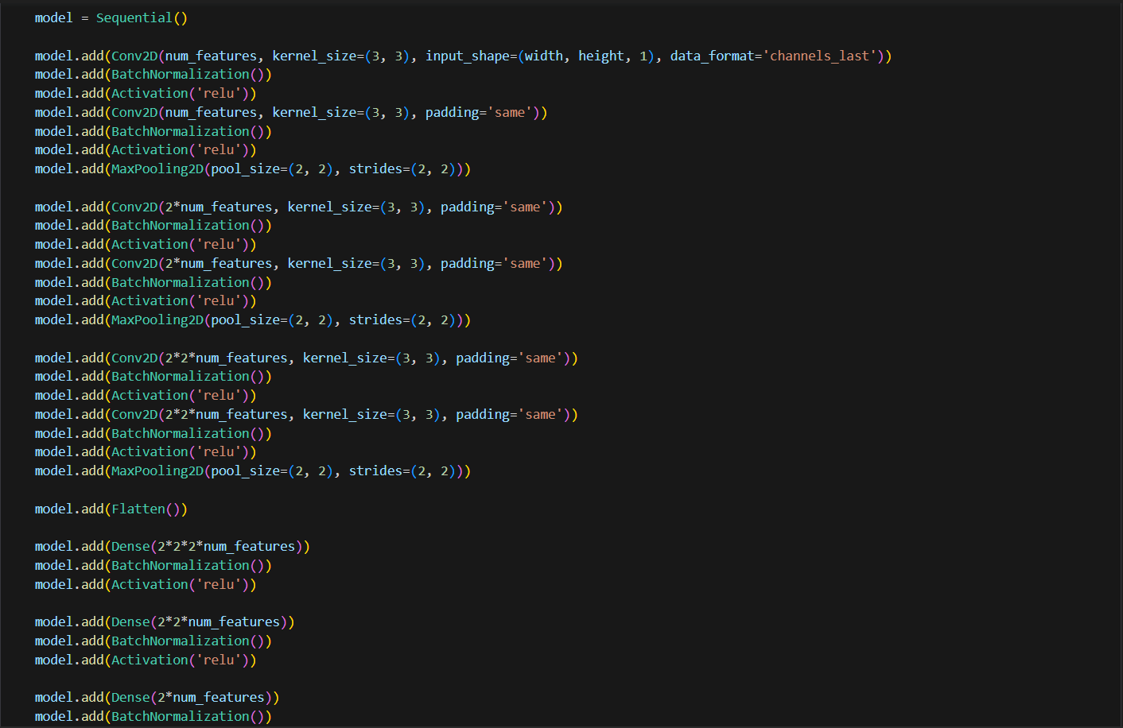
I have trained total 30 epochs and the total time needed for training is around 17 minutes. The average time spent on each epoch was 30 seconds.

Slide 7
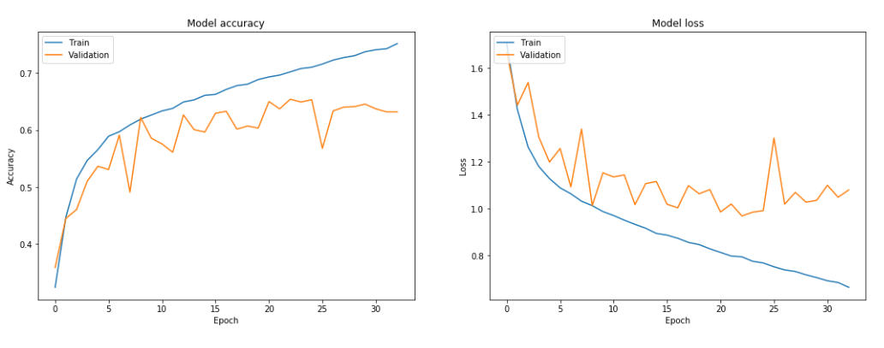
Training curve:

Slide 8
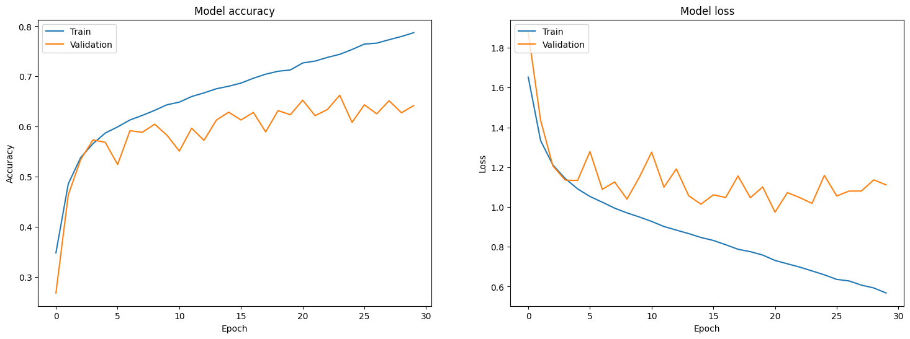
Training curve:

Slide 9
The Regularization and Optimization Used:
Regularization:
Optimization:
Batch Normalization: It is used after each convolutional and dense layer to normalize the activations, helping with faster convergence and reducing overfitting.
Adam Optimizer: The model's parameters are optimized using the Adam optimizer. It is an adaptive optimization algorithm that combines the benefits of both AdaGrad and RMSProp. It adjusts the learning rate dynamically for each parameter, resulting in efficient convergence.

Slide 10
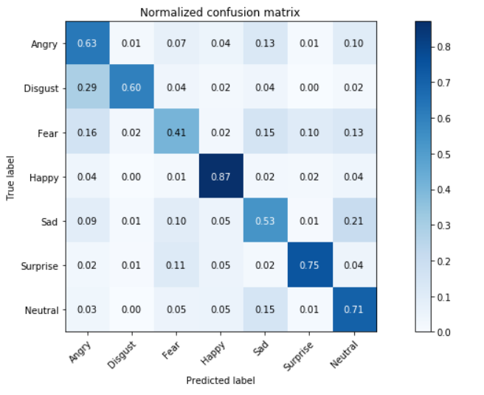
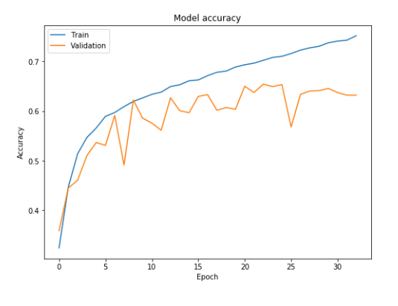
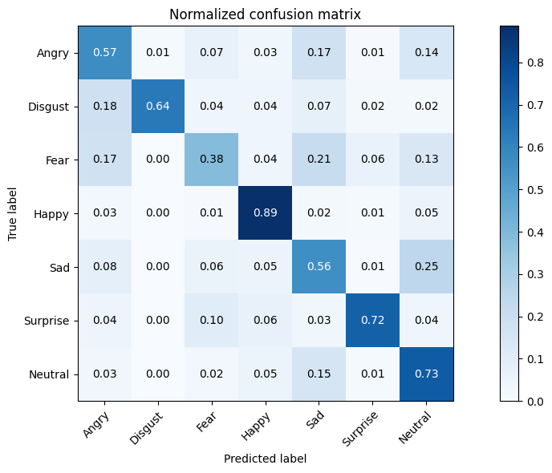
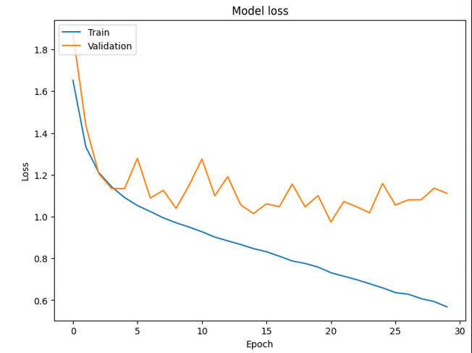
The Confusion Matrix and Model Accuracy :
Confusion matrix:
Model accuracy: 67%

Slide 11
Future Works:
Improve model performance: Experiment with different architectures, such as deeper or wider networks, to enhance the accuracy and robustness of facial expression detection.
Fine-tune hyperparameters: Conduct a systematic hyperparameter search to optimize the model's performance, including learning rate, batch size, regularization strength, and network depth.
Data augmentation: Explore additional data augmentation techniques, such as rotation, translation, and scaling, to increase the diversity and variability of the training dataset.
Transfer learning: Investigate the potential of using pre-trained models, such as VGG or ResNet, as a starting point for facial expression detection and fine-tune them on the specific task.
Ensemble methods: Explore ensemble techniques, such as model averaging or stacking, to combine predictions from multiple models and improve overall performance.

Slide 12
Conclusion:
In this project, we developed a deep learning model for facial expression detection using the FER2013 dataset.
The model consists of convolutional neural network layers followed by fully connected layers and achieved promising results.
By leveraging image data augmentation and early stopping, we trained the model to recognize seven facial expressions with high accuracy.
The model's performance was evaluated using validation and test sets, and it demonstrated strong performance in accurately classifying facial expressions.
Further improvements can be made by exploring different architectures, fine-tuning hyperparameters, and incorporating advanced techniques like transfer learning and ensemble methods.
Facial expression detection has numerous applications, including human-computer interaction, emotion recognition, biometrics, social robotics, and virtual reality, where accurate and real-time emotion detection enhances user experiences and interactions.
With continued research and development, facial expression detection can contribute to various fields and pave the way for more sophisticated and personalized human-machine interactions.

