Slide 1
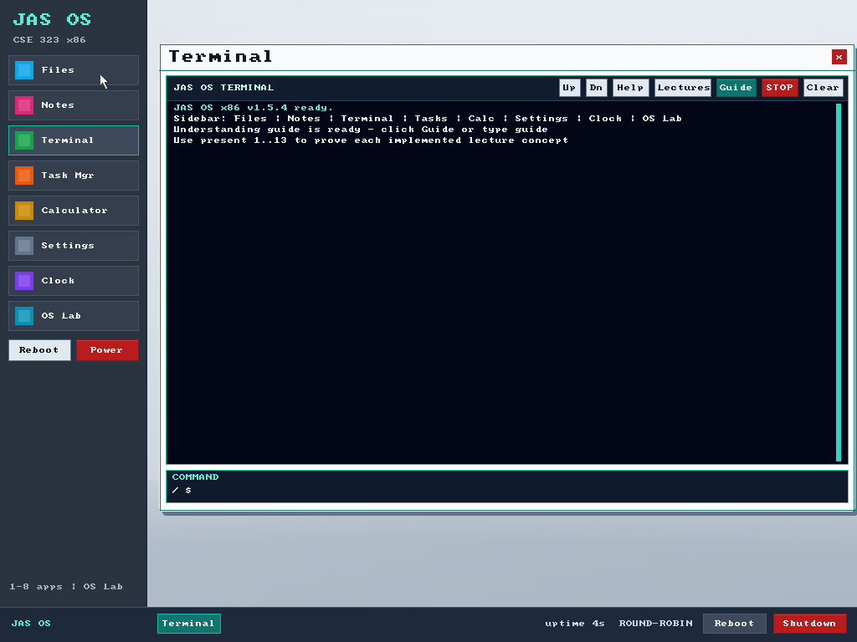

CSE 323 · COURSE-CONCEPT OPERATING SYSTEM
JAS OS
My x86 implementation of CSE 323 concepts
Motive: test and prove my own understanding
Chapters 1–13 · Jubayed Ahmed Sahel
JAS OS · 1/12

Slide 2
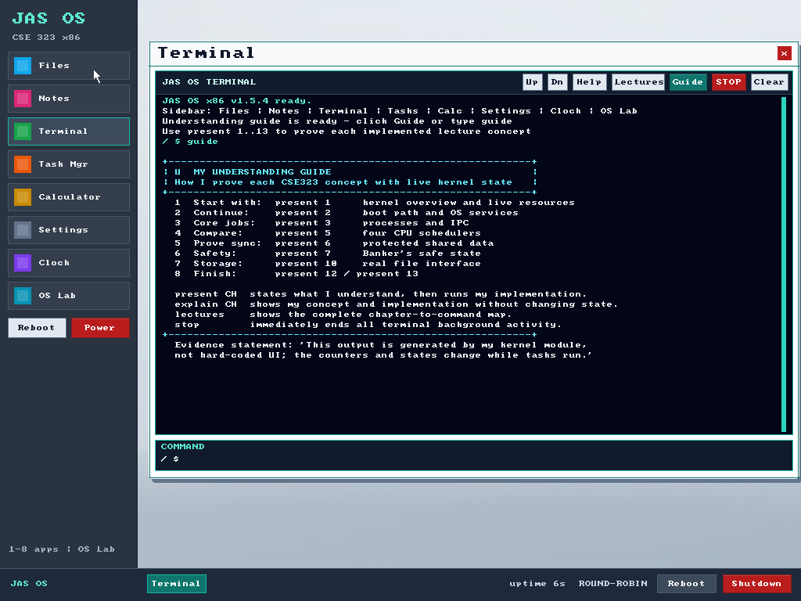
LIVE KERNEL PROOF · 01
A guide to evidence of my understanding
Each lecture concept maps to my implementation and live state.
Guide, Lectures, STOP, and clear controls stay visible.
JAS OS · 2/12

Slide 3
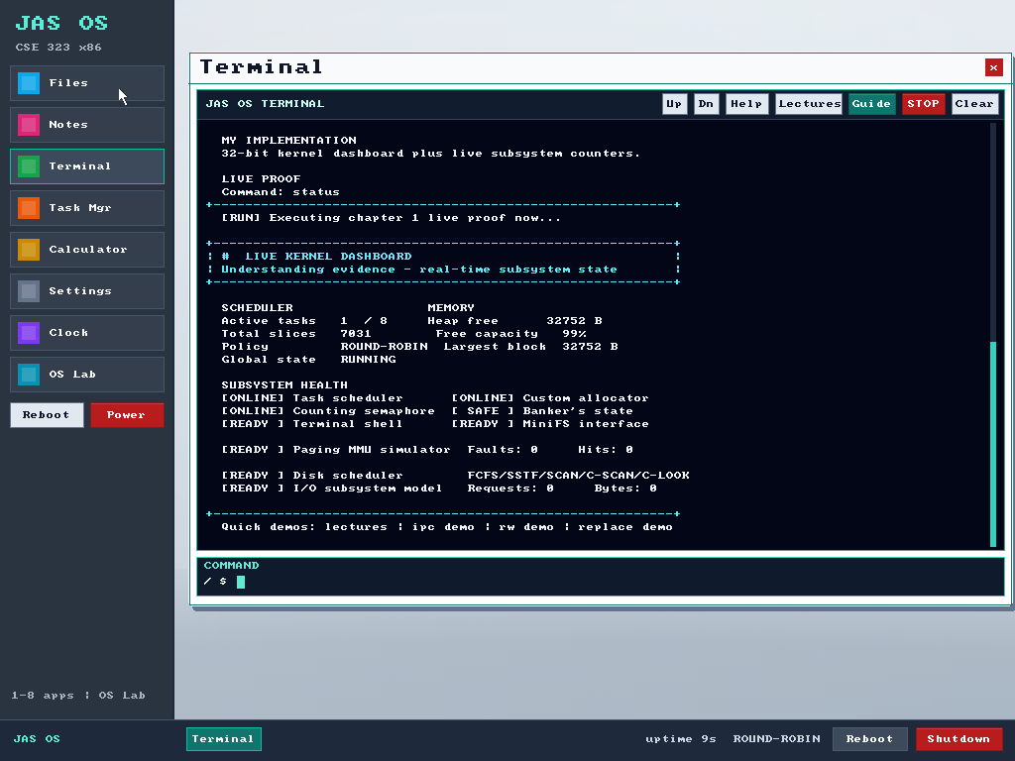
LIVE KERNEL PROOF · 02
The kernel exposes live system state
Boot path and services
Scheduler and tasks
Heap, paging, MiniFS, storage, and I/O
JAS OS · 3/12

Slide 4
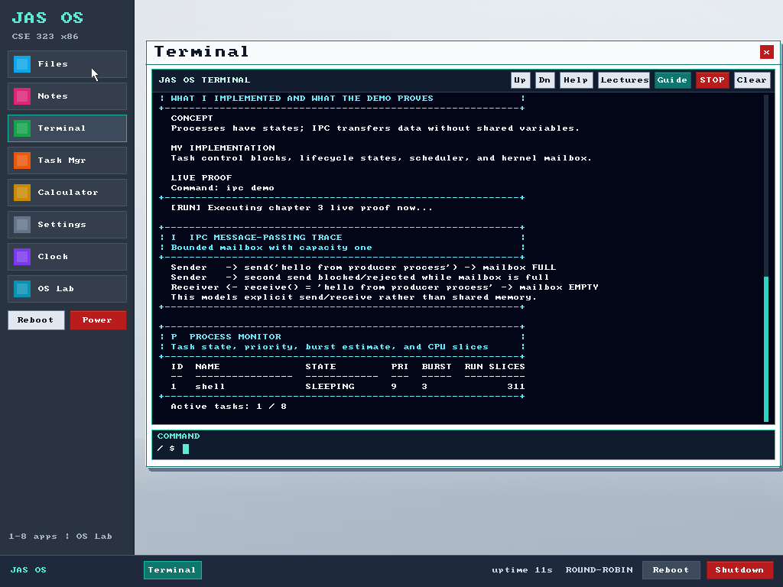
LIVE KERNEL PROOF · 03
Processes communicate through a kernel mailbox
Task control blocks
Lifecycle states
Explicit send and receive
Observable task table
JAS OS · 4/12

Slide 5
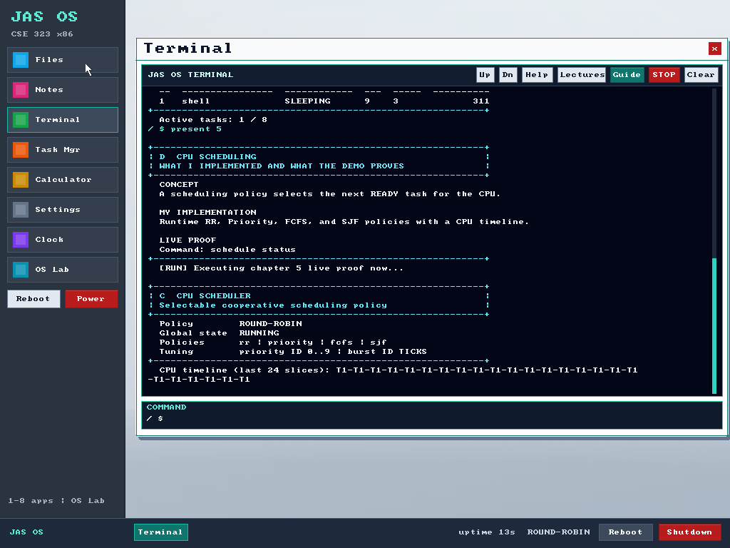
LIVE KERNEL PROOF · 04
Four CPU schedulers can be compared live
Round Robin
Priority
First Come First Served
Shortest Job First
JAS OS · 5/12

Slide 6
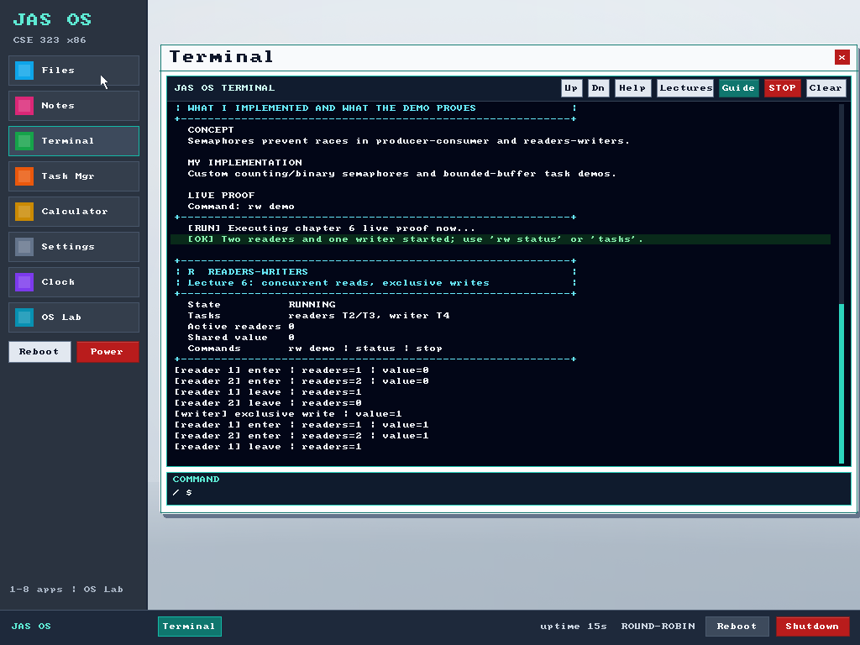
LIVE KERNEL PROOF · 05
Semaphores protect shared state
Concurrent readers
Exclusive writer access
Visible waiting and progress counters
JAS OS · 6/12

Slide 7
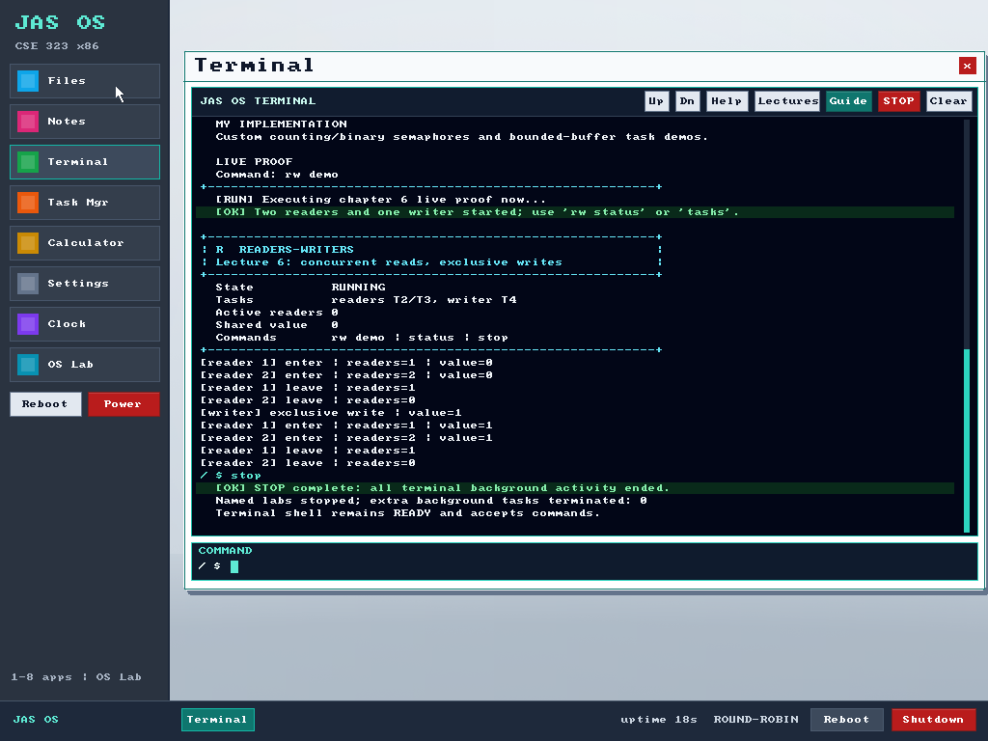
LIVE KERNEL PROOF · 06
One stop command ends all terminal activity
Kills non-shell jobs
Stops background output
Keeps the terminal responsive
Also available as a red STOP button
JAS OS · 7/12

Slide 8
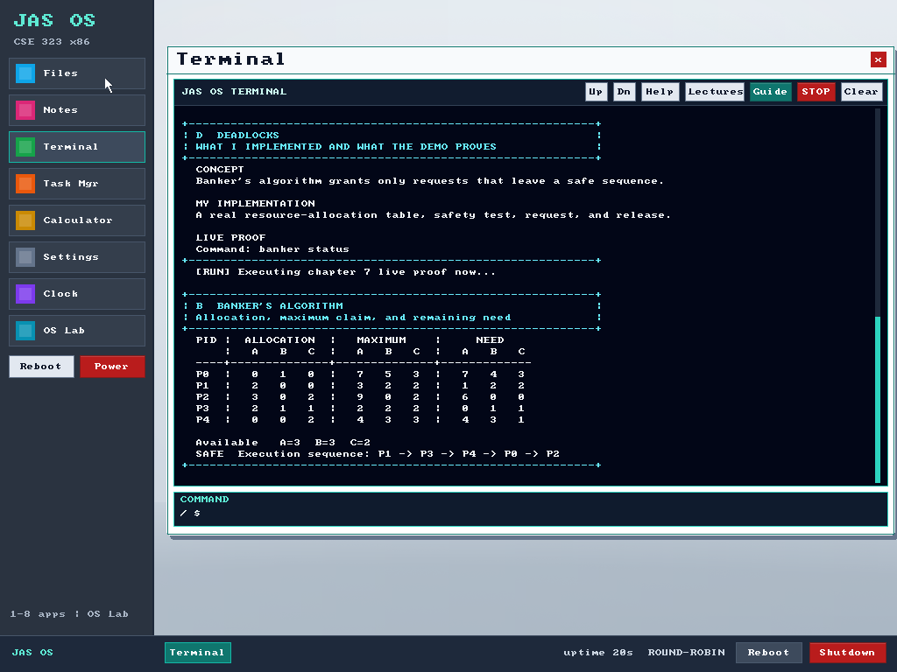
LIVE KERNEL PROOF · 07
Banker’s algorithm prevents unsafe allocation
Allocation, maximum, and need matrices
Available-resource calculation
Safe sequence required before grant
JAS OS · 8/12

Slide 9
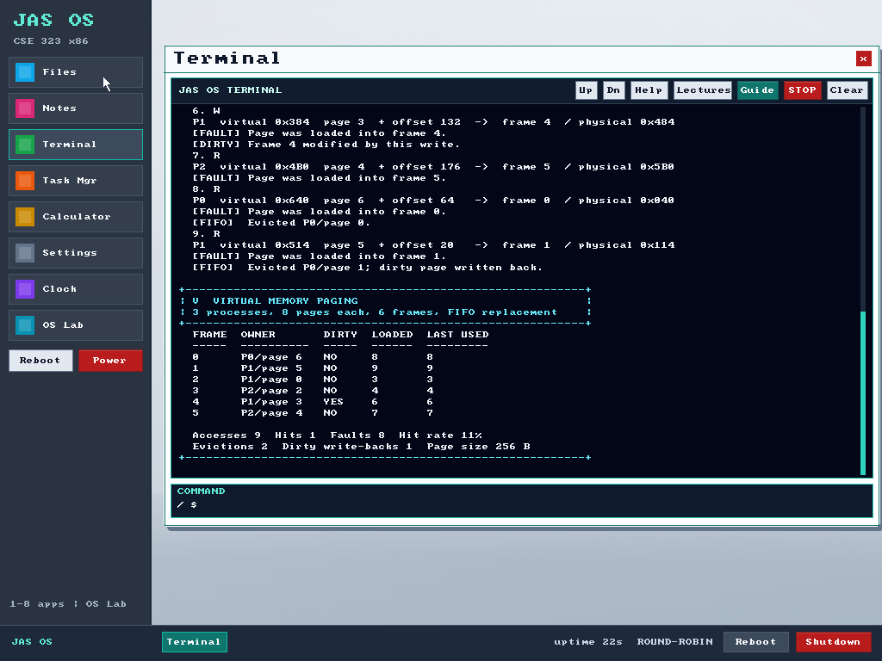
LIVE KERNEL PROOF · 08
Paging makes address translation observable
Virtual-to-physical mapping
Hits, faults, and dirty pages
Frame ownership
FIFO replacement
JAS OS · 9/12

Slide 10
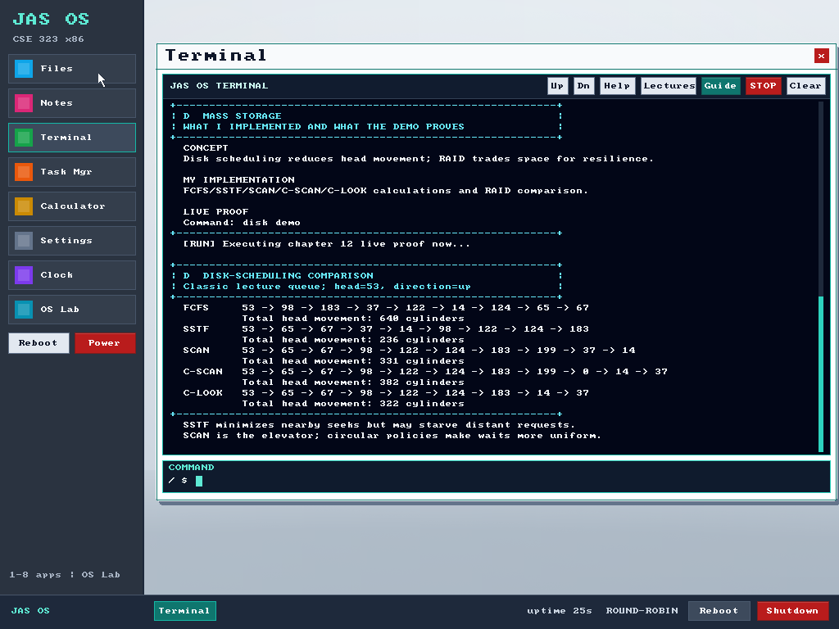
LIVE KERNEL PROOF · 09
Disk algorithms run on the same request queue
FCFS · SSTF · SCAN
C-SCAN · C-LOOK
Total head movement provides a direct comparison.
JAS OS · 10/12

Slide 11
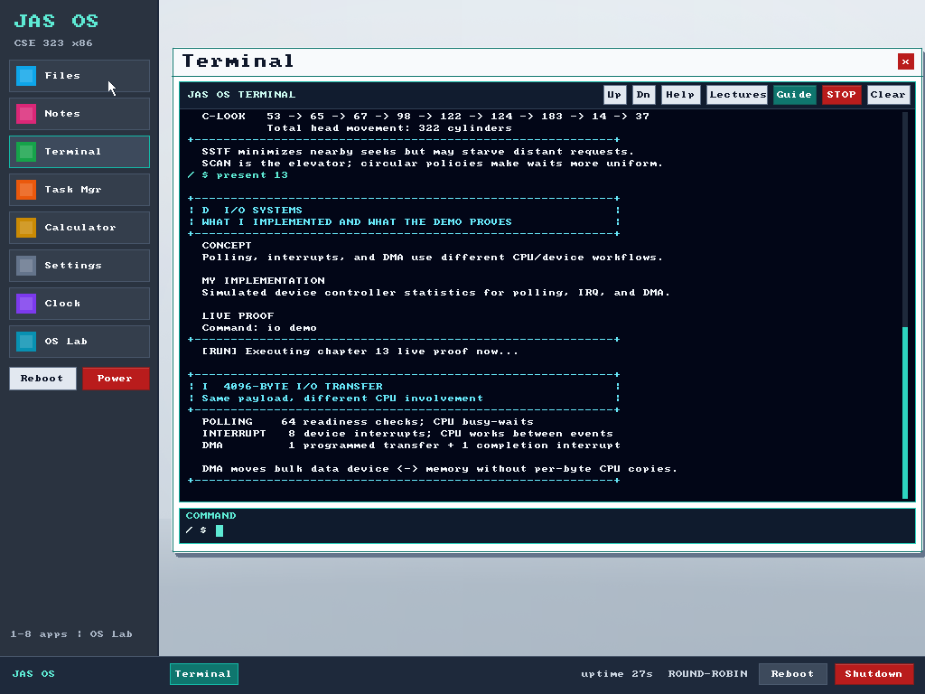
LIVE KERNEL PROOF · 10
I/O modes report their work with live counters
Polling
Interrupt-driven I/O
Direct memory access
Main course concepts complete through Chapter 13.
JAS OS · 11/12

Slide 12
JAS OS
Built to prove my OS understanding
Bootable ISO
Freestanding x86 kernel
Live evidence for Chapters 1–13
STAR report and source on GitHub
github.com/Jubayed-Sahel/JAS-OS
JAS OS · 12/12

