Slide 1
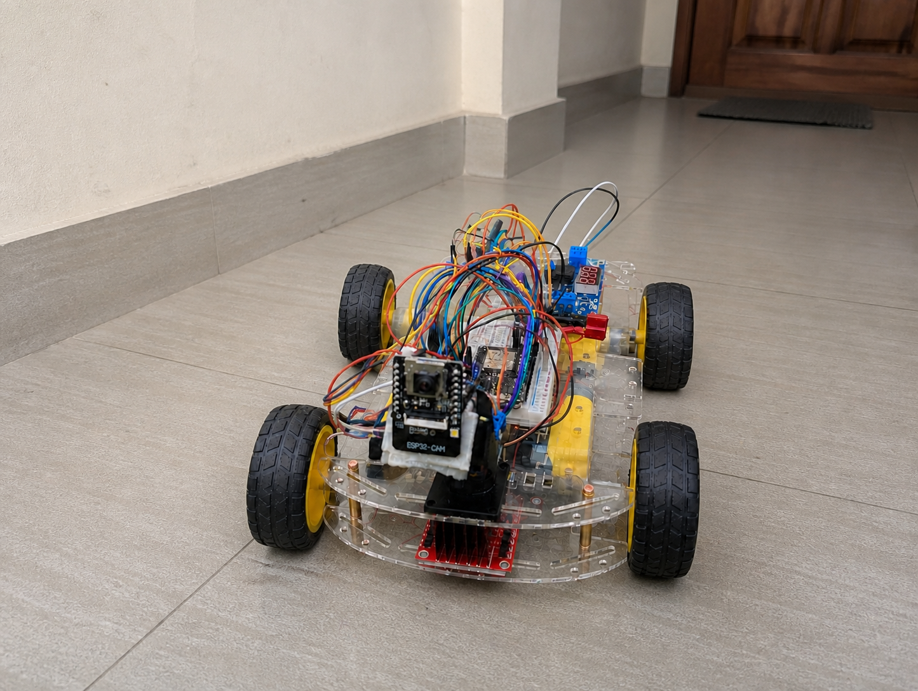
CSE499A · FINAL PRESENTATION
Neural
Rover
A Wi-Fi-controlled mobile robot with live pan–tilt video and fail-safe motion control
Jubayed Ahmed Sahel · Fahad Hossain Shourov
Pujon Chakraborty · Anonna Rahman Spondon
North South University · Supervisor: Dr. K. M. A. Salam
Notes:
Presenter: Jubayed Ahmed Sahel | Target time: 0:30
Introduce the team and the central result: the CSE499A rover platform is complete; face recognition remains the next-stage module.
Use the rover photograph to identify the completed physical platform, then move directly to the problem the system solves.
[Sources]
- IEEE_499A_Report/Neural_Rover_IEEE_499A_Report_Final.pdf
- Project Files/Neural Rover Home Veranda.png (user-supplied project image)

Slide 2
WHY NEURAL ROVER
Remote inspection needs control and awareness
A mobile platform is useful only when the operator can move it, see its surroundings, and stop it safely from one place.
MOVE
Four-wheel directional control from a phone or laptop
SEE
Live camera stream embedded in the same browser interface
AIM
Independent pan, tilt, and illumination control
STOP
Local fail-safe response when communication disappears
LEAD PRESENTER · Jubayed Ahmed Sahel
02
Notes:
Presenter: Jubayed Ahmed Sahel | Target time: 0:55
Frame the engineering problem as control plus visual awareness plus safety—not simply an RC car.
Use the four verbs as the project acceptance logic.
[Sources]
- README.md
- IEEE_499A_Report/Neural_Rover_IEEE_499A_Report_Final.pdf

Slide 3
SYSTEM ARCHITECTURE
How every module connects across the rover
OPERATOR
PROCESSING
ACTUATION
ROVER RESPONSE
MAIN ESP32
Web server + WebSocket
PWM / direction
Watchdog + fail-safe
2 × L298N
Left + right channels
Four motor outputs
4 DC MOTORS
Front + rear
Left + right drive
PWM + DIR
Wi-Fi · WebSocket
BROWSER / PHONE
Drive commands
Live video
Camera aim
UART2
ESP32-CAM
Camera capture
MJPEG stream
Flash LED
PAN / TILT
Two SG90 servos
GPIO 13 + GPIO 4
CAMERA AIM
Pan 0–180°
Tilt 0–180°
MJPEG
GPIO PWM
POWER + GROUND 3S battery → L298N motor rail | LM2596 → regulated 5 V for both ESP32 boards + servos | all modules share common ground
Main ESP32 controls motion and safety; ESP32-CAM streams video; one power system connects both.
LEAD PRESENTER · Jubayed Ahmed Sahel
03
Notes:
Presenter: Jubayed Ahmed Sahel | Target time: 1:30
Start at the browser: control commands travel over Wi-Fi and WebSocket to the main ESP32.
The main ESP32 owns motion, pan/tilt, the watchdog, and the fail-safe stop. It sends PWM and direction to the two L298N drivers, which run all four motors.
The ESP32-CAM handles capture and MJPEG streaming. UART2 keeps the two boards coordinated without letting video load block the motor safety loop.
Finish with power: the 3S battery feeds the motor rail; the LM2596 provides regulated 5 V; every module shares common ground.
[Sources]
- README.md
- Project Files/Neural Rover Architecture Detailed.png

Slide 4
HARDWARE IMPLEMENTATION
Accessible modules form a complete rover
01
CONTROL
02
VISION
30-pin ESP32
Web server · PWM · UART2
ESP32-CAM
MJPEG stream · flash LED
03
MOTION
04
VIEW + POWER
2 × L298N
4 geared DC motors
2 × SG90 servos
3S battery · LM2596 at 5.0 V
LEAD PRESENTER · Fahad Hossain Shourov
04
Notes:
Presenter: Fahad Hossain Shourov | Target time: 0:55
Name the four physical layers; avoid reading component lists verbatim.
Explain that two motor drivers give four independent reversible channels and the LM2596 isolates the regulated logic rail.
[Sources]
- README.md
- RC_CAR_COMPLETE_INFORMATION.md

Slide 5
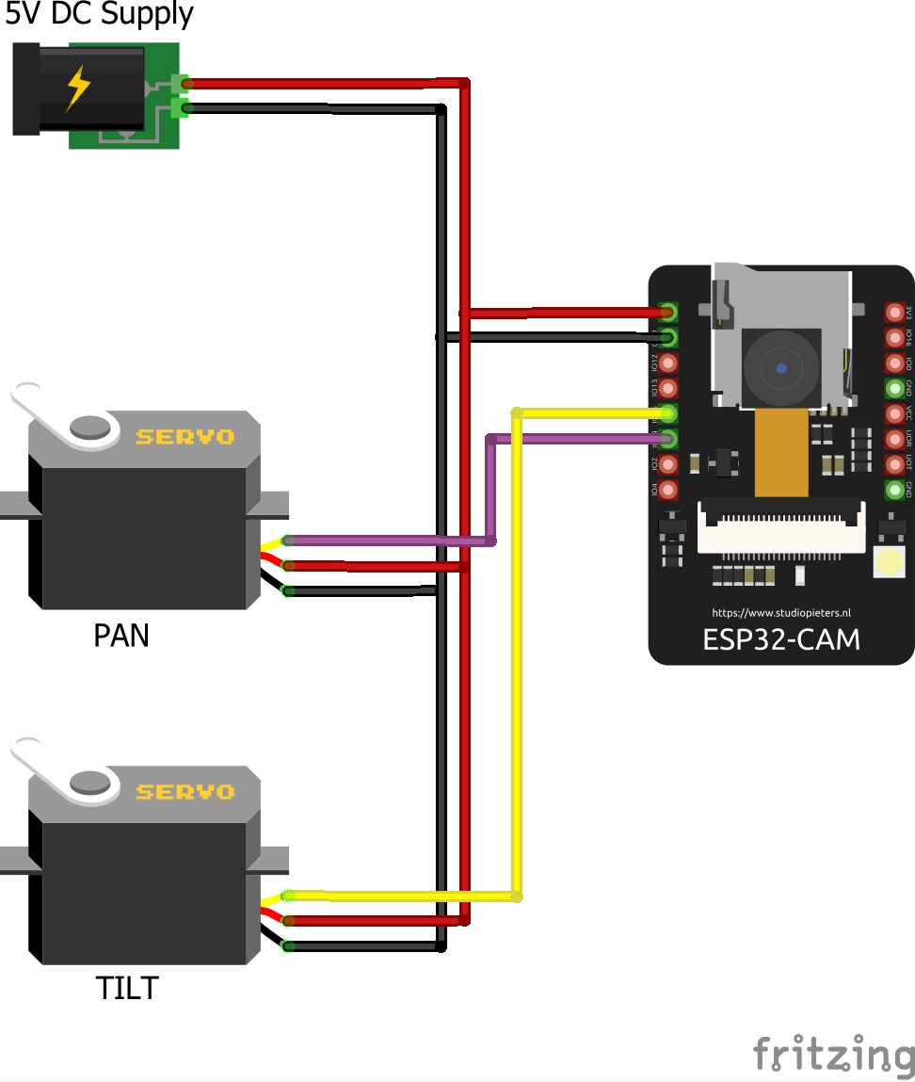
ELECTRICAL DESIGN
Shared power design makes integration reliable
MOTOR RAIL
3S battery → both L298N motor inputs
LOGIC RAIL
LM2596 → regulated 5.0 V for both ESP32 boards and servos
SIGNAL REFERENCE
Battery, controllers, drivers, and servos share one common ground
LEAD PRESENTER · Fahad Hossain Shourov
05
Notes:
Presenter: Fahad Hossain Shourov | Target time: 1:05
Explain why USB success alone did not prove vehicle stability: motor startup current and switching noise affect the logic rail.
Call out regulated 5 V, common ground, and the UART crossing between boards.
Handoff: Pujon will cover the control experience and safety firmware.
[Sources]
- RC_CAR_COMPLETE_INFORMATION.md
- Project Files/ESP32-CAM-Connection with hardware.jpeg

Slide 6
OPERATOR EXPERIENCE
One browser page unifies control and video
Persistent WebSocket control keeps commands responsive while MJPEG video remains visible in the same interface.
CONTROL LOOP
Browser
↓ WebSocket commands
DRIVE
Press-and-hold F / B / L / R · Stop on release
Main ESP32
↓ PWM + direction
WATCH
Live stream from ESP32-CAM on port 81
Four motors + pan / tilt
AIM
Pan P0–P180 · Tilt T0–T180 · Flash control
LEAD PRESENTER · Pujon Chakraborty
06
Notes:
Presenter: Pujon Chakraborty | Target time: 1:00
Demonstrate the control logic verbally: hold to move, release to stop, and keepalive while held.
Mention the browser integrates the camera rather than requiring separate control and video pages.
[Sources]
- README.md
- RC_CAR_COMPLETE_INFORMATION.md

Slide 7
FAIL-SAFE CONTROL
Safety is enforced on the rover—not in the browser
Any lost control path returns every motor enable output to zero.
40
1300
01
Button release
02
Stale command
ms reversal
dead time
ms command
timeout
03
Browser disconnect
04
Wi-Fi loss
Direction reversal first neutralizes PWM and motor polarity, then applies the new command.
LEAD PRESENTER · Pujon Chakraborty
07
Notes:
Presenter: Pujon Chakraborty | Target time: 1:10
Make the safety claim explicit: the browser is only a client; the rover owns the stop decision.
Use the two numeric anchors to explain dead time and stale-command timeout.
Handoff: Anonna will summarize validation and the next phase.
[Sources]
- README.md
- IEEE_499A_Report/Neural_Rover_IEEE_499A_Report_Final.pdf

Slide 8
PROJECT STATUS
499A is complete; face recognition comes next
COMPLETED AND VERIFIED
NEXT-STAGE MODULE
✓ Four-wheel motion and corrected motor polarity
Face
recognition
✓ Browser + WebSocket control with reconnection
✓ Live ESP32-CAM stream in the control page
✓ Pan, tilt, and camera-light control
Laptop-side InsightFace processing will consume the rover’s existing MJPEG stream.
✓ Power integration, UART discovery, and fail-safe stop
✓ System testing, documentation, and IEEE report
LEAD PRESENTER · Anonna Rahman Spondon
08
Notes:
Presenter: Anonna Rahman Spondon | Target time: 1:00
State the boundary confidently and honestly: all embedded rover objectives are complete; face recognition is not presented as finished.
Point out that the completed stream and network architecture already provide the input required by the AI module.
[Sources]
- README.md
- RC_CAR_COMPLETE_INFORMATION.md
- IEEE_499A_Report/Neural_Rover_IEEE_499A_Report_Final.pdf

Slide 9
NEXT PHASE
499B adds an independent AI layer
01
02
03
INGEST
RECOGNIZE
RESPOND
Read the existing MJPEG stream on the GPU laptop
Enroll known people and compare face embeddings
Log events; later add fall detection and caregiver alerts
Key advantage: the AI layer can evolve independently because motion safety remains on the main ESP32.
LEAD PRESENTER · Anonna Rahman Spondon
09
Notes:
Presenter: Anonna Rahman Spondon | Target time: 1:00
Explain the three-step roadmap: stream ingestion, face enrollment/recognition, then event response.
Treat fall detection and alerts as later extensions, not completed deliverables.
[Sources]
- NEURAL_ROVER.md
- Next plans.txt
- RC_CAR_COMPLETE_INFORMATION.md

Slide 10
NEURAL ROVER
A complete rover platform—
ready for its AI layer.
Demo path
Connect → Drive → Stream → Pan / Tilt → Fail-safe stop
Questions?
CSE499A · North South University
LEAD PRESENTER · Anonna Rahman Spondon
10
Notes:
Presenter: Anonna Rahman Spondon | Target time: 0:30 + questions
Close by resolving the opening: Neural Rover now combines motion, visual awareness, and local safety in one tested platform.
If a live demo follows, use the sequence shown. Invite questions after the fail-safe stop demonstration.
[Sources]
- README.md
- IEEE_499A_Report/Neural_Rover_IEEE_499A_Report_Final.pdf

