Slide 1

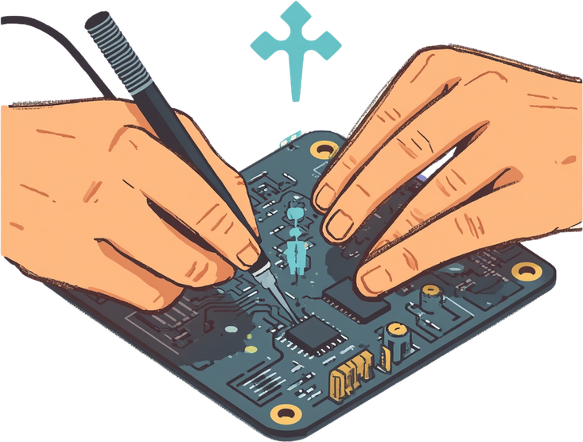
Neural Rover —
AI-Powered Elderly Monitoring RC Car
Name : Jubayed Ahmed Sahel (2221173642)
Name : Fahad Hossain Shourav (2233219642)
Name : Pujon Chakraborty (23125616642)

Slide 2
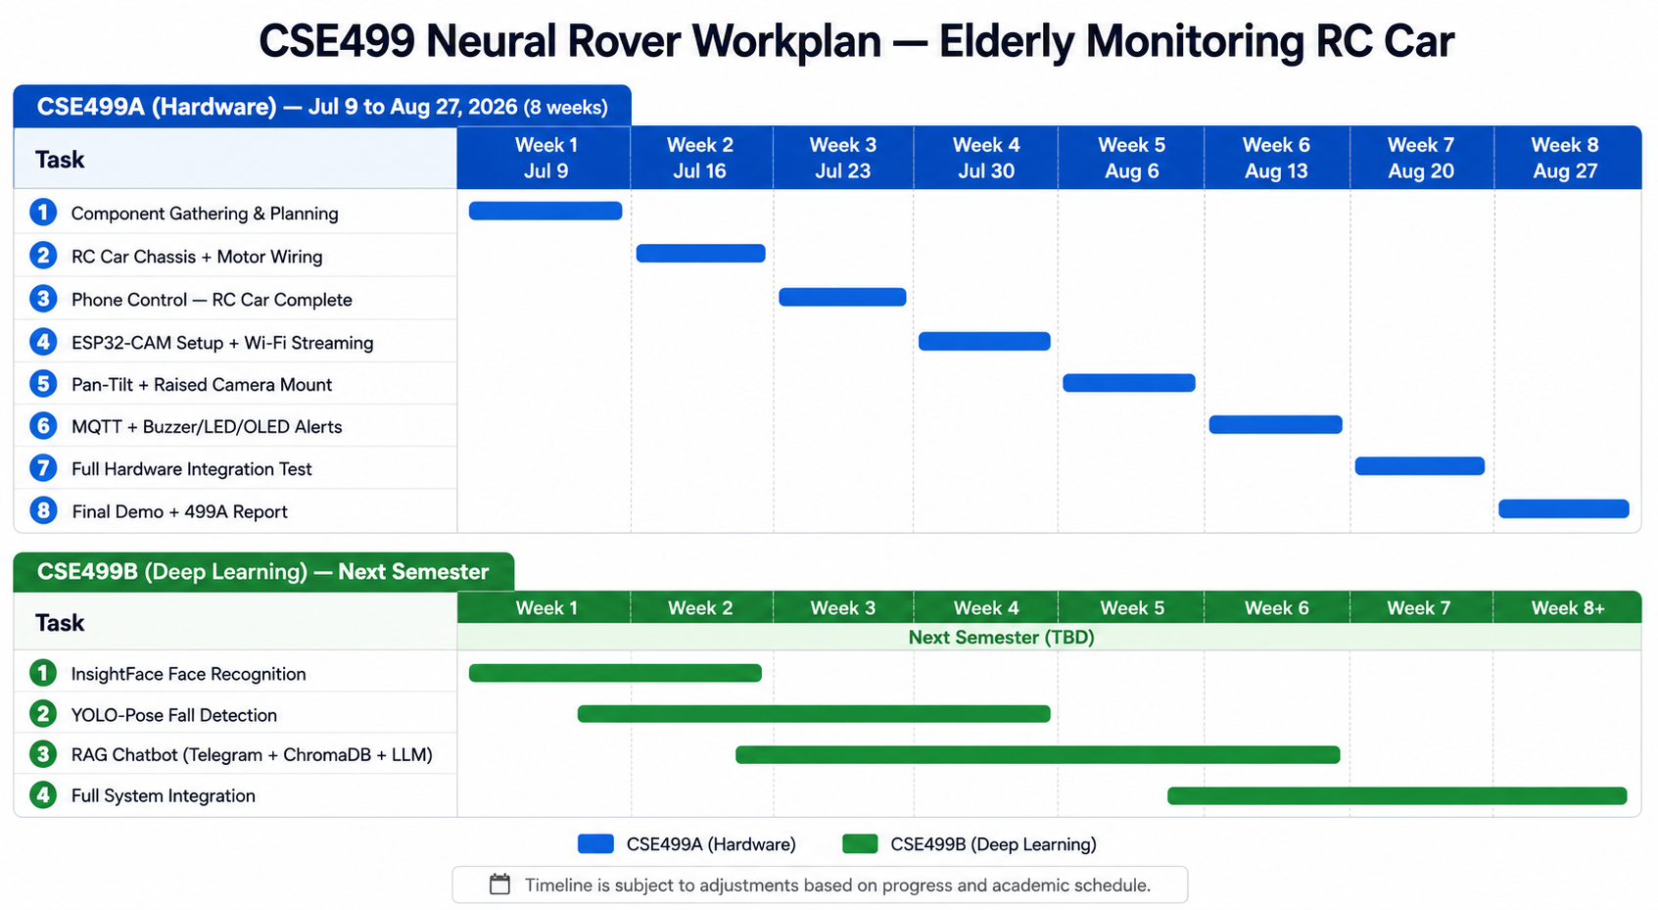

Slide 3
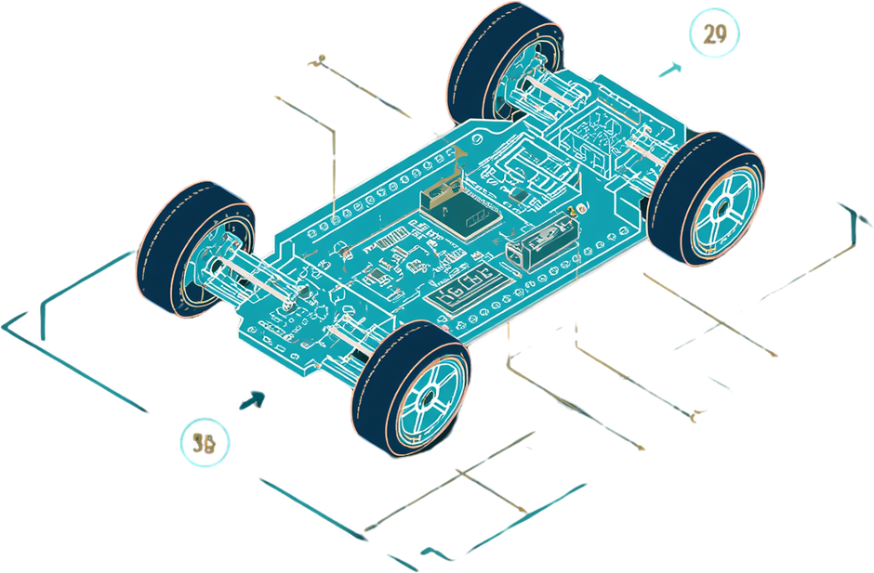
Weeks 1–2
WEEK 1 (JUL 9)
Component Gathering
· Finalize parts list
· Draw circuit diagram
· Plan wiring
WEEK 2 (JUL 16)
Chassis + Motor Wiring
· Assemble chassis
· Mount motors and wheels
· Wire motor driver to ESP32
· Test basic movement
Deliverable: Car chassis built, motors spinning

Slide 4
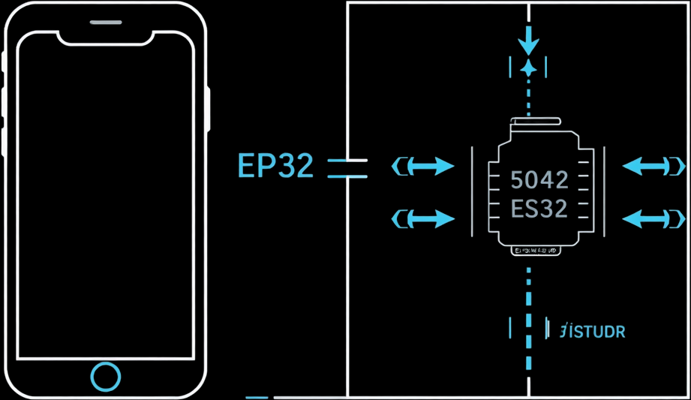
Week 3 (Jul 23): Phone Control
📱 Implementation Steps
• Connect phone app to ESP32 via Bluetooth / WiFi
• Implement forward / reverse / steer controls
• Tune motor speed and turning radius
• Test control range and responsiveness
✅ Deliverable: RC car drives via phone
🔧 Components
• ESP32 Dev Board
• L298N Motor Driver
• 5V Power Bank
• Phone App (BT / WiFi)

Slide 5
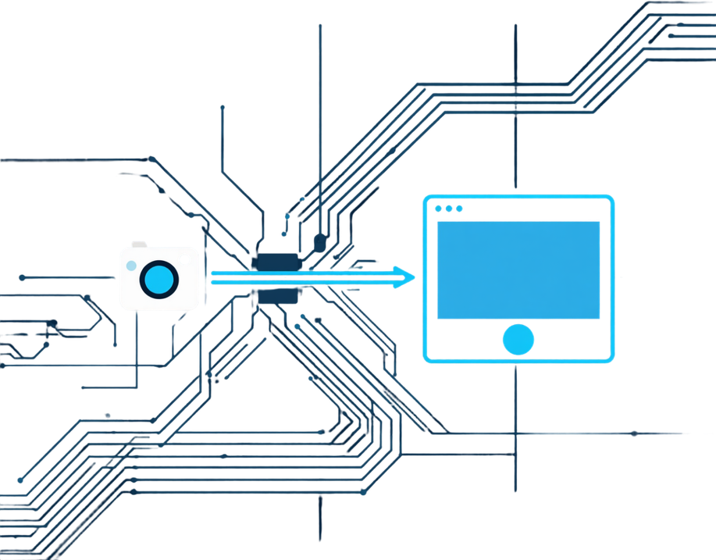
Week 4 (Jul 30): ESP32-CAM + Video Streaming
• Flash CameraWebServer firmware on ESP32-CAM
• Connect ESP32-CAM to WiFi network
• Obtain local IP address from serial monitor
• Access live MJPEG video stream on laptop browser
• Test stream stability and frame rate
✓ Deliverable: Live video stream visible on laptop browser via local IP
Components: ESP32-CAM, USB-to-TTL Programmer, WiFi Router, Laptop Browser

Slide 6
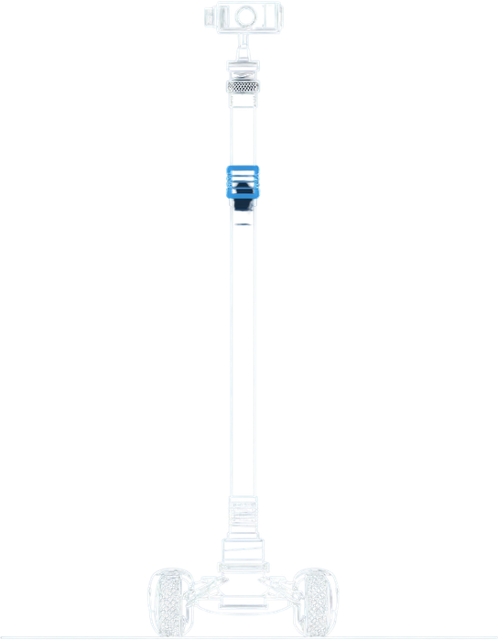
Week 5 (Aug 6): Pan-Tilt + Camera Mount
• Build ~80cm rigid stalk from PVC pipe
• Mount pan-tilt servos at top of stalk
• Attach ESP32-CAM to pan-tilt assembly
• Control tilt angle via PWM to aim camera at face level
• Tune servo angles for optimal face-level coverage
✔ Deliverable:
Camera mounted at ~80cm height, pan-tilt adjustable via PWM signal

Slide 7
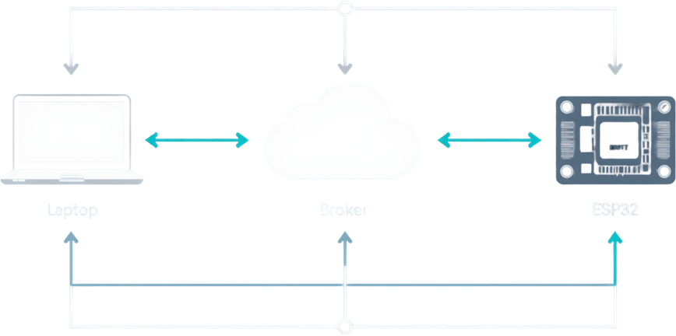
Week 6 (Aug 13): MQTT + Alert System
Setup & Publisher
• Set up MQTT broker (HiveMQ Cloud free tier)
• Python publisher sends alert message when detection occurs
• ESP32 subscriber listens for incoming alerts
Deliverable:
✓ End-to-end MQTT alert system working
✓ Real-time alert flow from detection to hardware response

Slide 8
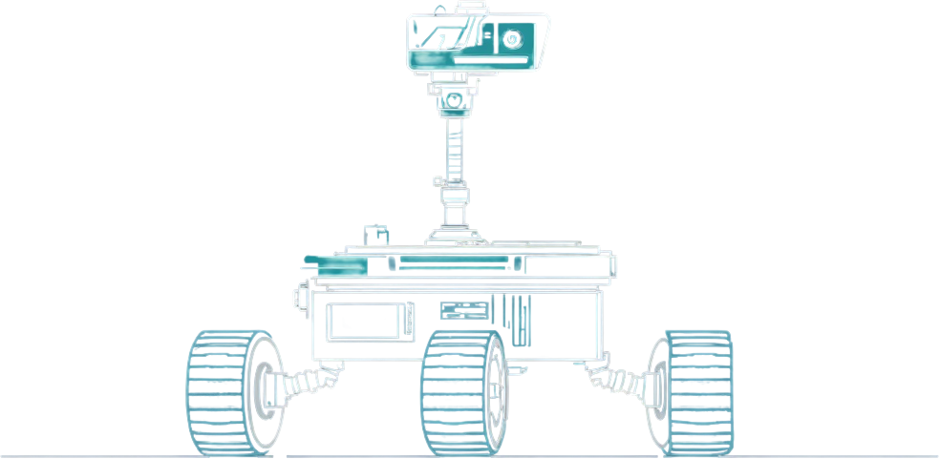
Weeks 7–8
WEEK 7 (AUG 20)
Rover drives, streams, and receives alerts simultaneously. Conduct 1-hour stress test across full system. Debug and fix integration issues.
WEEK 8 (AUG 27)
Live demo of complete hardware system. Submit CSE499A project report.
Deliverable: Working hardware, live demo, and report submitted.

Slide 9
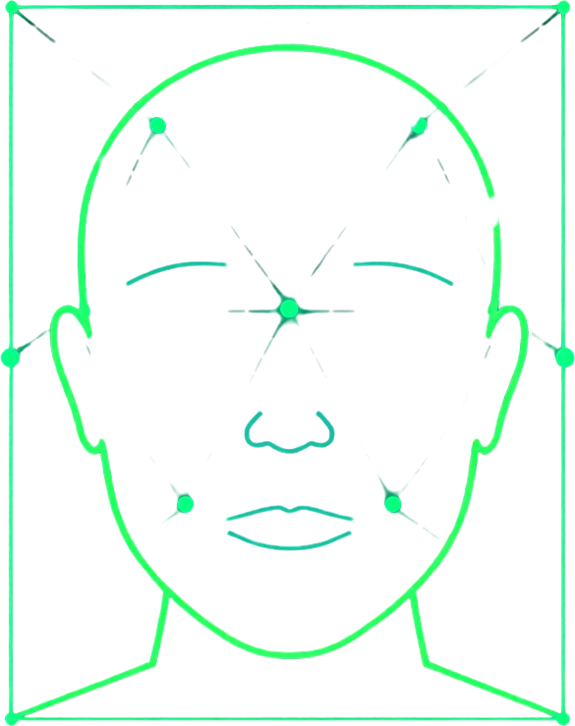
CSE499B — Deep Learning Phase
System Integration
  Seamlessly integrate all modules into a comprehensive elderly monitoring system.
InsightFace
  Implement face recognition technology: Enroll residents and detect & match faces in real-time from the rover stream.
YOLO-Pose
  Utilize fall and posture detection: Receive alerts if a resident is found on the floor.
Telegram Chatbot
  Empower caregivers with a chatbot: Ask an LLM, “Who hasn’t been seen in the last 2 hours?”

