Slide 1
Stage 3 — Dataset Augmentation
589 originals → 2121 training records · audit verified
Deep Doc Extractor · HP E877 Series User Guide
Team DocuForge
Woosong University Capstone 2026
Industry Partner: HP Printing Korea — Data Science Team
April 2026

Slide 2
Stage 3 Objective
Multiply the Stage 2 dataset via question-side paraphrasing while preserving each original answer
Process
Example
1
LLM rephrases each question
ORIGINAL
Qwen3.5:9B at temperature 0.7 — 3 paraphrased variations per accepted Stage 2 question
Q: How can one get involved in HP Planet Partners?
A: Visit www.hp.com/hprecycle and select your country/region.
2
Similarity filter applied
Embed each variation; keep only sim ∈ [0.70, 0.97] vs original (LLD §3.4.3)
VARIATION 1
Q: What steps are needed to participate in the HP Planet Partners program?
3
Original answer preserved
Variation only replaces messages[1] (user question) — assistant content untouched
VARIATION 2
Q: How do I become part of HP's recycling initiative?
4
Export augmented dataset
JSONL + CSV with full provenance (parent qid, variation index, status)
VARIATION 3
Q: What is necessary to participate in HP Planet Partners' return program?
Answer preserved across all variations →
Stage 3 Evaluation · Team DocuForge
2 / 7

Slide 3
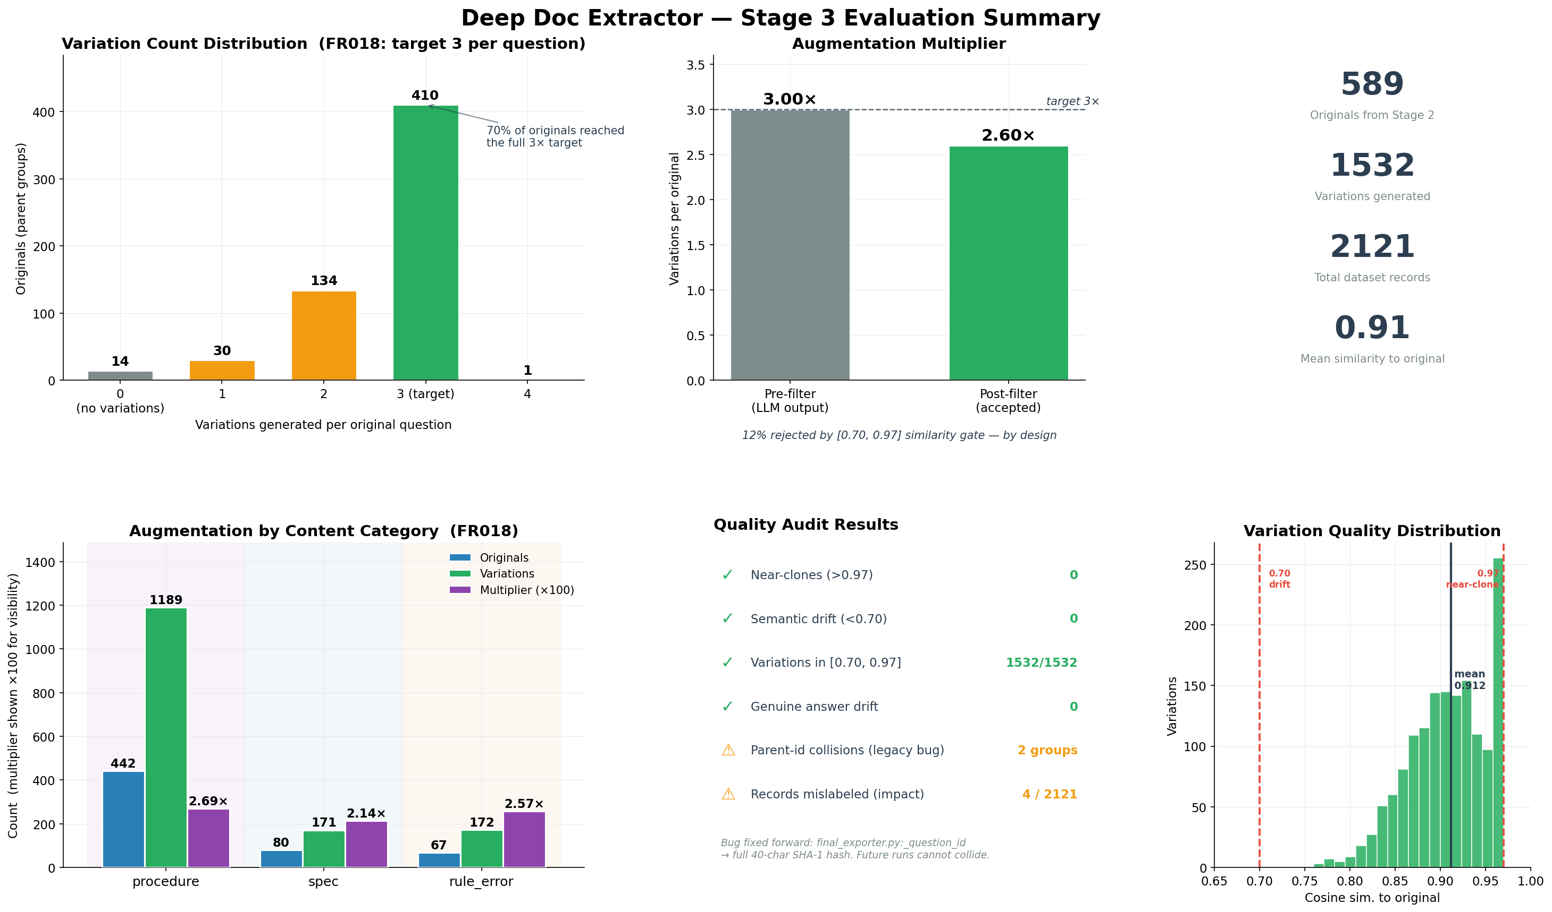
Results Dashboard
Variation distribution · multiplier · category breakdown · audit · similarity distribution
Stage 3 Evaluation · Team DocuForge
3 / 7

Slide 4
Key Metrics
Stage 3 outputs vs LLD §3.4 / FR018-FR021 targets
589
1532
2121
0.91
Original questions
Variations accepted
Total dataset records
Mean similarity to source
Target compliance
Metric | Target (LLD §3.4 / FR) | Achieved | Status
Variations per question (FR018) | 3 | 2.66 avg | ✓ Met (post-filter)
Near-clones rejected (>0.97) | 0 in output (FR019) | 0 / 1532 | ✓ Met
Semantic drift rejected (<0.70) | 0 in output (FR019) | 0 / 1532 | ✓ Met
Answer preservation | 100% (LLD §3.4.1) | 100% (no drift) | ✓ Met
Final export format (FR020) | JSONL + CSV with provenance | Both written | ✓ Met
Mentor batch package (FR021) | Optional intermediate export | mentor_batch.jsonl | ✓ Met
Stage 3 Evaluation · Team DocuForge
4 / 7

Slide 5
Audit Finding — Parent ID Collision
Discovered during Stage 3 quality review · diagnosed · fixed forward
What the audit caught
The fix (1 line)
Symptom
BEFORE
Two variation groups had multiple distinct answers — looked like answer drift.
hashlib.sha1(q.encode()).hexdigest()[:12]
12 hex chars · 48 bits · birthday-paradox collision
Root cause
Parent IDs were SHA-1 hashes truncated to 12 hex characters. Two different Stage 2 questions hashed to identical 12-char prefixes, so their variations grouped together.
AFTER
hashlib.sha1(q.encode()).hexdigest()
40 hex chars · 160 bits · collision probability ≈ 0
Diagnosis path
Impact on current dataset
1. Audit script flagged 2 groups with multiple answers
2. Inspected groups → saw two v1's and two v2's per parent
3. Counter on (parent_id, variation_index) confirmed duplicates
4. Traced to _question_id() in final_exporter.py
4 records of 2121 mislabeled (0.19%)
Questions and answers individually still valid
Stage 4 keys on chunk_id, not augmented_from — RAG unaffected
No regeneration needed; bug fixed forward
Stage 3 Evaluation · Team DocuForge
5 / 7

Slide 6
Insights from the Data
What the variation distribution and similarity profile tell us
01
02
100% of variations in-spec
70% of originals hit full 3× target
1532 / 1532 variations land in the [0.70, 0.97] window. Mean similarity to source = 0.91. The augmentation gate is enforcing the LLD §3.4.3 spec correctly — every kept variation is genuinely paraphrased without semantic drift.
410 of 589 originals received the full 3 variations; 134 got 2; 30 got 1. The 12% that fell short were rejected by the post-LLM similarity filter — the pipeline emits only quality-passed variations, not raw LLM output.
03
04
Procedure dominates augmentation
Audit caught what manual review wouldn't
Procedure questions yielded 2.69× multiplier (1189 variations from 442 originals) — the highest of the three categories. Spec lags at 2.14×, reflecting the same MiniLM-on-spec embedding limitation observed in Stage 2.
The 2 collisions surfaced only because the audit script ran a (parent_id, variation_index) Counter check. Visual inspection of 2121 records by the team would have missed them. Validates automated quality reports per stage.
Stage 3 Evaluation · Team DocuForge
6 / 7

Slide 7
VERDICT
Stage 3 PASS
2121 augmented records · 0 quality issues · bug fixed forward
Next Steps
1
Stage 4 — RAG indexing
Index 2121 records into ChromaDB with sentence-transformers embeddings (FR022, FR023).
2
Stage 4 — Streamlit chat
Launch local RAG chat on localhost:8501; verify grounded answers with source citations (FR025, FR026).
3
End-to-end validation
Submit known-answer queries (e.g. toner replacement) and confirm offline operation (FR028).
Team DocuForge · Woosong University × HP Printing Korea · April 2026

